Slide 1
Genetic determinants of dabigatran plasma levels and their relation to bleeding
Guillaume Pare MD
On behalf of RE-LY Genetics: Guillaume Pare MD, Niclas Eriksson PhD, Thorsten Lehr PhD, Stuart Connolly MD, John Eikelboom MD, Michael D. Ezekowitz MD PhD , Tomas Axelsson PhD, Sebastian Haertter PhD, Jonas Oldgren MD PhD, Paul Reilly PhD, Agneta Siegbahn MD PhD, Ann-Christine Syvanen PhD, Claes Wadelius MD PhD, Mia Wadelius MD PhD, Heike Zimdahl-Gelling PhD, Salim Yusuf MD, Lars Wallentin MD PhD
From the Population Health Research Institute, Uppsala Clinical Research Center, Thomas Jefferson Medical College, McMaster University, Uppsala University and Boehringer Ingelheim Pharma Inc.
ESC Clinical Trial & Registry Update III: Updates on Atrial Fibrillation and Valves
Woensdag 29 augustus 2012

Slide 2
Background
Dabigatran etexilate is effective and safe in prevention of stroke in AF patients compared with warfarin
Dabigatran etexilate is an oral prodrug that is rapidly converted by esterases (CES1) to the active agent dabigatran
We hypothesized genetic factors are responsible for some of the inter-individual variability in dabigatran exposure
ESC Clinical Trial & Registry Update III: Updates on Atrial Fibrillation and Valves
Woensdag 29 augustus 2012

Slide 3
RE-LY Trial
AF patients with at least one additional RF for stroke
18,113 patients with median follow-up of 2.0 years
Randomized trial of two fixed doses of dabigatran etexilate (110 and 150 mg bid) and open-label warfarin
110 mg as effective as warfarin
150 mg superior to warfarin
Both doses had lower minor and major bleeds
Connolly et al. N Engl J Med. 2009 Sep 17;361(12):1139-51

Slide 4
Methods Summary
Genome-wide analysis (551,203 markers) of dabigatran peak and trough concentration (N=1,490)
Identification of genetic determinants of peak and trough concentration
Association testing of genetic determinants of dabigatran concentration with safety and efficacy outcomes (N=1,694)
ESC Clinical Trial & Registry Update III: Updates on Atrial Fibrillation and Valves
Woensdag 29 augustus 2012

Slide 5
Methods
Primary efficacy endpoint defined as stroke or systemic embolism
Primary safety endpoint define as any bleeding, minor and major
1,694 dabigatran etexilate-treated RE-LY participants of European ancestry successfully genotyped
Illumina Human610-quad beadchip (551,203 SNPs passed QC)
807 warfarin-treated participants also genotyped
1,490 participants also had peak (1 to 3H) and trough concentrations measured by HPLC-MS/MS
ESC Clinical Trial & Registry Update III: Updates on Atrial Fibrillation and Valves
Woensdag 29 augustus 2012

Slide 6
Study Population
 | Warfarin | Dabigatran 110 mg | Dabigatran 150 mg
Baseline characteristics
N | 807 | 849 | 845
Age | 72.2 (7) | 71.7 (7.5) | 71.9 (7.6)
Female (%) | 273 (33.8%) | 259 (30.5%) | 272 (32.2%)
BMI (Kg/m²) | 29.4 (5.6) | 28.9 (5.7) | 29.2 (5.3)
CHADS2 | 2.0 (1.1) | 2.0 (1.2) | 2.0 (1.1)
History of Stroke (%) | 83 (10.3%) | 91 (10.7%) | 77 (9.1%)
History of Diabetes (%) | 158 (19.6%) | 178 (21.0%) | 159 (18.8%)
Aspirin Use (%) | 228 (28.3%) | 265 (31.2%) | 234 (27.7%)
Dabigatran concentration
Number with measurements (%) | - | 752 (88.6%) | 738 (87.3%)
Trough Concentration (ng/mL) | - | 73 (48) | 105 (72)*
Peak Concentration (ng/mL) | - | 156 (94) | 220 (133)*
Events
Ischemic Stroke or Systemic Emboli (%) | 12(1.5%) | 15(1.8%) | 17(2.0%)
Any Bleed (%) | 325(40.3%)* | 289(34.0%) | 298(35.3%)
Major Bleed (%) | 45(5.6%) | 49(5.8%) | 52(6.2%)
Minor Bleed (%) | 306(37.9%)* | 270(31.8%) | 275(32.5%)

Slide 7
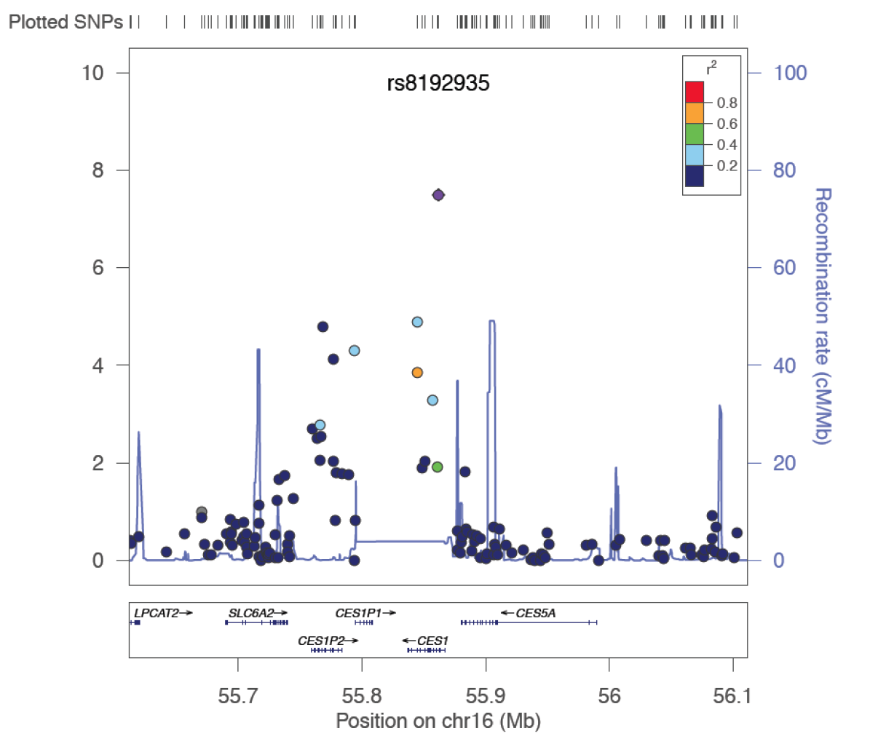
CES1 Locus – Peak Concentration
-Log10( P-value)
ESC Clinical Trial & Registry Update III: Updates on Atrial Fibrillation and Valves
Woensdag 29 augustus 2012

Slide 8
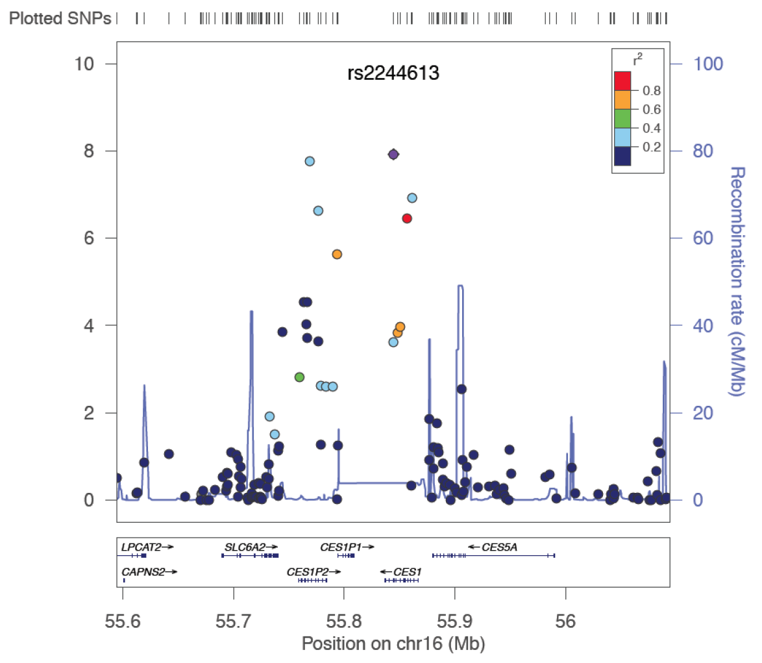
CES1 Locus – Trough Concentration
-Log10( P-value)
ESC Clinical Trial & Registry Update III: Updates on Atrial Fibrillation and Valves
Woensdag 29 augustus 2012

Slide 9
Association with Events
 |  |  | rs4148738 (ABCB1; Peak concentration) |  |  | rs8192935 (CES1; Peak concentration) |  |  | rs2244613 (CES1; Trough concentration)
Event |  |  | OR (95%CI) * | P |  | OR (95%CI) * | P |  | OR (95%CI) * | P
Ischemic Stroke or Systemic embolism |  |  | 0.88(0.53-1.46) | 0.62 |  | 0.76(0.43-1.34) | 0.34 |  | 0.70(0.33-1.47) | 0.34
Any Bleeding |  |  | 0.94(0.82-1.09) | 0.44 |  | 0.89(0.76-1.03) | 0.13 |  | 0.67(0.55-0.82) | 7x10⁻⁵
Major Bleeding |  |  | 1.14(0.85-1.52) | 0.40 |  | 0.88(0.64-1.21) | 0.44 |  | 0.66(0.43-1.01) | 0.06
Minor Bleeding |  |  | 0.94(0.81-1.09) | 0.38 |  | 0.89(0.76-1.05) | 0.17 |  | 0.70(0.57-0.85) | 4x10⁻⁴
- *: Odds ratio per minor allele (gene-dose effect)
- Logistic regression with adjustment for dose, age, sex, CHADS2, ASA, CrCl and first 10 principal components
- Significance set at P < 0.05
ESC Clinical Trial & Registry Update III: Updates on Atrial Fibrillation and Valves
Woensdag 29 augustus 2012

Slide 10
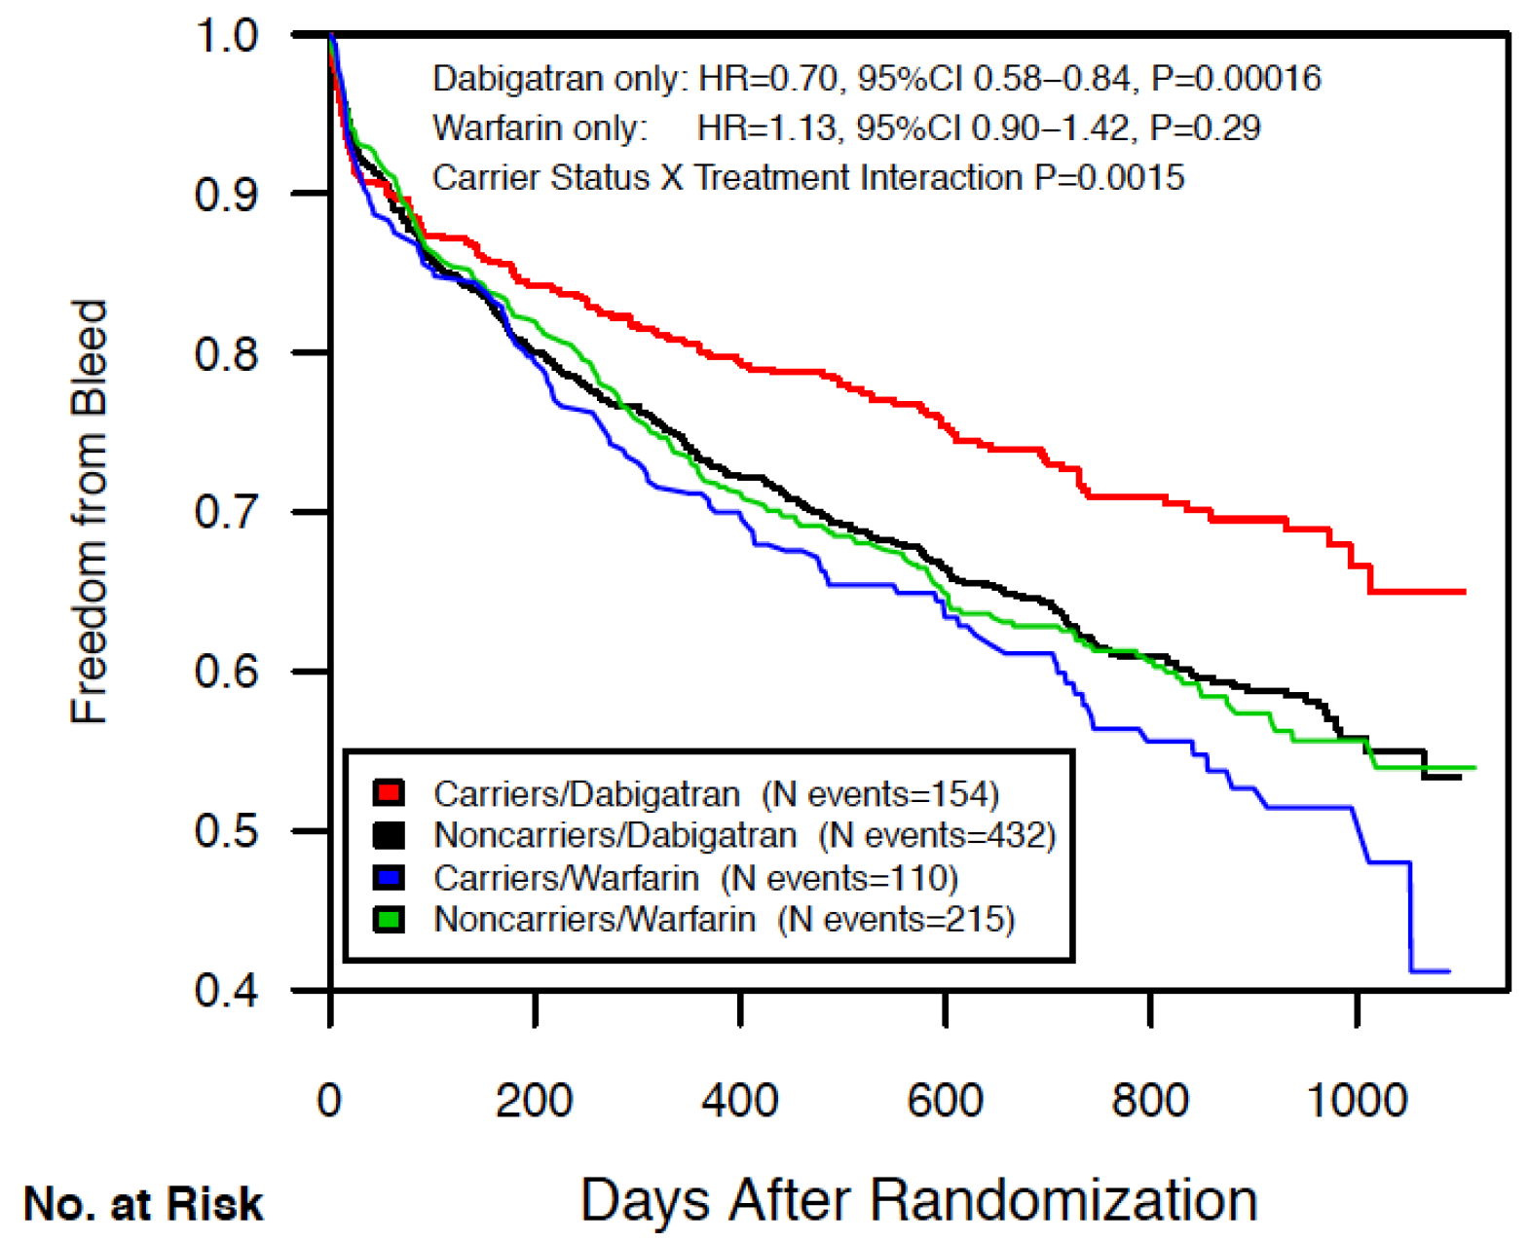
Survival Analysis
Freedom from bleed according to rs2244613 carrier status
ESC Clinical Trial & Registry Update III: Updates on Atrial Fibrillation and Valves
Woensdag 29 augustus 2012

Slide 11
Conclusions
ABCB1 and CES1 loci are associated with dabigatran concentration
Dabigatran etexilate is a substrate of ABCB1
CES1 is responsible for the biotransformation of dabigatran etexilate into dabigatran
32.8% of Europeans are carriers of the CES1 SNP rs2244613
Each minor allele is associated with 15% decrease in trough concentration
Carriers have 27% decrease in relative risk of bleed
14% decrease in relative risk of bleed for low vs high dose of dabigatran etexilate in the parent study
No association with efficacy – but modest statistical power
ESC Clinical Trial & Registry Update III: Updates on Atrial Fibrillation and Valves
Woensdag 29 augustus 2012

