Slide 1

Improvement in risk classification in the prevention of cardiovascular disease:
A role for atherosclerosis imaging ?
Michiel Bots, MD PhD
Julius Center for Health Sciences & Primary Care

Slide 2
Conflicts of interest
I am completely unbiased, but …
Considerable proportion of my career is based on CIMT measurements
  ‘so, there is lots at stake ……’
I work and have worked with several national and international profit and non-profit organizations
I run a core laboratory, the Vascular Imaging Center, in Utrecht, NL
Personal views

Slide 3
Content
CV risk classification
  Why ?
  In whom ?
  How to measure improvement ?
Evidence for ‘atherosclerosis measurements’
  Endothelial function (FMD)
  Coronary calcifications
  Carotid plaque & common CIMT
Summary

Slide 4
Risk classification: Why ?
Absolute benefit determined by absolute risk, irrespective of cause of risk
  Older patients benefit more
  Males benefit more than females
  Benefits higher after first event
  Benefit of BP reduction higher in smokers
  Benefits of statins higher in hypertensives
  Those who needed, benefit most, at reasonable cost

Slide 5
Identification of high risk individuals
High risk
  Those with previous cardiovascular disease
    AMI; CHD; stroke/TIA; peripheral arterial disease/ heart failure
  Those with diabetes mellitus, rheumatoid arthritis
    Risk prediction rule + (age = + 15 years)
  Free from previous symptomatic CVD
    Risk prediction rule
CVRM guideline 2011

Slide 6
Risk prediction rule
 | Variables | Outcome
Framingham Risk Score | Age sex BP smoking use of HTN medications TC HDL | Coronary heart disease (angina, MI, sudden death)
Global cardiovascular risk | Age Sex SBP smoking TC HDL DM use of HTNmedications | Coronary heart disease, stroke, heart failure, PVD
SCORE | Age, sex SBP smoking TC or TC/HDL ratio | Fatal CV events
ASSIGN | Age sex SBP TC HDL family history, social deprivation | CV death, CHD admission, CABG, PTCA
Reynolds (men) | Age SBP smoking TC HDL hsCRP hgbAlc (DM) family history | MI, stroke, coronary revascularisation or CV death
QRISK | Age sex SBP smoking TC/HDL family history use of HTN medications BMI social deprivation | MI, CHD, stroke, TIA

Slide 7
Risk prediction: existing CVD rules
Framingham (USA)
QRISK (UK)
PROCAM (Germany)
ASSIGN (Schotland)
SCORE (EU)
REYNODS (USA)
GLOBAL score (USA)
CUORE (Italy)
MUCA (china)
Japan model
Thailand (recal FRS)
New Zealand (recal FRS)
Busselton Heart Score (Australia)
AUSSCORE chart (australia)

Slide 8
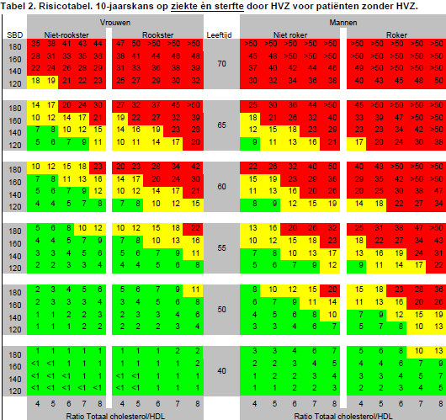
Recent Dutch CardioVascular Risk factor Management guidelines (2011)

Slide 9

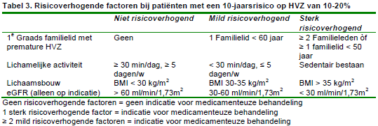
Treatment of individuals is based on absolute risk estimates
CVRM guideline 2011

Slide 10
Why improvement?
Risk scores (FHS, SCORE) still far from perfect
  Most events occur at modest elevations of risk
  No events in those with highest risks
Important population groups will easily be missed
  (e.g., the young, women as absolute risks are geared towards older age. )
Notes:
Here we see from two of the largest trials, clear evidence of lowering BP and cholesterol in those with above average, average and below average levels

Slide 11
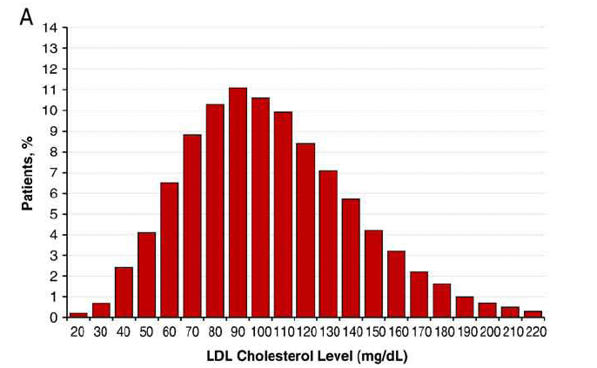
Of 136,905 patients hospitalized with CAD, more than 75% had LDL levels below 130 mg/dl
Heart attack with normal LDL
Lipid levels in patients hospitalized with coronary artery disease: An analysis of 136,905 hospitalizations in Get With The Guidelines
Sachdeva et al. Am Heart J 2009;157:111
Notes:
11

Slide 12

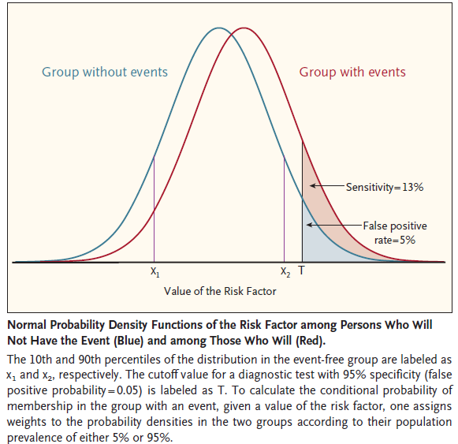

Slide 13
Content
CV risk classification
  Why ?
  In whom ?
  How to measure improvement ?
Evidence for ‘atherosclerosis measurements’
  Endothelial function (FMD)
  Coronary calcifications
  Carotid plaque & common CIMT
Summary

Slide 14
How to measure improvement in CVD risk prediction: USE-IMT cohort
Original prediction model
< 5%
5-9%
10-19%
≥ 20%
Cohort with event follow up
Framingham variables and atherosclerosis measurements
NRI = 23%
= (24/289 – 4/289) + (332/1006 -166/1006)

Slide 15
How to measure improvement in CVD risk prediction: USE-IMT cohort
Original prediction model |  |  |  |  | All
< 5% |  |  |  |  | 7609
5-9% |  |  |  |  | 6729
10-19% |  |  |  |  | 5324
≥ 20% |  |  |  |  | 2068
 |  |  |  |  | 21730

Slide 16
How to measure improvement in CVD risk prediction: USE-IMT cohort
 | Extended prediction model
Original prediction model | < 5% | 5-9% | 10-19% | ≥ 20% | All
< 5% |  |  |  |  | 7609
5-9% |  |  |  |  | 6729
10-19% |  |  |  |  | 5324
≥ 20% |  |  |  |  | 2068
 |  |  |  |  | 21730

Slide 17
How to measure improvement in CVD risk prediction: USE-IMT cohort
 | Extended prediction model
Original prediction model | < 5% | 5-9% | 10-19% | ≥ 20% | All
< 5% |  |  |  |  | 7609
5-9% |  |  |  |  | 6729
10-19% |  |  |  |  | 5324
≥ 20% |  |  |  |  | 2068
 | 7772 | 5605 | 6269 | 2114 | 21730
NRI = 23%
= (24/289 – 4/289) + (332/1006 -166/1006)

Slide 18
How to measure improvement in CVD risk prediction: USE-IMT cohort
 | Extended prediction model
Original prediction model | < 5% | 5-9% | 10-19% | ≥ 20% | All
< 5% |  |  |  |  | 7609
5 – 9% |  |  |  |  | 6729
10-19% |  |  |  |  | 5324
≥ 20% |  |  |  |  | 2068
 | 7772 | 5605 | 6269 | 2114 | 21730
NRI = 23%
Gray no change in category: New model no use
= (24/289 – 4/289) + (332/1006 -166/1006)

Slide 19
How to measure improvement in CVD risk prediction: USE-IMT cohort
 | Extended prediction model
Original prediction model | < 5% | 5-9% | 10-19% | ≥ 20% | All
< 5% |  |  |  |  | 7609
5 – 9% |  |  |  |  | 6729
10-19% |  |  |  |  | 5324
≥ 20% |  |  |  |  | 2068
 | 7772 | 5605 | 6269 | 2114 | 21730
NRI = 23%
Orange change in category: With new model higher risk
= (24/289 – 4/289) + (332/1006 -166/1006)

Slide 20
How to measure improvement in CVD risk prediction: USE-IMT cohort
 | Extended prediction model
Original prediction model | < 5% | 5-9% | 10-19% | ≥ 20% | All
< 5% |  |  |  |  | 7609
5 – 9% |  |  |  |  | 6729
10-19% |  |  |  |  | 5324
≥ 20% |  |  |  |  | 2068
 | 7772 | 5605 | 6269 | 2114 | 21730
NRI = 23%
Green change in category: With new model lower risk
= (24/289 – 4/289) + (332/1006 -166/1006)

Slide 21
How to measure improvement in CVD risk prediction: USE-IMT cohort
 | Extended prediction model
Original prediction | < 5% | 5-9% | 10-19% | ≥ 20% | All
WITHOUT EVENTS
< 5% |  |  |  |  | 7609
5 – 9% |  |  |  |  | 6729
10-19% |  |  |  |  | 5324
≥ 20% |  |  |  |  | 2068
 | Extended prediction model
Original prediction | < 5% | 5-9% | 10-19% | ≥ 20% | All
WITH CV EVENTS
< 5% |  |  |  |  | 7609
5 – 9% |  |  |  |  | 6729
10-19% |  |  |  |  | 5324
≥ 20% |  |  |  |  | 2068
NRI = 23%
= (24/289 – 4/289) + (332/1006 -166/1006)

Slide 22
Net Reclassification Improvement
Net Reclassification Improvement
NRI
NRI = (move up | event– move down | event) +
(move down | non-event – move up | non-event )

Slide 23
Content
CV risk classification
  Why ?
  In whom ?
  How to measure improvement ?
Evidence for ‘atherosclerosis measurements’
  Endothelial function (FMD)
  Coronary calcifications
  Carotid plaque & common CIMT
Summary

Slide 24
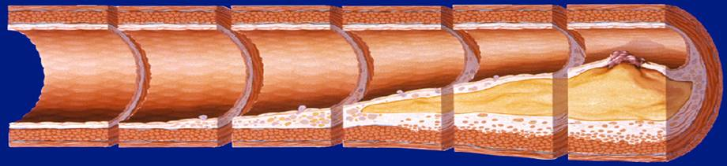
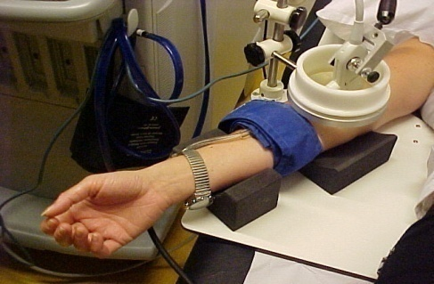
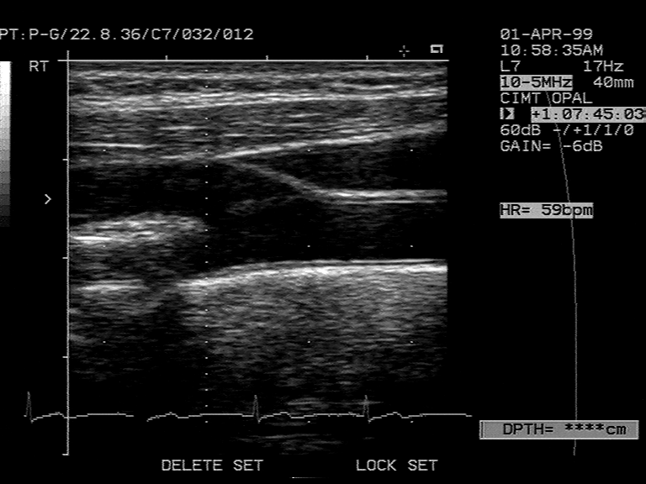
Imaging of atherosclerosis

Slide 25

Approach taken
Systematic review
  PubMed, EMBASE search
  CIMT, CAC, FMD, MR atherosclerosis
  Cohort studies
  Added value (AUC, NRI)

Slide 26
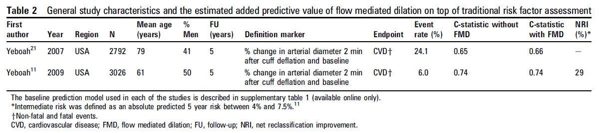
Flow-mediated dilation
Authors do not recommend FMD as a clinical risk stratification tool unless
Results replicated
Reproducibility FMD improved.

Slide 27
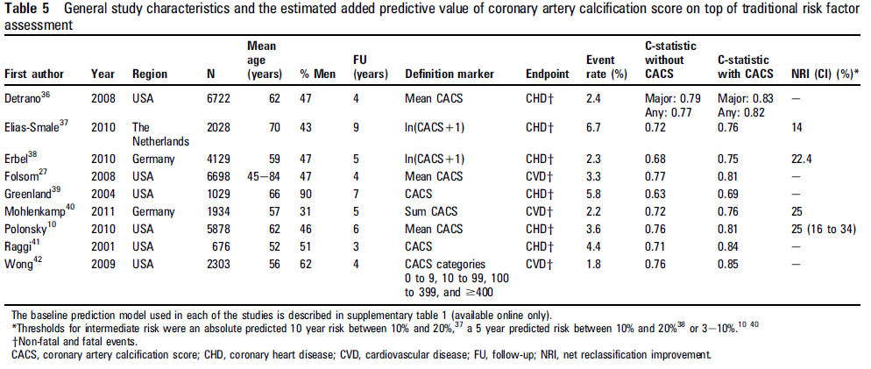
Coronary artery calcification
Increase AUC of 0.04 – 0.11

Slide 28
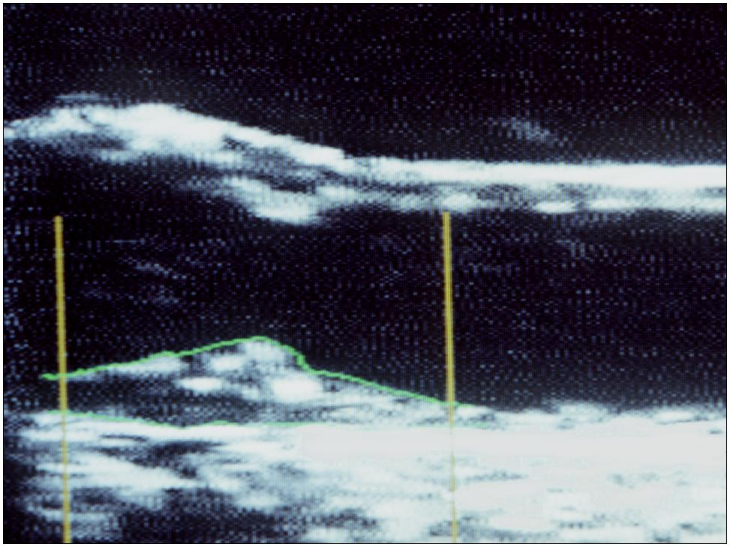
Carotid plaque

Slide 29
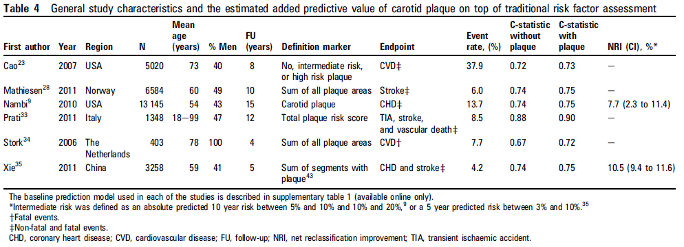
Carotid plaque
Increase AUC of 0.00 – 0.05

Slide 30
Carotid intima media thickness
IMT 0.544 mm
IMT 1.541 mm

Slide 31
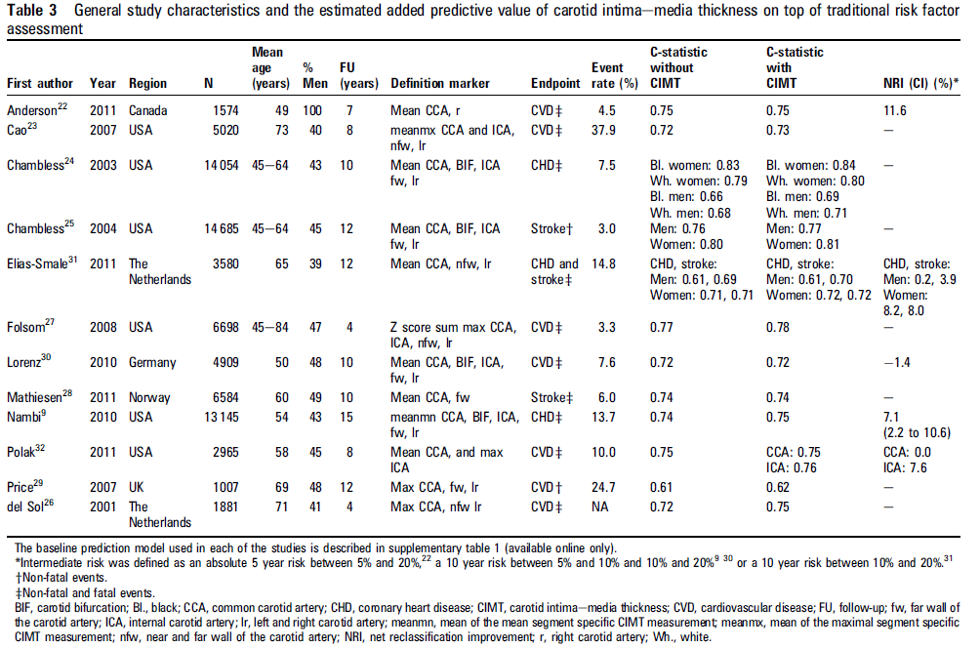
Carotid intima-media thickness
Increase AUC of 0.01 – 0.02

Slide 32
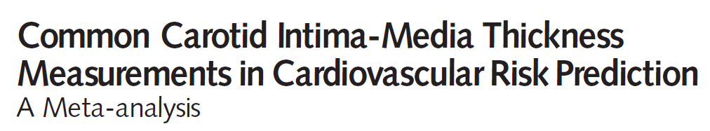
Carotid intima-media thickness
Individual participant data meta analysis
14 population based cohorts
45.828 participants with individual data
4007 cardiovascular events
  (CV death, non fatal AMI, stroke)
Common CIMT added to Framingham score
Notes:
32

Slide 33
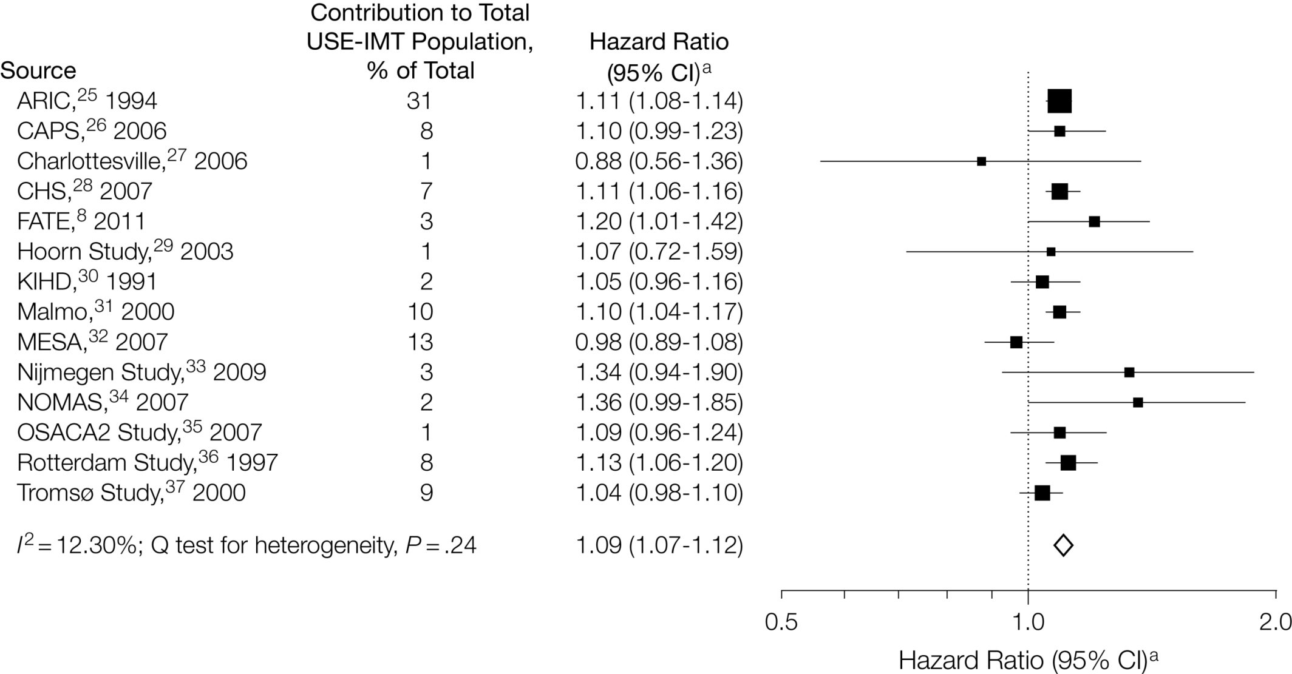
Common CIMT and events
Hazard ratio per 0.1 mm increase in CIMT

Slide 34
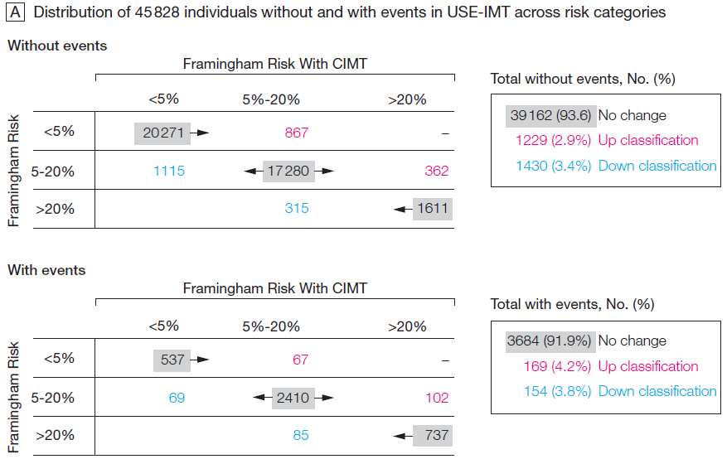
Carotid intima-media thickness

Slide 35
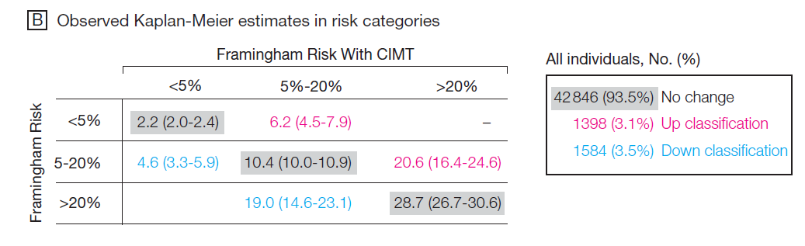
What are the risks in those shifted?

Slide 36
Net reclassification improvement in USE-IMT
All 0.8% [0.1 – 1.6]
  Men 0.9% [-0.2 – 1.9]
  Women 0.8% [-0.2 – 1.6]
Intermediate risk 3.6% [2.7 – 4.6]
  Men 3.2% [2.3 – 4.4]
  Women 3.9% [2.7 – 4.9]
Authors conclusion
The added value of common CIMT alone in 10-year risk prediction of cardiovascular events, in addition to the Framingham Risk Score, is small and unlikely to be of clinical importance

Slide 37
Net reclassification improvement using common CIMT in USE-IMT
In diabetics
  No additional value
    Diabetologia (in press)
In hypertensives
  No additional value
    J Hypertension (submitted)

Slide 38
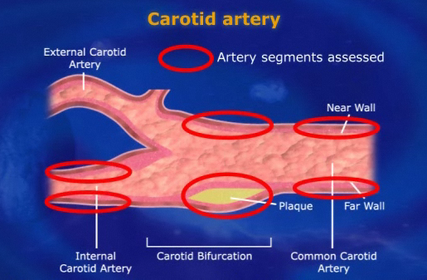
Carotid intima-media thickness
Notes:
38

Slide 39
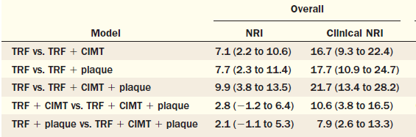
Carotid intima media thickness and plaque measurements
ARIC study: all segments CIMT with and without plaque
Clin NRI = intermediate risk

Slide 40
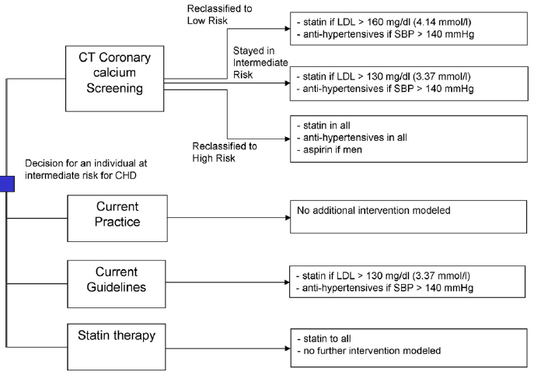
How about cost effectiveness ?
Coronary calcification measurements
  Based on Rotterdam Study findings
  Markov Model
Authors conclusion
Screening for coronary artery calcium with CT in individuals at intermediate risk of CHD is probably cost-effective in men but is unlikely to be cost-effective in women.
  J Am Coll Cardiol 2011;58:1690–701

Slide 41
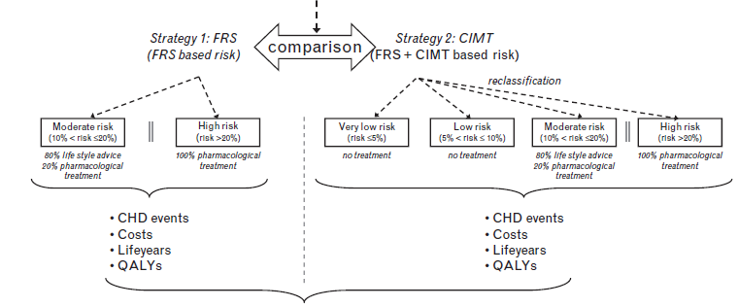
How about cost effectiveness ?
CIMT + plaque findings
  Based on ARIC, 50-59 yrs olds
  Markov Model
  SCORE (fatal and non fatal combined) > 10%
Authors conclusion
Over a 10-year period CIMT measurements were cost-effective with a probability of 66% (men), and 94% (women). Over a 30-year period, CIMT
measurements acceptable cost-effectiveness for men and women
  J Hypertension 2013, 31:782–790

Slide 42
Summary
Large heterogeneity across studies in terms of
  definition of the baseline prediction model,
  risk thresholds,
  studied events
  sample size (too small)
  population (age range, with/without CVD)
  way of summarising atherosclerosis
  Medication after baseline
  INDIVIDUAL PARTICIPANT DATA ANALYSIS
  (pooling of cohorts)

Slide 43
Is there a role for atherosclerosis imaging in risk classification?
Coronary calcification
  Most powerful predictor, considerable shifts, NRI observational evidence seems consistent, cost effective in intermediate risk
    Radiation, logistics, coincidental findings
Flow mediated dilatation
  Too little evidence (studies)
Carotid plaque (alone)
  Powerful predictor, too little evidence on shifts
    Definition, logistics

Slide 44
Is there a role for atherosclerosis imaging in risk classification?
Common CIMT (alone)
  Predictor of event, little shifts, slightly more in intermediate risk
  No role !
Common, bifurcation, internal CIMT and plaques
  Powerful predictor, considerable shifts, consistency across studies needed, cost effective in > 10%
    Definition, logistics
Note:
Risk classification in those free from CVD
No RCTs comparing two strategies yet

Slide 45
Acknowledgements
Use-IMT collaborators
Sanne A. E. Peters, MSc; Todd J. Anderson, MD; Annie R. Britton, PhD; Jacqueline M. Dekker, PhD; Marinus J. Eijkemans, PhD; Gunnar Engström, MD, PhD; Gregory W. Evans, MA; Jacqueline de Graaf, MD, PhD; Diederick E. Grobbee, MD, PhD; Bo Hedblad, MD, PhD; Albert Hofman, MD, PhD; Suzanne Holewijn, PhD; Ai Ikeda, PhD; Maryam Kavousi, MD, MSc; Kazuo Kitagawa, MD; Akihiko Kitamura, MD, PhD; Hendrik Koffijberg, PhD; Eva M. Lonn, MD; Matthias W. Lorenz, MD; Ellisiv B. Mathiesen, MD; Giel Nijpels, MD, PhD; Shuhei Okazaki, MD; Daniel H. O’Leary, MD; Joseph F. Polak, MD; Jackie F. Price, MD; Christine Robertson, MBChB; Christopher M. Rembold, MD; Maria Rosvall, MD, PhD; Tatjana Rundek, MD, PhD; Jukka T. Salonen, MD, PhD; Matthias Sitzer, MD; Coen D. A. Stehouwer, MD, PhD; Jacqueline C. Witteman, PhD; Karel G. Moons, PhD
Thanks you for your attention!
Happy to take some questions

