Slide 1
Een specifiek antidotum voor DOACs is nodig!
Pieter Willem Kamphuisen
Vasculaire Geneeskunde
Universitair Medisch Centrum Groningen

Slide 2
Conflicts of interest
P.W. Kamphuisen
Internist-vasculair geneeskundige
Research contracts: | Pfizer, Boehringer Ingelheim, LeoPharma
Consulting: | Boehringer Ingelheim, Roche, Daiichi Sankyo
Employment in industry: | -
Stockholder of a healthcare company: | -
Owner of a healthcare company: | -
Other: | -

Slide 3

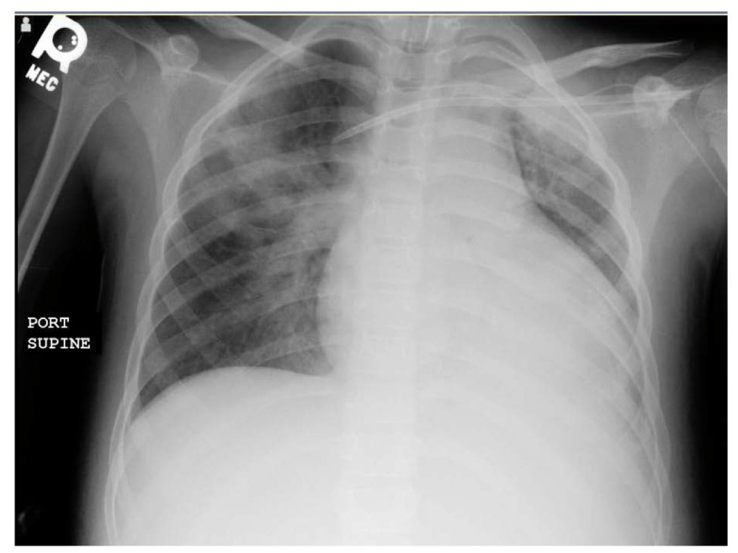
Vrouw, 76 jaar
Met spoed naar SEH
8 jaar geleden AF en CVA
Dabigatran 150 mg 2dd sinds 1 jaar
Auto-ongeluk, thorax trauma
BP = 100/60 mmHg
Hb = 4.8 mmol/l
eGFR = 38 mL/min
aPTT = 87s
PT = 15.2 sec

Slide 4
DOAC heeft geen antidotum!

Slide 5
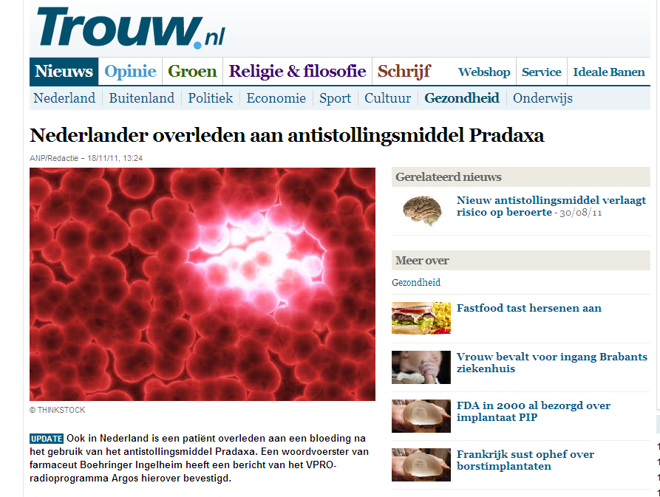

Slide 6
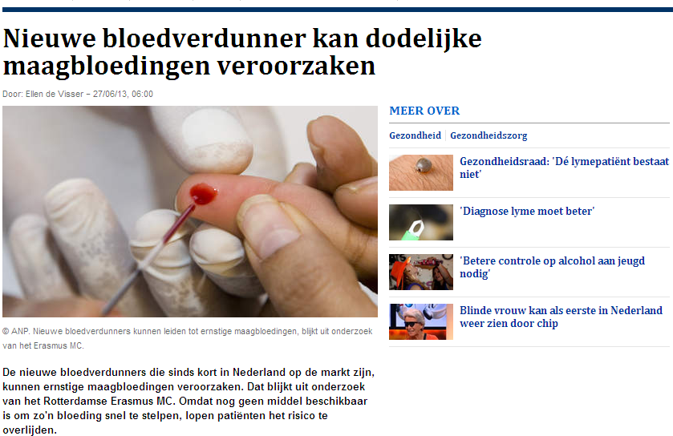

Slide 7
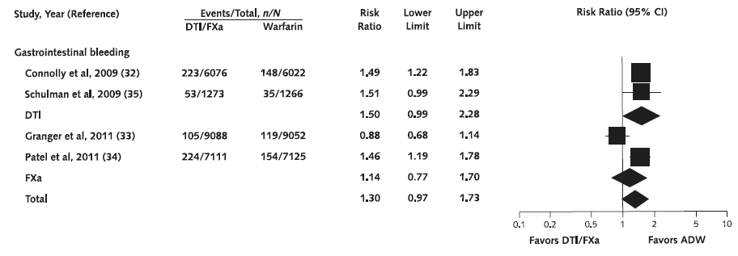
Gastrointestinale bloedingen bij DOAC’s
Adam SS. Ann Intern Med 2012;157:796-807

Slide 8
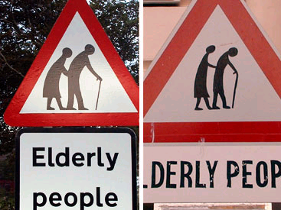
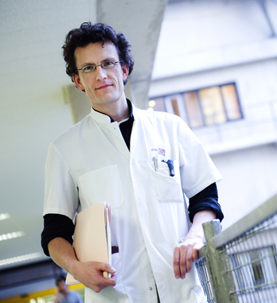
DOACs bij de kwetsbare ouderen?

Slide 9
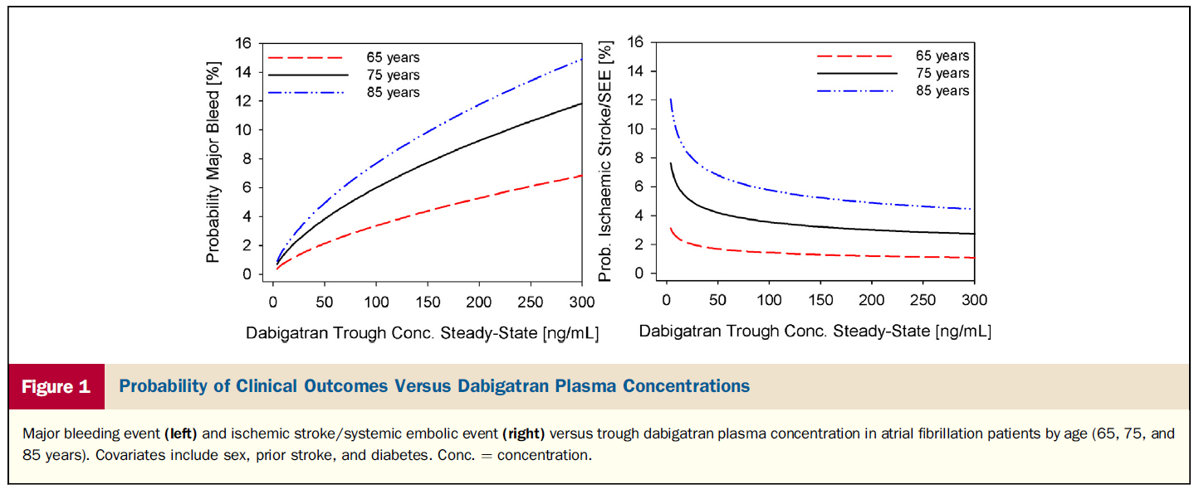
Reilly P. JACC 2014

Slide 10
Hoe kunnen we de DOAC remmen?

Slide 11
Primaire farmacologische behandeling om de bloeding te stoppen
Protrombine complex concentraat
Geactiveerd protrombine complex concentraat
Recombinant Factor VIIa
Fresh frozen plasma

Slide 12
Studies naar couperen DOACs bedroevend
 | Dabigatran | Rivaroxaban | Apixaban | Edoxaban
Oral activated charcoal | Adsorbs and neutralizes, in vitro data¹ | No data | Adsorbs and neutralizes, in vivo data² | No data
Haemodialysis | Human volunteers, case reports^{3,4} | Not possible | Not possible | In vitro data⁵
Fresh frozen plasma | Animal model⁶ | Animal model⁷ model | No data | No data
Factor VIIa | Animal models^{6,8} human volunteers, case report^{4,11} | Animal models^{7,9,10} human volunteers, case reports¹¹ | Animal model¹² | Animal model¹³
3-factor PCC | Animal model¹⁴ | Human volunteers¹⁵ | No data | No data
4-factor PCC | Animal models^{6,8,16–18} human volunteers^{11,19} | Animal models^{7,9,10} human volunteers, case reports^{11,15,19,20} | Animal model¹² | Animal model¹³
1. van Ryn J et al. Blood 2009;114:Abstr 1065; | 8. van Ryn J et al. Blood 2011;118:Abstr 2316; | 15. Levi M et al. J Thromb Haemost doi: 10.1111/jth.12599;
2. Wang X et al. Clin Pharmacol Ther 2012;91(Suppl 1):Abstr PI-90; | 9. Perzborn E et al. Thromb Haemost 2013:110:162–72; | 16. Pragst I et al. J Thromb Haemost 2012;10;1841–8;
3. Warkentin TE et al. Blood 2012;119:2172–4; | 10. Godier A et al Anesthesiology 2012;116:94–102; | 17. Grottke O et al. Crit Care 2014, 18:R27;
4. Kumar R et al. J Int Care Med doi:10.1177/0885066614527417; | 11. Marlu R et al. Thromb Haemost 2012;108:217–24; | 18. Honickel M et al. Crit Care. 2014; 18(Suppl 1):P115;
5. Yoshigae Y et al. Clin Pharmacol Ther 2013;93(Suppl 1):Abstr PIII-84; | 12. Martin A-C et al. J Am Coll Cardiol 2012; 59:E573; | 19. Eerenberg ES et al. Circulation 2011;124:1573–9;
6. Zhou W et al. Stroke 2011;42:3594–9; | 13. Fukuda T et al. Thromb Haemost 2012;107:253–9; | 20 Beyer-Westendorf J.et al Blood 2014;124:955–62
7. Zhou W et al. Stroke 2013;44:771–8; | 14. van Ryn J et al. Circulation 2012;126:A11195;

Slide 13
Stollingstesten totaal ongeschikt om effect DOACs betrouwbaar te meten
 | Dabigatran | Apixaban | Edoxaban | Rivaroxaban
PT |  |  | Prolonged local calibration required | Prolonged suggests excess bleeding risk local calibration required
aPTT | Prolonged At trough >2.5× ULN suggests excess bleeding risk |  | Prolonged | 
INR |  |  |  | 
dTT | Prolonged Quantitative but no published data on threshold values for bleeding or thrombosis |  |  | 
Anti-FXa assays | Not applicable | In development | Quantitative but no data on threshold values for bleeding or thrombosis
ECT | Prolonged Quantitative but no published data on threshold values for bleeding or thrombosis | Not affected | Not affected | Not affected
aPTT = activated partial thromboplastin time;
dTT = dilute thrombin time; ECT = ecarin clotting time; FXa = Factor Xa; INR = international normalized ratio;
PT = prothrombin time; ULN = upper limit of normal
Modified from Heidbuchel H et al. Europace 2013;15:625–51

Slide 14
DOACs zonder antidotum is onverantwoord!

