Slide 1
Fuelling the knowledge of blood coagulation signaling with time-resolved quantitative phosphoproteomics of thrombin-stimulated endothelial cells
Maartje van den Biggelaar
Sanquin Research
Plasma Proteins

Slide 2
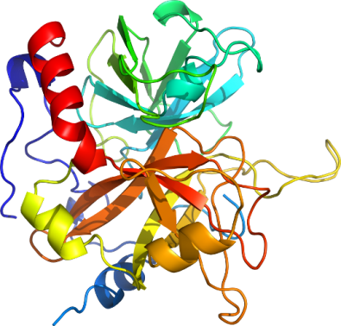
Thrombin is the key serine protease in blood coagulation
SM
EC
EC
SM

Slide 3
Thrombin is the key serine protease in blood coagulation
SM
EC
EC
SM

Slide 4
Thrombin is the key serine protease in blood coagulation
SM
EC
tissue factor
EC
SM

Slide 5
Thrombin is the key serine protease in blood coagulation
SM
EC
tissue factor
EC
SM

Slide 6
Thrombin is the key serine protease in blood coagulation
SM
EC
activated
platelet
activated
platelet
activated
platelet
activated
platelet
activated
platelet
activated
platelet
activated
platelet
activated
platelet
activated
platelet
TF
activated
platelet
EC
SM

Slide 7
Thrombin is the key serine protease in blood coagulation
SM
EC
FV
FVa
FVIII
FVIIIa
XI
XIa
activated
platelet
activated
platelet
activated
platelet
activated
platelet
activated
platelet
activated
platelet
activated
platelet
activated
platelet
activated
platelet
TF
activated
platelet
EC
SM

Slide 8
Thrombin is the key serine protease in blood coagulation
SM
EC
FV
FVa
fibrinogen
FVIII
FVIIIa
XI
XIa
fibrin
activated
platelet
activated
platelet
activated
platelet
activated
platelet
activated
platelet
activated
platelet
activated
platelet
activated
platelet
activated
platelet
TF
activated
platelet
EC
SM

Slide 9
Thrombin is the key serine protease in blood coagulation
SM
EC
TF
EC
SM

Slide 10
Thrombin directly engages with endothelial cells
SM
EC
N
N
loss of barrier
function
Weibel-Palade
body secretion
loss of barrier
function
PAR

Slide 11
Aim of the study
SM
EC
Elucidate thrombin signalling in endothelial cells
using an unbiased approach
by exploiting the power of modern mass spectrometry technology
to perform in-depth quantitative phosphoproteomics
EC
SM

Slide 12
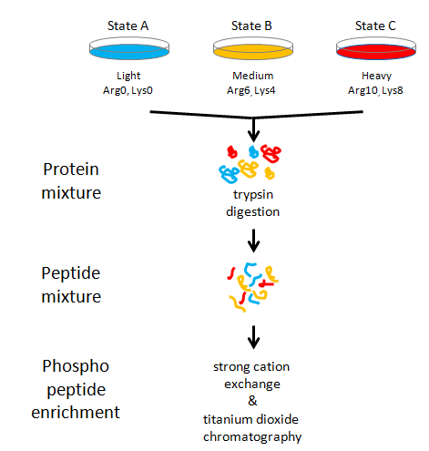
Quantitative mass spectrometry-based phosphoproteomics

Slide 13
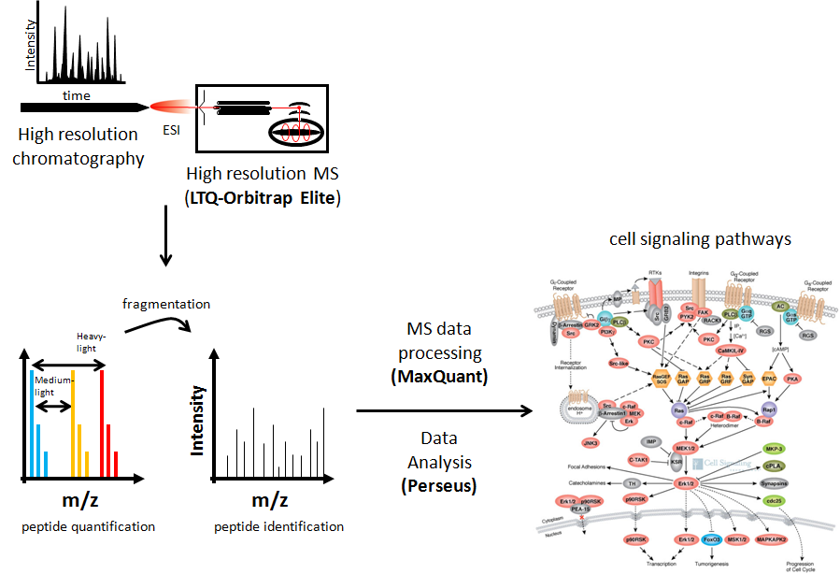
Quantitative mass spectrometry-based phosphoproteomics

Slide 14
Thrombin induces rapid responses in endothelial cells
0 min
2 min
5 min
10 min
30 min
Red: VWF
Green: PECAM1
secreted VWF strings
Thrombin: 1U/ml

Slide 15
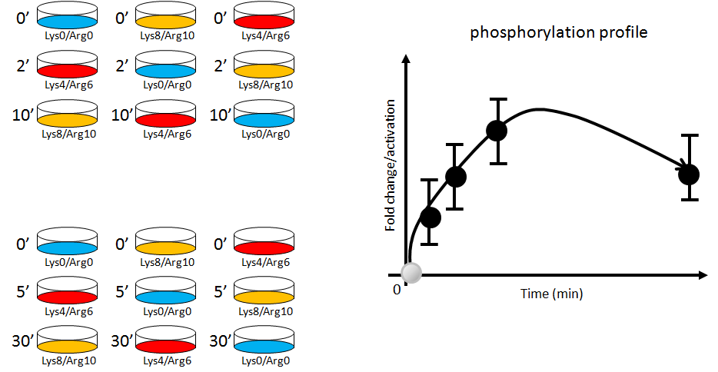
Three-way reversed SILAC labelling allows for time-resolved analysis

Slide 16
SILAC MS reproducibly quantified > 7,000 phosphorylation sites in endothelial cells
7,791 class I phosphorylation sites were identified and quantified
in at least 2 out of 3 experiments in each of the 4 time points
exp 1
exp 2
exp 3
r=pearson correlation coefficient
exp 1
exp 2
exp 3
2 minutes

Slide 17
SILAC MS identified a variety of thrombin-induced phosphorylation sites
2,224 class I phosphorylation sites were found to be regulated over the 30-minute time-course
<-0.75
>0.75
downregulation
upregulation
Median:0.05
Stdev:0.70

Slide 18
SILAC MS identified enrichment of thrombin-induced pathways and downstream effectors
Pathways
Leukocyte transendothelial migration
Focal adhesion
Regulation of actin cytoskeleton
Molecular function
Enzyme activator activity
GTPase activator activity
Ras GTPase activator activity
Enzyme regulator activity
Small GTPase regulator activity
GTPase regulator activity
Guanyl-nucleotide exchange factor activity
Ras Guanyl-nucleotide exchange factor activity
Rho Guanyl-nucleotide exchange factor activity
Nucleoside-triphosphate regulator activity
Phospholipid binding
Lipid binding
Structural constituent of cytoskeleton
Domains
RhoGEF
SH3
Plekstrin Homology
enrichment value > 1
(FDR 0,05)

Slide 19
SILAC MS identified regulated phosphorylation sites on proteins known to mediate thrombin signaling
PAR
Gα
Gβ
Gγ
Gα-Q
Gα-I
Gα-12/13
Gβ
Gγ
PLC
PKA
RhoGEF
Fyn
PKC
CalmKs
Rho
ROCK2

Slide 20
SILAC MS identified regulated phosphorylation sites on proteins known to mediate thrombin signaling
PAR
Gα
Gβ
Gγ
Gα-Q
Gα-I
Gα-12/13
Gβ
Gγ
PLC
PKA
RhoGEF
Fyn
PKC
CalmKs
MAPKs
Rho
ROCK2

Slide 21
SILAC MS identified regulated phosphorylation sites on proteins known to mediate thrombin signaling
PAR
Gα
Gβ
Gγ
Gα-Q
Gα-I
Gα-12/13
Gβ
Gγ
PLC
PKA
RhoGEF
Fyn
PKC
CalmKs
Rho
ROCK2

Slide 22
SILAC MS identified regulated phosphorylation sites on proteins known to mediate thrombin signaling
Gα
Gβ
Gγ
Gα-Q
Gα-I
Gα-12/13
Gβ
Gγ
PLC
PKA
RhoGEF
Fyn
PKC
CalmKs
Rho
ROCK2

Slide 23
Hierarchical clustering of regulated phosphorylation sites demonstrates distinct kinetic profiles
2 min
5 min
10 min
30 min
SILAC ratio (log2)
-2
0
+2

Slide 24
Gene ontology enrichment of the distinct kinetic phosphorylation profiles
actin
membrane
focal adhesion
cell junctions
GTPase regulation
cytoskeleton
signaling pathways
enrichment value
(FDR 0,075)
contraction
morphogenesis
0
5
microtubules

Slide 25
Gene ontology enrichment of the distinct kinetic phosphorylation profiles
actin
membrane
focal adhesion
cell junctions
GTPase regulation
cytoskeleton
signaling pathways
enrichment value
(FDR 0,075)
contraction
morphogenesis
0
5
microtubules

Slide 26
Gene ontology enrichment of the distinct kinetic phosphorylation profiles
enrichment value
(FDR 0,075)
0
5

Slide 27
Gene ontology enrichment of the distinct kinetic phosphorylation profiles
enrichment value
(FDR 0,075)
0
5

Slide 28
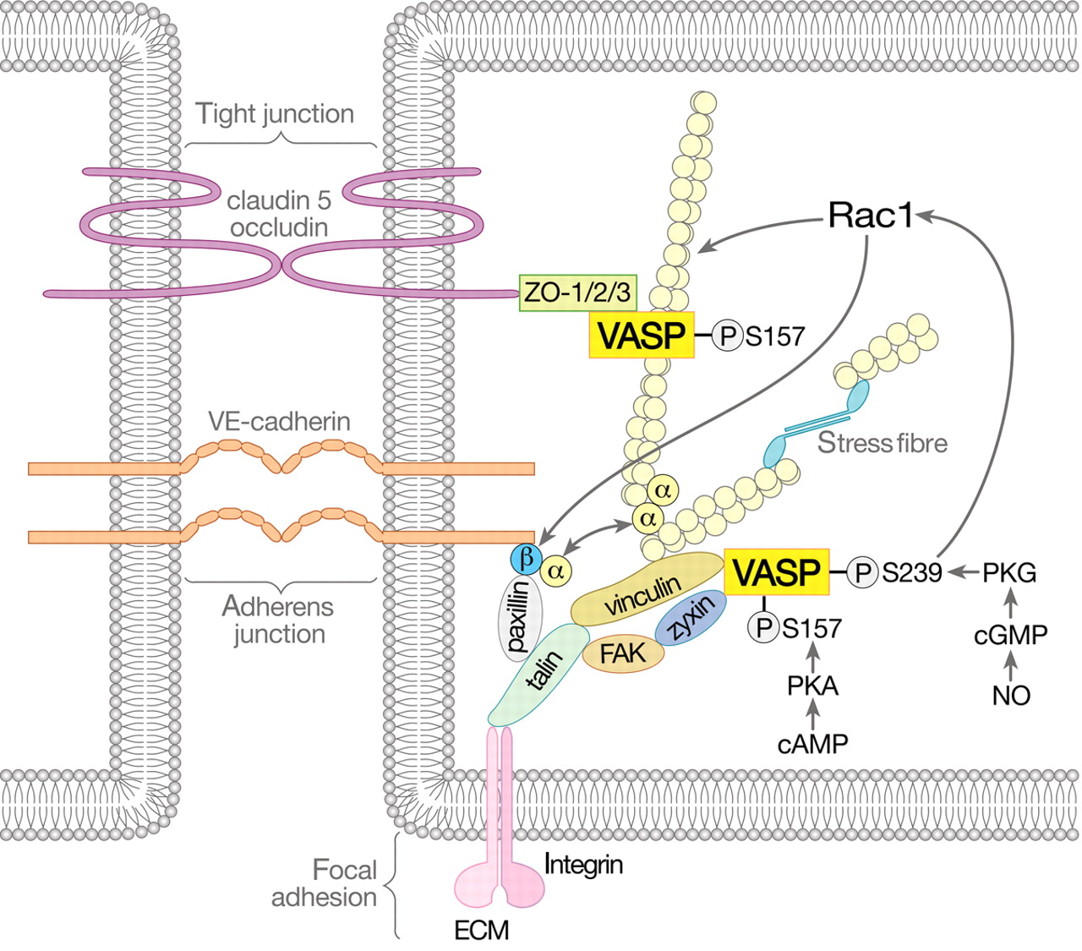
Mechanisms of VASP-dependent endothelial barrier regulation
Schlegel N , Waschke J Cardiovasc Res 2010;87:1-3
Published on behalf of the European Society of Cardiology. All rights reserved. © The Author 2010. For permissions please email: journals.permissions@oxfordjournals.org.

Slide 29
Mechanisms of VASP-dependent endothelial barrier regulation
Focal Adhesion Kinase
Vinculin
Talin-1
Paxillin
Zyxin
Catenin alpha-1
Catenin delta-1
Tight junction protein zo-1
Tight junction protein zo-2
Schlegel N , Waschke J Cardiovasc Res 2010;87:1-3
Published on behalf of the European Society of Cardiology. All rights reserved. © The Author 2010. For permissions please email: journals.permissions@oxfordjournals.org.

Slide 30
Multiple proteins involved in focal adhesions show regulated phosphorylation sites with distinct kinetic profiles
2 min
5 min
10 min
30 min
59 phosphorylation sites
on 32 gene products
SILAC ratio (log2)
-2
0
+2

Slide 31
Enrichment analysis of regulated phosphorylation sites identifies important thrombin-induced pathways and downstream effector functions
Pathways
Leukocyte transendothelial migration
Focal adhesion
Regulation of actin cytoskeleton
Molecular function
Enzyme activator activity
GTPase activator activity
Ras GTPase activator activity
Enzyme regulator activity
Small GTPase regulator activity
GTPase regulator activity
Guanyl-nucleotide exchange factor activity
Ras Guanyl-nucleotide exchange factor activity
Rho Guanyl-nucleotide exchange factor activity
Nucleoside-triphosphate regulator activity
Phospholipid binding
Lipid binding
Structural constituent of cytoskeleton
Domains
RhoGEF
SH3
Plekstrin Homology
>50 regulated phosphorylation sites
32 proteins
>200 regulated phosphorylation sites
96 proteins
20 RhoGEFs
9 RhoGAPs
Kinases
>180 regulated phosphorylation sites
66 kinases
enrichment value > 1
(FDR 0,05)

Slide 32
Summary and perspectives
Thrombin induces widespread phosphorylation of a large array of downstream effectors with distinct kinetic profiles
Our study:
provides a powerful resource for cell biologists working in the fields of endothelial barrier function and PAR-mediated signaling
identifies the regulation of a variety of novel proteins, including kinases, allowing for potential pharmacological intervention in thrombin and PAR-mediated signaling
emphasizes the intimate relation between coagulation and vascular biology
shows the enormous potential of using a global phosphoproteomic approach to unravel endothelial cell signaling

Slide 33
Sander Meijer
Koen Mertens
Juanra Hernandez
Lisa Neilson
Sara Zanivan

