Slide 1

Medicamenteuze Therapie van HFpEF
Prof. Adriaan A. Voors, cardiologist
University Medical Center Groningen
Notes:
Bedankt voor de introductie en de uitnodiging voor de presentatie.
De titel van mijn presentatie luidt als volgt:

Slide 2


Disclosures
AAV received consultancy fees and/or research grants from: Alere, Bayer, Cardio3Biosciences, Celladon, Merck/MSD, Novartis, Servier, Torrent, Trevena, Vifor.
AAV is supported by a grant from the European Commission: FP7-242209-BIOSTAT-CHF
AAV is Clinical Established Investigator of the Dutch Heart Foundation (2006T37)

Slide 3
Heart Failure Guidelines
“No treatment has yet been shown, convincingly, to reduce morbidity and mortality in patients with HF-PEF. Diuretics are used to control sodium and water retention and relieve breathlessness and oedema as in HF-REF. Adequate treatment of hypertension and myocardial ischaemia is also considered to be important, as is control of the ventricular rate in patients with AF.”
ESC HF Guidelines 2012; EJHF 2012

Slide 4
Treatment of HFpEF
 | Rec | LOE
Control of BP according to Hypertension guidelines | I | B
Diuretics to reduce symptoms due to volume overlaod | I | C
Coronary revascularization for patients with CAD in whom angina/ischemia is present despite GDMT | IIa | C
Management of AF according to current guidelines to improve symptoms | IIa | C
Using beta-blockers, ACEi and/or ARBs for hypertension | IIa | C
ARBs might be consider to decrease hospitalizations | IIb | B
Nutritional supplementation is not recommended | III | C
2013 ACCF/AHA Heart Failure Guidelines; JACC 2013

Slide 5
Use of Diuretics in HFpEF
Main aim: achieve and maintain euvolaemia (‘dry weight’) at lowest achievable dose.
Dose must be adjusted, particularly at dry body weight, to avoid the risk of dehydration leading to hypotension and renal dysfunction.
This may reduce cardiac output in patients with HF-PEF and often needlessly prevents the use of (or achievement of the target dose of) other disease-modifying therapies
ESC HF Guidelines 2012; EJHF 2012

Slide 6
Randomized Clinical Trials in HFpEF
 | Charm-Preserved | PEP-CHF | I-PRESERVE
Drug | Candesartan 32 mg vs. Placebo | Perindopril 4 mg vs. Placebo | Irbesartan 300 mg vs. Placebo
Number | 3023 | 850 | 4128
Age | 67 years | 75 years | 72 years
% Female | 40 | 55 | 60
LVEF | >40% (54) | >40% (64) | >45% (60)
Primary Outcome | CV-death or HF-hosp | Death or HF-hosp | Death or CV-hosp
Follow-up | 37 months | 25 months | 50 months

Slide 7

Effect of ACEi in HFpEF: PEP-CHF
Cleland et al. EJHF 2006

Slide 8
Effect of ACEi in HFpEF: PEP-CHF
Cleland et al. EJHF 2006

Slide 9
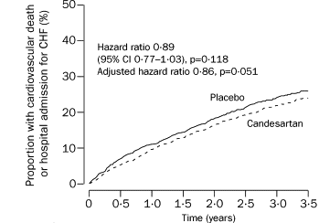
Effects of ARB in HFpEF:
CHARM-preserved
Yusuf et al. Lancet 2003

Slide 10
Effects of ARB in HFpEF:
CHARM-preserved
Yusuf et al. Lancet 2003

Slide 11
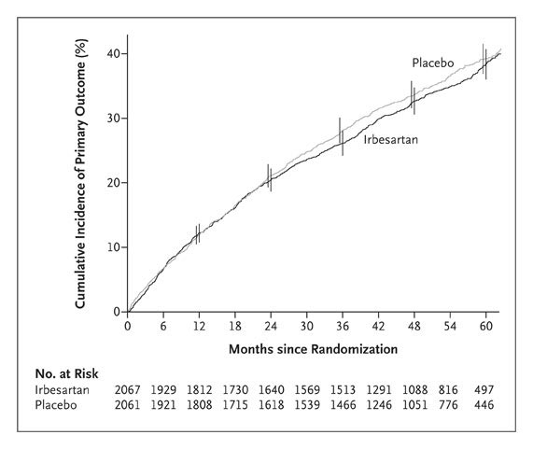
Effects of ARB in HFpEF:
I-PRESERVE
Massie et al. NEJM 2008

Slide 13
TOPCAT: methods
Objective: to determine effects of spironolactone on composite endpoint of CV-mortality, aborted cardiac arrest or HF-hospitalization in HFpEF patients
Inclusions: Symptomatic HF, Age ≥50, LVEF ≥45%, stratified according to:
  HF-hospitalization in past year
  Elevated NPs (BNP ≥100 pg/mL or NT-proBNP ≥360 pg/mL)
Major exclusions: eGFR <30 ml/min/1.73m², K⁺ ≥5 mmol/L, AF >90/min, recent ACS.

Slide 14
Variable | Spironolactone (n=1722) | Placebo (n=1723)
Age | 69 years | 69 years
Female | 52% | 51%
LVEF | 56% | 56%
Stratum HF hospitalization Natriuretic Peptide | 71.5% 28.5% | 71.5% 28.5%
Hypertension | 91% | 92%
NYHA class II NYHA class III | 63.3% 33.8% | 64.3% 32.2%
Coronary Artery Disease | 57% | 60%
Atrial Fibrillation | 35% | 35%
Diabetes Mellitus | 33% | 32%

Slide 15
Variable | Spironolactone (n=1722) | Placebo (n=1723)
Systolic Blood Pressure | 130 mmHg | 130 mmHg
Diastolic Blood Pressure | 80 mmHg | 80 mmHg
Heart rate | 68 bpm | 68 bpm
eGFR (ml/min/1.73m²) | 65 | 66
Serum Potassium | 4.3 mmol/L | 4.3 mmol/L
Medications ACE-i of ARB Beta-blocker Diuretic Statin Anticoagulant | 84% 78% 81% 53% 23% | 84% 77% 82% 52% 22%

Slide 16
Primary outcome
Mean follow-up 3.3 years
Outcome | Spironolactone | Placebo | HR (95%CI) and p-value
Primary Outcome | 320 (18.6%) 5.9/100pt-yr | 351 (20.4%) 6.6/100pt-yr | 0.89 (0.77-1.04) P=0.138
Primary Components
CV Mortality | 160 (9.3%) 2.8/100pt-yr | 176 (10.2%) 3.1/100pt-yr | 0.90 (0.73-1.12) P=0.354
Aborted Cardiac Arrest | 3 (<1%) 0.05/100pt-yr | 5 (<1%) 0.09/100pt-yr | 0.60 (0.14-2.50) P=0.483
HF Hospitalization | 206 (12.0%) 3.8/100pt-yr | 245 (14.2%) 4.6/100pt-yr | 0.83 (0.69-0.99) P=0.042

Slide 17
Safety
Total number of SAE’s:
spironolactone 835 (48.5%)
placebo 855 (49.6%)
However… Doubling Creatinine above ULN
HR=1.49 (1.18-1.87); P<0.001
 | Spironolactone | Placebo | P-value
Hyperkalemia (≥ 5.5 mmol/L) | 322 (18.7%) | 157 (9.1%) | <0.001
Hypokalemia (< 3.5 mmol/L) | 279 (16.2%) | 394 (22.9%) | <0.001

Slide 18
TOPCAT: Subgroups
Of 22 pre-specified subgroups, only 1 showed a significant interaction with treatment
Enrolled by: | Spironolactone | Placebo | HR (95% CI) P-value
Natriuretic Peptide | 78/490 (15.9%) | 116/491 (23.6%) | 0.65 (0.49-0.87) P=0.003
Heart Failure Hospitalization | 242/1232 (19.6%) | 235/1232 (19.1%) | 1.01 (0.84-1.21) P=0.923

Slide 19
TOPCAT: Conclusions
Treatment with spironolactone did not alter the primary composite endpoint, but reduced hospitalizations for heart failure
Use of spironolactone in these patients requires careful monitoring of K⁺ and creatinine

Slide 20


Slide 21
Why novel therapies in HFpEF?
HFpEF increasingly prevalent
Prognosis as poor as systolic heart failure
Different pathophysiology and different patient characteristics
Drugs that are beneficial in HFrEF do not seem to be beneficial in HFpEF
As yet, no proven pharmacological therapy for HFpEF

Slide 22
HFpEF: what’s in the pipeline?
PDE-5 inhibition (sildenafil)
Sinus node inhibition (ivabradine)
Soluable Guanylate Cyclase stimulation (vericiguat)
Beta-blockade
Angiotensin Receptor Neprilysin Inhibition (LCZ696)
Exercise

Slide 23
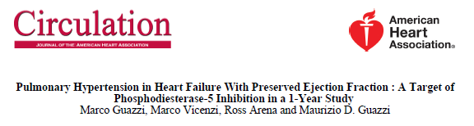
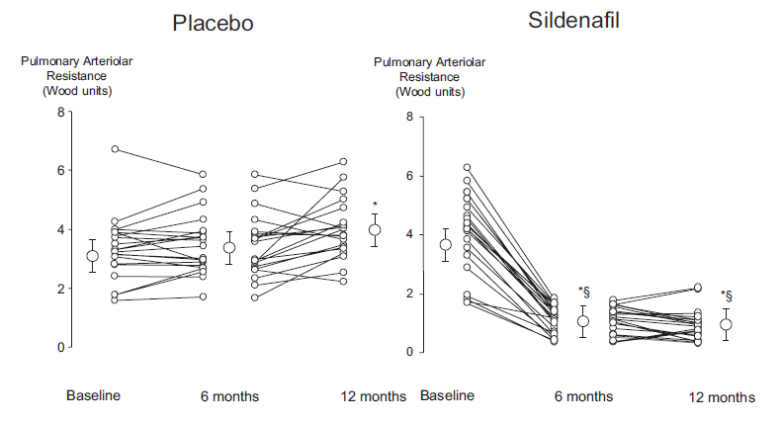
Guazzi et al. Circulation 2011

Slide 24
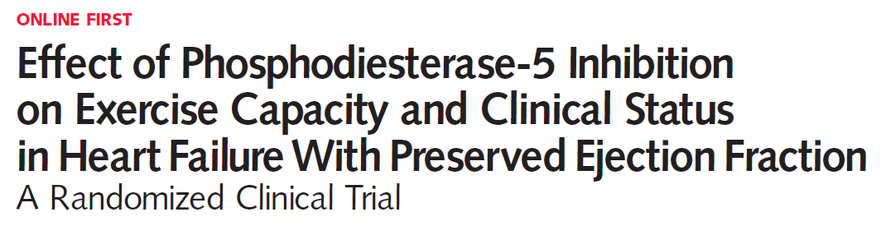
Methods 216 stable outpatients with HF, LVEF 50%, elevated NT-proBNP or elevated invasively measured filling pressures, and reduced exercise capacity were randomized to Sildenafil (n=113) or placebo (n=103)
Main Outcome Measures Primary end point was change in peak oxygen consumption after 24 weeks of therapy.

Slide 25
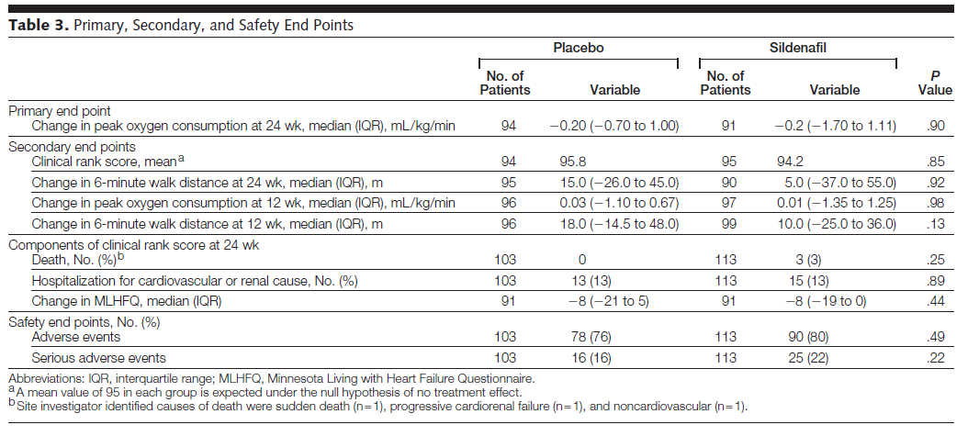
RELAX: main outcomes

Slide 26
HFpEF: PDE-5 inhibitors
Study Drug | N | Patients | 1e Endpoint | Institution
Sildenafil | 44 | LVEF>50% PAP>40 mmHg | PAP, RVF | University of Milano (Guazzi)
Udenafil | 52 | LVEF ≥50% NYHA II-IV | ∆VO2max | Seoul National Univesity Hospital (Kim)
Sildenafil | 50 | LVEF≥50% PAP>40 mmHg | PAP, PCWP | University Medical Center Groningen (Hoendermis)

Slide 27
HFpEF: what’s in the pipeline?
PDE-5 inhibition (sildenafil)
Sinus node inhibition (ivabradine)
Soluable Guanylate Cyclase stimulation (vericiguat)
Beta-blockade
Angiotensin Receptor Neprilysin Inhibition (LCZ696)
Exercise

Slide 28
Why Ivabradine in HFpEF?
Heart Rate independent risk factor for mortality in HFpEF
Ivabradine Effective in HFrEF
Ivabradine improves diastolic function in experimental and human studies
Ivabradine lowers myocardial and vascular collagen content
Ivabradine improves vascular stiffness in experimental studies

Slide 29
61 patients with HFpEF were randomly assigned to ivabradine 5 mg twice daily (n=30) or placebo (n=31) for 7 days in this double-blind trial.
CPX with echo of myocardial function and left ventricular filling were undertaken at rest and after exercise.

Slide 30
Ivabradine improves exercise capacity in HFpEF
Kosmala et al. JACC 2013

Slide 31
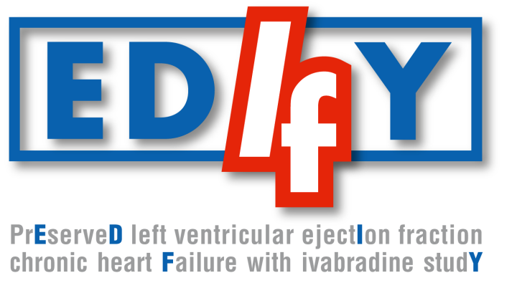
Effect of ivabradine versus placebo on cardiac function, exercise capacity, and neuroendocrine activation in patients with Chronic Heart Failure with Preserved left ventricular Ejection Fraction
An 8-month, randomised double-blind, placebo controlled, international, multicentre study
Primary objective± to assess the effect of ivabradine compared to placebo on the diastolic function, exercise capacity, and the neuroendocrine activation over an 8-month treatment period in 400 patients with HF-PEF

Slide 32
HFpEF: what’s in the pipeline?
PDE-5 inhibition (sildenafil)
Sinus node inhibition (ivabradine)
Soluable Guanylate Cyclase stimulation (vericiguat)
Beta-blockade
Angiotensin Receptor Neprilysin Inhibition (LCZ696)
Exercise

Slide 33
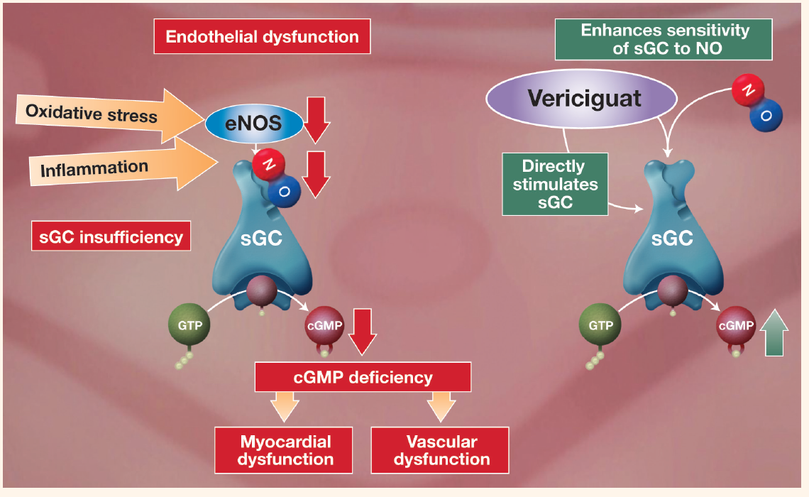
Soluble guanylate cyclase – a novel target for the treatment of heart failure
cGMP, cyclic guanosine monophosphate; eNOS, endothelial nitric oxide synthase; GTP, guanosine triphosphate; NO, nitric oxide; sGC, soluble guanylate cyclase
cGMP, cyclic guanosine monophosphate; eNOS, endothelial nitric oxide synthase; GTP, guanosine triphosphate; NO, nitric oxide; sGC, soluble guanylate cyclase.

Slide 34
Soluble Guanylate Cyclase stimulator Heart Failure Studies:
The SOCRATES Program
 | SOCRATES-REDUCED | SOCRATES-PRESERVED
Design | 2 randomized parallel-group, placebo-controlled, double-blind, dose finding Phase IIb studies of 4 dose regimens of the oral sGC stimulator vericiguat over 12 weeks
Inclusion Criteria | Worsening chronic heart failure requiring hospitalization (or IV diuretic for HF) with initiation after clinical stabilization
 | LVEF <45% | LVEF ≥45% Left atrial (LA) enlargement
Primary Outcome | NT-proBNP at 12 weeks | NT-proBNP / LA vol. at 12 weeks (split α: each p<0.025)
Enrollment | 410 patients in 5 arms | 470 patients in 5 arms
Study status | FPFV Nov 29, 2013 | FPFV Nov 6, 2013
CT.gov ID | NCT01951625 | NCT01951638

Slide 35
HFpEF: what’s in the pipeline?
PDE-5 inhibition (sildenafil)
Sinus node inhibition (ivabradine)
Soluable Guanylate Cyclase stimulation (vericiguat)
Beta-blockade
Angiotensin Receptor Neprilysin Inhibition (LCZ696)
Exercise

Slide 36
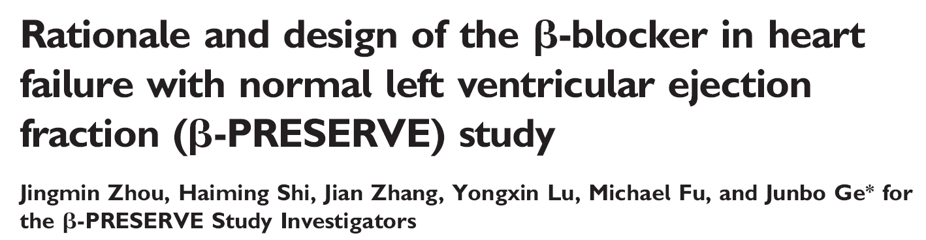
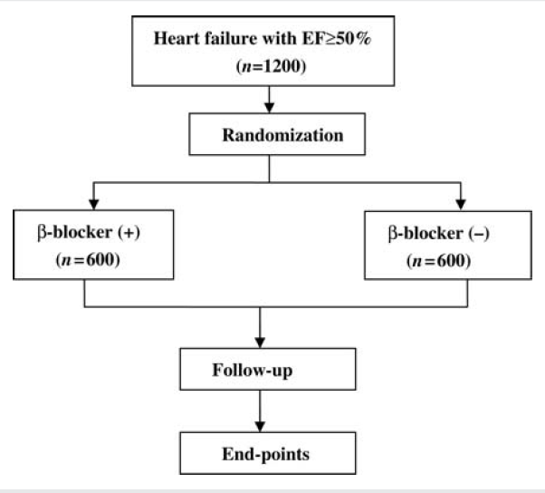
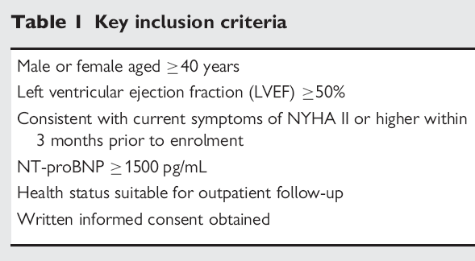
1e endpoint: CV death and/or HF admission

Slide 37
HFpEF: what’s in the pipeline?
PDE-5 inhibition (sildenafil)
Sinus node inhibition (ivabradine)
Soluable Guanylate Cyclase stimulation (vericiguat)
Beta-blockade
Angiotensin Receptor Neprilysin Inhibition (LCZ696)
Exercise

Slide 38
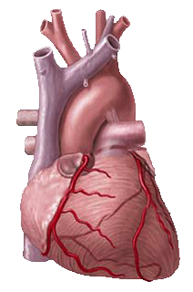
LCZ696 has the potential to restore the appropriate balance of the RAAS and natriuretic peptides in HF
Damage
Beneficial physiological response
Pathophysiological response
NPs
NP system
RAAS
Ang II
NEP
Dual
NEP/RAAS
inhibition
(LCZ696)
X
X
X
Inactive
fragments
AT₁ receptor
Vasodilation
 blood pressure
 sympathetic tone
aldosterone levels
fibrosis
hypertrophy
Natriuresis/Diuresis
Vasoconstriction
 blood pressure
 sympathetic tone
 aldosterone
fibrosis
hypertrophy
HF
symptoms/
progression
Neurohormonal balance
Notes:
38
AT₁=angiotensin II type 1; Ang II=angiotensin II; ARB=angiotensin receptor blocker; HF=heart failure; NEP=neprilysin; NP=natriuretic peptides; RAAS=renin-angiotensin-aldosterone system

Slide 39
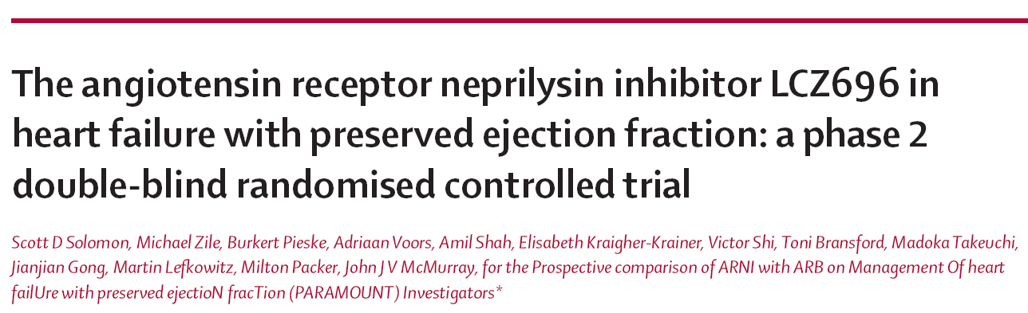

Slide 40
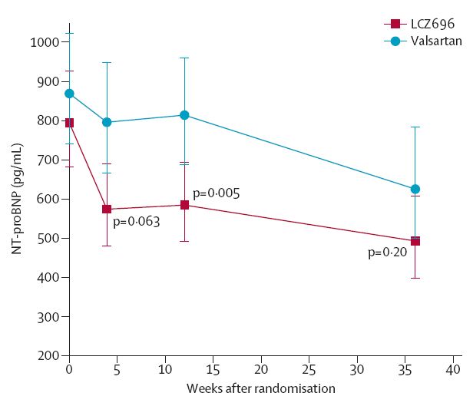
PARAMOUNT: main results
Solomon et al. Lancet 2012

Slide 41
Changes in Echocardiographic Measures
Left Atrial Volume
Left Atrial Width
12 Weeks
36 Weeks
0.00
12 weeks
36 weeks
2
1
LCZ696
Valsartan
0
-0.05
-1
Change in Left Atrial Volume (ml)
Change in LA Width (cm)
-2
-0.10
-3
-4
-0.15
-5
P = 0.18
P = 0.003
E/E’
P = 0.07
P = 0.03
-6
-0.20
2.0
Lateral E’
12 Weeks
36 Weeks
0.0
1.5
P = 0.40
-0.2
-0.4
P = 0.56
Change in Lateral Mitral Annular
Relaxation Velocity (E') (cm/s)
-0.6
1.0
-0.8
Change in E/E'
-1.0
0.5
-1.2
-1.4
-1.6
0.0
12 weeks
36 weeks
-1.8
P = 0.71
P = 0.42
-2.0
Solomon et al. Lancet 2012

Slide 42
PARAGON-HFPEF: study design
Target patient population: ∼4,300 patients with symptomatic HF (NYHA Class II–IV) and LVEF ≥45%
Randomization 1:1
Double-blind treatment period
Active run-in period
LCZ696 200 mg BID
Screening
Valsartan
80 mg BID*
LCZ696
100 mg BID
Valsartan 160 mg BID
On top of optimal background medications for co-morbidities (excluding ACEIs and ARBs)
up to 2 weeks
3–8 weeks
~240 weeks
Primary outcome: CV death and total (first and recurrent) HF hospitalizations (anticipated ~1,721 primary events)
*Valsartan 40 mg BID (up to 2 weeks) followed by
valsartan 80 mg BID as an optional starting run-in dose for
those patients being treated with less than the minimum
dose of ACEI or ARB at Visit 1
Solomon SD, et al. Poster presentation at ESC-HF Congress, 25 May 2013; Clinicaltrials.gov NCT01920711;accessed March 2014

Slide 43
HFpEF: what’s in the pipeline?
PDE-5 inhibition (sildenafil)
Sinus node inhibition (ivabradine)
Soluable Guanylate Cyclase stimulation (vericiguat)
Beta-blockade
Angiotensin Receptor Neprilysin Inhibition (LCZ696)
Exercise

Slide 44
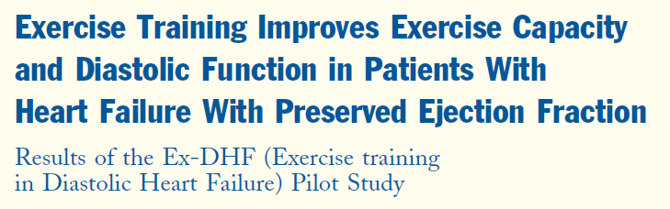

Primary Endpoint: peak VO2
Edelman et al. JACC 2011
Notes:
44

Slide 45
63 HFpEF patients (70 years) were randomized to 16 weeks of ET (walking, arm and leg ergometry, n=32) or attention control (CT) (n=31)
Kitzman et al. JACC 2013

Slide 46
ET increased peak VO2 (ET: 15.8 ml/kg/min vs. CT: 13.8 ml/kg/min, p<0.0001)
Kitzman et al. JACC 2013

Slide 47
HFpEF: Exercise training
Study Drug | N | Patients | 1e Endpoint | Institution
Exercise training (EX-DHF) | 340 | LVEF>50% Diastolic dysfunction | Combined Clinical Endpoint | Multicenter
Exercise training | 50 | LVEF ≥50% Echo: diastolic dysfunction | ∆6MWT | University of Michigan (Alexander)
Exercise Training | 80 | LVEF >50% | ∆VO2max | Hadassah University Hospital (Gotsman)
Exercise Training (EXEC) | 100 | LVEF ≥50% | Observational | Mayo Clinic (Borlaug)

Slide 48
Conclusions: treatment of HFpEF
Limited evidence
Careful diuretic treatment
RAAS-inhibitor inevitable, but limited evidence
Spironolactone? Potential risks and benefits..
A lot in the pipeline
  LCZ696?
  Ivabradine?
  Sildenafil?
  Soluable Guanyl Cyclase stimulator?
  Devices?

Slide 49

Most important…..

