Slide 1

The Danish Heart Failure Registry
Danish experiences during 10 years
Anne Nakano Quality advisor for DHFR
On behalf of the Danish Heart Failure steering group
Heart Failure Indicators for DHFR, Kastel´t Kerckebosch, Zeist Donderdag 19 december 2013

Slide 2
overview
  Background and principles about the registry
  Indicators: Development and implementation
  Aims and methods
Some results from the Danish Heart Failure Register
Challenges
Summing up experiences
Conclusion
The Danish Heart Failure Register
Notes:
2

Slide 3
BACKGROUND
  Important scientific advances have been made within the last decades regarding Heart Failure care.
  Major gaps between “knowing” and “doing” in routine clinical settings.
  Development and dissemination of clinical guidelines alone are not sufficient.
Systematic quality improvement initiatives are needed.

Slide 4
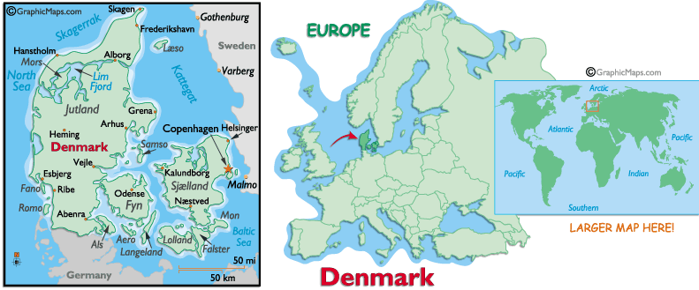
Population 5.5m
42 Heart Failure units
Notes:
4

Slide 5
Danish Heart Failure Registry - Mission
Improving diagnostics, treatment and rehabilitation
Documentation for clinical governance and organisational priority setting
Information for citizens and patients
Research infrastructure

Slide 6
The Danish Heart Failure Registry
  Indicator monitoring based on process-, and outcome indicators
Data collection initiated in 2003, fully implemented from 2004
Nationwide clinical registry
Reporting is mandatory for all hospital departments treating patients with heart failure
> 40.000 incident cases have been registered

Slide 7
Danish Heart Failure Registry: Organisation
  A public and tax financed registry
  A multidisciplinary board of health professionals appointed by scientific societies and professional organisations
  Supported by a national organisation providing IT and secretariat support as well as clinical epidemiological and biostatistical assistance.
  Governed by a secretariat referring to the ’Political Board’ representing the regions (=hospital owners), health authorities, professional and patient organisations

Slide 8
A united project
The 5 Danish Regions
The National Board of Health
The Danish Medical Associations
The scientific associations for physicians
The scientific associations for other professionals taking care of the patient
Patient organisations

Slide 9
The quality of Health Service
Secure the quality and transparency of Health Services
The organisational quality, coordination and continuity of health services
Prevention, diagnostic, treatment, care and rehabilitation

Slide 10
Goals for the Danish Heart Failure Database
Better quality for Health Care for HF patients
Dialog including priorities of future treatment and care of HF patients

Slide 11
Basic principles
Professionals plan quality measures and indicators
Professionals interpret and assess results before publication
Publication of results
Processes are evidencebased (following clinical guidelines), and transparent

Slide 12
Indicators
Possible to measure
Used to surveillance
Publication of results
Processes are evidencebased (following clinical guidelines), and transparent

Slide 13
Phase of development
3a. Phase of hearing
3b. Test of the database
2. Evidence: guidelines and litterature
1. Indicator development
6. Implementation
4. Final Indicatorset
5. Regional conferences for implementation
Notes:
Flowdiagram

Slide 14

Report of data
The Danish Heart Failure
database
Transfer of data
Dataanalysis
1. Clinical observations
Feedback of data to the wards/departments: Every month/quarterly
Quality development
Feedback of data adjusted for prognostic factors:
Once yearly (Reports)
Regional/local clinical audit
(not mandatory)
National clinical audit
Publication of the report on www.sundhed.dk

Slide 15
Aim
Figure. Modified Donabedian model (JAMA. 1988;260:1743-8)
Quality of Heart failure care
Structure
E.g.
Equipment
Personnel
Organizational context (medical specialization, volume)
Process
E.g.
Early diagnostic
acute treatment
Secondary prophylaxis
Early mobilization and rehabilitation
Outcome
E.g.
Mortality
Quality of life
Bed-day use
Resource utilization
Notes:
15

Slide 16
Methods - data sources
CPR
treatment, and care
Prognostic factors
Civil Registration System
Vital status
National Patient Registry
Bed-day use, comorbidity
Local hospital charges
Danish Stroke Registry
Danish Heart Failure Registry
Statistics Denmark
Socioeconomic status
Danish Medicines Agency
Filled precsriptions
Notes:
16

Slide 17
4. Proportion of patients, with reduced systolic function (LVEF≤40%), who start individualised supervised physical training by a physiotherapist at hospital at least12 weeks after admission/outpatient contact or after consultation by a physiotherapist at hospital are referred to training in the municipality
Notes:
17

Slide 18
3b. Proportion of patients, with reduced systolic function (LVEF≤40%), medicated with, starting with/trying to start treatment with: Betablockers at least12 weeks after admission/first outpatient contact
Notes:
18

Slide 19
3c. Proportion of patients, with reduced systolic function (LVEF≤35%), medicated with, starting with/trying to start treatment with: Aldosteron antagonist at least12 weeks after admission/first outpatient contact
Notes:
19

Slide 20
6 (amb). Proportion of patients, readmitted within 4 weeks after discharge or first outpatient control/contact
Notes:
20

Slide 21
6 (indl). Proportion of patients, readmitted within 4 weeks after discharge or first outpatient control/contact
Notes:
21

Slide 22
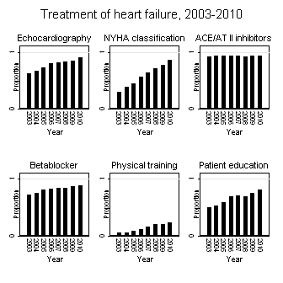
Results individual indicators
Nakano et al. BMC Health Services Research 2013, 13:391

Slide 23
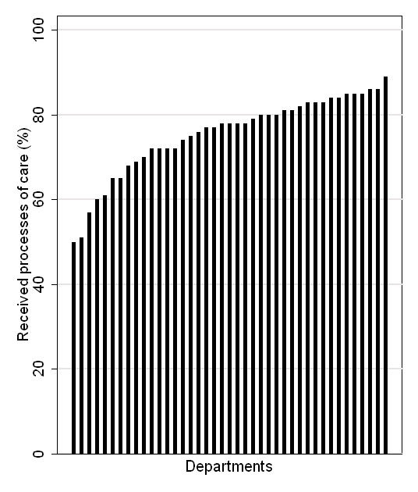
Variation in quality of care between departments
Nakano et al. BMC Health Services Research 2013, 13:391

Slide 24
(Selected) Challenges
  Unadressed questions about the organisation of care
  Weak evidence base underlying a substantial proportion of guideline recommandations
  Insufficient improvements in quality of care due to lack of acceptance and impact of the recommandations
  Uncertanties about the magnitude of inequalities in clinical outcome and quality of heart failure care across patient groups (age, gender, socioeconomic status, comorbidity etc.) and the mechanisms driving these differences

Slide 25
Organisation DK/local
Superior leadership and coordination
Professional engagement
Engagement from the management of the hospital
Any similar existing database? (heart failure, atrial fibrillation)

Slide 26
Summing up experiences
  Strengths
  Combined top-down/ bottom-up initiative
    Attention from politicians, administrators and the public
    Clinical ownership
  Closely linked with national clinical guidelines
  Stable core dataset has allowed long term monitoring of key indicators
  Enables a one-track collection of core heart failure data
Challenges
Data collection burden – more smart use of available data sources required
Need for more relevant outcome data, in particular functional outcome and QoL
Uncovered areas:
  Long-term rehablitation and secondary/tertiary prevention
The Danish Heart Failure Registry
Notes:
26

Slide 27
Data, Data everywhere…. But not much of it linked
GP
Lab Data
Screening
Hospital Data
Purpose Built
Investigations
Social Services
Other
Pharmacy
Notes:
27

Slide 28
Record-Linked Data
Completing the Jigsaw
Purpose Built
Lab Data
Other
GP
Pharmacy
Hospital
Social Services
Screening
Investigations
Notes:
28

Slide 29
CONCLUSION
  Use of guideline recommended processes of care has improved among patients with incident HF included in the Danish Heart Failure Registry between 2003 and 2010. During the same period, a decrease in mortality was observed.
  Multiple possiblities and challenges remain for further strengthening the role of the Danish Heart Failure Registry as an important tool for the improvement of quality of heart failure care and research.

Slide 30
  Thank you for your attention

