Slide 1
Antisense and
Apo B Synthesis Inhibition

Slide 2
Content
Antisense and Apo B Synthesis Inhibition
Mipomersen: Clinical Results
Phase 3 Clinical Program
Extension Study
Future Development
Additional Emerging Therapies

Slide 3
Apo B-100: Long-recognized as a Promising Target for Pharmacological Intervention
Focused Function: Specific to Atherosclerosis
Apo B provides the structural core of all atherogenic lipoproteins: VLDL, IDL, all forms of LDL, including Lp(a).
Apo B
Therapeutic platform mimicking an experiment of nature
Familial hypobetalipoproteinemia (FHBL), caused by genetic mutations resulting in extremely low levels of Apo B; results in low plasma cholesterol, reduced atherosclerosis, and heart disease
Mechanistic Analog LDL apheresis reduces all atherogenic lipoproteins through use of resins that bind and remove Apo B–containing particles from plasma.
Notes:
Apo B provides the structural core of all atherogenic lipoproteins: very-low density lipoprotein (VLDL), intermediate-density lipoprotein, all forms of LDL, including lipoprotein (a) (Lp[a]).

Slide 4
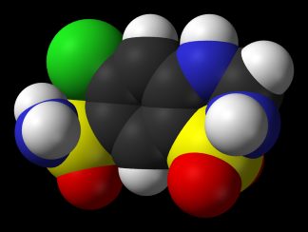
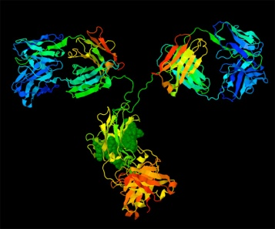
Unlike Conventional Approaches, Antisense Technology Provided a Method for Targeting Apo B
SMALL MOLECULE
ANTIBODY
Target-specific active sites on proteins/enzymes
Cannot cross cell membrane, and Apo B is synthesized in hepatocytes
ANTISENSE
Preferentially distributes to liver
Reaches intracellular targets via uptake by DNA scavenger receptors
Toth PP. J Clin Lipidol. 2011;5(6):441-449.

Slide 5
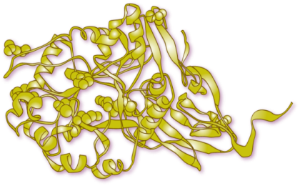
Antisense Drug Discovery Selectively Targets 1, and Only 1, Gene Product
Traditional, Small Molecule
Antisense Drug (oligonucleotide)
Disease-Associated Protein
Prevents Production of Disease-Associated Protein
mRNA
90% are metabolized in liver via CYP450
Half-lives variable, often short
Metabolized by endo- and exo-nucleases in tissues
Long half-lives
ASO = antisense oligonucleotide;.
Adapted from: Crooke ST, ed. Antisense Drug Technology: Principles, Strategies and Applications. 2nd ed. Boca Raton, FL: CRC Press; 2007:601-639.

Slide 6
Mipomersen – A 2nd Generation Antisense Drug
‘Gapmer’ design (to activate RNase H)
MOE modification at ends
DNA in middle
Phosphorothioate throughout
20 bases for high specificity and affinity
Molecular model of mipomersen
5’-wing
gap
3’-wing
G C C T C
A G T C T G C T T C
G C A C C
MOE
DNA
MOE
MOE side chain

Slide 7
Mipomersen Crosses the Hepatocyte and Nuclear Membrane to Target the mRNA for Apo B
Mipomersen (Apo B) antisense strand
Hepatocyte cell membrane
mRNA-antisense duplex
RNase H recognizes duplex
Apo B mRNA
RNA is cleaved
Adapted from Figure 1.10 in Crooke. Antisense Drug Technology: Principles, Strategies, and Applications, 2nd ed. 2008.p29.
DNA
Nucleus
Cytoplasm

Slide 8
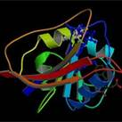
Mechanism of Action RNase H-mediated Degradation of Target mRNA
Antisense Drugs
(Oligonucleotides)
mRNA-DNA
Duplex
mRNA-H Recognizes Duplex
mRNA
RNase H
Target Protein
X

Slide 9
Metabolism of Mipomersen Drug Metabolism and Disposition
Mipomersen
5′-GCCTC AGTCTGCTTC GCACC-3′
5′ -
-3′
2′-MOE
deoxy
2′-MOE
PB: F_{b} = 96%
endonuclease
P450 not involved
PB: F_{b} = 85%
NOTE: Endo- and exo-nucleases are
ubiquitously expressed in all cell
types and organs
exonuclease
urine
+
+
PB: F_{b} not determined (estimated <80%)
Yu RZ, et al. Clin Pharmacokinet. 2009;48(1):39-50.
Yu RZ, et al. Drug Metab Dispos. 2007;35(3):460-468.
Notes:
Like all ASOs, mipomersen is metabolized by nucleases and the resulting fragments are excreted in urine (see Yu et al, 2007 and 2009). Unmetabolized, 97% of mipomersen is bound to protein in human plasma, whereas a lower fraction (85%) of the endonuclease fragments (10-mers) is bound to protein. In general, the shorter the oligonucleotide length, the lower the fraction bound to plasma proteins. Because cytochrome P450 is not involved in the metabolism of mipomersen (see Yu et al, 2009), the potential for interaction with other drugs is believed to be minimal.

Slide 10
Targeting Apo B Production Reduces Formation of VLDL and Other Atherogenic Lipoproteins
mRNA
Apo B
Atherogenic
particles
Normal
synthesis of Apo B–containing
particles
Mipomersen
inhibits
Apo B
synthesis
Mipomersen
Apo B synthesis inhibited

Slide 11
The Development of Mipomersen Resulted From 30+ Years of Antisense Drug Discovery
1978
Dr. Paul Zamecnik publishes first demonstration of antisense technology
2003
Mipomersen
sodium enters clinic
1998
Vitravene (fomiversen)
FDA approved for CMV
2007
Phase 3 begins
1970s | 1980s | 1990s | 2000s | 2010s
2002
Chemical structure solved for Apo B
“hot spot”
2012
FDA
filing
1988
2011
EMA
filing
2005
Phase 2 dose-ranging
complete 200 mg
selected
2010
EMA = European Medicines Agency.

Slide 12
Reductions in Total Cholesterol Correlate With Apo B mRNA in Liver in vivo
Total cholesterol and Apo B mRNA levels in HF-fed mice (6 weeks of treatment)
Normal cholesterol
ISIS 147764
(murine Apo B ASO)
Crooke RM, et al. J Lipid Res. 2005;46:872-884.
Notes:
Apo B mRNA suppression correlated tightly with reduction in total cholesterol levels in HF-fed mice. The 15% and 76% reductions in Apo B mRNA levels in 5 and 25 mg/kg treated mice corresponded with total cholesterol reductions of 8% and 46%, respectively. Treatment with 50 mg/kg of murine-specific Apo B ASO lowered Apo B mRNA levels by 88% and levels of total cholesterol by 55%, effectively normalizing cholesterol to levels observed in chow-fed, saline-treated control mice, represented by the dashed white line (82 mg/dL).

Slide 13
Pharmacology Proof of Concept ApoB Inhibition Mitigates Atherosclerotic Lesion Development in LDLr-Deficient Mice
Treatment
Saline
ApoB ASO
0.35
0.30
High Cholesterol
0.25
0.20
Aortic Sinus Lesion Volume, mm³
Diet
0.15
0.10
0.05
High-Fat Cholesterol
0.00
saline
ASO
saline
ASO
HC
HFC
%∆
(vs saline)
- 80%
- 86%
Mullick AE, et al. J Lipid Res. 2011;52:885-96.

Slide 14
Phase 2: Hypercholesterolemia, Monotherapy Dose-dependent Reduction of LDL-C
Once Weekly Dosing
(n = 10) (n = 8) (n = 8) (n = 8) (n = 8) (n = 8)
Treatment period
Day
Akdim F, et al. Eur Heart J. 2011

Slide 15
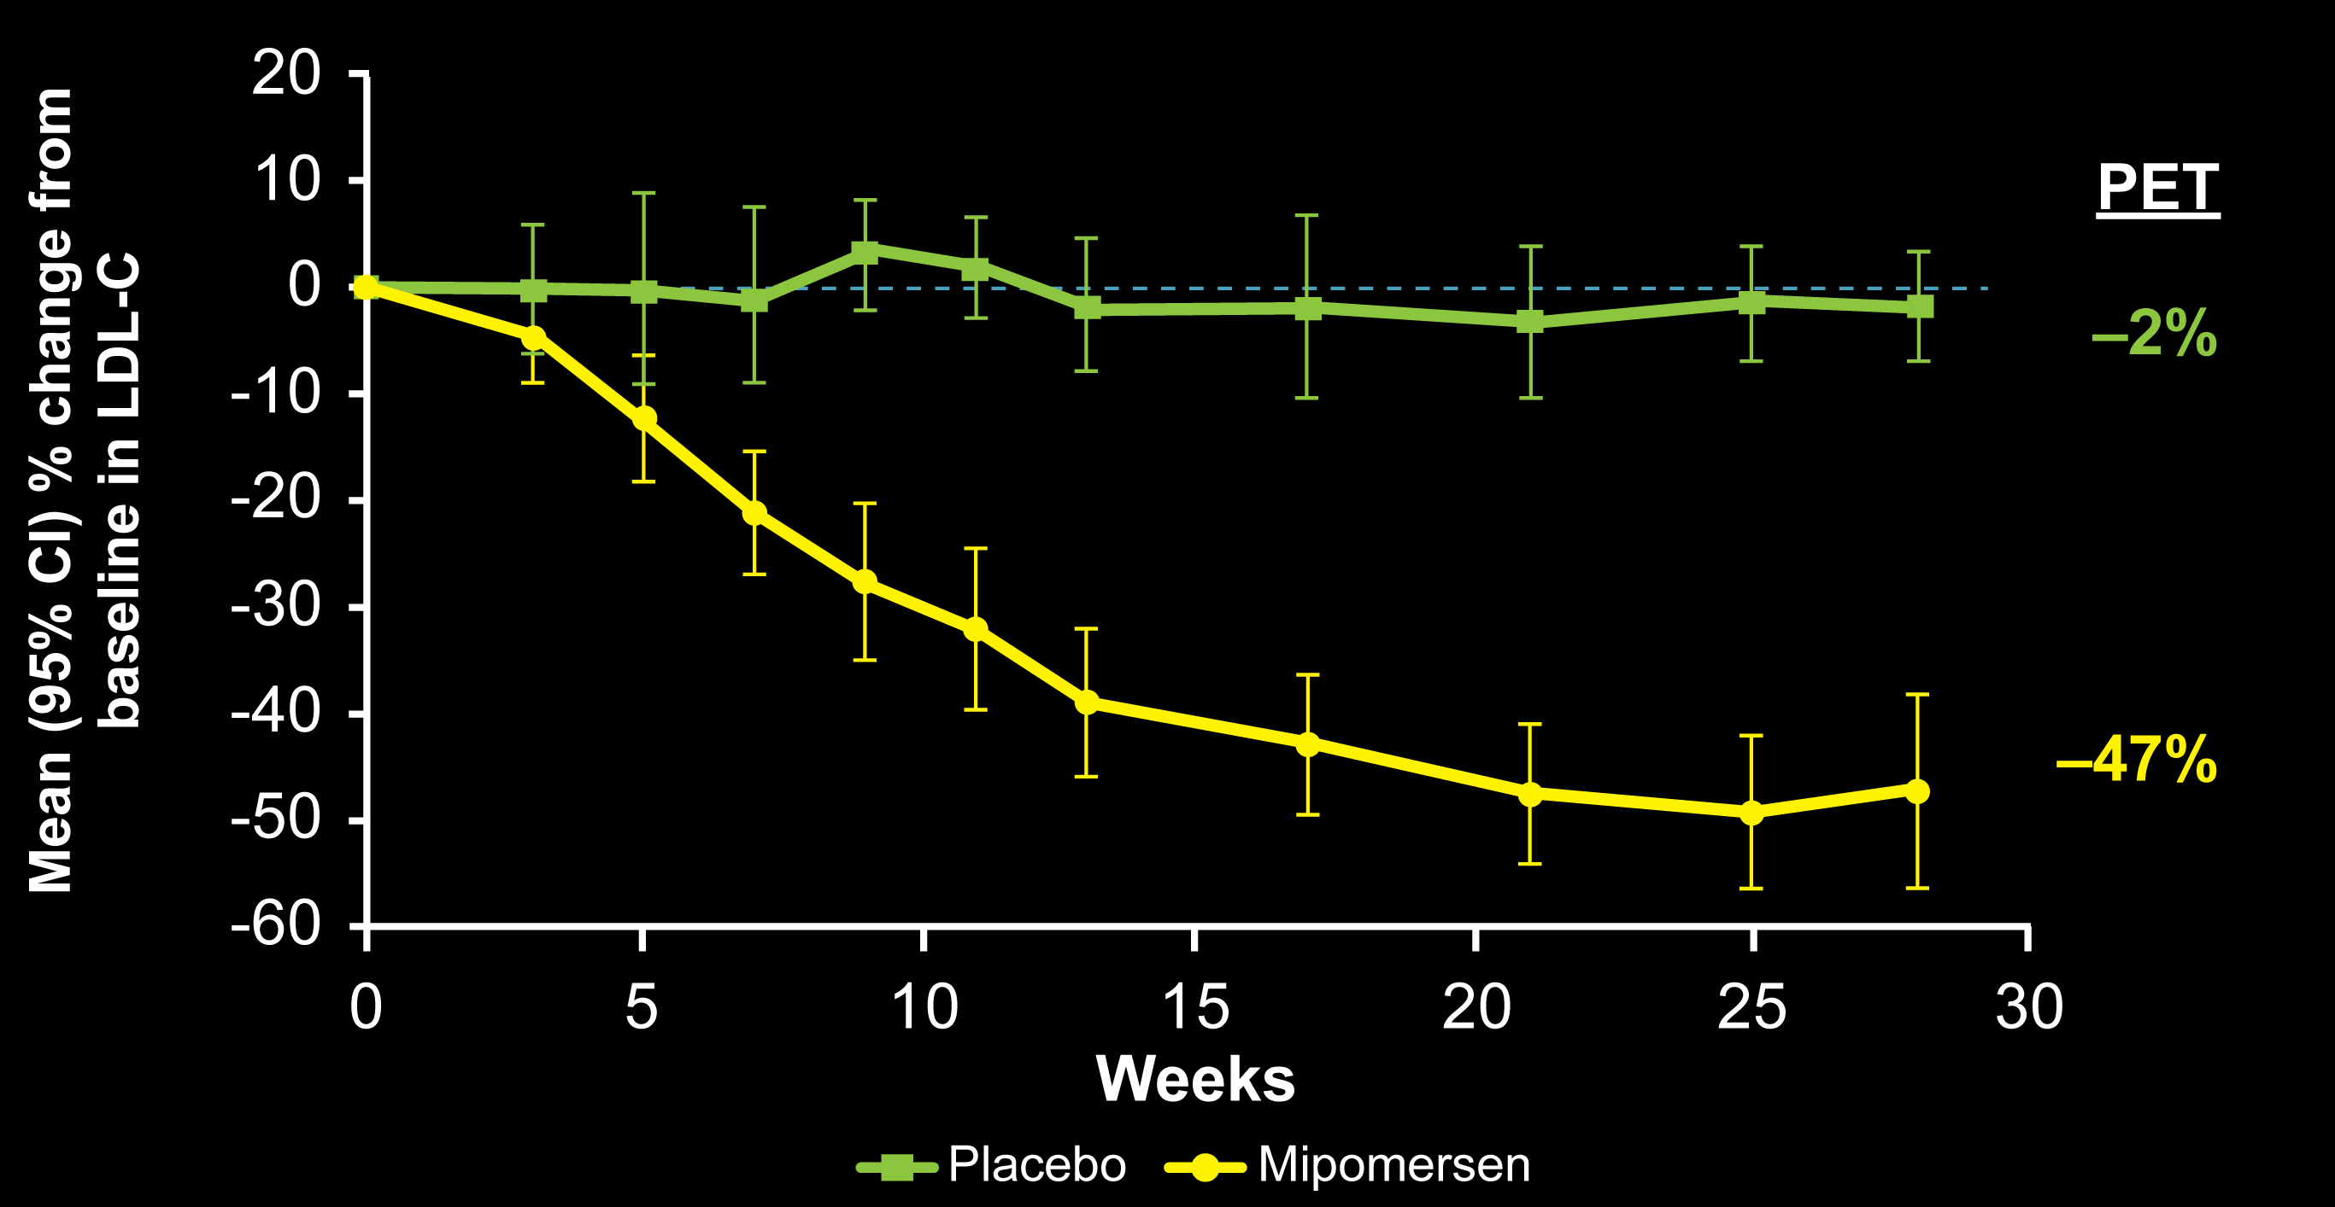
Mipomersen Significantly Reduced LDL-C in Statin-Intolerant Patients (approx. half were FH)
CI, confidence interval; PET, primary efficacy time point, 2 weeks after final dose.
LDL-C (mg/dL) | Placebo (N = 12) | Mipomersen (N = 21)
Baseline, mean (SD) | 244 (66) | 242 (91)
PET, mean (SD) | 236 (53) | 128 (74)
Absolute change, mean | -7 | -114
M. Visser, E.S.Stroes, et.al., AHA: 2011

Slide 16
Mipomersen Pharmacokinetic and Pharmacodynamic Properties
Elimination Half-Life (t_{1/2}) = 1-2 months
Metabolism
Mipomersen is metabolized in tissues by endonucleases
Primarily excreted in the urine
No CYP450 induction or inhibition, not a substrate
No P-glycoprotein inhibition; not expected to be a substrate
No protein binding interaction with statins
Drug-Drug Interactions
No effect on mipomersen pharmacokinetics when administered concurrently with lipid-lowering agents, β-blockers, ACE inhibitors, or platelet aggregation inhibitors
No QTc changes in dedicated electrocardiographic study
Yu, R. Z., T. W. Kim, et al. Drug Metab Dispos,2007.35(3):460-8.

Slide 17
Mipomersen Summary of Phase 3 Clinical Studies
Mipomersen led to reductions in all apoB-containing atherogenic lipids measured when added to maximally tolerated lipid lowering therapy and diet
Average LDL-C reduction > 100 mg/dL in severe HeFH and HoFH populations
Increase or no change in HDL-C (+2 to +19%)
Frequently observed on-treatment adverse events were injection site reactions and flu-like symptoms
On average, TEAEs were mild to moderate in severity
Elevations in liver transaminases (ALT, AST) also occurred commonly
No effect on liver synthetic function, i.e. total bilirubin, albumin, and PT
Modest median increase in hepatic fat was observed in mipomersen treated patients
No adverse clinical sequelae associated with the liver fat changes were identified
Overall safety and efficacy consistent across all patient populations studied

Slide 18
Phase 3 Extension Study
Raul Santos (Brazil), Bart Duell, Cara East, John Guyton, Patrick Moriarty, Joanne Donovan, Robert Mittleman. Long-term safety and efficacy of mipomersen in patients with familial hypercholesterolemia not controlled by maximally tolerated lipid lowering therapy. Abstract 790. IAS Sydney 25-29 March 2012

Slide 19
Phase 3 Extension Study Study Design
Multi-center, phase 3 open-label extension study at 33 sites in 7 countries
200 mg mipomersen weekly SC injection for up to 4 years
Assessments include safety parameters, liver MRI, lipid parameters
Index study data is included for patients who initiated OLE <6-mo from last dose of mipomersen in the index study
n = 38*
(86%)
HoFH
1 yr
2 yrs
†
N=141
Severe
HeFH
n = 9*
(100%)
24 wk
f/u
24 wk
f/u
HeFH
n = 94*
(82%)
* n, represents number of patients enrolled from the index study. Value in parenthesis is the percent of eligible patients enrolled.
† Eight of 26 sites that participated in the index study were open for the extension study.
Presented at the 16th International Symposium on Atherosclerosis; Sydney, Australia, 2012
Notes:
CS6 Study Population
Patients with familial hypercholesterolemia or severe hypercholesterolemia
On lipid-lowering therapy
Completed dosing in Phase 3 index study *
Had a satisfactory safety profile per Investigator judgment
* Phase 3 Index Studies
ISIS 301012-CS5 (NCT00607373; HoFH)
MIPO3500108 (NCT00794664; severe HeFH)
ISIS 301012-CS7 (NCT00706849; HeFH)
Two patients have rolled over from ISIS 301012-CS17 for 2 additional years of dosing.
Data for these patients is not included in the current set of results (November ‘11 cut-off).
# Eligible patients by index study
CS5 N = 38 (16 pbo; 22 mipo) ; 44 of 51 eligible, 86% enrolled/dosed
CS7 N = 94 (39 pbo;55 mipo) ; 114 of 124 eligible, 82% enrolled/dosed
MIPO35 N = 9 (3 pbo;6 mipo) 9 eligible, 100% enrolled/dosed
Total 57 pbo; 84 mipo
Total eligible 167
84% enrolled/dosed
19

Slide 20
Phase 3 Extension Study Sustained Reduction of Atherogenic Lipoprotein on top of Max Tolerated Lipid Lowering Therapy
 |  | % Change from Baseline
Lipoprotein Mean (95%CI) | Baseline (N=141) | Wk 26 (n = 130) | Wk 52 (n = 111) | Wk 76 (n = 66) | Wk 104 (n = 53)
LDL-C | 233 (147) | -28‡ (-32, -25) | -27‡ (-31, -23) | -27‡ (-33, -22) | -28‡ (-35, -22)
Non-HDL-C | 256 (151) | -27‡ (-30, -24) | -25‡ (-29, -21) | -25‡ (-30, -20) | -27‡ (-33, -21)
Apo B | 175 (81) | -29‡ (-32, -26) | -28‡ (-32, -24) | -30‡ (-35, -26) | -31‡ (-37, -26)
Lp(a) | 61 (55) | -21‡ (-25, -17) | -16‡ (-23, -10) | -17‡ (-24, -10) | -14‡ (-22, -5)
HDL-C | 46 (14) | +6† (3, 10) | +6* (2, 10) | +3 (-1, 8) | +10† (3, 17)
Baseline values are the mean (SD) in mg/dL. P-values were determined by the Wilcoxon Rank Sign test.
* p-value <0.05, † p-value <0.01, ‡ p-value <0.001.
Presented at the 16th International Symposium on Atherosclerosis; Sydney, Australia, 2012

Slide 21
Phase 3 Extension Study Sustained Reduction in LDL-C, Apo B & Lp(a) with Long-term Treatment on top of Max Tolerated Lipid Lowering Therapy
0
LDL-C
apoB
Lp(a)
-5
-10
-15
Mean % Change (+/-95% CI)
-20
-25
-30
-35
-40
n=141
130
111
66
53
BSLN
26
52
76
104
Week
Presented at the 16th International Symposium on Atherosclerosis; Sydney, Australia, 2012

Slide 22
Phase 3 Extension Study Safety Data
On-treatment AEs, n (%)
Serious AEs ª | 33 (23)
SAEs not related or unlikely related in 29 patients
AEs leading to Treatment Discontinuation | 62 (44)
AEs leading to Dose Adjustment ^{b} | 42 (30)
Injection site reactions ^{c} | 138 (98)
Median incidence per injection of 10%
Flu-like symptoms | 92 (65)
Median incidence per injection of 2%
Alanine Aminotransferase Levels,^{d} n (%)
≥ 3 x ULN, two consecutive results ≥7 days apart | 18 (13)
ª SAEs included 1 death considered not related to drug ^{b} Dose interruption or dose decrease ^{c} Generally self limiting and mild to moderate in severity ^{d} No increases in ALT ≥3x ULN with concomitant increases in total bilirubin ≥2x ULN during the treatment period. No Hy’s law.
Presented at the 16th International Symposium on Atherosclerosis; Sydney, Australia, 2012
Notes:
SAEs possibly-related to drug: 4 events/4 patients (2.8%); glomerulonephritis membranous, atrial fibrillation, biliary colic and appendicitis
6 events/6 patients SAE unlikely related to drug
45 events/27 patients SAEs not related to drug
29 patients SAE event(s) not related or unlikely related

Slide 23
Phase 3 Extension Study Patients completing 2 yrs of treatment: 6-Month Incidence of ISR, FLS and ALT Events
90
ISR
80
FLS
ALT Increase
70
60
50
AE Frequency (%)
40
30
20
10
0
≤ 26 wk
(N=52)
26-52 wk
(N=52)
52-76 wk
(N=52)
76-104 wk
(N=52)
104-130 wk
(N=49)
ISR denotes injection site reaction and includes the related preferred MedDRA terms, e.g. erythema, pain, haematoma, discolouration, pruritis and swelling.
FLS denotes flu-like symptoms and includes the following preferred MedDRA terms: chills, fatigue, influenza-like illness, malaise, pyrexia, arthralgia and myalgia.
Presented at the 16th International Symposium on Atherosclerosis; Sydney, Australia, 2012

Slide 24
Phase 3 Extension Study Increase in Median ALT Level Stabilizes with Extended Dosing
140
120
3xULN
100
Median ALT (IQR), U/L
80
60
40
ULN
20
1
5
9
1
1
2
2
3
3
4
5
5
6
7
7
8
9
9
1
1
1
1
1
1
1
1
1
3
7
1
6
2
9
5
2
8
4
0
6
3
0
7
0
1
1
2
3
3
4
5
6
4
0
6
3
0
8
7
6
4
Time Point (Weeks)
N = 141
140
139
135
134
130
130
121
118
113
111
84
70
80
66
75
65
63
54
40
36
30
32
16
10
5
2
Presented at the 16th International Symposium on Atherosclerosis; Sydney, Australia, 2012

Slide 25
Phase 3 Extension Study Increase in Median % Liver Fat Returns Towards Baseline with Extended Dosing and in Post-Treatment F/U
40
Values shown represent the median change from baseline in percent liver fat.
30
20
13%
Change from Baseline in % Liver Fat Content
10
7%
5%
5%
3%
0
0%
-10
-20
n=
60
31
45
39
15
25
26
52
76
104
130
Post W24
Week
Presented at the 16th International Symposium on Atherosclerosis; Sydney, Australia, 2012
Notes:
Plot includes data from a total of 89 patients who had a baseline measurement and at least one measurement during treatment.
The change from baseline in % liver fat was statistically significant at all time points except Week 130 and Post-Treatment Week 24 as determined by the Wilcoxon Rank Sign test.
In the box plots, the bottom and top edges of the box are the 25th and 75th percentiles. The center horizontal line is the 50th percentile (median). The blue dots are the means. The fences are at 1.5×interquartile range above the 75th percentile or below 25th percentile; Stars are the extreme values. Percentage values represent the median.

Slide 26
Phase 3 Extension Study Safety Summary
No new safety findings
Similar profile to that observed in all four 6-month Phase 3 studies
Most patients experienced injection site reactions
Incidence was infrequent by injection
1 in 10 injections; or 5 per year on average
Generally self-limiting and mild to moderate in severity
Some patients experienced flu-like symptoms
Most common symptom was fatigue
Incidence was very infrequent by injection
1 in 50 injections; or 1 per year on average
Similar liver safety to that observed in 6-month Phase 3
Presented at the 16th International Symposium on Atherosclerosis; Sydney, Australia, 2012

Slide 27
Phase 3 Long Term Extension Study Overall Summary
A total of 141 patients, including HoFH, Severe HeFH and HeFH subjects enrolled in the extension study
Sustained lipid-lowering activity with extended treatment
In addition to maximally tolerated lipid lowering therapy
All atherogenic lipids measured remained reduced with extended treatment including LDL-C, Apo B, Lp(a), non-HDL-C and TGs
No loss of LDL-C response over 2 years of treatment
Safety and tolerability profile remains consistent with Phase 3 index studies
Preclinical observations of liver adaptation to reduced lipid transport apparent in long-term clinical experience
Increase in median % liver fat decreased with continued dosing past week 52, either at full or altered dose*
*Altered dose refers to dose adjustments and dose holidays
Presented at the 16th International Symposium on Atherosclerosis; Sydney, Australia, 2012

Slide 28
Emerging Therapies in Development
CETP inhibitor
Anacetrapib* (Merck)
*Projected 2018
MTP inhibitor
Lomitapide (Aegerion)
2011 | 2012 | 2013 | 2014 | 2015 | 2016
Apo B inhibitor
Mipomersen (Genzyme)
PCSK9 inhibitors
PCSK9 mAbs (Regeneron/Sanofi Amgen, Pfizer)
PCSK9 siRNA (Santaris)
PCSK9 siRNA (Alnylam)
PCSK9 ASO (ISIS-BMS)
CETP = cholesterol ester transfer protein;
= monoclonal antibodies;
MTP = microsomal triglyceride transfer protein.
Notes:
28
28
28
28

