Slide 1
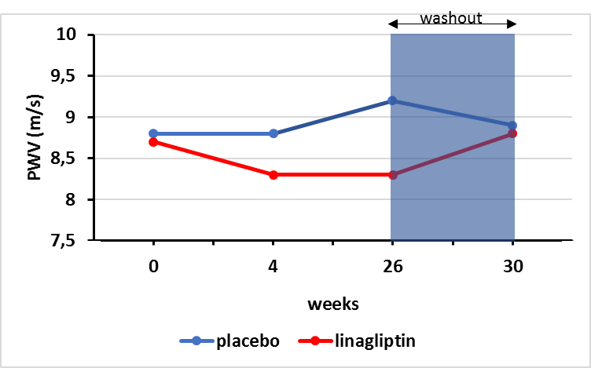
Pulse wave velocity
Treatment of treatment-naïve T2DM patients with linagliptin or placebo
Adapted from: de Boer SA, et al., Diabetes, Obesity and Metabolism, 2017

