Slide 1

Familial Hypercholesterolemia
European Perspective
Eric Bruckert,
Pitié-Salpêtrière Hospital
Institute of Cardiometabolism and Nutrition (ICAN)
Paris, France
Zeist, 12 sept 2014

Slide 2
Disclosure slide, Eric Bruckert
Research contracts: AMGEN, Danone, Aegerion
Consulting/presentation: AstraZeneca, Amgen, Genfit, MSD, Sanofi-Regeneron, Unilever, Danone , Aegerion
Employment in industry: None
Stockholder of a healthcare company: None
Ownership of a healthcare company: None

Slide 3
Severe familial hypercholesterolemia
Statin intolerance
Severe HyperTg with a risk of pancreatitis
Common hyperTg with high CV risk
Isolated hypoHDLemia
High Lp(a) (isolated or in hypercholesterolemic patients)
Unmet clinical needs in lipidology

Slide 4
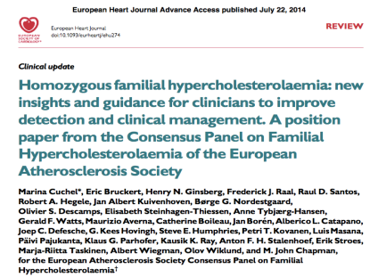
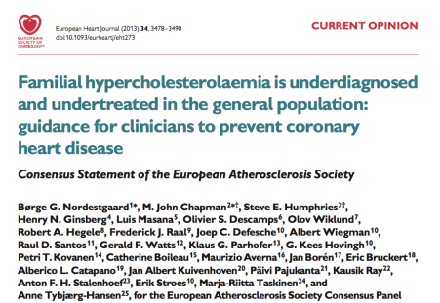
FH poorly diagnosed in Europe

Slide 5
Homozygous Familial Hypercholesterolemia

Slide 6
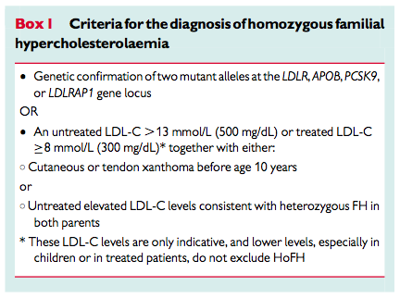
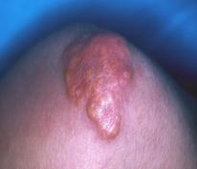
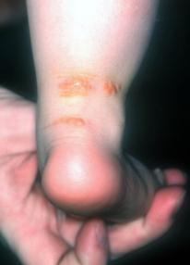
Definition according to the EAS consensus statement
Cuchel M, Bruckert E, Ginsberg H et al. Eur Heart Journal 2014

Slide 7
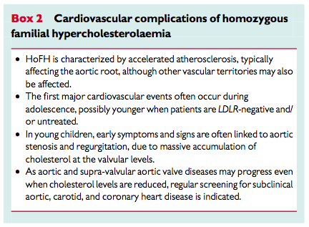
Late referral of hoFH patients to specialised center due to underestimation of CVD complications
Cuchel M, Bruckert E, Ginsberg H et al. Eur Heart Journal 2014

Slide 8
Differentiation from sitosterolemia
Extremely rare disease with transient major elevation of cholesterol and clinical features ressembling hoFH
But
No family history (recessive disorder)
Decrease of serum cholesterol upon diet, BAS* or ezetimibe
Dramatic increase of serum plant sterol
Good CVD prognosis when diagnosis made at a young age**
Mutations in two ATP binding cassette transporter genes, ABCG5 and/or ABCG8
*Bile Acid Sequestrant
**Hansel B et al. Atherosclerosis 2014

Slide 9
Homozygous Familial Hypercholesterolemia in Europe
We need a registry at the level of Europe or at least within different countries. Several questions remain since the classical clinical outcome has changed over time and because we need to have long term and extensive follow up of new drugs put on the market with limited experience
In the clinical department we have 53 patients with extensive data recorded from medical file. Large French centers have agreed to collaborate and increase the number

Slide 10
Heterozygous Familial Hypercholesterolemia

Slide 11
Patients with heFH should be identified for at least 4 reasons
Population at higher risk and thus with lower LDL-c target. Treatment needs to be started at a young age
Diagnosis of FH is the basis for cascade screening
Diagnosis of FH Improves the medical care and compliance
Diagnosis of FH might be useful for reimbursment in some countries and might be an indication for future therapeutic options

Slide 12
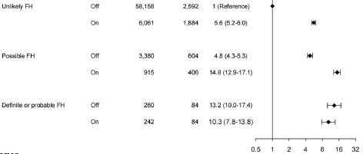
Risk of CHD in heFH
Copenhagen General Population Study (n=69,209)
Dutch criteria (no use of xanthoma or corneal arcus)
After exclusion of hypothyroidism, there were 0.20% of definite FH, 0.53% of probable, 6.3% of possible FH and 93% of unlikely FH
Adjusted odd ratio for CAD in non treated patients with definite/probable FH: 13.2 (95% CI 10.0 – 17.4)
Benn M et al. JCEM 2012

Slide 13
Why such a high risk?
High serum levels of LDL-c/longer half life
Life-time exposure from birth
Pre natal exposure to high cholesterol?
High Lp(a)
Lower HDL-c and efflux capacity of large HDL2 particles¹
A
B
20
10.0
7.5
18
ABCG1- dependent
HDL2 efflux capacity (%)
SR-BI dependent
HDL2 efflux capacity (%)
16
5.0
14
2.5
12
r = –0.473; p<0.02
r = –0.485; p=0.02
0.0
10
0.2
0.4
0.6
0.8
1.0
1.2
1.4
1.6
1.8
2.0
0.2
0.4
0.6
0.8
1.0
1.2
1.4
1.6
1.8
2.0
C-IMT
C-IMT
1. Guérin M. Curr Opin Lipidol 2012;Epub;doi: 10.1097/MOL.0b013e328353ef07

Slide 14
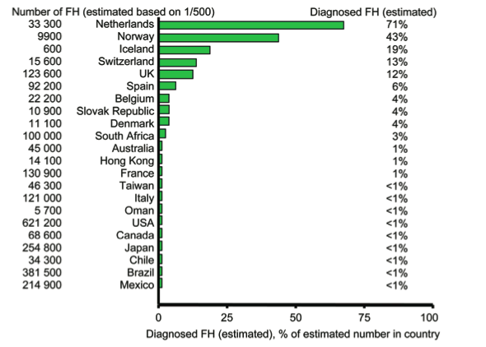
Estimated percent individuals diagnosed with FH
As most countries do not have valid nationwide registries for FH, several values in this figure represent informed estimates from clinicians/scientists with recognized expertise in and knowl- edge of familial hypercholesterolaemia in their respective countries.

Slide 15
“Clinical diagnosis” with the use of score
High level of CT or LDL
Family history
Clinical finding
MEDPED
Dutch criteria
Simon Broome criteria
Japanese criteria

Slide 16
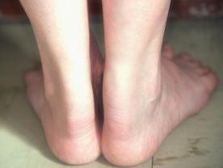
Familial Hypercholesterolemia: Dutch criteria
Diagnostic total score
  Certain: ≥8
  Probable: 6–7
  Possible: 3–5
 | Score
Family history
I. First-degree with premature coronary or vascular disease | 1
II. First-degree relative to LDL-C levels >95th percentile, and/or | 1
I. First-degree relative to tendon xanthomas and/or arcus cornealis | 2
II. Children <18 years old with LDL-C levels >95th percentile | 2
Personal history
I. Coronary heart disease | 2
II. Premature peripheral or cerebrovascular disease | 1
Physical signs
I. Tendon xanthomas | 6
II. Arcus cornealis (<45 years old) | 4
Blood analysis (with triglyceride levels <200 mg/dl, <2.3 mmol/l)
I. LDL-C >330 mg/dl (8.5 mmol/l) | 8
II. LDL-C 250–329 mg/dl (6.5–8.5 mmol/l) | 5
III. LDL-C 190–249 mg/dl (4.9–6.5 mmol/l) | 3
IV. LDL-C 155–189 mg/dl (4.0–4.9 mmol/l) | 1
DNA analysis
Functional mutation in LDL-receptor gene present | 8
For example: xanthomas with LDL-C >190 mg/dl,
give a score of 8
(i.e. a certain diagnosis of HeFH)
Marks D et al. Atherosclerosis 2003;168:1

Slide 17
Familial Hypercholesterolemia: limitations of clinical and biological criteria
Might be absent in individuals with young parents (especially if treated)
 | Score
Family history
I. First-degree with premature coronary or vascular disease | 1
II. First-degree relative to LDL-C levels >95th percentile, and/or | 1
I. First-degree relative to tendon xanthomas and/or arcus cornealis | 2
II. Children <18 years old with LDL-C levels >95th percentile | 2
Personal history
I. Coronary heart disease | 2
II. Premature peripheral or cerebrovascular disease | 1
Physical signs
I. Tendon xanthomas | 6
II. Arcus cornealis (<45 years old) | 4
Blood analysis (with triglyceride levels <200 mg/dl, <2.3 mmol/l)
I. LDL-C >330 mg/dl (8.5 mmol/l) | 8
II. LDL-C 250–329 mg/dl (6.5–8.5 mmol/l) | 5
III. LDL-C 190–249 mg/dl (4.9–6.5 mmol/l) | 3
IV. LDL-C 155–189 mg/dl (4.0–4.9 mmol/l) | 1
DNA analysis
Functional mutation in LDL-receptor gene present | 8
Might be absent in statin treated individuals
Frequently overlooked or absent in young individuals
Threshold values vary according to age. Not known in most treated patients
Marks D et al. Atherosclerosis 2003;168:1

Slide 18
Diagnosis
Clinical diagnosis identifies only 50% of patients using genetic testing as the gold standard*
Possible and definite FH have mutation in 20-30 and 60-80% of cases
Prognosis
Patients with positive genetic testing have a higher CV risk
Impact on medical care
Despite availability of clinical scores for years the number of patients with FH treated with statin is impressively low
Family screening
Genetic testing is useful for family screening
Why Genetic Testing is recommended?
* Leren TP et al. Community Genet 2008

Slide 19
French ADH Research Network
Molecular data from 1358 French probands from 11 regions in France
Mutations in the LDLR gene in 1003 subjects (46.0% missense, 14.6% frameshift, 13.6% splice, and 11.3% nonsense mutations, 9.7% major rearrangements, 3.8% small in frame deletions /insertions, and 1.0% UTR mutations
Mutations in the APOB gene in 89 probands
Mutations in the PCSK9 gene in 10 probands
Respective contribution of each known gene to ADH is: LDLR 73.9%, APOB 6.6%, PCSK9 0.7%.
No mutation was found in 19.0% of the probanbs
Marduel M et al. Human Mutation 2010

Slide 20
Impact of genetic testing for FH
The genetic diagnosis
Did not seem to have a great impact on patients’lives
Reduced the uncertainty that surrounded health status
Incentivised patients to maintain healthy lifestyles*
Changed the social status in as much as their strict life-style regime was now based on a formal medical category rather than a general motivation to keep healthy**
*particularly salient for those receiving a positive diagnosis but even in those receiving a negative
**Several patients described difficulty explaining to others their dietary choices in social situations. This caused embarrassment as they have to explain their behaviour in terms of having a medical condition rather than being fussy or needlessly watchful
Hollands et al BMC Medicam Genetics 2012

Slide 21
Management of FH patients
Non systemic drug
Effective 2nd line
Outcome data
Tolerability
Apheresis
FH Patients
Bile acid sequestrants
New therapeutic options
Diet
Nicotinic acid
Fibrates
Lomitapide
CETP inhibitors
PCSK9 mAb
Mipomersen
Thyroid analog
ANGPTL3
Statin
Cholesterol
Absorption
Inhibitors
 Effective, accessible, outcomes data
Myopathy, Liver enzyme rises
 Effective 2nd line
Outcome data? Tolerability, Non-responsiveness

Slide 22
Loss-of-Function PCSK9 Mutations Are Associated with Low LDL-C and Low Prevalence of CHD Events
No nonsense mutation
(n = 3,278)
50th Percentile
30
20
10
0
Mean 138 mg/dL
88% reduction in the risk of CHD events during 15-year follow-up
12
8
4
0
9.7%
0 50 100 150 200 250 300
Frequency (%)
Coronary Heart Disease (%)
PCSK9^{142x} or PCSK9^{679X}
(n=85)
30
20
10
0
Mean 100 mg/dL
(-28%)
1.2%
No Yes
0 50 100 150 200 250 300
PCSK9^{142x} or PCSK9^{679X}
Plasma LDL cholesterol in black subjects (mg/dL)
Adapted from Cohen JC et al. N Engl J Med 2006;354:1264–72
Notes:
Patients with the nonsense mutation in PCSK9 had a 28% reduction in mean LDL-C and an 88% reduction in risk of CHD.(P = 0.008 for the reduction; hazard ratio, 0.11; 95 percent confidence interval, 0.02 to 0.81; P = 0.03)

Slide 23
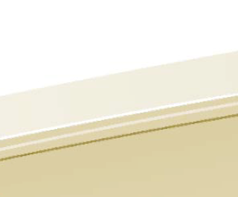


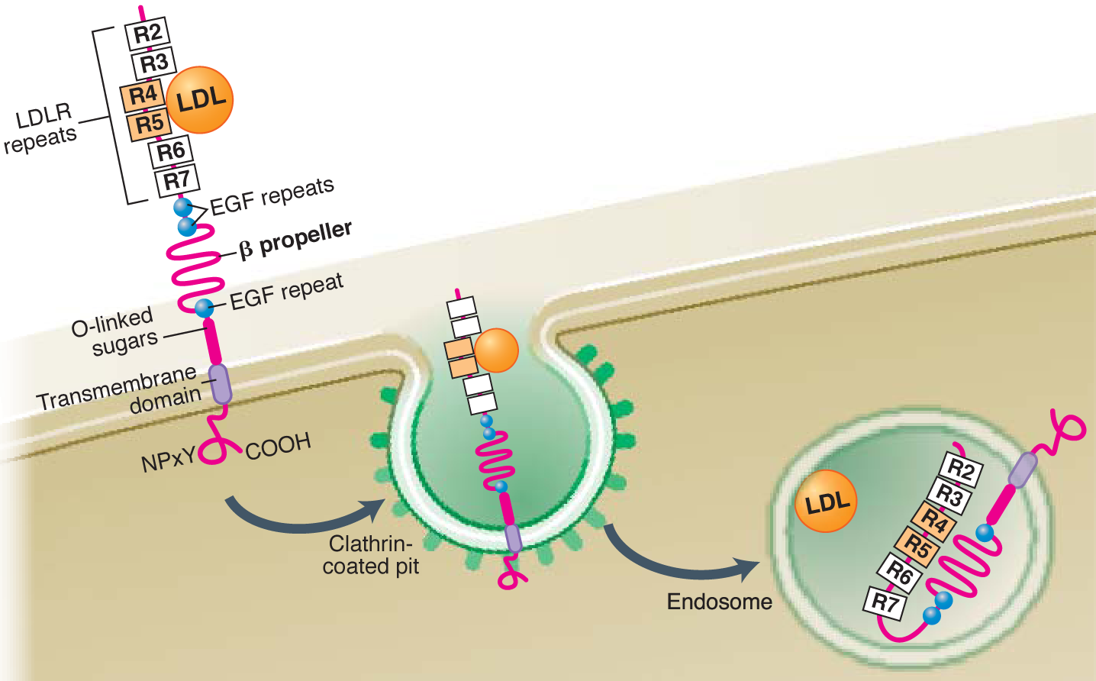

Proposed Mechanism of Action of
PCSK9 inhibitors on LDL-C
LDLR recycles to plasma membrane for multiple rounds of internalization of LDL particle
PCSK9 binds to the LDLR and targets it for degradation
Blocking mAb prevents PCSK9 binding to LDLR protecting it from degradation
PCSK9
LDL
LDLR
LDL
Blocking mAb
LDL
LDL
PCSK9 catalytic
PCSK9 pro
LDL
LDL
Recycling
vecicle
Recycling
vecicle
LDL
LDL
Endosome
(H+)
Endosome
(H+)
LDL
Lysosome
LDL
LDL
LDL
Lysosome
LDL
Lysosome
Notes:
23
When the pH falls, as occurs in the endosome, the ligand binding domain forms a physical association with the EGF precursor homology domain.
This conformational change in the LDLR releases LDL from the ligand binding domain and signals the receptor to return to the cell surface.

Slide 24
Two (three) Fully human PCSK9 monoclonal antibodies*with similar development and similar efficacy / safety profile
Injectable twice or once per month (some patients reluctant; expectation on compliance)
Few drug interactions; Few side effects expected exept allergic reactions and putative effect due to very low LDL-c. Side effect not dose-dependant
Distributed primarily in the circulation with limited extravascular distribution
3 types of indication in unmet clinical needs
Statin intolerance
Severe FH
High risk not at goal
Almost similar effects on lipid parameters in combinaison with statin
*AMGEN AND SANOFI-REGENERON ALIRO- and EVOLO- CUMAB

Slide 25
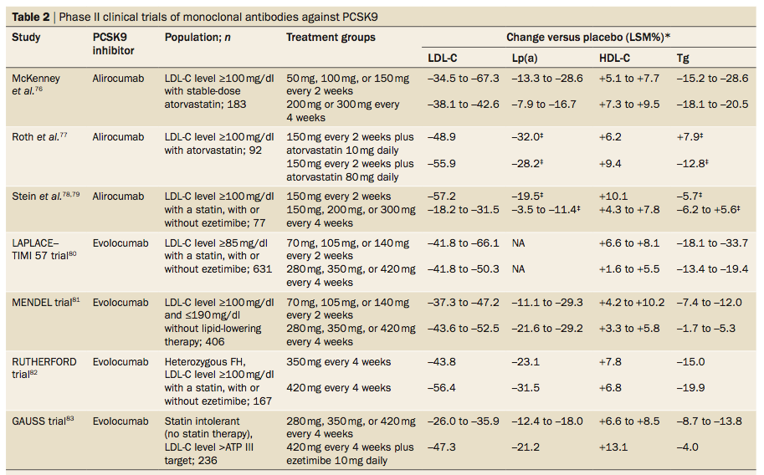

Slide 26
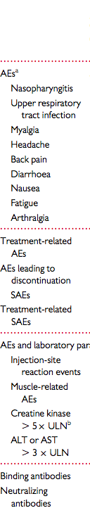
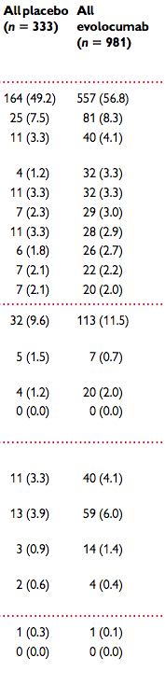
Meta-Analysis of 4 trials with evolocumab
The trials randomized 1359 patients to various doses of evolocumab every 2 weeks (Q2W) or 4 weeks (Q4W), placebo, or ezetimibe for 12 weeks
1252 patients contributed to efficacy and 1314, to safety analyses.
Mean % (95% CI) reductions in LDL-C vs. placebo ranged from 40.2% (44.6%, 35.8%) to 59.3% (63.7%, 54.8%) (all P , 0.001). Statistically significant reductions in apolipoprotein B (Apo B), non-HDL-c, triglycerides and Lp(a), and increases in HDL-C were also observed.
Adverse events (AEs) and serious AEs with evolocumab were reported in 56.8 and 2.0% of patients, compared with 49.2% ^{and 1.2% with} placebo. Adjudicated cardiac and cerebrovascular events were reported in 0.3 and 0% in the placebo and ^{0.9 and 0.3% in the} ^{evolocumab arms, respectively.}
Stein A et al. Eur Heart J 2014

Slide 27
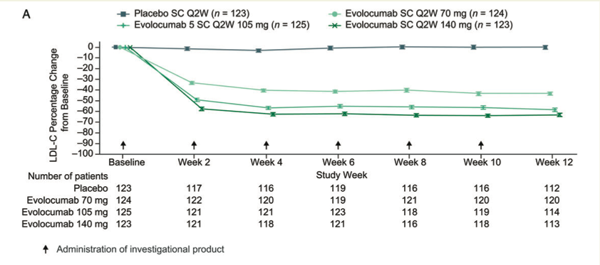
Analysis in a combined analysis of four phase 2 trials
Stein A et al. Eur Heart J 2014

Slide 28
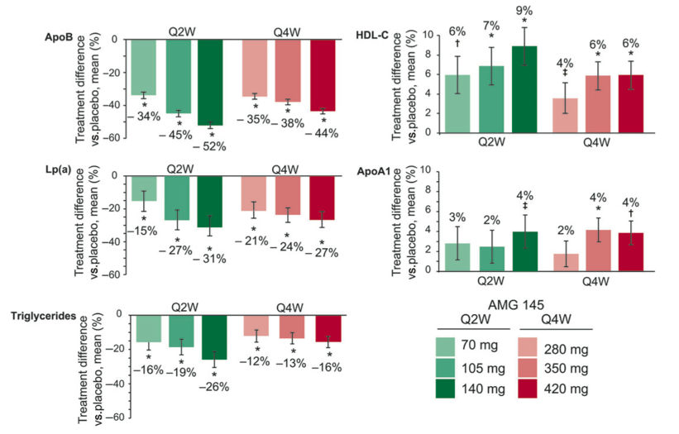
Analysis in a combined analysis of four phase 2 trials
Stein A et al. Eur Heart J 2014

Slide 29
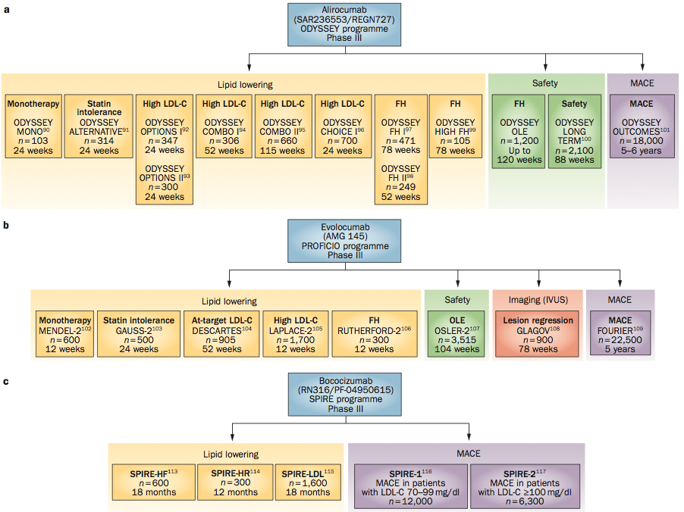
Phase III trials

Slide 30
Two CETP inhibitors bite the dust
Two CETP inhibitors on going development
Effect on lipid parameters characterised (major HDL increase). Effect on functionality to be confirmed.
A study will confirm the importance of efflux as a RF+++
Interesting effect on diabetes++
Two ongoing large trials
Anacetrapid has such a long half life that any clinical use will be difficult
The outcome trials have to be highly positive to allow clinical use
Anacetrapid decrease more LDL-c than evacetrapib

Slide 31
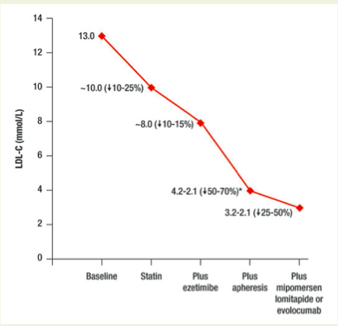
Reduction of LDL-c with treatment of hoFH
The figure gives an order of magnitude of LDL-c decrease.
There is considerable hetrogeneity in the effect of drugs depending on the genetic background
Cuchel M, Bruckert E, Ginsberg H et al. Eur Heart Journal 2014

Slide 32
New therapeutic options
Lomitapide: oral inhibitor of microsomal tg transport protein
Open-label trial; lomitapide, in addition to the standard of care including LDL apheresis, reduced plasma LDL-C and apoB levels by 50% and Lp(a) by 15%
Most frequently observed AEs: GI symptoms and liver fat accumulation
Mipomersen: antisense oligonucleotide targeting apoB mRNA
Placebo-controlled double-blind trial; mipomersen (weekly 200 mg, on top of standard LLAs, reduced plasma levels of LDL-C (mean 25%), apoB (27%), and Lp(a) (31%)
Most frequently reported events were injection site reactions (76% of patients), and flu-like symptoms. Elevations in ALT in 12% of patients (> 3 ULN).
Cuchel M, Bruckert E, Ginsberg H et al. Eur Heart Journal 2014

Slide 33
Heterozygous Familial Hypercholesterolemia in Europe
We need to follow the experience of Netherlands to improve family screening. In France we don’t really know the number of patients identified. It is fairly low
French family network (C Boileau): search for novel mutations
We need to have a registry at the level of Europe or at least within different countries. Several questions including clinical consequence of new drugs in FH (no specific outcome trials)
No « real » registry but a data base of approx. 1700 patients with rather detailed information. Need for a grant

Slide 34
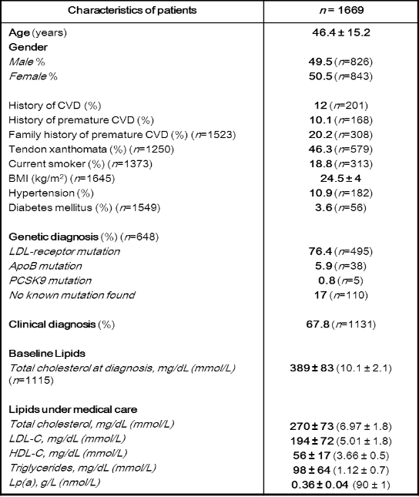
Characteristics of patients with FH under medical care in the French cross sectional study
Atherosclerosis 2014

Slide 35
A large number of patients not at LDL-c goal
25%
20%
15%
10%
5%
French Registry, Average LDL-c achieved in patients since 2005
Primary prevention
<70 70-100 101-130 131-160 161-190 >190 mg/dl
25%
20%
15%
10%
5%
Secondary prevention
Atherosclerosis 2014
<70 70-100 101-130 131-160 161-190 >190 mg/dl

Slide 36
A large number of patients not at LDL-c goal even in the subgroup treated with maximum lipid lowering therapy
Primary prevention
Secondary prevention
35
35
30
30
25
25
20
20
% of patients
% of patients
15
15
10
10
5
5
≤ 70
100 - 130
161 - 190
> 190
≤ 70
100 - 130
161 - 190
> 190
70 – 100
131 - 160
70 – 100
131 - 160
LDL-C concentrations (mg/dL)
*Combination of potent statin and ezetimibe
Atherosclerosis 2014

Slide 37
Patients upon statin in the French registry
Approx. 20% of patients not treated
Recent diagnosis
Non compliance
Intolerance
Patient not willing to be treated
No prescription by doctors
< 1995
> 2009
1995-2000
2005-2009
2000-2005
Atherosclerosis 2014

Slide 38
Conclusion
FH is a severe disease undiagnosed and often not adequately treated
Unique opportunity to improve diagnosis, family screening and treatment
Genetic testing should be extended
Registries at the level of Europe would be of major interest
Opportunity to assess benefit/risk of new LLAs

