Slide 1

The Impact of Dutch Platelet Function Research on Clinical Practice. All sorted out?
Jur ten Berg
April 2010
The St Antonius Center for Platelet Function Research
Nieuwegein, the Netherlands

Slide 2
“Going Dutch”
            Individualized
            Cheap
The St Antonius Center for Platelet Function Research
Nieuwegein, the Netherlands

Slide 3
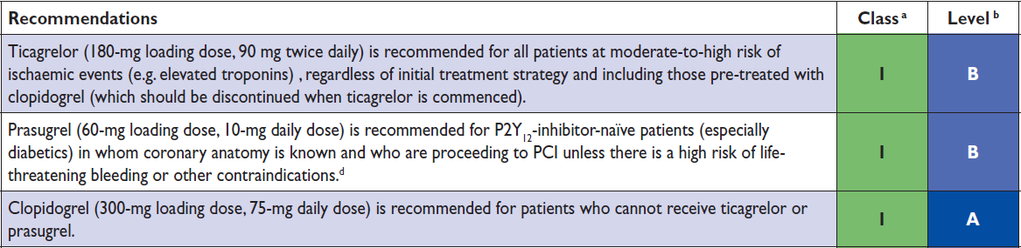
ESC guidelines on antiplatelet therapy
1) Dual antiplatelet therapy in all patients with
ACS and PCI.
2) No measurement of effect
3

Slide 4
Measuring
Anti-hypertensive drug
High Bloodpressure
Cholesterol lowering drugs
High Cholesterol
Antiplatelet therapy
???????
Measurement of
Bloodpressure
Start therapy
LDL level
Start therapy
????????
Start therapy
Antiplatelet th: response uniform in all patients

Slide 5
Response to antiplatelet drugs is not uniform!
5 μM ADP-induced Aggregation at 24h
33
300 mg clopidogrel
30
600 mg clopidogrel
27
24
Resistance = 28% (300 mg)
Resistance = 8% (600 mg)
21
% of Patients
18
15
12
9
6
Thrombosis
Bleeding
3
0
< −30
(−20,−10]
(0,10]
(20,30]
(40,50]
(60,70]
(−30,−20]
(−10,0]
(10,20]
(30,40]
(50,60]
> 70
Δ A %
(n = 194)
Gurbel PA et al. J Am Coll Cardiol. 2005;45:1392
Notes:
5

Slide 6
Treatment ACS: one option??
Aspirin
ASA low dose (≤160mg)
ASA high dose (>160mg)
None
Clopidogrel 300
Clopidogrel 600
Prasugrel 60
Ticagrelor 180
75mg/day
150mg/day
10mg/day
5mg/day
UFH
LMWH
Bivalirudin
Fondaparinux
None
Tirofiban
Abciximab
Eptifibatide
Upstream or Downstream

Slide 7
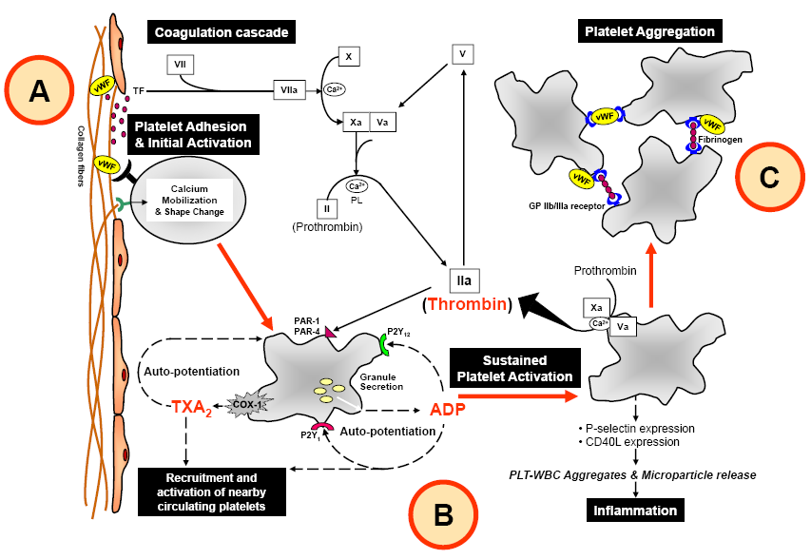
The Year 2015…
Thromboxane A2
Thrombin (FII)
ADP
FX
Aspirin
Aloxiprin
NCX-4016
Ridogrel
S18886
Picotonide
Ramatroban
Acenocoumarol
Phenprocoumon
Warfarin
LMWH
Dabigatran
Argatroban
Bivalirudin
SCH 530348
E-5555
Ticlopidine
Clopidogrel
Prasugrel
Ticagrelor
Cangrelor
Elinogrel
MRS2179
MRS2279
MRS2500
A2P5P
A3P5P
Acenocoumarol
Phenprocoumon
Warfarin
LMWH
Fondaparinux
Idraparinux
Rivaroxaban
Apixaban
Betrixaban
Edoxaban
LY517717
YM150
FX
Thrombin (FII)
FX
Rough Estimation:
By the year 2015, >50 antithrombotic drugs are commercially available!!!
Thromboxane A2
ADP

Slide 8
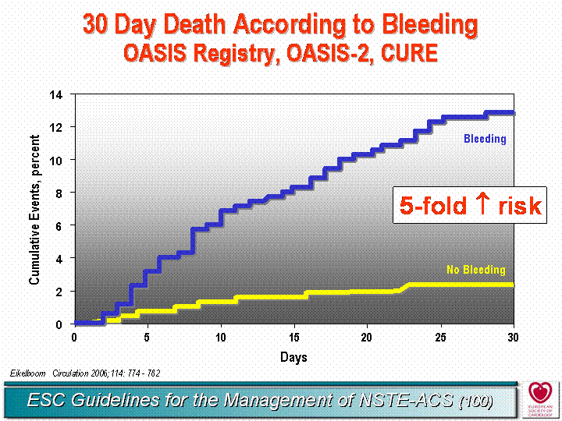
Wrong road! Return!
<>

Slide 9
Personalized Medicine
Measure Platelet Function ?
Marked interindividual variability in baseline (intrinsic) platelet reactivity.
High platelet reactivity marker worse outcome
Marked interindividual response to antiplatelet drugs
“One size fits all” doesn’t work

Slide 10
Interindividual Variability in Baseline
Platelet Reactivity
Spontaneous platelet aggregation have higher risk
149 patients 3 months following an AMI
Event Free Survival
84%
90
Negative SPA
76%
Intermediate SPA
70
46%
50
Positive SPA
30
3
10
20
30
40
50
60
Months post AMI
Trip MD. NEJM 1990;322:1549-54
Notes:
Another fairly old but pretty interesting study from the Amsterdam Medical Center showed that heightened spontaneous aggregation was associated with a worse clinical outcome in survivors after a first myocardial infarction

Slide 11
Why Should We Measure Platelet Function ?
Marked interindividual variability in baseline (intrinsic) platelet reactivity
Marked interindividual response to antiplatelet drugs
One size fits all doesn’t work

Slide 12
The Response to a Uniform Dose of Clopidogrel
Is Not Uniform
5 μM ADP-induced Aggregation at 24h
33
300 mg clopidogrel
30
600 mg clopidogrel
27
24
Resistance = 28% (300 mg)
Resistance = 8% (600 mg)
21
% of Patients
18
15
12
9
6
3
0
< −30
(−20,−10]
(0,10]
(20,30]
(40,50]
(60,70]
(−30,−20]
(−10,0]
(10,20]
(30,40]
(50,60]
> 70
Δ A %
(n = 194)
Gurbel PA et al. J Am Coll Cardiol. 2005;45:1392
Notes:
12

Slide 13
Why Should We Measure Platelet Function ?
Marked interindividual variability in baseline (intrinsic) platelet reactivity
Marked interindividual response to antiplatelet drugs
“One size fits all” DAPT (aspirin and clopidogrel) regime doesn’t work

Slide 14
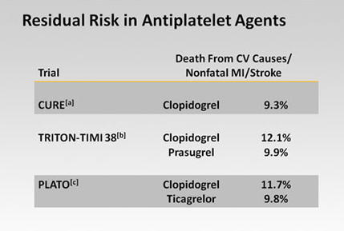
“One size fits all”: High Event Rate Despite Optimal DAPT
Dutch Stent Thrombosis
Registry (N=431)
70% of the patiënts on DAPT
High platelet reactivity despite antiplatelet therapy

Slide 15
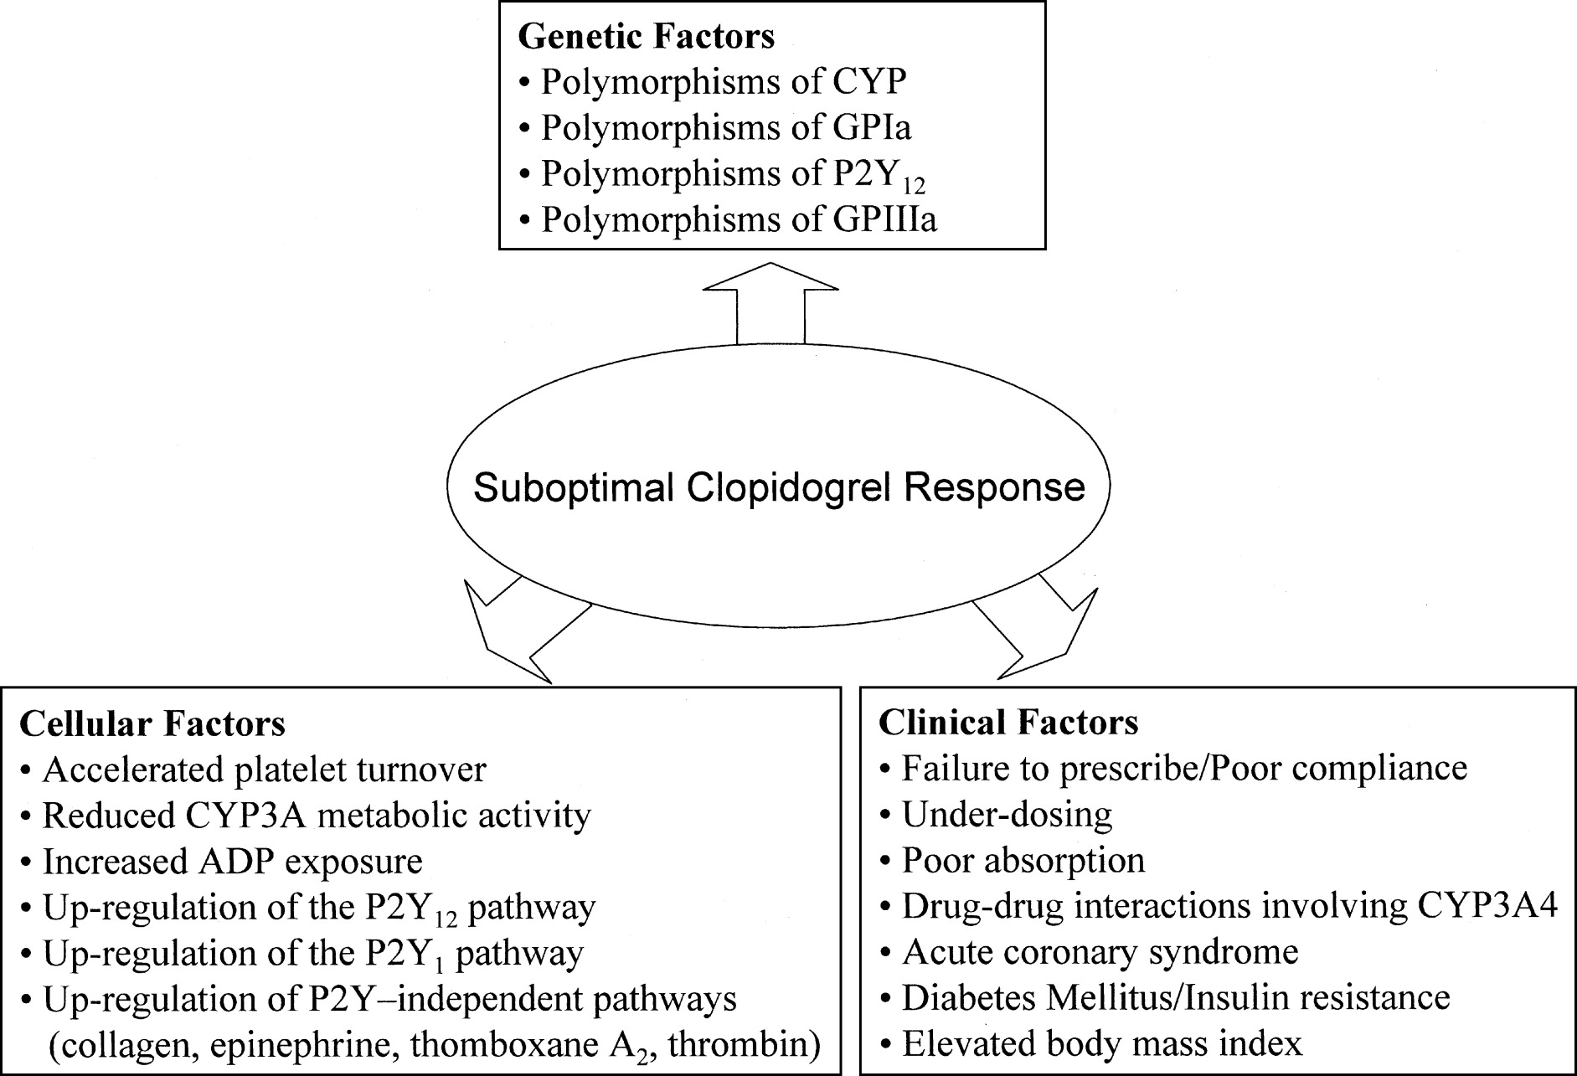
What causes high on-treatment platelet reactivity?
Notes:
15

Slide 16
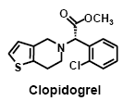
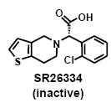
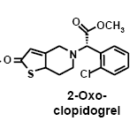
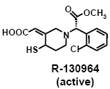
Clopidogrel response variability is largely due to variation of the active metabolite
Candidate enzymes related to less metabolization
Intestinal
Absorption
Esterases
90%
Limited
absorption
10%
P-glycoprotein
(ABCB1 gene polymorphism)
?
2C19, 1A2, 2B6
Hepatic P450
Cytochromes
Genetic polymorphisms and Drug-Drug Interactions
Two Step Oxidation
2C19, 2C9, 3A4, 2B6
Variable Active Metabolite Generation
Adapted from Kauzi M et al. Drug Metab Dispos. 2009; Gurbel et al. J Inv Cardiol. 2009
Notes:
16

Slide 17
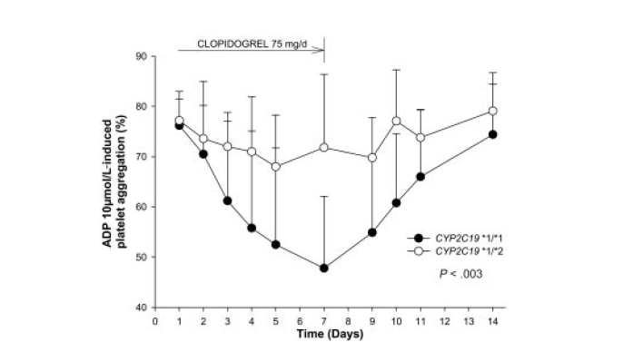
Background: CYP2C19*2 LOF and clopidogrel
29 healthy volunteers
The CYP2C19*2 loss-of-function allele is associated with a
marked decrease in platelet responsiveness to clopidogrel in
healthy volunteers and coronary artery disease patients
Hulot et al., Blood 2006
Notes:
Hulot eerste om dit te ontdekken!!!

Slide 18
CYP2C19 and CVD, MI or Stroke: Clopidogrel
CYP2C19 Reduced-Function Allele Carriers
N=1,459
* Carriers ~30% of the population
Mega JL et al. N Eng J Med. 2009; 360:354-62.
Notes:
Ergo: 53% meer kans op bereiken eindpunt
NB Ook verhoogde kans op stent thrombose!!! (factor 3, significant 2.6 vs. 0.8)
18

Slide 19
CYP2C19 and Stent Thrombosis: Clopidogrel
N=1,389
CYP2C19 Reduced-Function Allele Carriers
* Carriers ~30% of the population
Mega JL et al. N Eng J Med. 2009; 360:354-62.
Notes:
>3x RR op stent thrombosis
19

Slide 20
Do Platelet Function Assays Predict Clinical Outcomes in clopidogrel pretreated patients undergoing elective PCI
The POPular-study. JAMA 2010;303:754-62
Nicoline J Breet , Jochem W van Werkum, Heleen J Bouman, Johannes C Kelder, Henk T Ruven, Egbert T Bal, Vera H Deneer, Ankie M Harmsze, Benno JWM Rensing, Maarten J Suttorp, Jan AS van der Heyden, Christian M Hackeng, Jurriën M ten Berg
The St Antonius Center for Platelet Function Research
Nieuwegein, the Netherlands

Slide 21
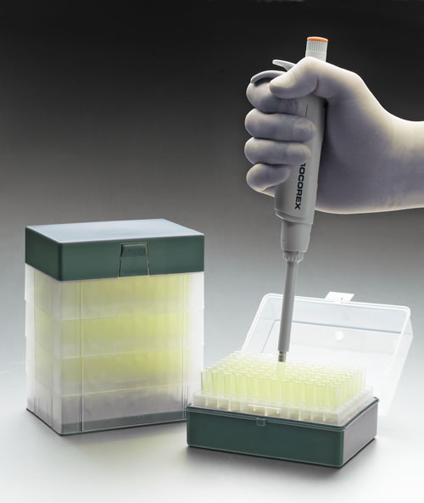
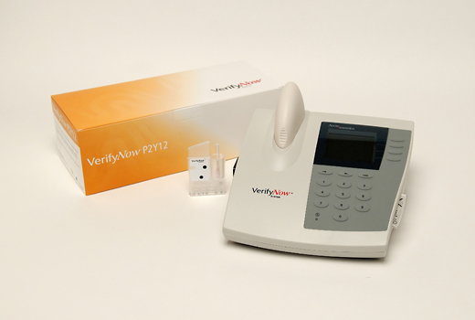
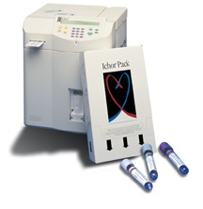
Platelet Function Tests
Light transmittance aggregometry (LTA)
  Aggregation based, platelet rich plasma (PRP)
  5 & 20 μmol/L ADP peak platelet aggregation
  Laboratory, trained technicians, time consuming
VerifyNow® P2Y12 assay
  Aggregation based, whole blood
  Bedside test, fully automated
Plateletworks®
  Single platelet count, whole blood
  Stimulation with ADP
  Bedside test, semi-automated
  Highly time dependent, performing < 10 min
Notes:
21

Slide 22
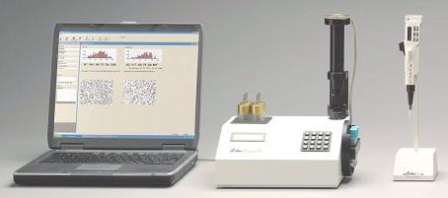
Tests more physiological shear-dependent
IMPACT-R
  Adhesion and shear-stress based,
  whole blood
  Both with and without ADP
  Extensive sample handling
PFA-100® system
  Shear-stress based, whole blood
  Bedside test
  Collagen/ADP cartrich
  INNOVANCE® PFA P2Y*
  ADP, PGE₁ and calciumchloride
* Product under development-not available for sale
Notes:
22

Slide 23
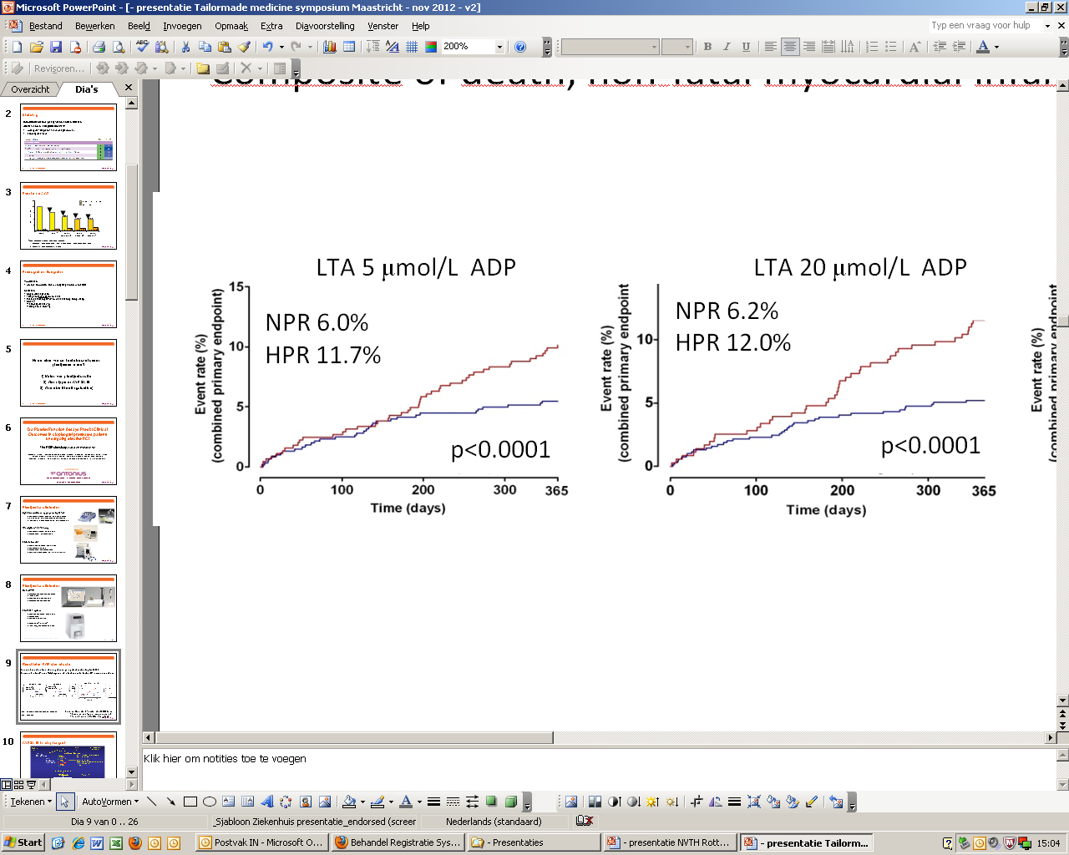
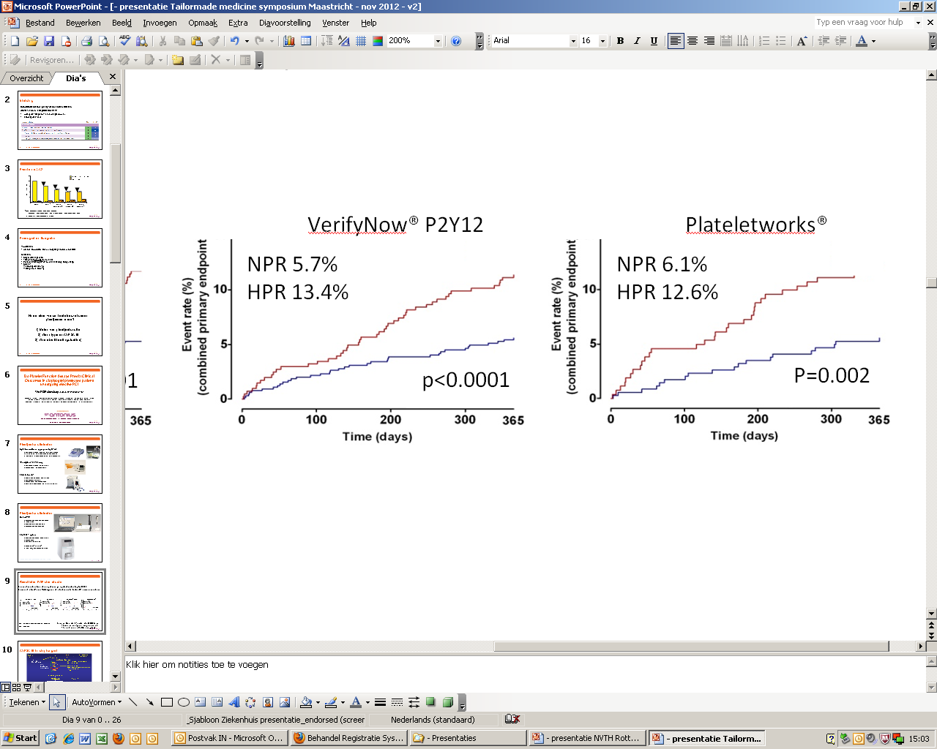
Consecutive patients on clopidogrel undergoing elective stenting
n=1069
Composite of death, non-fatal myocardial infarction, definite stent thrombosis and stroke
HPR = high-on treatment platelet reactivity
NPR = non-HPR
Receiver Operator Characteristic (ROC) Curve
  Based on one-year primary endpoint
  To determine cut-off for every test
Notes:
23

Slide 24
Why would we use these tests?
Short-term effect?

Slide 25






Tailored Clopidogrel Loading according to platelet reactivity
Bonello et al. JACC 2008
Non-emergent PCI : ACS and Stable angina (n= 1122)
Loading dose (LD) -ASA 250mg -Clopidogrel 600mg
VASP ≥ 50%
Randomization
(n=429)
CONTROL (n =215)
VASP-guided LD (n =214)
Up-to 3 additional LD of 600 mg every 24 hours until VASP < 50% before PCI
Maintenance dose -ASA 160 mg
-Clopidogrel 75 mg
1° endpoint: Definite stent thrombosis (ARC definition)
2° endpoints: MACE including CV death, MI and U-TVR
TIMI major and minor bleeding at 30 days

Slide 26
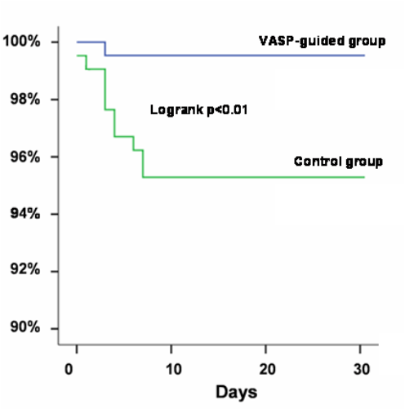
Control
(n= 214)
VASP-guided
(n= 215)
p
Cardiovascular death
4 (1.8)
0
0.06
Myocardial infarction
10 (4.8)
1 (0.5)
0.01
Urgent revascularization
5 (2.3)
0
0.06
All MACE
19 (8.9)
1 (0.5)
< 0.001
1 pt
8 pts
ST

Slide 27
Why would we use these tests?
Long-term effect?

Slide 28
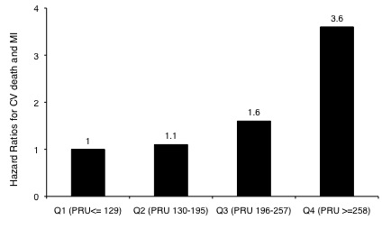
Risk for recurrent events concentrated in patients with highest on-treatment reactivity
Marcucci et al
N=683
12 month FU
75% normal platelet reactivity
Do excellent on clopidogrel
75 % of the patients tested have a residual platelet reactivity below cut-of value (<50%
aggregation LTA, <240 PRU VerifyNow)
Those patients are at very low risk of thrombotic events (tests have high [>94% NPV]). Thus
clopidogrel (generic low cost and low risk for bleeds) works fine in this low-risk group
Switch to stronger antiplatelet drugs in high residual reactivity improves outcome?

Slide 29
Price MJ et al , JAMA 2011
GRAVITAS Study Design
Elective or Urgent PCI with DES*
VerifyNow P2Y12 Test 12-24 hours post-PCI
N=5429
Yes
PRU ≥ 230
No
Normal On-treatment Reactivity
High On-treatment Reactivity
Random Selection
R
N = 1109
N = 1105
N = 586
High-Dose Clopidogrel†
clopidogrel 600-mg, then
clopidogrel 150-mg/day
Standard-Dose Clopidogrel†
clopidogrel 75-mg/day
Standard-Dose Clopidogrel†
clopidogrel 75-mg/day
Primary Efficacy Endpoint: CV Death, Non-Fatal MI, Stent Thrombosis at 6 mo
Pharmacodynamics: Repeat VerifyNow P2Y12 at 1 and 6 months
*Peri-PCI clopidogrel per protocol-mandated criteria to ensure steady-state at 12-24 hrs
†placebo-controlled
All patients received aspirin (81-162mg daily)
Notes:
Here are my disclosures

Slide 30
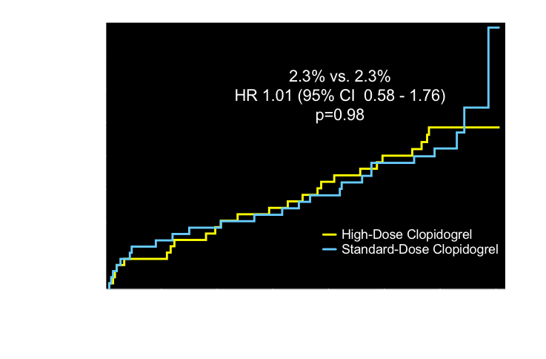
Primary Endpoint: CV Death, MI, Stent Thrombosis
Observed event rates are listed; P value by log rank test.
Price MJ et al, JAMA. 2011;305(11):1097-1105

Slide 31

Pharmacodynamics: Effect of SD vs HD Clopidogrel
Standard-Dose
High-Dose
500
P = 0.98
P < 0.001
400
Persistently high reactivity @ 30 days: 62% vs 40%, p<0.001
PRU
value
300
200
100
0
ITT population
N=1105
N=1013
N=940
N=1109
N=1012
N=944
Post-PCI
30 d
6 mo
Post-PCI
30 d
6 mo
Price MJ, AHA 2010
Notes:
This slide shows the pharmacodynamic effect of study drug in these patients with high residual reactivity.
The level of platelet reactivity significantly decreased in both groups over the first 30-days.
Compared to standard-dose clopidogrel, high dose clopidogrel significantly reduced the level of reactivity by approximately 40 PRUs and provided a 22% absolute reduction in the rate of high reactivity at 30 days.

Slide 32
CV Events and Post-PCI PRU In Patients With High and Not High Reactivity Treated With Clopidogrel 75-mg Daily
500
Red dots: patients with CV death, MI, or ST
400
PRU
12 - 24 hrs post-PCI
300
230 PRU
200
100
0
N=1105
N= 586
High Residual
Reactivity
Not High
Residual Reactivity
ITT population
Notes:
This plot illustrates the PRUs 12 to 24 hours after PCI in the patients who had events, stratified by group.
The post-PCI PRUs in the patients without high reactivity were clustered within the upper range for that group, the majority near the threshold of 230 PRU.
This observation must be considered exploratory and hypothesis-generating.

Slide 33

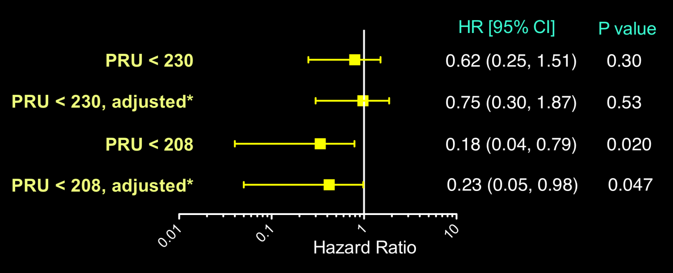
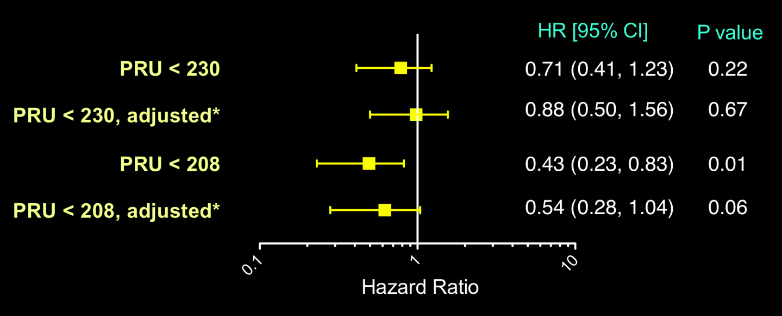
GRAVITAS: Hazard of Primary Endpoint According To Achieved OTR (Baseline or 30 days)
CV Death, MI or ST at 60 Days
N=2796
CV Death, MI or ST at 6 Months
Cox regression using OTR as a time-varying covariate
Price MJ et al, in submission

Slide 34
ARCTIC trial design
Coronary angiogram
Rd
Primary endpoint at 12 months:
Death, MI, stroke, stent thrombosis, urgent revascularization
VerifyNow
Standard of care
Drug ASA, clopidogrel, prasugrel, 2b3a and Dose adjust adjustments i
Stent-PCI
Stent-PCI
Drug and Dose adjustments if high platelet reactivity at Day 14
Standard of care
12-month FU
ARCTIC study protocol - Collet JP, et al. Am Heart J 2011;161:5-12

Slide 35
Ischemic Endpoints
 | Conventional | Monitoring | HR [95%CI] | P
Death or MI - % | 28.8 | 31.7 | 1.11 [0.96; 1.29] | 0.15
Any death - % | 1.6 | 2.3 | 1.41 [0.79; 2.50] | 0.24
Myocardial infarction - % | 28.4 | 30.3 | 1.08 [0.93; 1.25] | 0.32
Stent thrombosis - % | 0.7 | 1 | 1.34 [0.56; 3.18] | 0.51
Stroke or TIA- % | 0.6 | 0.7 | 1.15 [0.42; 3.18] | 0.78
Urgent revascularization - % | 4.2 | 4.5 | 1.06 [0.73; 1.55] | 0.76

Slide 36
Measure Platelet Function?
Select only high-risk patients for new agents (prasugrel/ticagrelor)
Reduce cost: Using clopidogrel in those 75% of
patients who are responders will reduce cost as
compared to using new agents in all patients (50 E vs 950 E)
Reduce the risk for bleeds

Slide 37
High Platelet Reactivity on Clopidogrel:
Switch to Prasugrel
Clopidogrel vs. Prasugrel at 24 hrs (healthy volunteers)
100.0
80.0
Interpatient variability
60.0
Inhibition of platelet aggregation (%)
40.0
Interpatient variability
20.0
0.0
Clopidogrel responder
Clopidogrel non-responder
-20.0
Response to clopidogrel
Response to prasugrel
Responder = ≥ 25% IPA at 4 and 24 hours
Brandt JT, et al. Am Heart J. 2007;153:66.e9-e16.

Slide 38
Daily Practice
Male, 62 years old
By the way: cardiothoracic surgeon
Risk Factors: hypertension and hypercholesterolemia
Stable angina for 1 year, now increase to CCS 4
R/ASA 100mg/dag, load clopidogrel 600 mg day before coronary angiography
Use platelet function test in this patient?

Slide 39
What Happened to the Cardiothoracic Surgeon?
CAG next day
Two-vessel disease with short lesion in dominant RCA and bifurcation lesion in mid-LAD-D
Surgeon: “no CABG”
“measure platelet function”
VerifyNow PRU post: 245; %IPA: 11
POPular risk score: 3,5
Breet et al | 1052 | VerifyNow P2Y12 | 1 yr death, MI, ST, CVA | PRU > 236 | ROC curve

Slide 40
Daily Practice

Slide 41
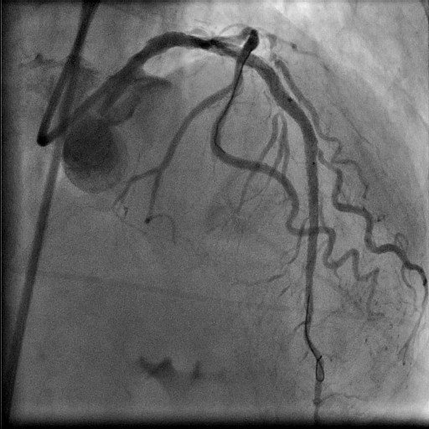
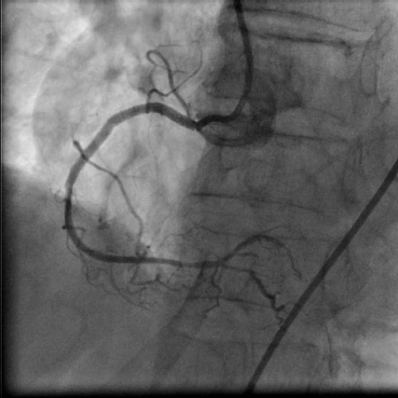
What Happened to the Surgeon?
A IIb/IIIa inhibitor was added before PCI to reduce the
risk of peri-procedural MI
3 DES were implanted, total stent length 46 mm
CK-MB peak post-PCI 11 (ULN: 5)
Aspirin 100 mg and Prasugrel 10 mg/d
Follow-up at 1 year: uneventful

Slide 42

POPular Risk Score
POPular Risk Score
Non-urgent PCI – 1500pt
Platelet aggregation
(VerifyNow):
< 236 PRU → 0 pnt
≥ 236 PRU → 2 pnt
(ACS <14days→1 pnt)
Low
864pt (58%)
High
349pt (23%)
ACS
287pt (19%)
CYP2C19 genetics
*1/*1 → 0 pnt
*1/*2 → 1 pnt
*2/*2 → 2 pnt
No additional
value
Genetics
+ risk factors
No additional value
Genetics
+ risk factors
Clinical Risk Factors
DM → 0,5 pnt
Stent >30mm→ 0,5 pnt
LVEF <30% → 0,5 pnt
Risk of thrombotic
event (high ≥ 2 pnt)
Low → clopidogrel
High → prasugrel
95%
5%
0%
100%
68%
32%
Low
High
Low
High
Low
High
Notes:
42

Slide 43
Tailored Antiplatelet Therapy 2
The value of PCI related antithrombotic treatment is determined by the balance between prevention of ischemic complications and induction of bleeding

Slide 44
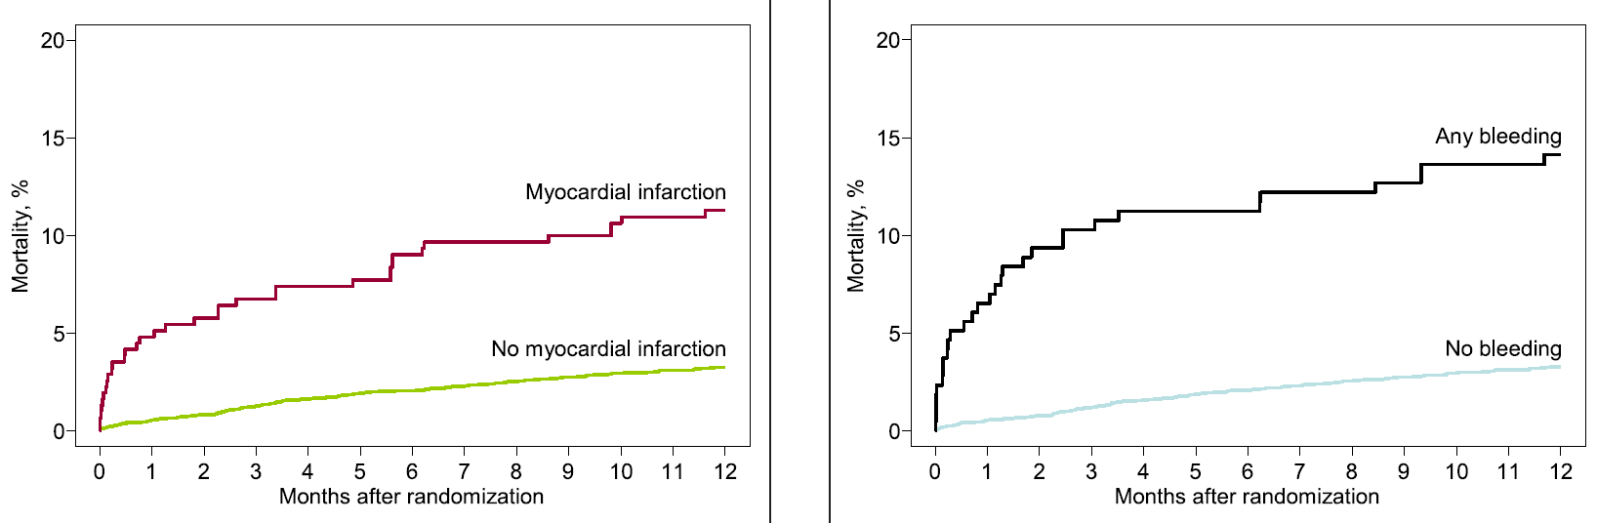
Measure Platelet Function ? 2
Both ischemic & bleeding complications have a strong
association with mortality in the first 12 months after PCI
Myocardial Infarction
Bleeding
n=5384
Ndrepepa et al., JACC 2008

Slide 45
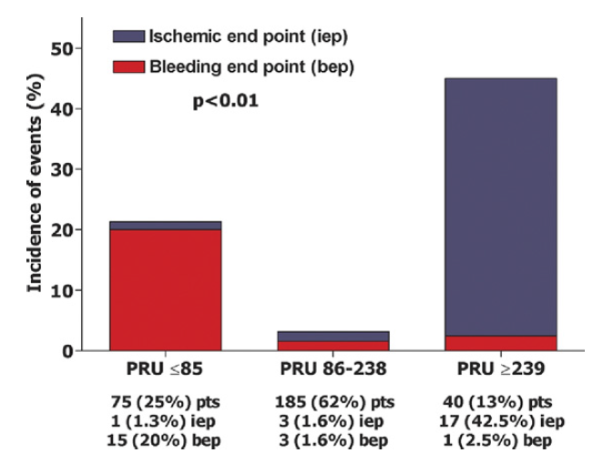
Bleeding risk increases below a platelet reactivity threshold
VerifyNow Assay
Campo G, et al. J Am Coll Cardiol 2011;57:2474–83
Notes:
45
45

Slide 46
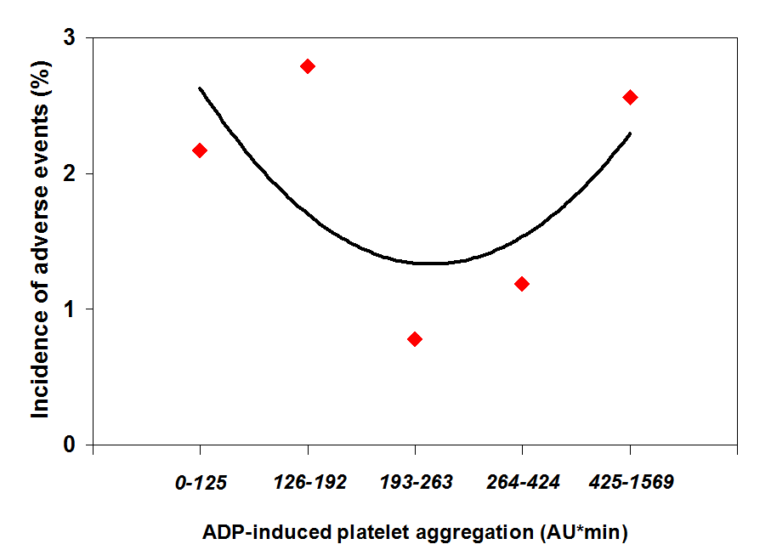
Defining a Therapeutic Window of ADP Blockade Sibbing et al.
↑Bleeding Risk!
↑Risk of ST
Incidence of adverse events per aggregation quintile
Combined for major bleeding (n=34) and definite stent thrombosis (n=16) in relation to platelet aggregation values (in AU*min)
Red points: Incidence per quintile Black curve: Polynomial fit (R=0.62) of points.
Ndrepepa et al., JACC 2008

Slide 47
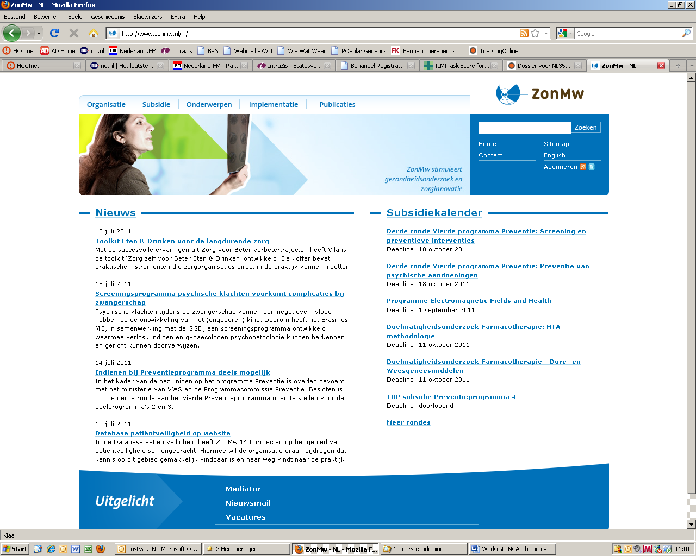
Use Genetics in Personalized Medicine?
POPular Genetics-study
STEMI patient undergoing primary PCI
St. Antonius Center for Platelet Function Research

Slide 48
Design N=2700

Slide 49
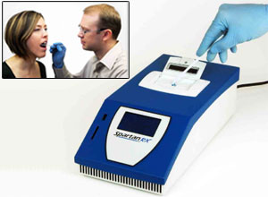
POPular genetics
Efficacy Endpoint (non-inferiority)
- Combined death, MI, ST, stroke and PLATO non-
CABG major bleeding
Safety endpoint (superiority)
      - PLATO major en minor bleed
Cost-effectiveness:
- Lower cost in genetic testing

Slide 50
Conclusions
Response to antiplatelet therapy is not uniform
Measure platelet function
Stronger antiplatelet agents only in high risk patients
Reduction of bleedings and cost
Thus “going Dutch”

