Slide 1


2013 ESH/ESC Hypertension Guidelines
2013 ESH-ESC Guidelines for the Management of Arterial Hypertension

Slide 2
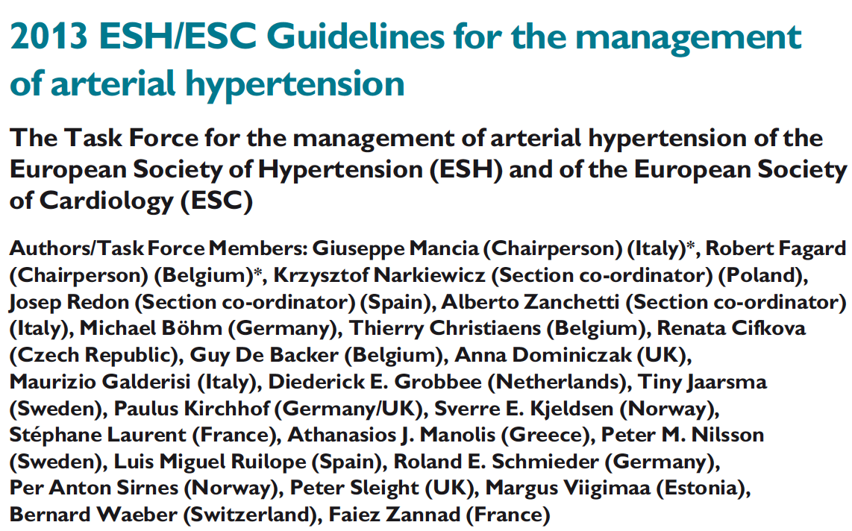
2013 ESH/ESC Hypertension Guidelines
Journal of Hypertension 2013
European Heart Journal 2013
Blood Pressure 2013
Notes:
Data taken from European cardiovascular disease statistics 2008

Slide 3
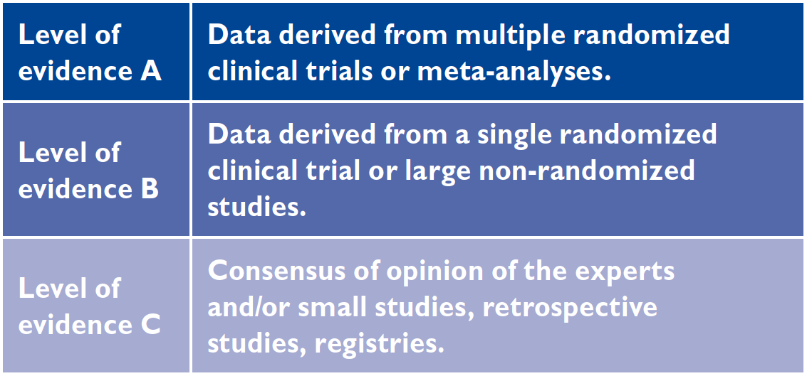
2013 ESH/ESC Hypertension Guidelines
Levels of evidence
Notes:
Data taken from European cardiovascular disease statistics 2008

Slide 4
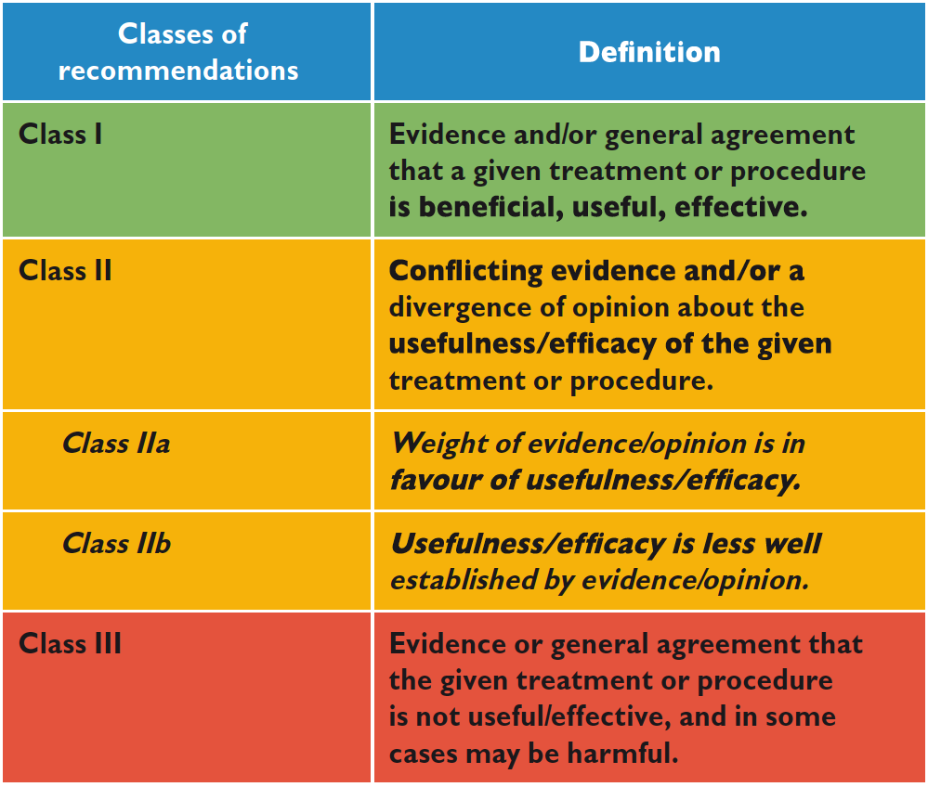
2013 ESH/ESC Hypertension Guidelines
Classes of recommendations
Notes:
Data taken from European cardiovascular disease statistics 2008

Slide 5
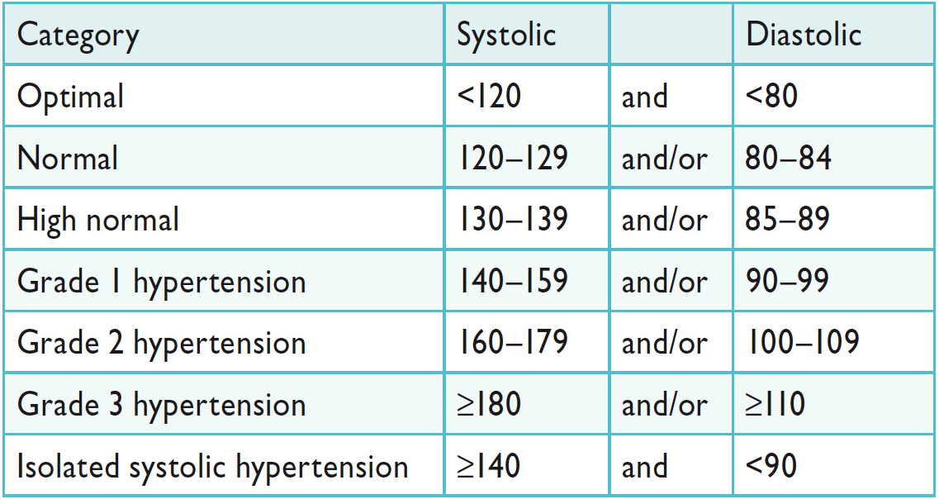
2013 ESH/ESC Hypertension Guidelines
Definitions and classification of
office blood pressure levels (mmHg)
No changes
Notes:
Data taken from European cardiovascular disease statistics 2008

Slide 6
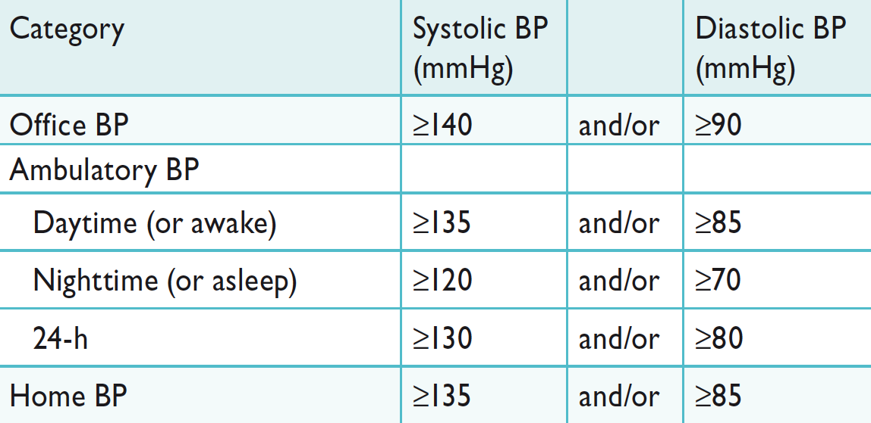
2013 ESH/ESC Hypertension Guidelines
Definitions of hypertension by office and out-of-office
blood pressure levels (mmHg)
No changes
Notes:
Data taken from European cardiovascular disease statistics 2008

Slide 7
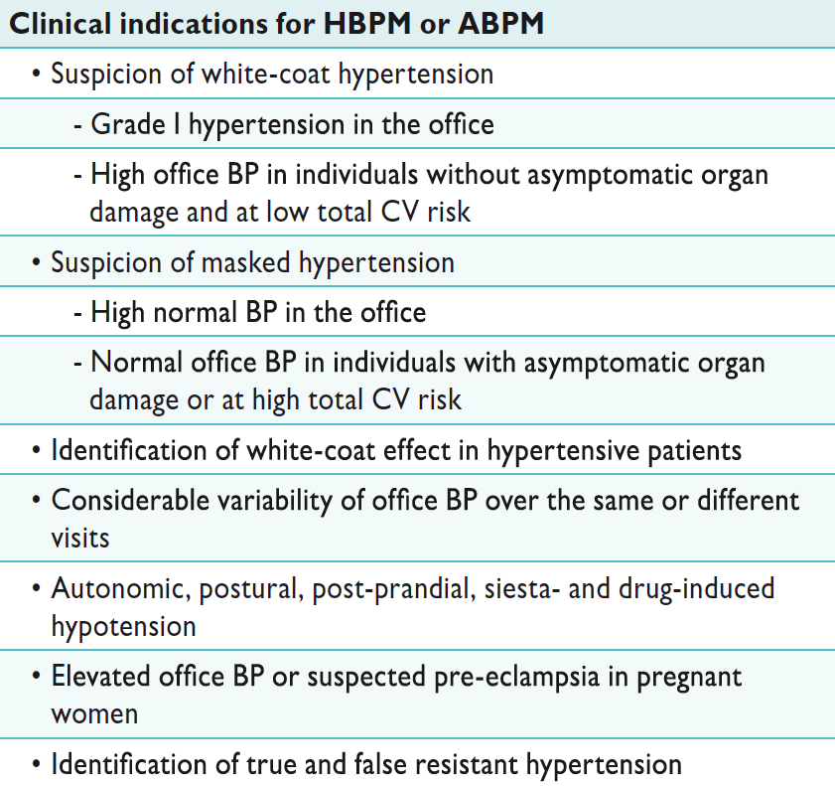
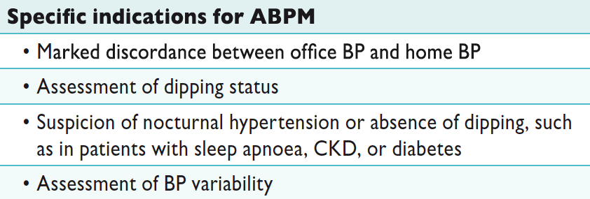
2013 ESH/ESC Hypertension Guidelines
Clinical indications for out-of-office
blood pressure measurement for diagnostic purposes
Notes:
Data taken from European cardiovascular disease statistics 2008

Slide 8
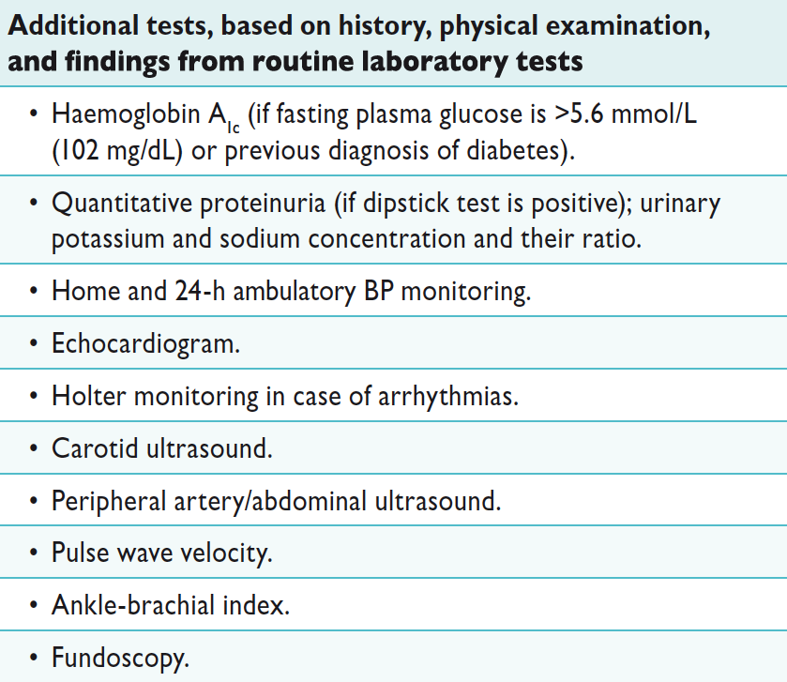
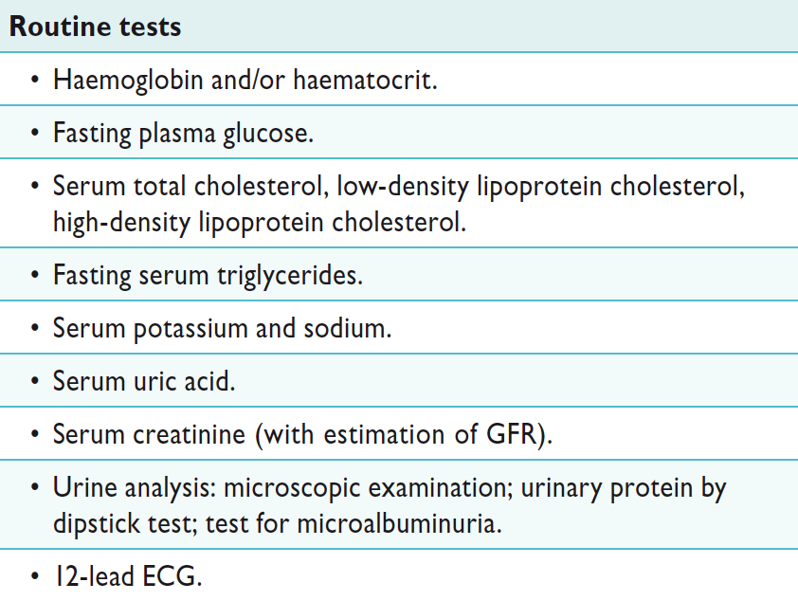
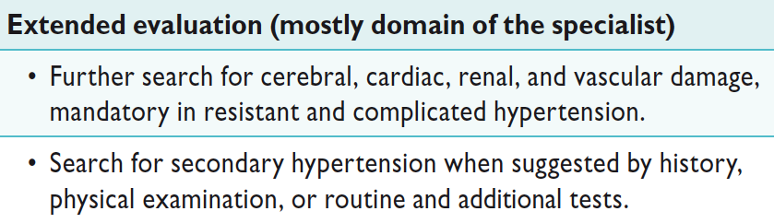
2013 ESH/ESC Hypertension Guidelines
Laboratory investigations
Notes:
Data taken from European cardiovascular disease statistics 2008

Slide 9
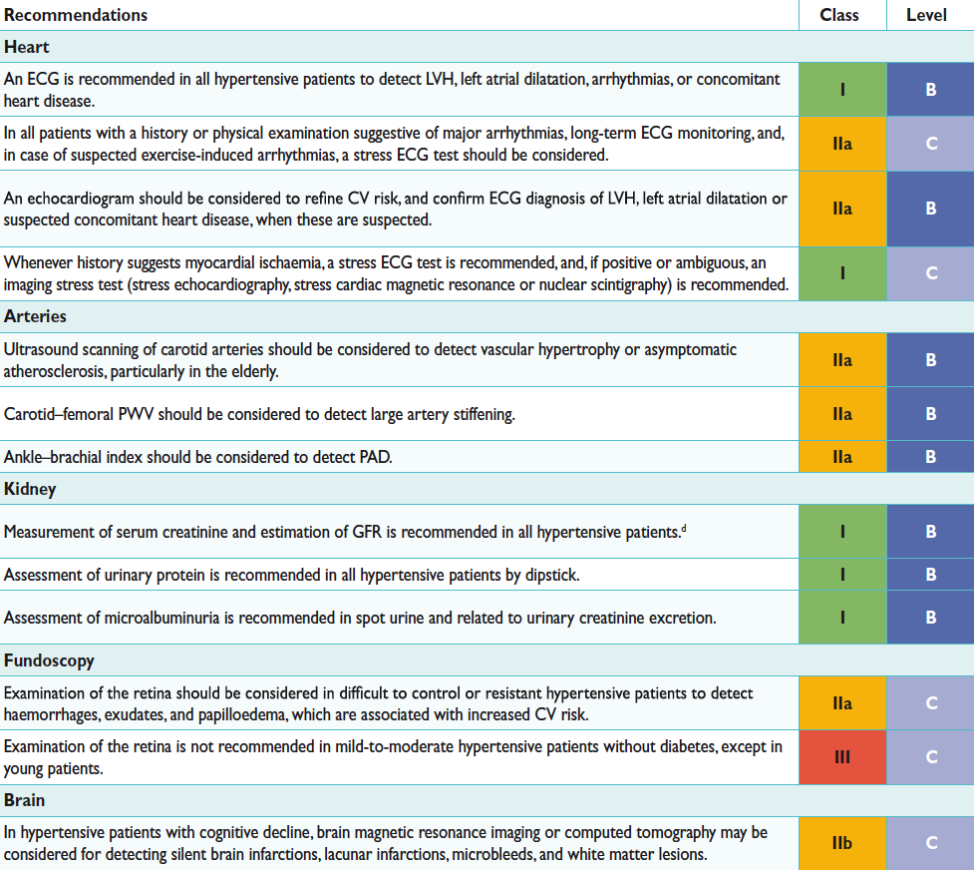
2013 ESH/ESC Hypertension Guidelines
Search for asymptomatic organ damage,
cardiovascular disease, and chronic kidney disease
Notes:
Data taken from European cardiovascular disease statistics 2008

Slide 10
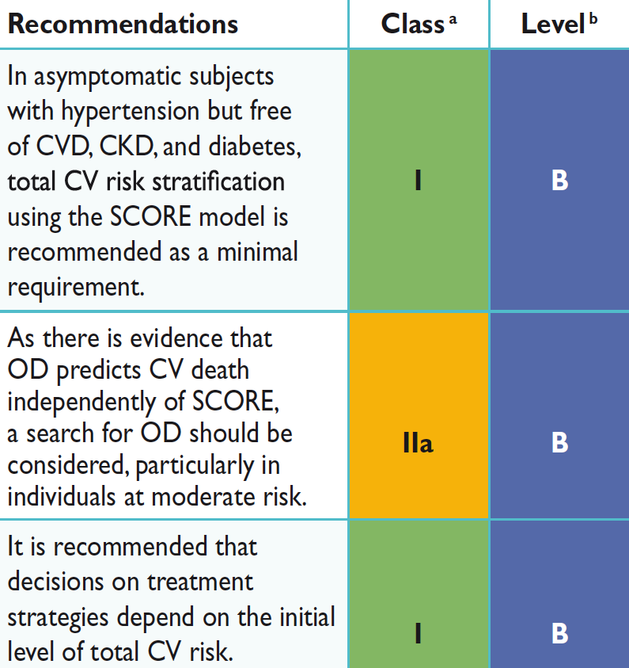
2013 ESH/ESC Hypertension Guidelines
Total cardiovascular risk assessment
Notes:
Data taken from European cardiovascular disease statistics 2008

Slide 11
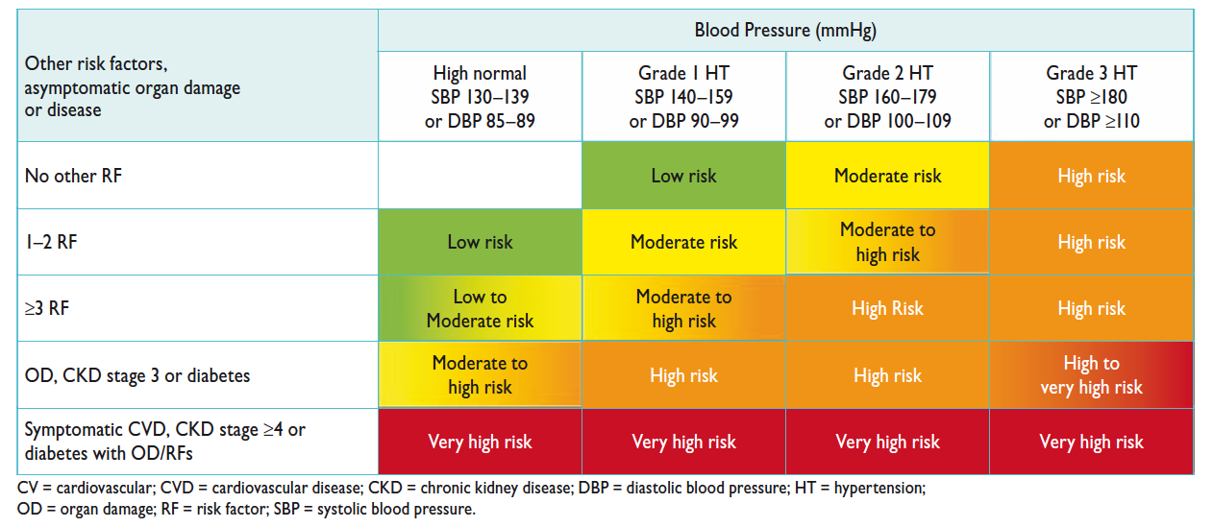
2013 ESH/ESC Hypertension Guidelines
Stratification of total CV risk in catefgories of
low, moderate, high and very high risk
Notes:
Data taken from European cardiovascular disease statistics 2008

Slide 12
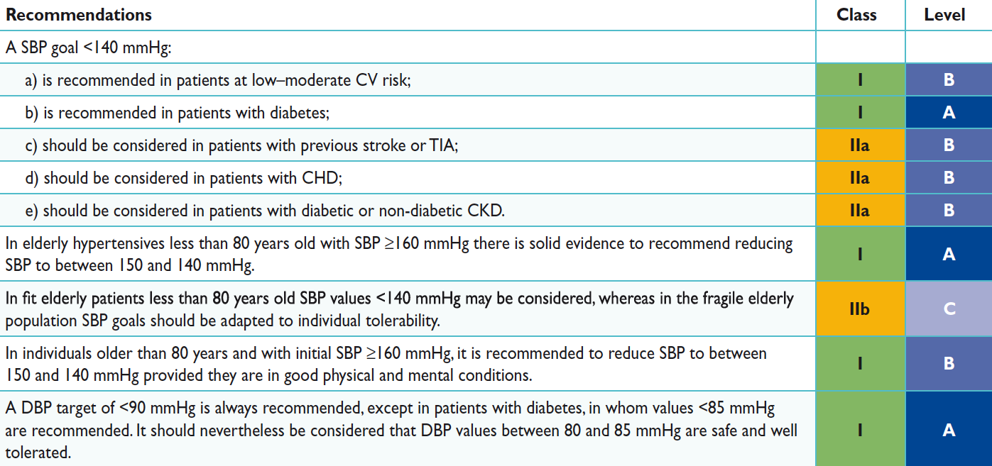
2013 ESH/ESC Hypertension Guidelines
Blood pressure goals in hypertensive patients
Notes:
Data taken from European cardiovascular disease statistics 2008

Slide 13

2013 ESH/ESC Hypertension Guidelines
Target BP for treatment - Other problems
No direct evidence available on target out-of-office BP values (ambulatory / home) for treatment
Linear relationship between BP reductions (clinic / out-of-office) and markers of organ damage (LVH / proteinuria and microalbuminuria) over a wide BP range reported in several studies
Prognostic significance of changes in organ damage still under debate
Notes:
Data taken from European cardiovascular disease statistics 2008

Slide 14
2013 ESH/ESC Hypertension Guidelines
Target SBP < 130 mmHg at high / very high CV risk
No clear / consistent evidence of CV event reduction also by subgroup / post-hoc data analysis
No beneficial effects on risk of ESRD in nephropathic patients
Although mainly based on post-hoc approach suspicion of a possible J curve phenomenon
Notes:
Data taken from European cardiovascular disease statistics 2008

Slide 15
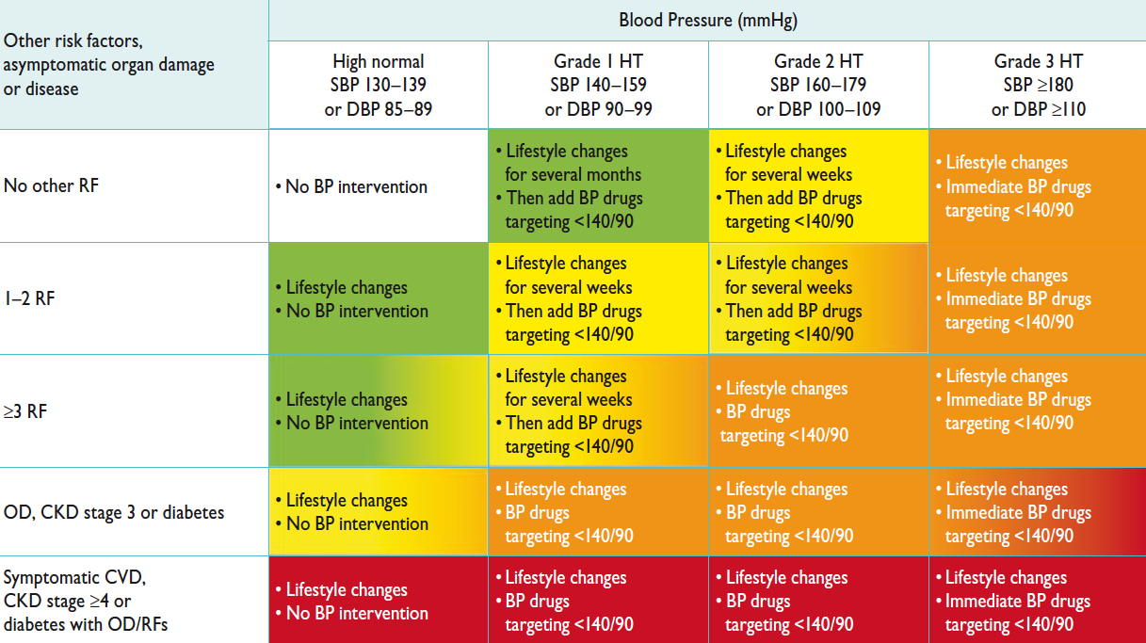
2013 ESH/ESC Hypertension Guidelines
Initiation of lifestyle changes and
antihypertensive drug treatment
Notes:
Data taken from European cardiovascular disease statistics 2008

Slide 16
Recommendations-2007

Slide 17
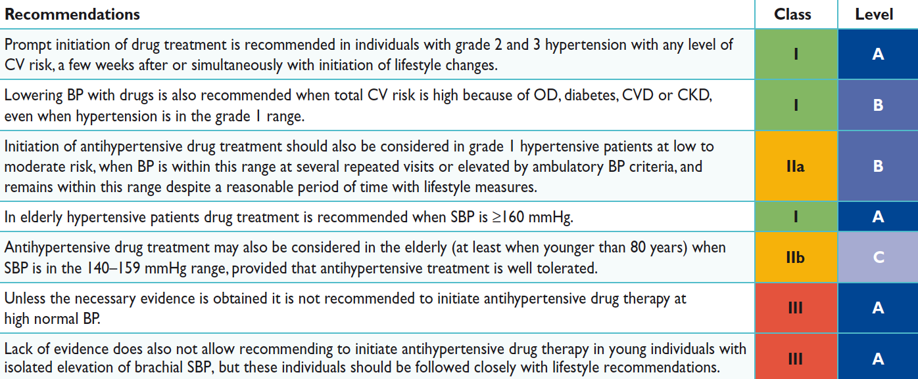
2013 ESH/ESC Hypertension Guidelines
Initiation of antihypertensive drug treatment
Notes:
Data taken from European cardiovascular disease statistics 2008

Slide 18
2013 ESH/ESC Hypertension Guidelines
Choice of antihypertensive drugs -
Conclusions from 2013 (and 2003 and 2007) Guidelines
The main benefits of antihypertensive treatment are due to lowering BP “per se” and are laragely independent of the drug employed
Although meta-analyses occasionally claim superiority of one class for some outcomes this largely depends on selection bias of trials. The largest meta-analyses do not show clinically relevant between-class differences
Current Guidelines reconfirm that the following drugs classes are all suitable for initiation and maintenance of antihypertensive treatment either as monotherapy or in some combinains with each other (IA)
  Diuretics (thiazides / chlorthalidone / indapamide)
  Beta-blockers
  Calcium antagonists
  ACE-inhibitors
  Angiotensin receptor blockers
Notes:
Data taken from European cardiovascular disease statistics 2008

Slide 19
2013 ESH/ESC Hypertension Guidelines
Choice of antihypertensive drugs
5.2.1.8 Should antihypertensive agents be ranked in order of choice?
Notes:
Data taken from European cardiovascular disease statistics 2008

Slide 20
2013 ESH/ESC Hypertension Guidelines
Arguments against classifying drugs
in order of choice
Major mechanism of the benefit of antihypertensive treatment is lowering of BP “per se”
Effects on cause-specific mechanisms are similar or differ by only a minor degree between agents
The type of outcome in a given patient is unpredictable
All classes of antihypertensive agents have their advantages but also their contraindications
Notes:
Data taken from European cardiovascular disease statistics 2008

Slide 21
2013 ESH/ESC Hypertension Guidelines
Arguments against classifying drugs
in order of choice
All-purpose ranking of drugs for general antihypertensive usage is not evidence-based
Recommendations should advice on drugs to be preferentially considered (IIaC) based on
  use in trials on specific conditions
  greater effectiveness on OD and risk factors
  adverse effect (and risk of treatment discontinuation)
Notes:
Data taken from European cardiovascular disease statistics 2008

Slide 22
2013 ESH/ESC Hypertension Guidelines
Combination treatment
No matter which drug is employed, monotherapy can effectively reduce BP in only a limited number of hypertensive patients
Most patients require the combination of at least two drugs to achieve BP control
The issue is
  whether combination treatment should always be preceded by a “monotherapy” attempt
  whether and when it can be the initial approach
Notes:
Data taken from European cardiovascular disease statistics 2008

Slide 23
2013 ESH/ESC Hypertension Guidelines
Two drug combinations as initial treatment
Cons
One of the two drugs may be ineffective
Ascribing side effects more difficult
Pros
When one agent ineffective, finding an alternative monotherapy may be a painstaking process, adversely affecting compliance
Prompter response in a larger number of patients (benefit in high risk patients?)
Lower drop-out rate
Notes:
Data taken from European cardiovascular disease statistics 2008

Slide 24
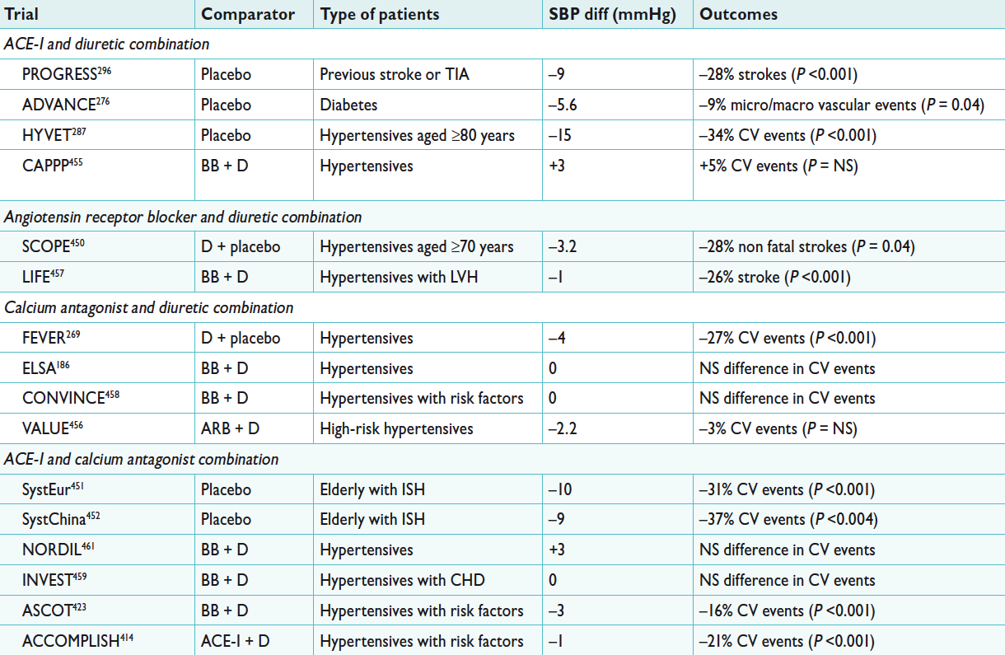
2013 ESH/ESC Hypertension Guidelines
Major drug combinations used in trials of antihypertensive treatment
in a step-up approach or as a randomized combination - 1
Notes:
Data taken from European cardiovascular disease statistics 2008

Slide 25
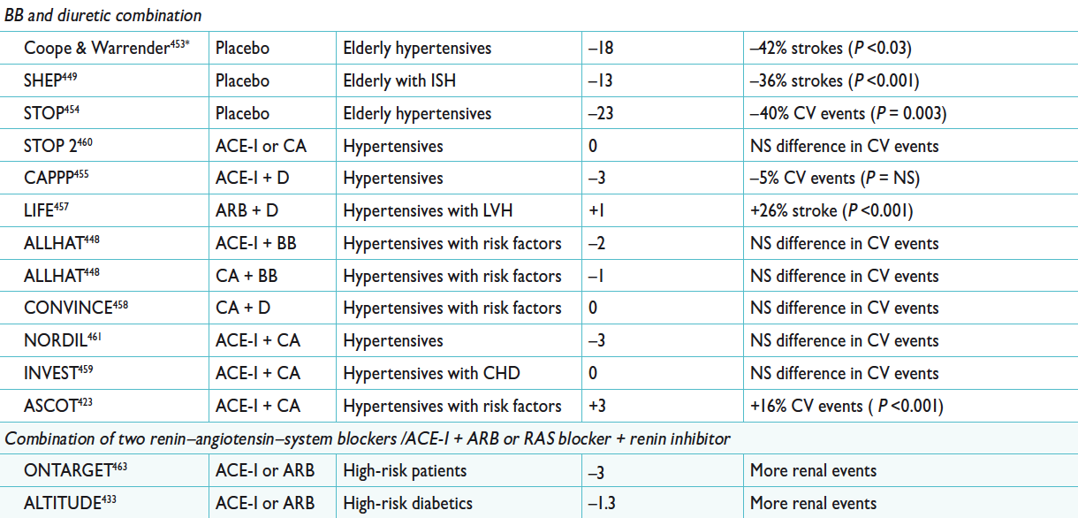
2013 ESH/ESC Hypertension Guidelines
Major drug combinations used in trials of antihypertensive treatment
in a step-up approach or as a randomized combination - 2
Notes:
Data taken from European cardiovascular disease statistics 2008

Slide 26
2013 ESH/ESC Hypertension Guidelines
Preferred drug combinations
Randomized comparisons between drug combinations / or monotherapy only in few trials (ADVANCE / FEVER / ACCOMPLISH)
In all other trials
  Treatment started with one drug / other drugs added
  2nd-3th … drugs chosen among those not used in other treatment arms
Notes:
Data taken from European cardiovascular disease statistics 2008

Slide 27
2013 ESH/ESC Hypertension Guidelines
Preferred combinations
With the exception of an ARB plus a CA
(never systematically used in an outcome trial)
all combinations were used in at least one active arm of placebo-controlled trials with significant benefit
Notes:
Data taken from European cardiovascular disease statistics 2008

Slide 28
2013 ESH/ESC Hypertension Guidelines
Preferred combinations
Evidence
Class | Level
IIa | C
Other drug combinations should be considered and probably are beneficial in proportion to the extent of BP reduction -
However, combinations that have successfully been used in trails may be preferable
Notes:
Data taken from European cardiovascular disease statistics 2008

Slide 29
2013 ESH/ESC Hypertension Guidelines
Fixed-dose (single tablet) combinations
Evidence
Class | Level
IIb | B
Combinations of two antihypertensive drugs at fixed doses in a single tablet may be recommended and favoured, because reducing the number of daily pills improves adherence which is low in patients with hypertension
Notes:
Data taken from European cardiovascular disease statistics 2008

Slide 30
2013 ESH/ESC Hypertension Guidelines
Therapeutic intervention in
White Coat Hypertension (WCH)
No RCT has ever investigated whether BP-lowering drugs lead to CV event reduction
Drug treatment may be considered if WCH is associated with
  Dysmetabolic risk factors
  Organ damage
  Normal home with high ABP or viceversa
In absence of the above intervention may be limited to lifestyle changes but this decision should be accompanied by a close FU (including periodical out-of-office BP measurements)
Notes:
Data taken from European cardiovascular disease statistics 2008

Slide 31
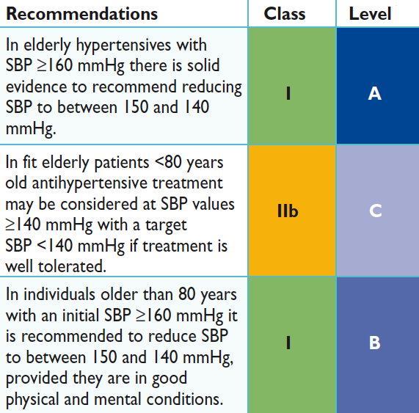
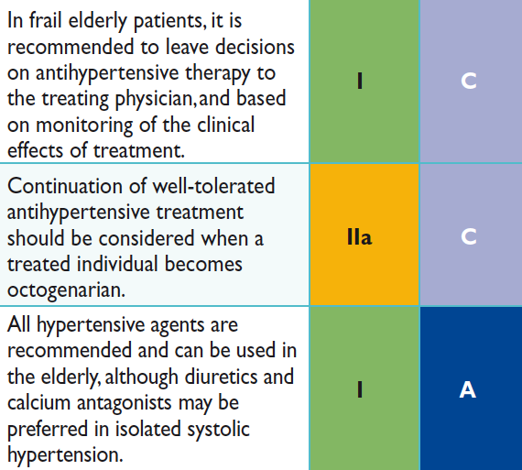
2013 ESH/ESC Hypertension Guidelines
Antihypertensive treatment strategies in the elderly
Notes:
Data taken from European cardiovascular disease statistics 2008

Slide 32
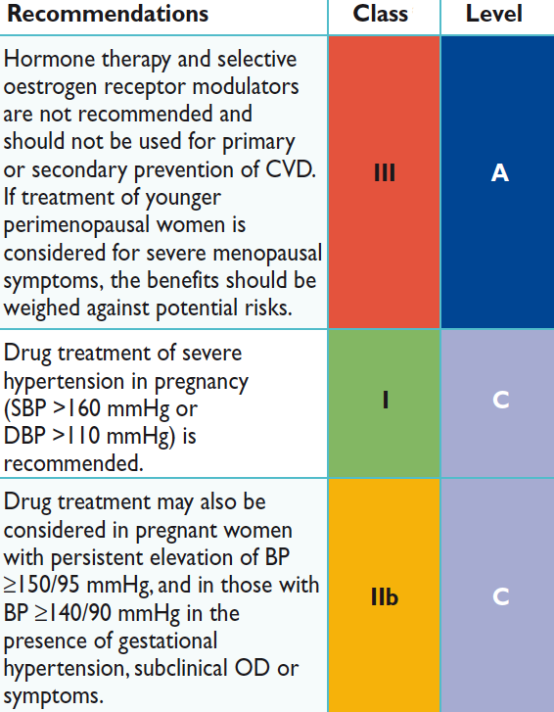
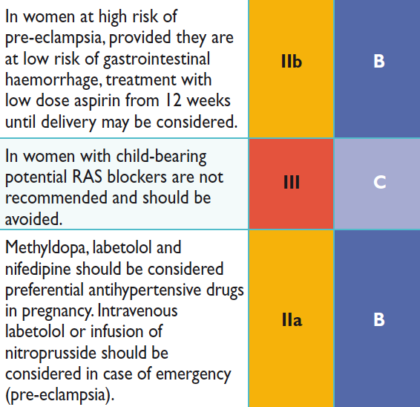
2013 ESH/ESC Hypertension Guidelines
Treatment strategies in hypertensive women
Notes:
Data taken from European cardiovascular disease statistics 2008

Slide 33
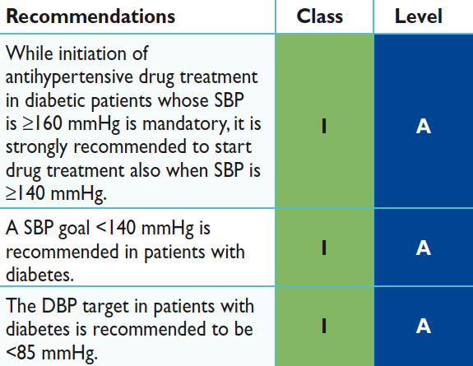
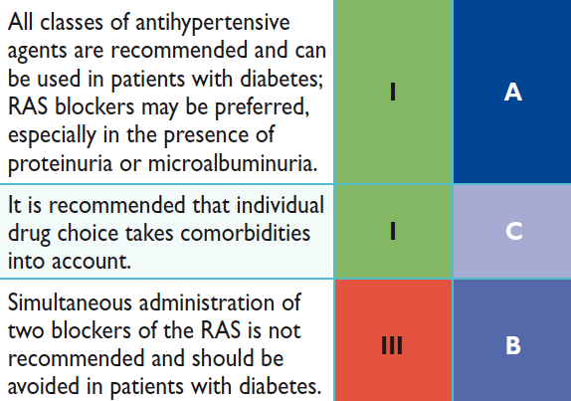
2013 ESH/ESC Hypertension Guidelines
Treatment strategies in patients with diabetes
Notes:
Data taken from European cardiovascular disease statistics 2008

Slide 34
2013 ESH/ESC Hypertension Guidelines
Treatment strategy in hypertensive patients with MS
Lifestyle changes, particularly weight loss and physical exercise (IB)
Antihypertensive agents potentially improving or at least not worsening insulin sensitivity (RAS blockers/CA) should be considered as the preferred drugs (IIaC)
Beta-blockers (with the exception of vasodilating beta-blockers) and diuretics should be considered only as additional drugs (IB)
BP lowering drugs are not recommended in MS individuals with high-normal BP (IIIA)
Notes:
Data taken from European cardiovascular disease statistics 2008

Slide 35
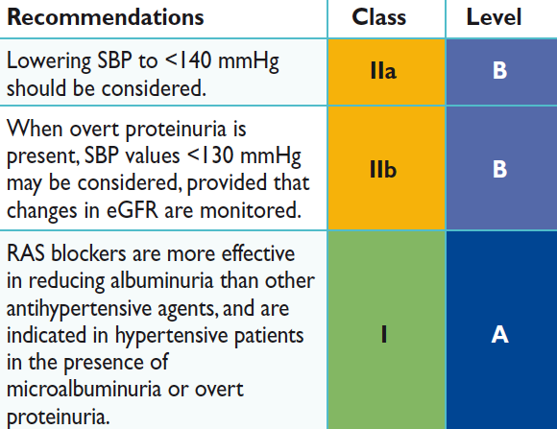
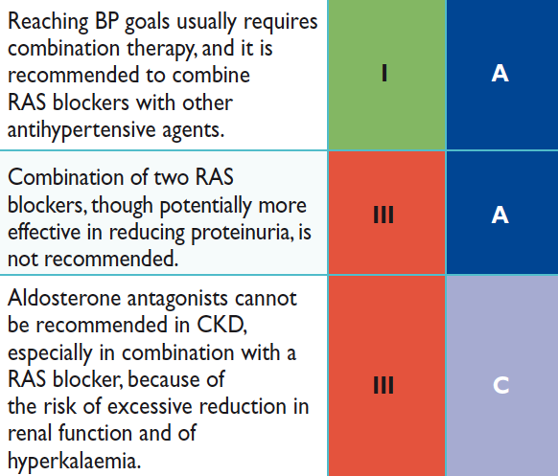
2013 ESH/ESC Hypertension Guidelines
Treatment strategies in hypertensive patients with
nephropathy
Notes:
Data taken from European cardiovascular disease statistics 2008

Slide 36
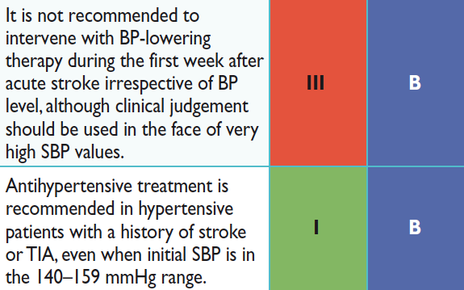
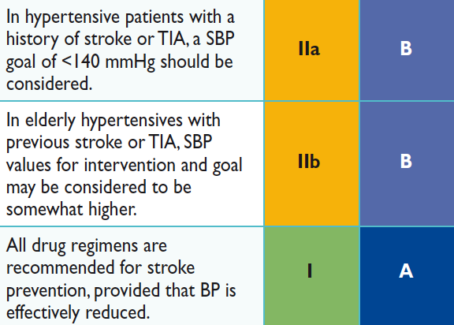
2013 ESH/ESC Hypertension Guidelines
Treatment strategies in hypertensive patients with
cerebrovascular disease
Notes:
Data taken from European cardiovascular disease statistics 2008

Slide 37
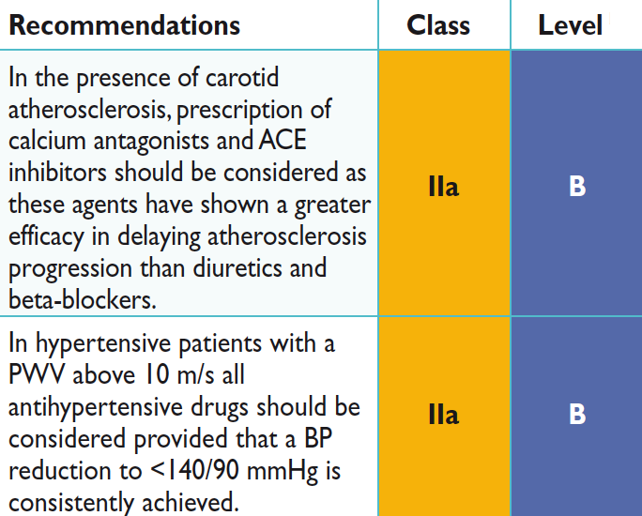
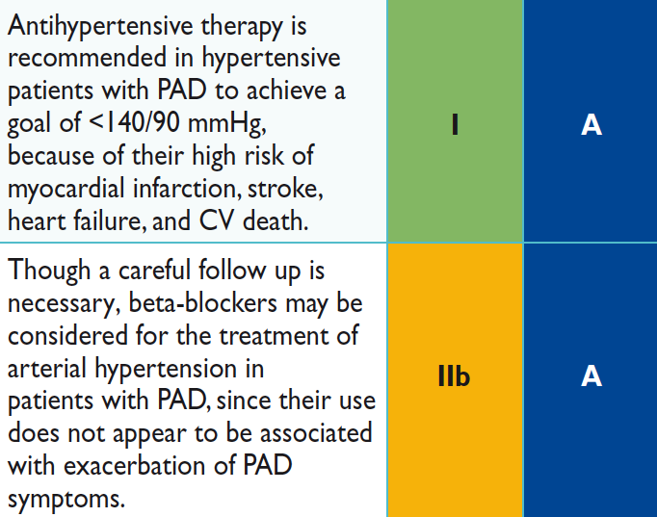
2013 ESH/ESC Hypertension Guidelines
Treatment strategies in hypertensive patients with
atherosclerosis, arteriosclerosis, and peripheral artery disease
Notes:
Data taken from European cardiovascular disease statistics 2008

Slide 38
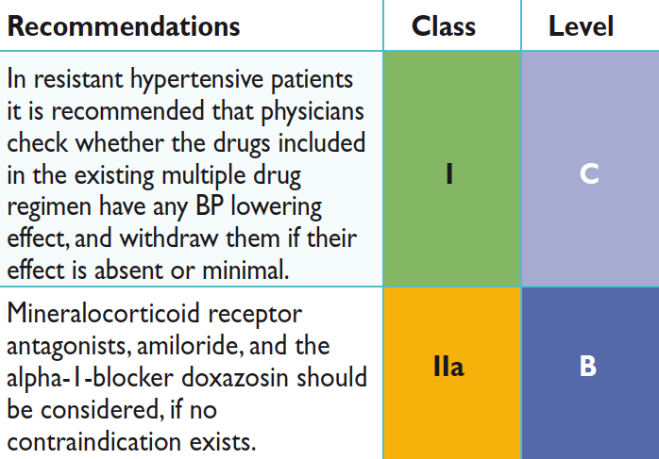
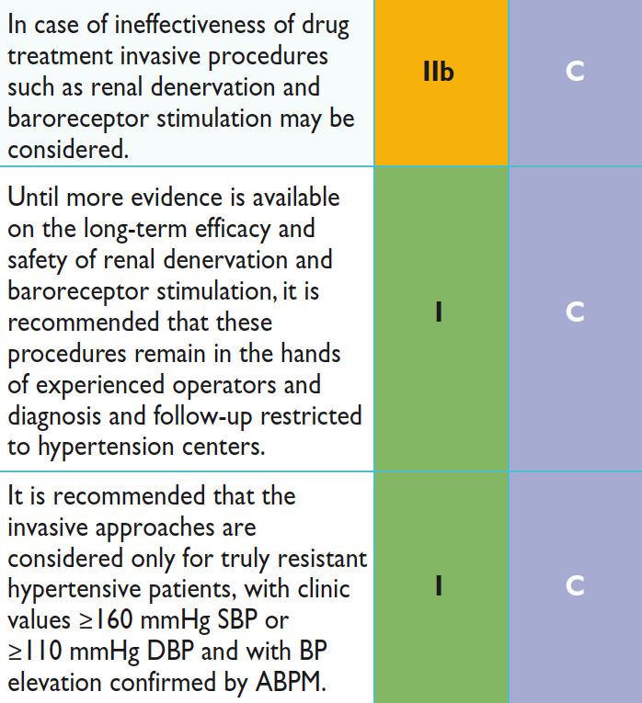
2013 ESH/ESC Hypertension Guidelines
Treatment strategies in hypertensive patients with
resistant hypertension
Notes:
Data taken from European cardiovascular disease statistics 2008

Slide 39
2013 ESH/ESC Hypertension Guidelines
Treatment strategies in hypertensive patients with
resistant hypertension
Notes:
Data taken from European cardiovascular disease statistics 2008

Slide 40
2013 ESH/ESC Hypertension Guidelines
Can antihypertensive medications be stopped?
In some patients in whom treatment is accompanied by an effective BP control for an extended period it may be possible to reduce the number/dosage of drugs
This may be particularly the case if BP control is accompanied by healthy lifestyle changes, removing the environmental pressor influences
Medication reduction should be gradual and patients should be frequently checked
Notes:
Data taken from European cardiovascular disease statistics 2008

Slide 41
2013 ESH/ESC Hypertension Guidelines
Follow-up - Elevated BP at control visits
Search for the cause(s)
  Poor adherence
  Persistence of a WC effect (repeated BP measurements)
  Occasional or more regular consumption of drugs / substance raising BP or opposing antihypertensive effects (tactful / stringent questioning of patients / family)
If responsible, ineffective treatment should be modified without delay to avoid clinical inertia
Notes:
Data taken from European cardiovascular disease statistics 2008

Slide 42
2013 ESH/ESC Hypertension Guidelines
Gaps in evidence and need for future trials - 1
Should antihypertensive drug treatment be given to all patients with grade 1 hypertension when their CV risk is low-to-moderate?
Should elderly patients with a SBP between 140 and 160 mmHg be given antihypertensive drug treatments?
Should drug treatment be given to subjects with white-coat hypertension? Can this condition be differentiated into patients needing or not needing treatment?
Should antihypertensive drug treatment be started in the high normal BP range and, if so, in which patients?
What are the optimal office BP values (i.e. the most protective and safe) for patients to achieve by treatment in different demographic and clinical conditions?
Do treatment strategies based on control of out-of-office BP provide an advantage (reduced clinical morbidity and mortality, fewer drugs, fewer side-effects) over strategies based on conventional (office) BP control?
What are the optimal out-of-office (home and ambulatory) BP values to be reached with treatment and should targets be lower or higher in high risk hypertensives?
Notes:
Data taken from European cardiovascular disease statistics 2008

Slide 43
2013 ESH/ESC Hypertension Guidelines
Gaps in evidence and need for future trials - 2
Does central BP add to CV event prediction in untreated and treated hypertensive patients?
Do invasive procedures for treatment of resistant hypertension compare favourably with the best drug treatment and provide long-term BP control and reduction of morbid and fatal events?
Do treatment-induced changes in asymptomatic OD predict outcome? Which measures—or combinations of measures—are most valuable?
Are lifestyle measures known to reduce BP capable of reducing morbidity and mortality in hypertensive patients?
Does a treatment-induced reduction of 24h BP variability add to CV protection by antihypertensive treatment?
Does BP reduction substantially lower CV risk in resistant hypertension?
Notes:
Data taken from European cardiovascular disease statistics 2008

