Slide 1


Baroreflex activatie therapie
Dr. A.A. (Bram) Kroon
internist-vasculair geneeskundige
Maastricht UMC+, Interne Geneeskunde

Slide 2
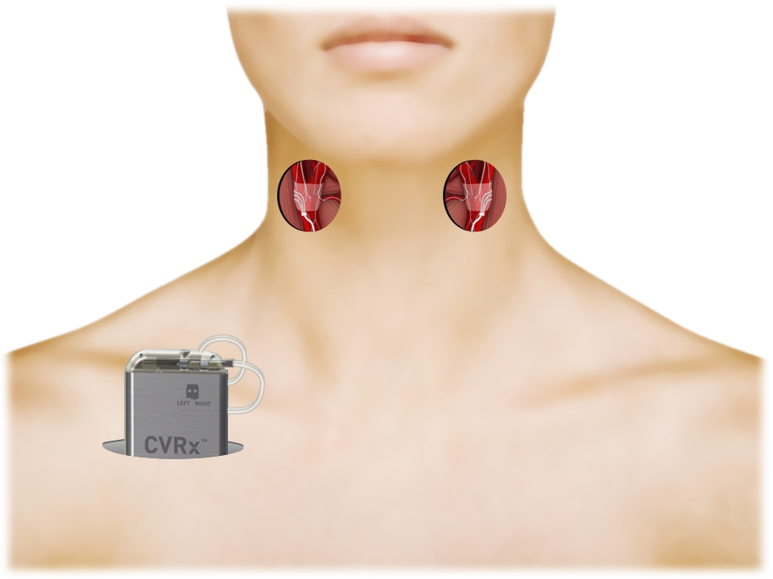
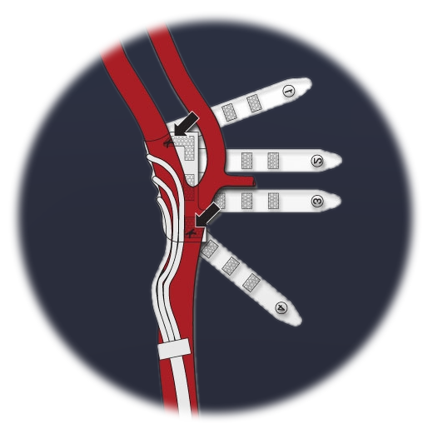
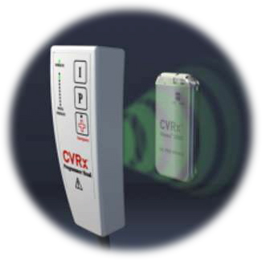
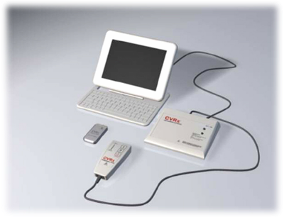
The CVRx® Rheos System
Programming
System
Baroreflex
Activation Leads
A permanently implantable medical device that electrically activates baroreceptors
Bilateral electrodes
External programmer
Implantable
Pulse Generator
Notes:
The programming system enables us to change the settings of the pulse generator with respect to amplitude (V), frequency of the pulses (Hz), the pulse width (PPS), mode of pulse generation (continuous, burst), side (left, right, bilateral)

Slide 3
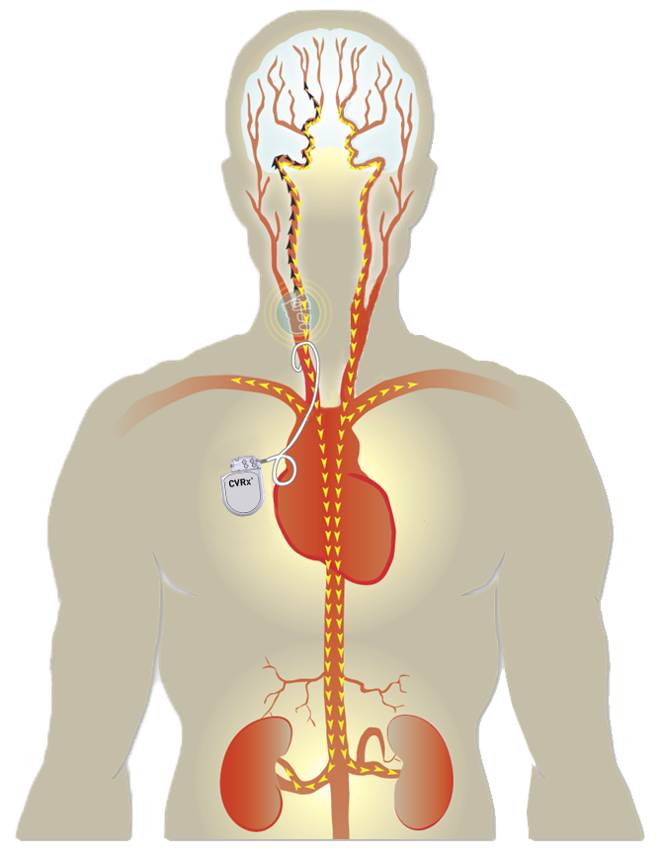
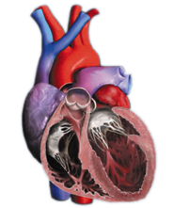
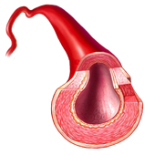
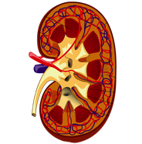
CVRx Barostim Platform
CVRx Programmable Barostim Platform
Designed to electronically activate baroreceptors which signal the brain to orchestrate a multi-systemic response to address chronic, progressive diseases: hypertension, heart failure, arrhythmia…
Barostim
Brain
Autonomic Nervous System
Reduce Sympathetic Activity
Enhance Parasympathetic Activity
HEART: rate slows, to allow more time for heart to fill with blood, and reduce workload and energy demand
ARTERIES: relax, making it easier for blood to flow through the body and reducing cardiac exertion
KIDNEYS: reduce fluid in the body, lowering excessive blood pressure and workload on the heart
Notes:
3
3
3

Slide 4
Intended to Inhibit Sympathetic Activity
Acute Muscle Sympathetic Nerve Activity After 3 Months of Therapy
Heusser et al., J Hypertens 2009;27(suppl):S288
4

Slide 5
Trial Design
DEBuT (phase 2)
Baseline
“OFF”
Therapy
“ON”
3-Month
follow-up
Long-Term follow-up
Implant
Device Activation
Additional visits completed
Additional visits completed
Notes:
5
5

Slide 6
DEBuT Study Results
Sustained Reduction of BP over 5 years
Systolic
(Baseline = 193 ± 36 mmHg)
Diastolic
(Baseline= 111 ± 20 mmHg)
Heart Rate
(Baseline= 74 ± 12.8 mmHg)
0
-0.8
-10
-4.2
-4.5
-3.1
-5.4
-18
-22
-21
-20
Change in BP (mmHg)
Anti-hypertensive Medications Changes
Baseline | 5.0 ± 1.3
1 year | -0.2 ± 0.3
2 years | -0.7 ± 0.4
3 years | -0.8 ± 0.3
4 years | -1.6 ± 0.3
5 years | -1.6 ± 0.4
-30
-29
-30
-36
-38
-40
-40
1 year
2 years
-50
-53
-53
3 years
4 years
5 years
N = 18
On File at CVRx
193/111 mmHg ⇒ 140/82 mmHg at 5 Years
6
Notes:
6
6

Slide 7
Sustained Reduction in 24-hr Ambulatory BP
Systolic
(Baseline = 176 mmHg)
Diastolic
(Baseline = 107 mmHg)
Heart Rate
(Baseline = 80 BPM)
0
-5
-6
-10
-8
Change in mmHg or BPM
-11
-15
-13
-20
-19
-25
1 year, n=22
2 years, n=15
-24
All P-values < 0.01
Notes:
152/94

Slide 8
Trial Design
DEBuT (phase 2)
Baseline
“OFF”
Therapy
“ON”
3-Month
follow-up
Long-Term follow-up
Implant
Device Activation
Additional visits completed
Additional visits completed
Pivotal (phase 3)
Implant
Randomization
6-Month Blinded
Evaluation Period
6-Month Blinded
Evaluation Period
Long-Term Follow-Up
N = 181
Group A – Device ON
Group A – Device ON
N = 84
Group B – Device OFF
Group B – Device ON
-1
0
3
6
9
12
(months)
8
Notes:
8
8

Slide 9
Phase-3 Long Term Data in Resistant HTN
183
178
No BAT
180
BAT
170
168
169
169
Group B
Group A
Roll-in
SBP using BpTRU
(mmHg)
160
160
Group B
152
150
Group A
146
143
145
143
142
Goal – 140
N=322
N=322
N=84
181
54
N=80
170
52
N=78
166
50
N=271
Screening
Pre-Implant
Pre-Activation
(1 month post-Implant)
Month 6
Month 12
Most Recent
(22 – 53 months)
0
Group B
Group A
Roll-in
Group B
Group A
Roll-in
-10
-8
-10
-10
Change in SBP using BpTRU
(mmHg, +/- SE)
-20
-16
-26
-30
-32
-32
-32
-33
-36
-40
Bakris et al., J Am Soc Hypertens 2012
Notes:
9

Slide 10
eGFR (4 factor-MDRD)
BAT off
BAT on
* P < 0.01

Slide 11
renin & aldosterone
BAT off
BAT on
Presented as geometric mean (95%CI)
Adjustments included SBP, ATI, race, antihypertensive drug classes,
eGFR, BMI, gender, age, coronary artery disease etc.

Slide 12
2e generatie ‘devices’

Slide 13
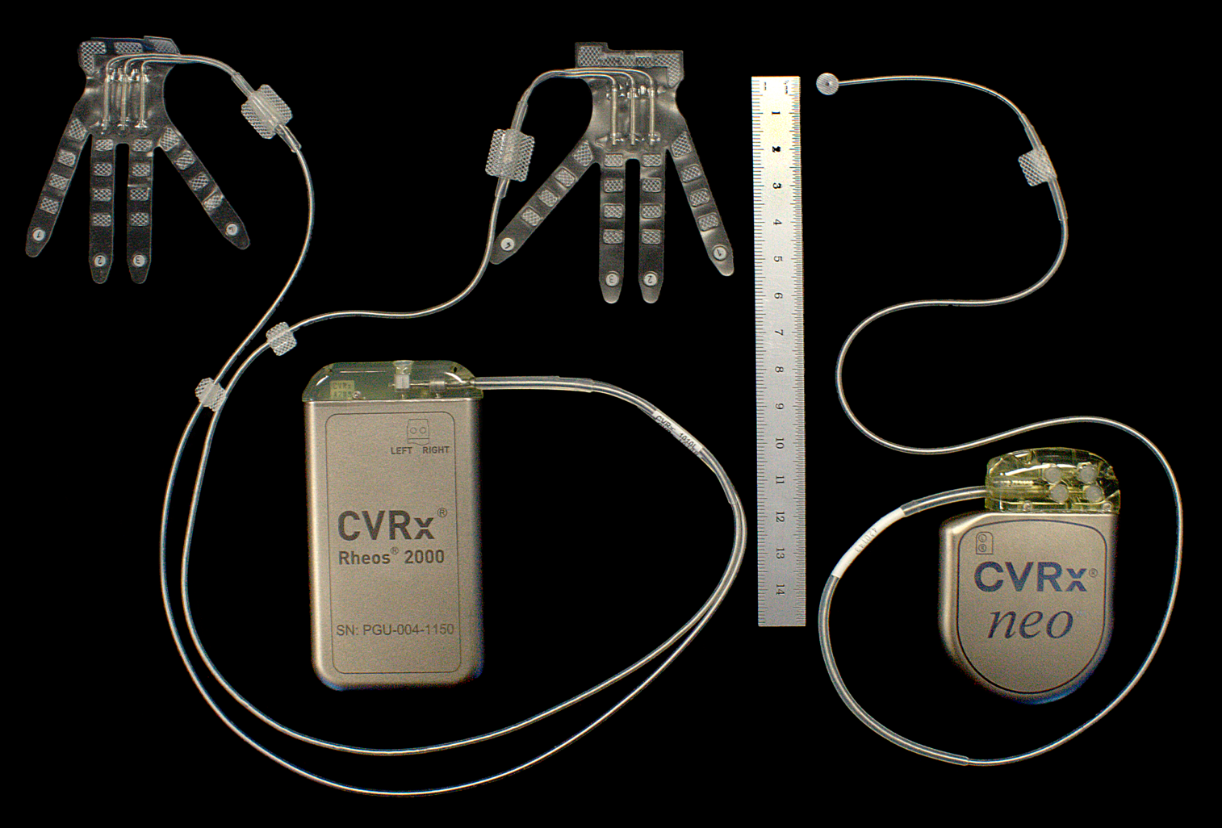
2nd Generation Platform
1st Generation
2nd Generation

Slide 14
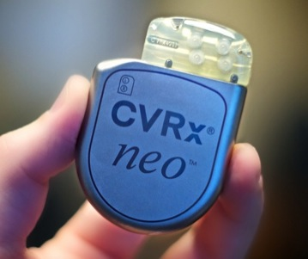
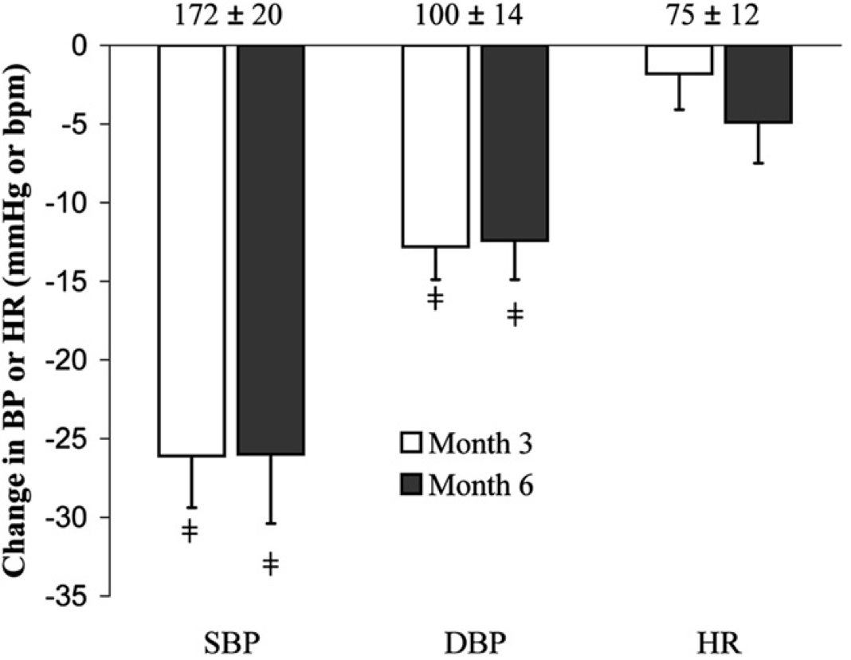
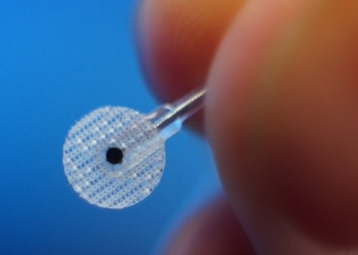

2nd Generation – Efficacy
⧧P<0.001
Hoppe et al., J Am Soc Hypertens 2012

Slide 15
All Patients with Baseline SBP ≥ 160mmHg (N=16)
SBP
DBP
HR
Baseline
186
±
16
106
±
13
78
±
11
0
-5
-6
-8
-8
-10
-15
^
^
-15
-17
-18
Change in BP or HR (mmHg or bpm)
-20
†
†
-26
†
-25
-29
-29
6 month
-30
12 month
-35
*
Most Recent
(16.5 ± 3.0 months)
†
†
-40
^ p<0.05 ; * p=0.003 ; † p<0.001
de Leeuw PW et al., ASH 2013.

Slide 16
2nd Generation – Safety
2nd Generation
1st Generation
Hoppe et al., J Am Soc Hypertens 2012

Slide 17
Behandeling van non-responders op RDN

Slide 18
Barostim After Renal Denervation
Pre-Clinical
Baroreflex Activation
Mean Arterial Pressure (mmHg)
-2
0
2
4
6
8
10
12
14 (days)
Lohmeier, et al., Hypertension 2005;46(10):816

Slide 19
Barostim After Renal Denervation
Pre-Clinical
Baroreflex Activation
Mean Arterial Pressure (mmHg)
-2
0
2
4
6
8
10
12
14 (days)
Lohmeier, et al., Hypertension 2005;46(10):816

Slide 20
High-Risk Patients with Prior Renal Nerve Ablation (N=5)
SBP
DBP
HR
Baseline
183
±
17
106
±
15
83
±
12
0
-5
-7
-11
-10
-15
-18
-20
-20
6 month
-26
Change in BP or HR (mmHg or bpm)
12 month
-25
*
*
-30
-34
-35
-40
^
-45
-50
^
^ p ≤ 0.08 ; * p<0.05

Slide 21
Conclusions
Barostim neo system
Significantly and durably reduces blood pressure in high-risk resistant hypertension patients
  29 mmHg reduction in SBP sustained > 16 months
Equally reduces blood pressure in patients for whom renal denervation failed to provide control
  34 mmHg reduction in SBP at 12 months
  Barostim mechanism of action more comprehensive than inhibition of renal sympathetic nerve traffic
  Barostim may be more effective at reducing global sympathetic activity than renal denervation
Notes:
21

Slide 22
BAT bij hartfalen

Slide 23
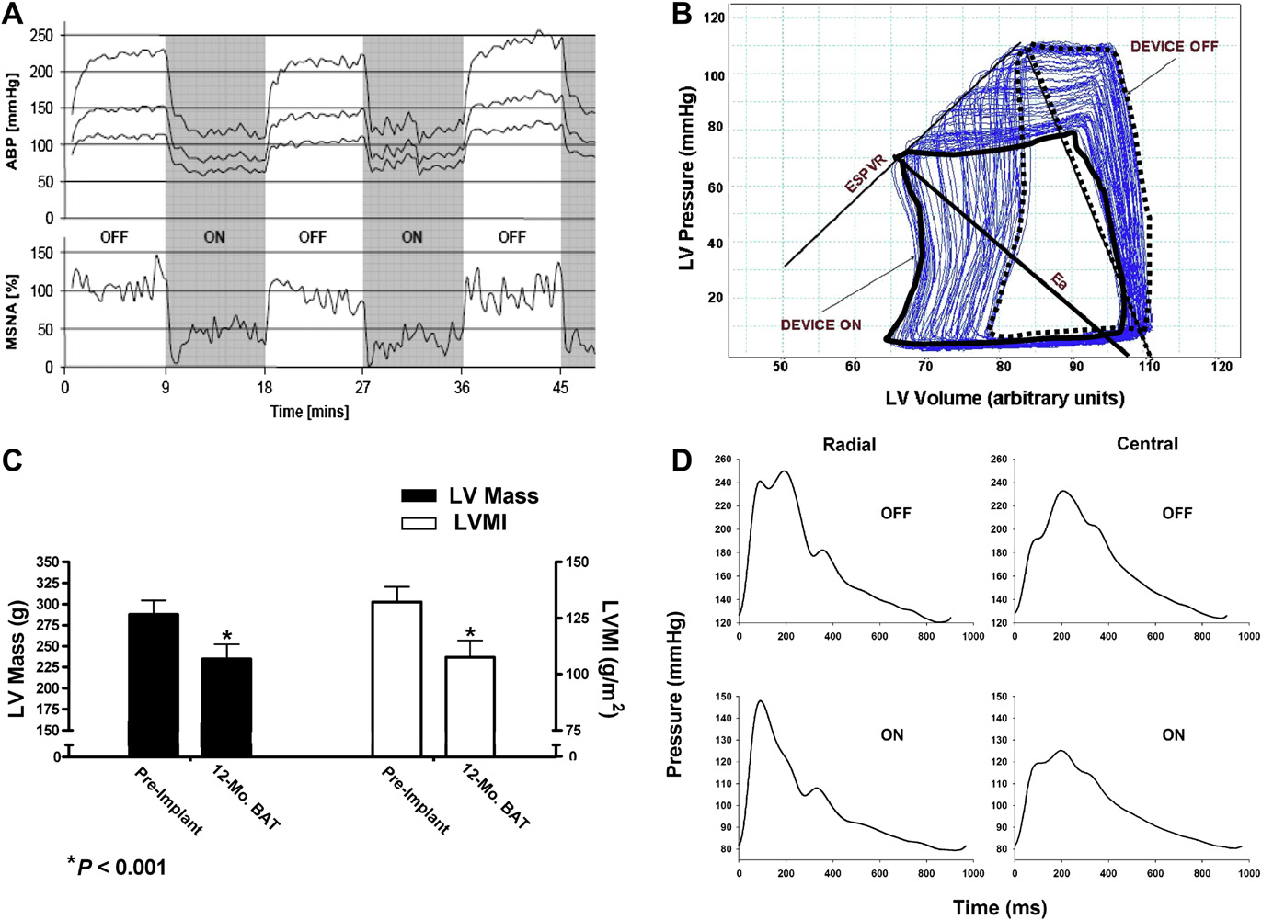
Barostim Therapy
23
Notes:
23

Slide 24
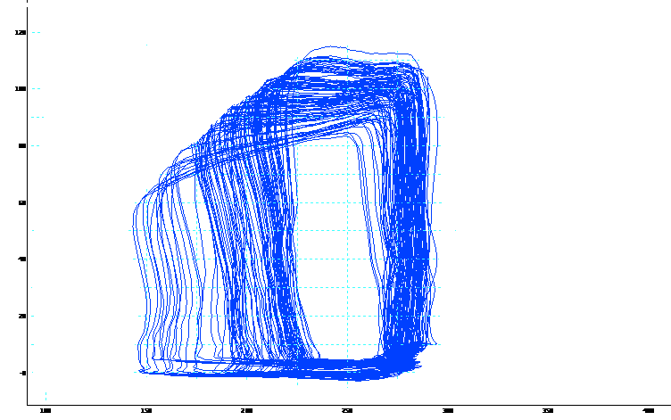
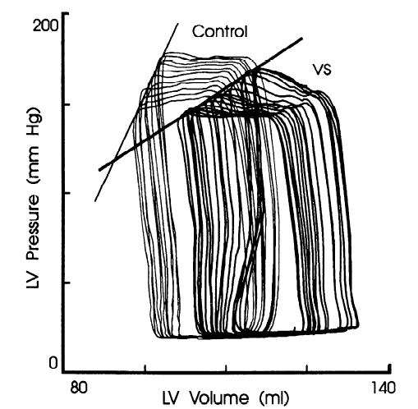
Effects of BAT vs Vagal Nerve Stimulation
Baroreflex Activation
(Preserved contractile function)
Vagal Nerve Stimulation
(Depressed contractile function)
ON
OFF
LV Pressure (mmHg)
Volume (mV)
Xenopoulos et al, Am J Physiol 1994
24

Slide 25
Effects of BAT Compared with Esmolol
Baseline
100
80
Rheos
60
LV Pressure
β-blocker
40
20
0
Rheos + β-blocker
LV Volume
25

Slide 26
Pressure-Volume Loops with BAT
Diastolic Function
Parameter | % Change
LV Diastolic Pressure | -18% ± 5.3
LV Diastolic Volume | -1.2% ± 0.5
Tau | -15% ± 7
Peak Filling Rate/EDV | +34% ± 9
Systolic Function
Parameter | % Change
Systolic Pressure | -23% ± 5
Ejection Fraction | +28% ± 10
Stroke Volume | +21% ± 9
Resistance | -21% ± 4
Cardiac Output | -3% ± 5
Energetics
Parameter | % Change
Heart Rate | -20% ± 3
dpdt_{max} | -14% ± 5
Rate-Pressure Product | -18% ± 4
Energetics
N = 12
26

Slide 27
On-going Heart Failure Trial
BASELINE
1:1 RANDOMIZATION
MEDICAL MANAGEMENT (N=70)
IMPLANT
DEVICE + MEDICAL MANAGEMENT (N=70)
Long-term
Follow-up
1
3
6 Months
12
Open Label Phase
First 10 patients treated open-label
Randomized Phase
140 patients randomized 1:1
Primary Efficacy Objective
To determine whether the Barostim neo system produces an increase in Left Ventricular Ejection Fraction (LVEF) from screening through 6 months of follow-up
Key Inclusion Criteria
LVEF ≤ 35%
NYHA Class III
On stable, guideline-directed heart failure therapy for at least 4 weeks
Serum creatinine ≤ 2.5 mg/dL and not being treated with dialysis

Slide 28
Early Clinical Results in Heart Failure
Δ=-8.8 ± 2.2
p=0.01
Δ=-13.6 ± 1.1
p<0.001
Δ=+76.2 ± 14.7
p=0.004
NYHA Class, N (%)
IV
III | 8 (100%)
II |  | 5 (71%)
I |  | 2 (29%) | 1 (100%)
 | Baseline | 3 Months | 6 Months

Slide 29
Take home messages:
BAT is effectieve, alternatieve manier om BP te verlagen bij therapieresistente hypertensie
De tweede generatie is net zo effectief en veroorzaakt minder perioperatieve complicaties
BAT heeft een gunstig effect op eindorgaanschade (cardiaal, renaal en vasculair)
BAT is een alternatief bij non-responders na RDN
BAT is mogelijk inzetbaar bij hartfalen

