Slide 1





Novel insights into regulation of plasma triglyceride levels
Sander Kersten, Nutrition Metabolism and Genomics group,
Wageningen University, the Netherlands

Slide 2
High plasma triglycerides as part of
elevated CVD risk profile
Atherogenic dyslipidemia
↑ Triglycerides
↓ HDL-cholesterol
↑ Cholesterol/HDL-cholesterol ratio
«Normal» LDL-cholesterol but ↑ apo B
Small, dense LDL and HDL
Postprandial hyperlipidemia
Inflammation
Insulin resistance
Insulin resistance
Hyperinsulinemia
Hyperglycemia
Type 2 diabetes
Lipid core
Thin fibrous cap
Thrombotic state
↑ PAI-1
↑ Fibrinogen
CORONARY ATHEROSCLEROSIS
UNSTABLE PLAQUE
Inflammatory state
↑ CRP
↑ Cytokines
Increased risk of acute
coronary syndrome
Abdominal obesity
Metabolic risk factors
Notes:
Cluster of metabolic athero-thrombotic and pro-inflammatory disturbances resulting from visceral obesity, contributing not only to the progression of coronary atherosclerosis, but also increasing the risk of an acute coronary syndrome.
KW: metabolic syndrome, risk factors, obesity, diabetes

Slide 3
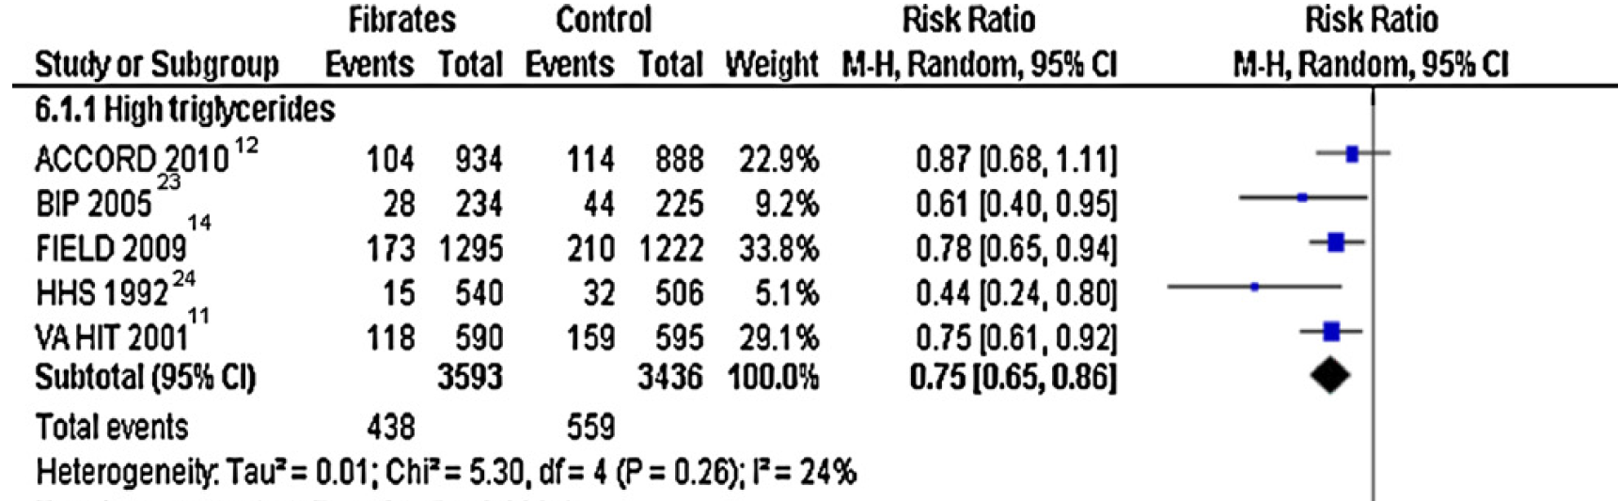
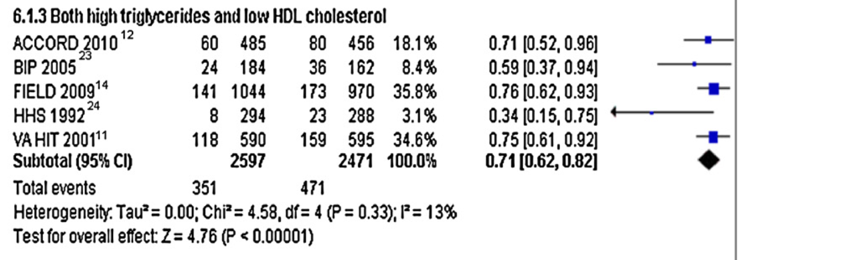
Efficacy of fibrates in CVD risk reduction

Slide 4
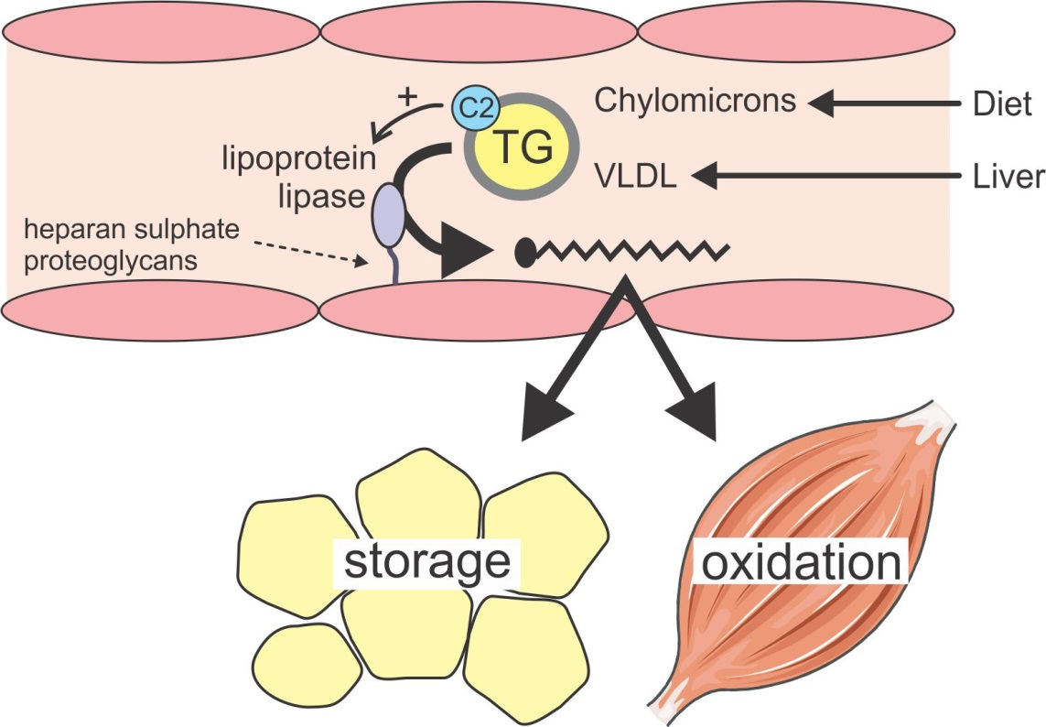
Traditional view of triglyceride hydrolysis

Slide 5
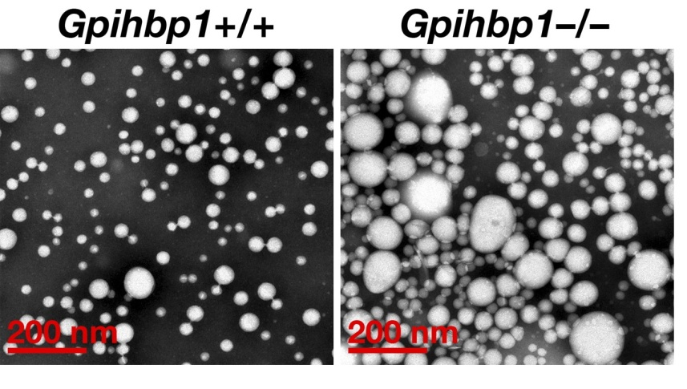
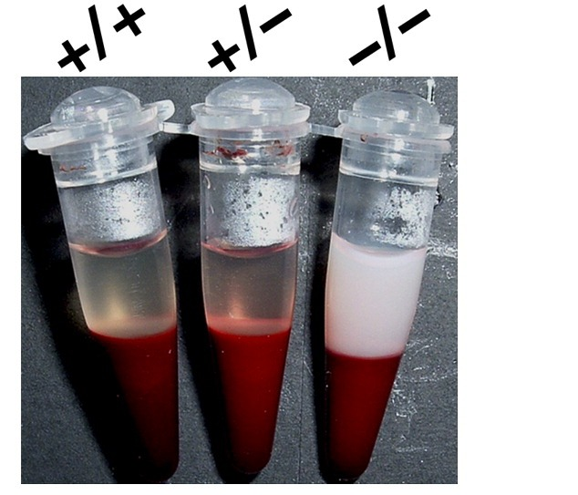
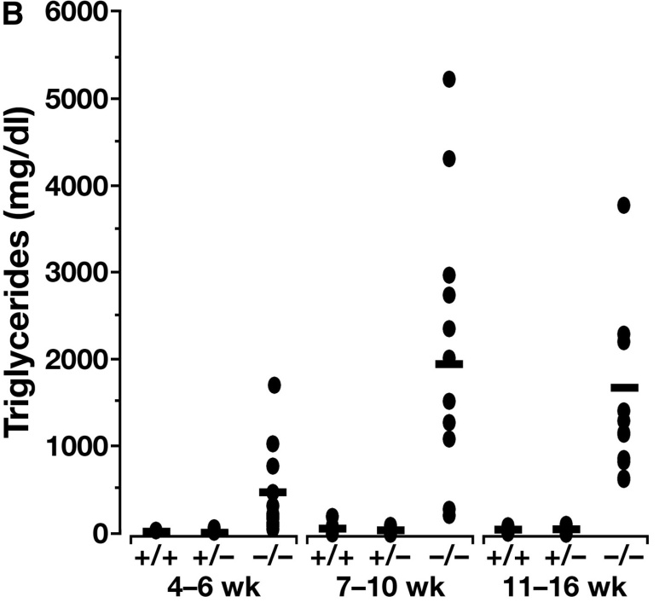
Phenotype of Gpihbp1 -/- mice
Beigneux et al. Cell Metabolism 2007

Slide 6
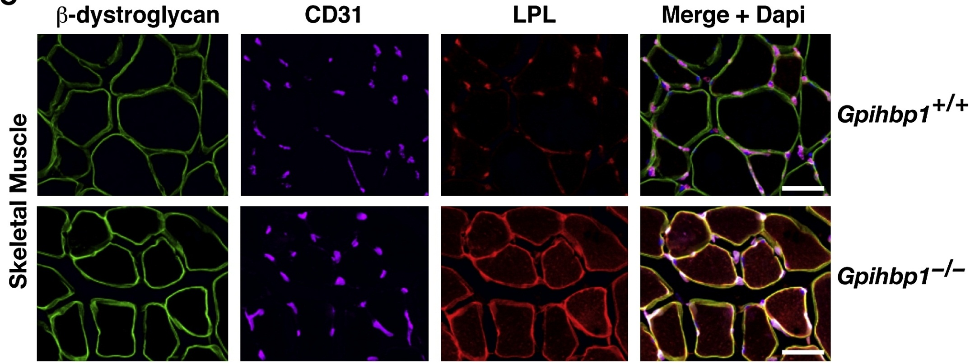
LPL does not reach the endothelial
surface in Gpihbp1 -/- mice
Davies et al. Cell Metabolism 2010

Slide 7
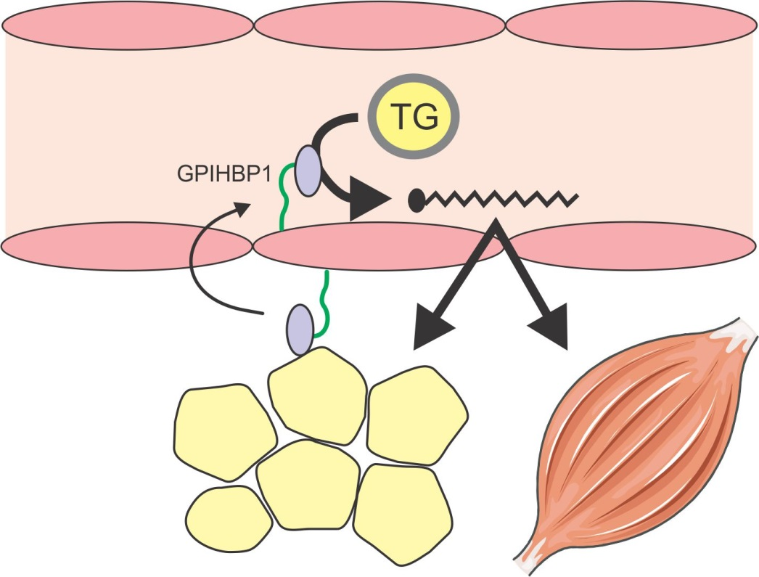
Gpihbp1 carries LPL from myocyte/
adipocyte to endothelial surface

Slide 8
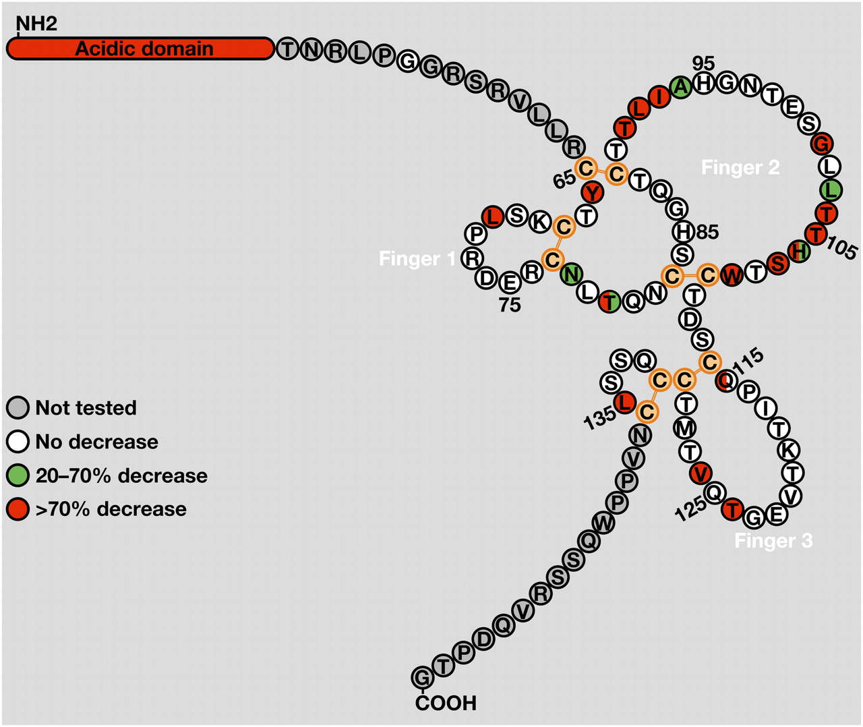
Mutations in GPIHBP1 gene lead to severe hypertriglyceridemia
COOH
G
Adapted from Young, JLR 2011

Slide 9
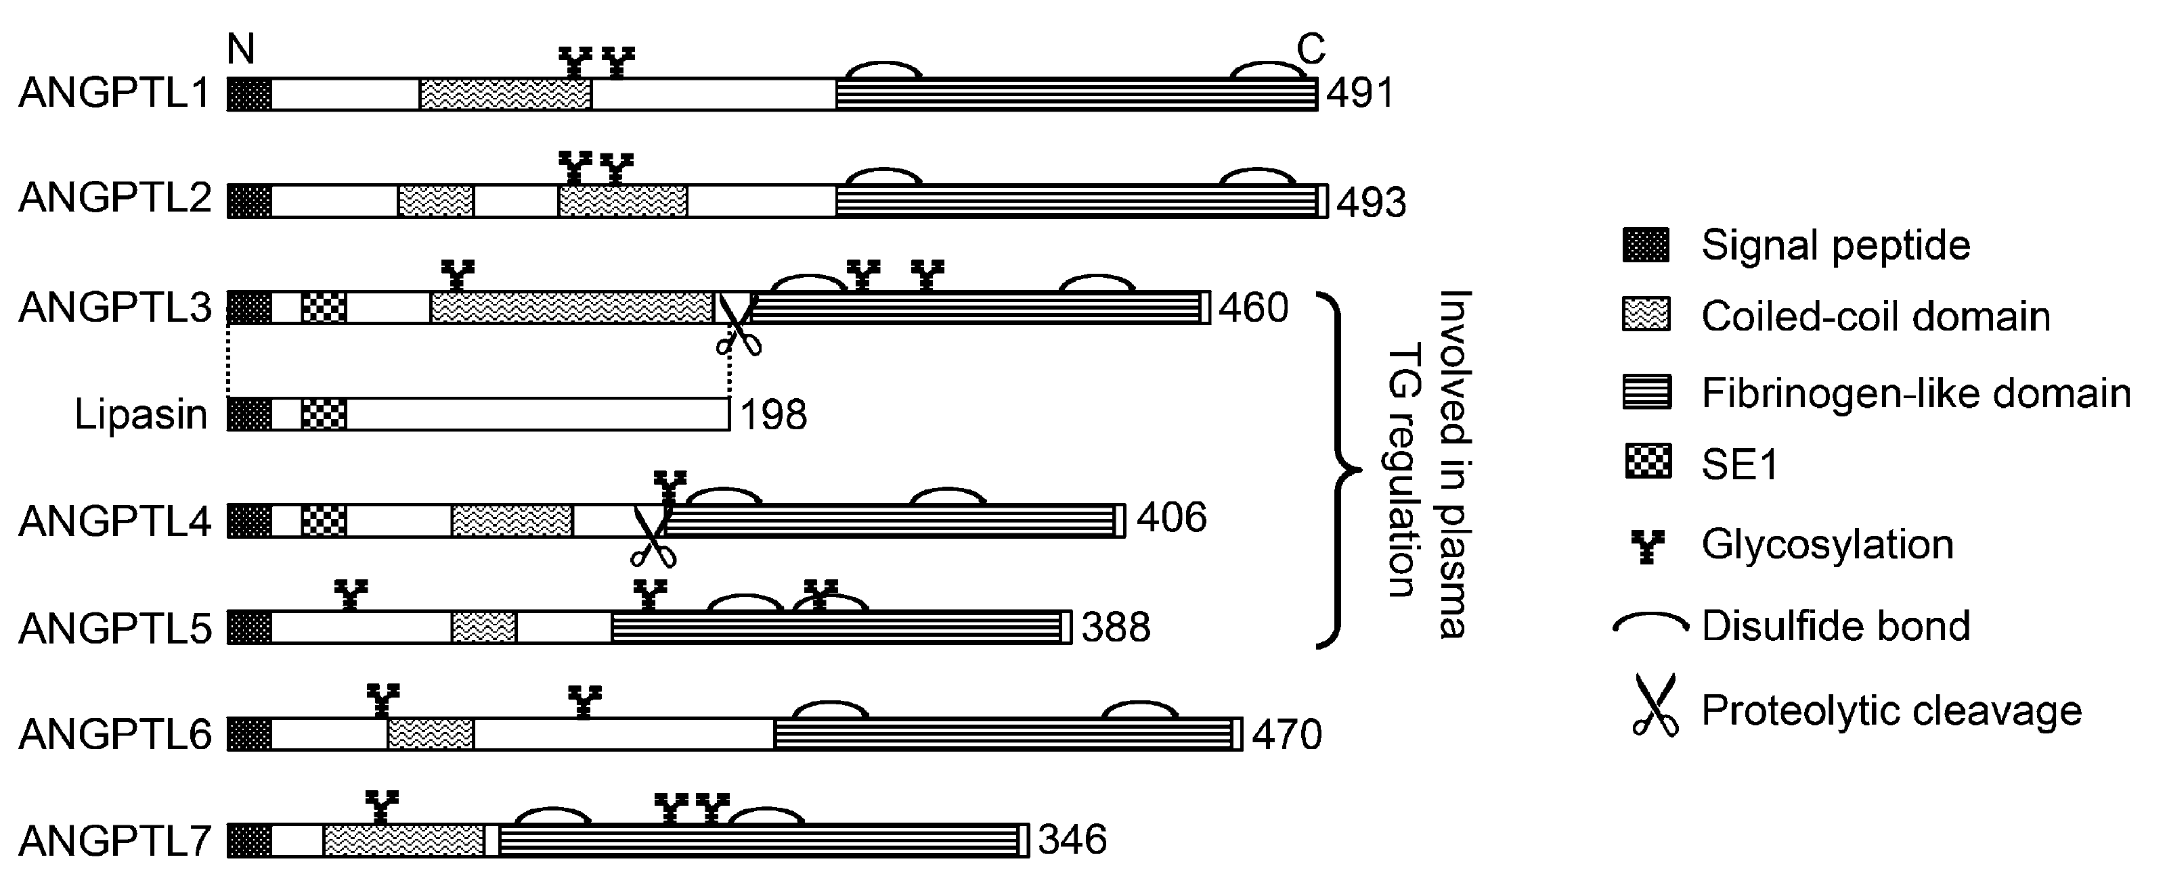
Family of Angiopoietin-like proteins
regulate LPL activity
ANGPTL8
Regulation of
plasma TG
Adapted from Zhang, BBRC 2013

Slide 10
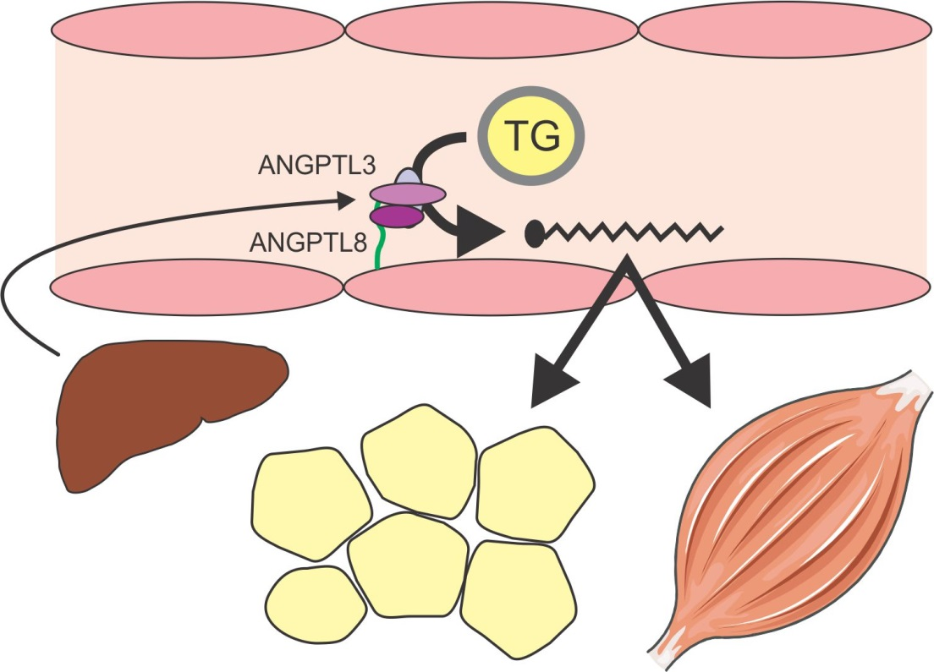
Liver derived Angptl3 and Angptl8 inhibit
peripheral LPL activity

Slide 11
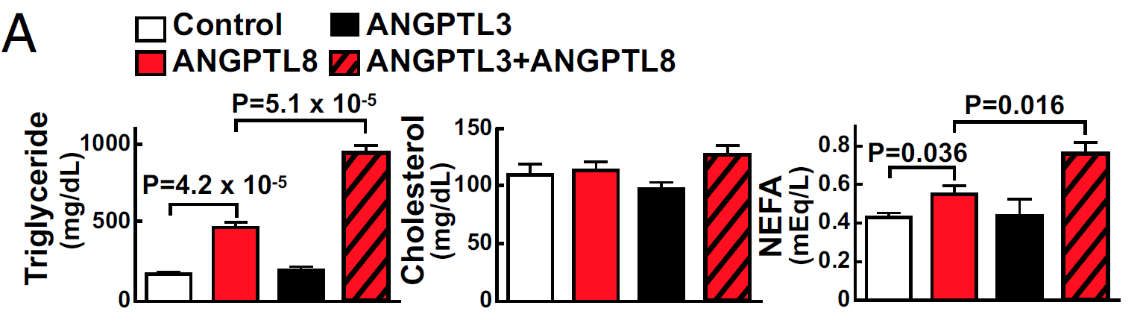
Hypertriglyceridemic effect of Angptl3 may
depend on Angptl8
Adapted from Quagliarini, PNAS 2013
Notes:
Plasma TAG level did not change in mice expressing ANGPTL3 alone, whereas coexpression with ANGPTL8 resulted in hypertriglyceridemia, despite a reduction in circulating ANGPTL3. ANGPTL8 coimmunoprecipitated with the N-terminal domain of ANGPTL3 in plasma of these mice. In cultured hepatocytes, ANGPTL8 expression increased the appearance of N-terminal ANGPTL3 in the medium, suggesting ANGPTL8 may activate ANGPTL3. Consistent with this scenario, expression of ANGPTL8 in Angptl3(-/-) mice failed to promote hypertriglyceridemia

Slide 12
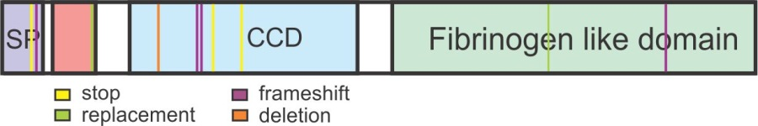
Mutations in ANGPTL3 gene lead to familial combined hypolipidemia
Low plasma levels of total cholesterol, LDL-C, HDL-C and triglycerides or combinations thereof

Slide 13
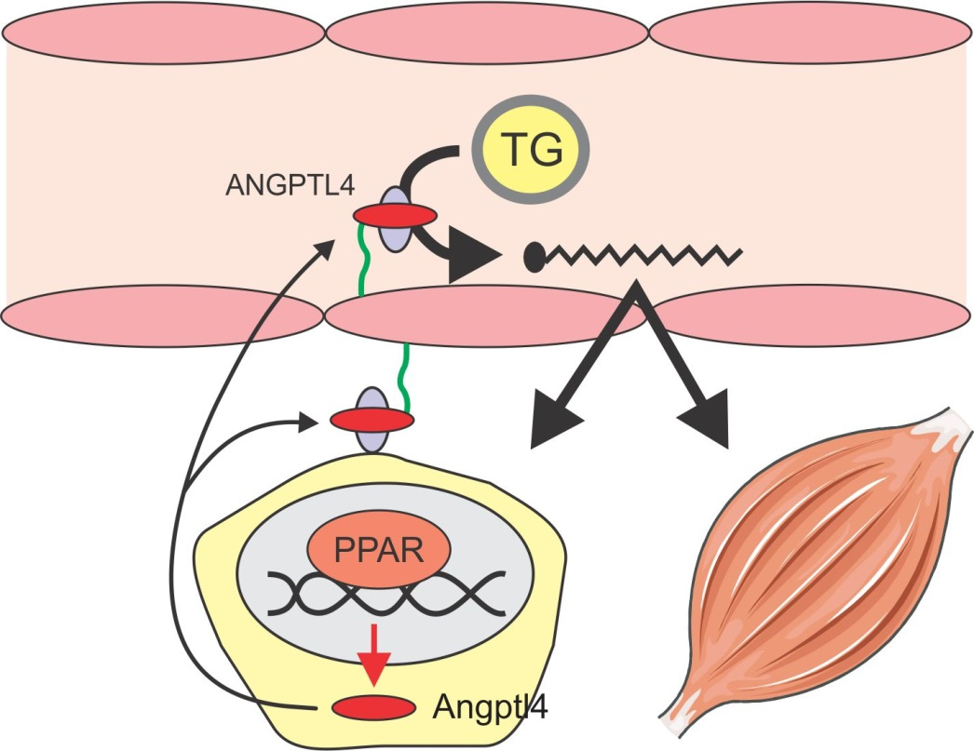
Angptl4 inhibits LPL and plasma TG
clearance

Slide 14


Potent hypertriglyceridemic effect
of Angptl4 overexpression
Angptl4 -/-
Angptl4 +/+
Angptl4-Tg

Slide 15
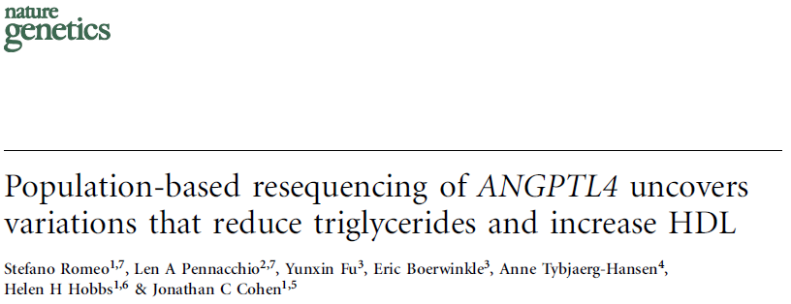

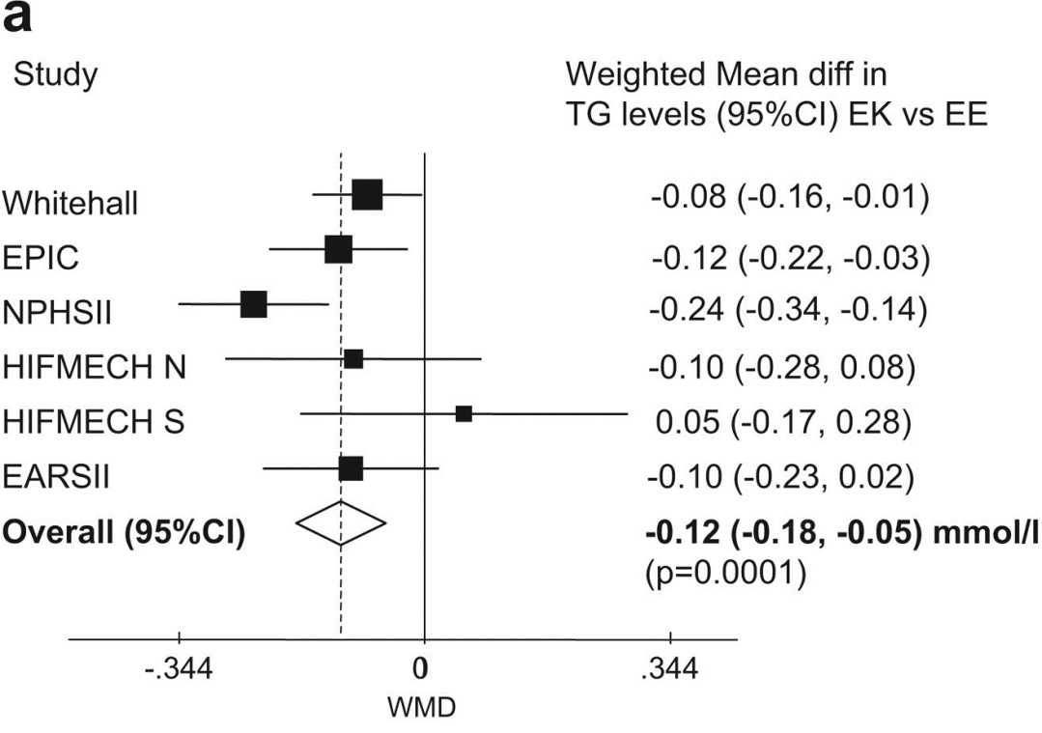
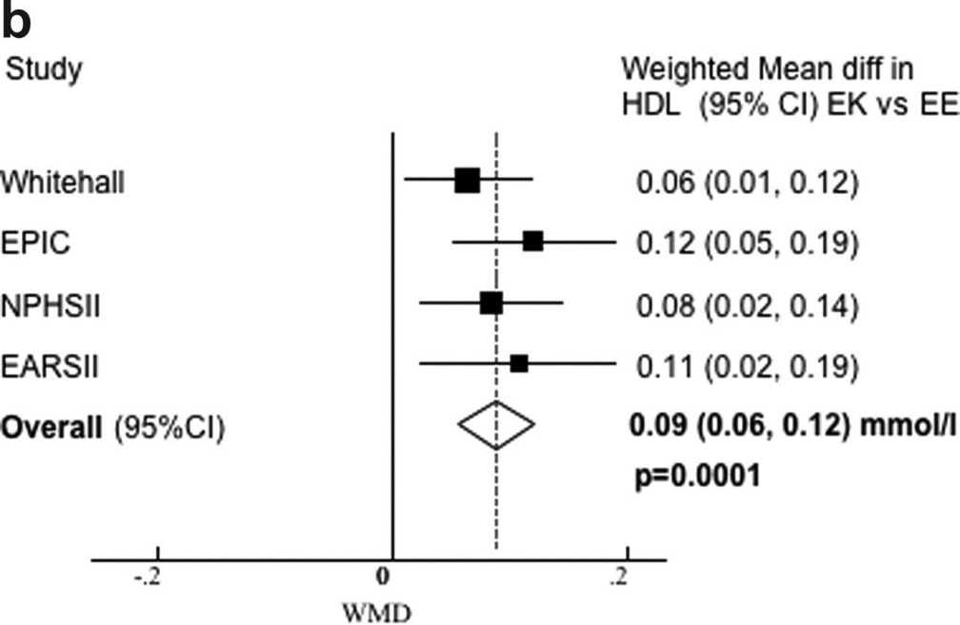
E40K mutation completely disables LPL
inhibition by Angptl4

Slide 16
Support from Genome- Wide Association Studies
30 GWAS loci (n=19840) affecting blood lipids at p<5x10⁻⁸
VLDLR
GPIHBP1
Kathiresan et al. Nature Genetics 2009
PPARG

Slide 17
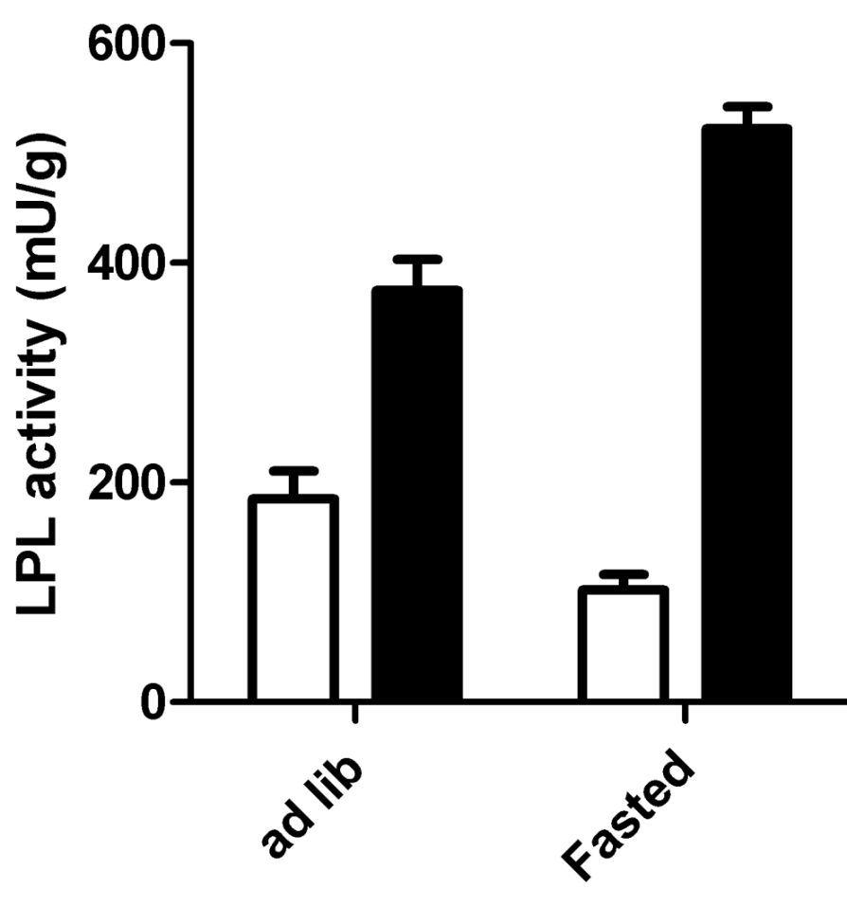
Decrease in LPL activity during fasting is
abolished in Angptl4-/- mice
Wildtype
Angptl4-/-
Kroupa et al. BMC Physiol. 2012

Slide 18
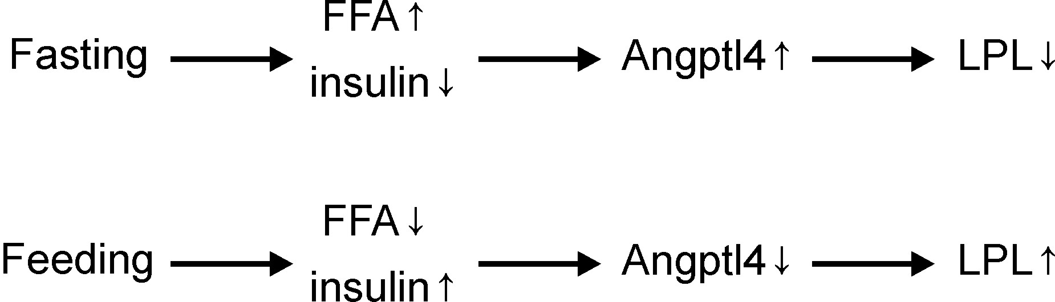
Angptl4 governs adipose LPL activity during
fasting and feeding
Diminished fatty acid uptake
into adipose tissue
Enhanced fatty acid uptake
into adipose tissue

Slide 19
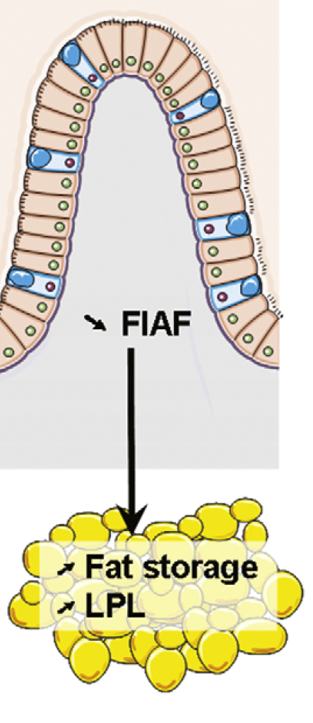

Angptl4 as proposed mediator between
gut microbiota and fat storage
Based on Backhed et al. PNAS 2004

Slide 20
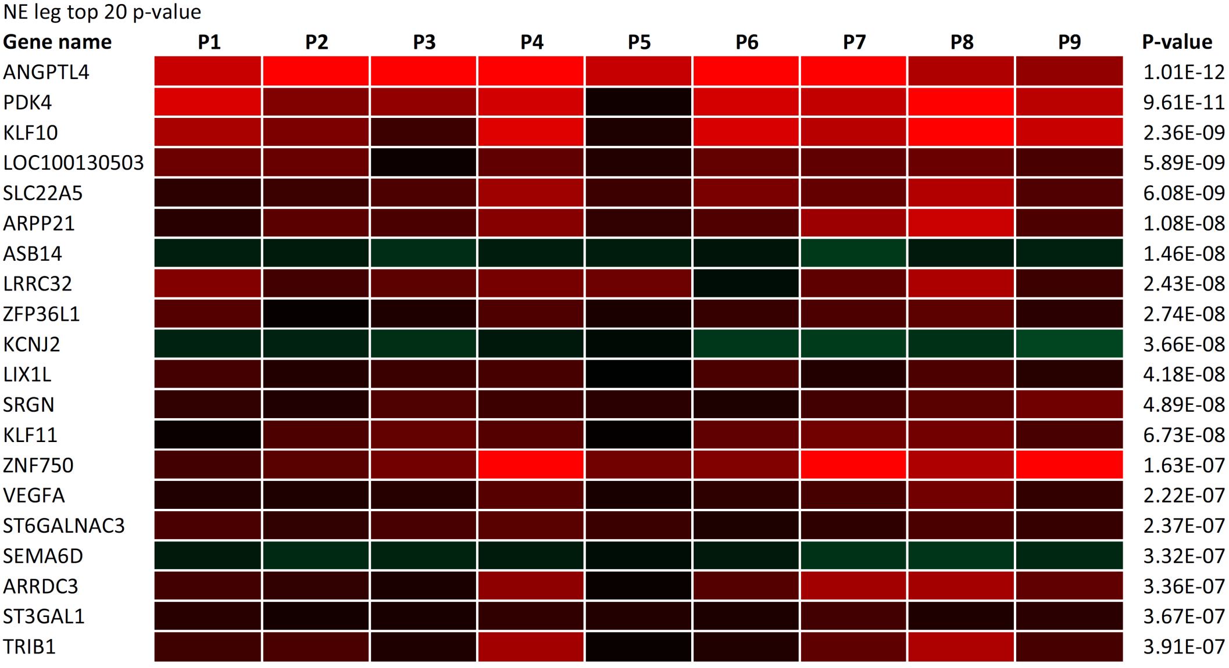
ANGPTL4 is the most significantly upregulated
gene in the non-exercising leg

Slide 21
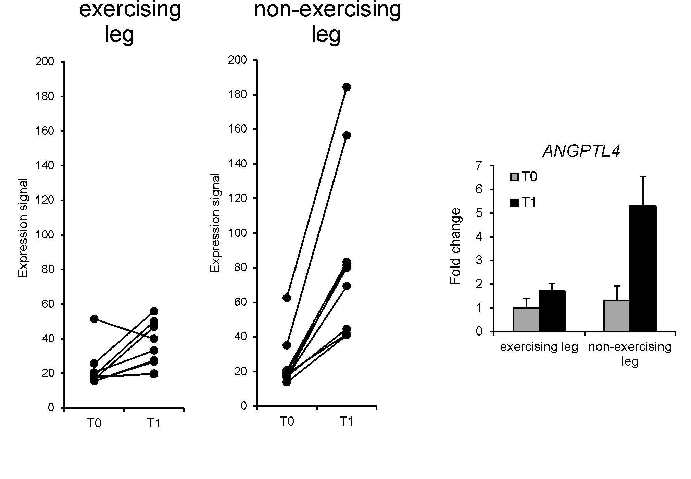
ANGPTL4 is specifically increased in the
non-exercising leg

Slide 22
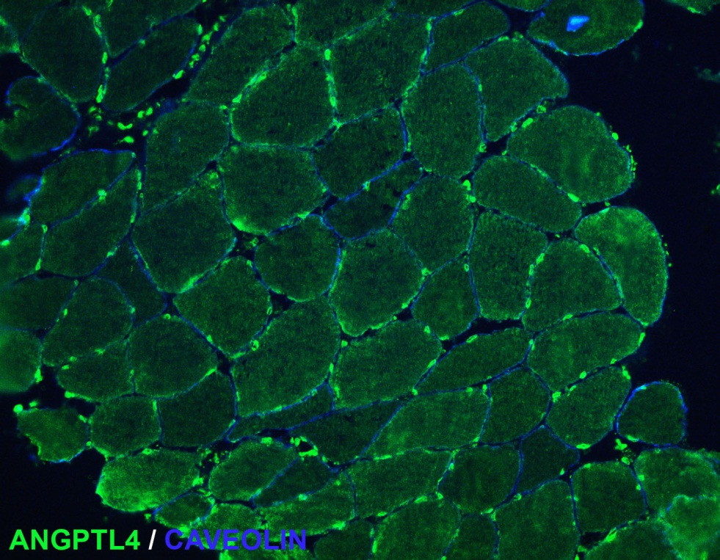
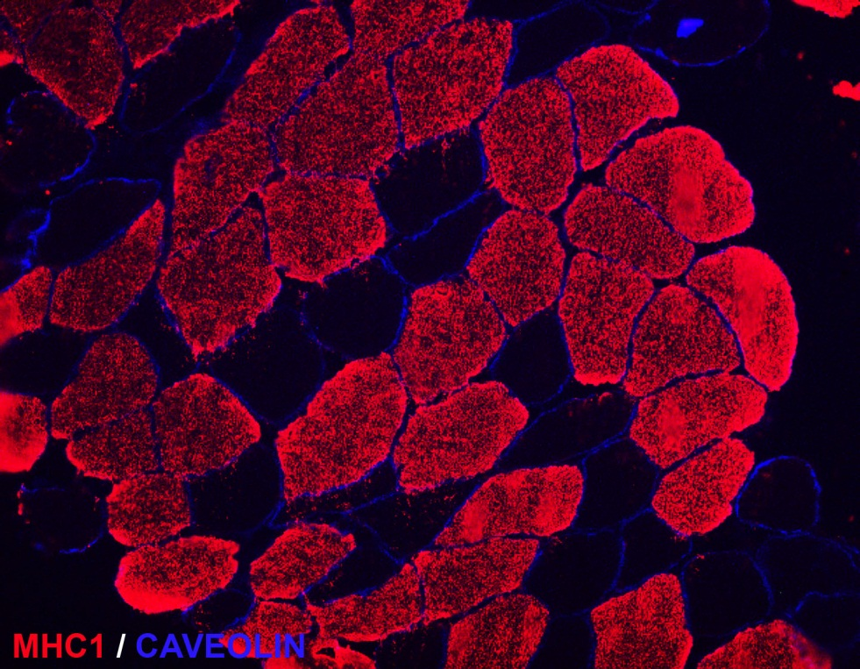
ANGPTL4 is slightly more abundant in
slow twitch fibers

Slide 23
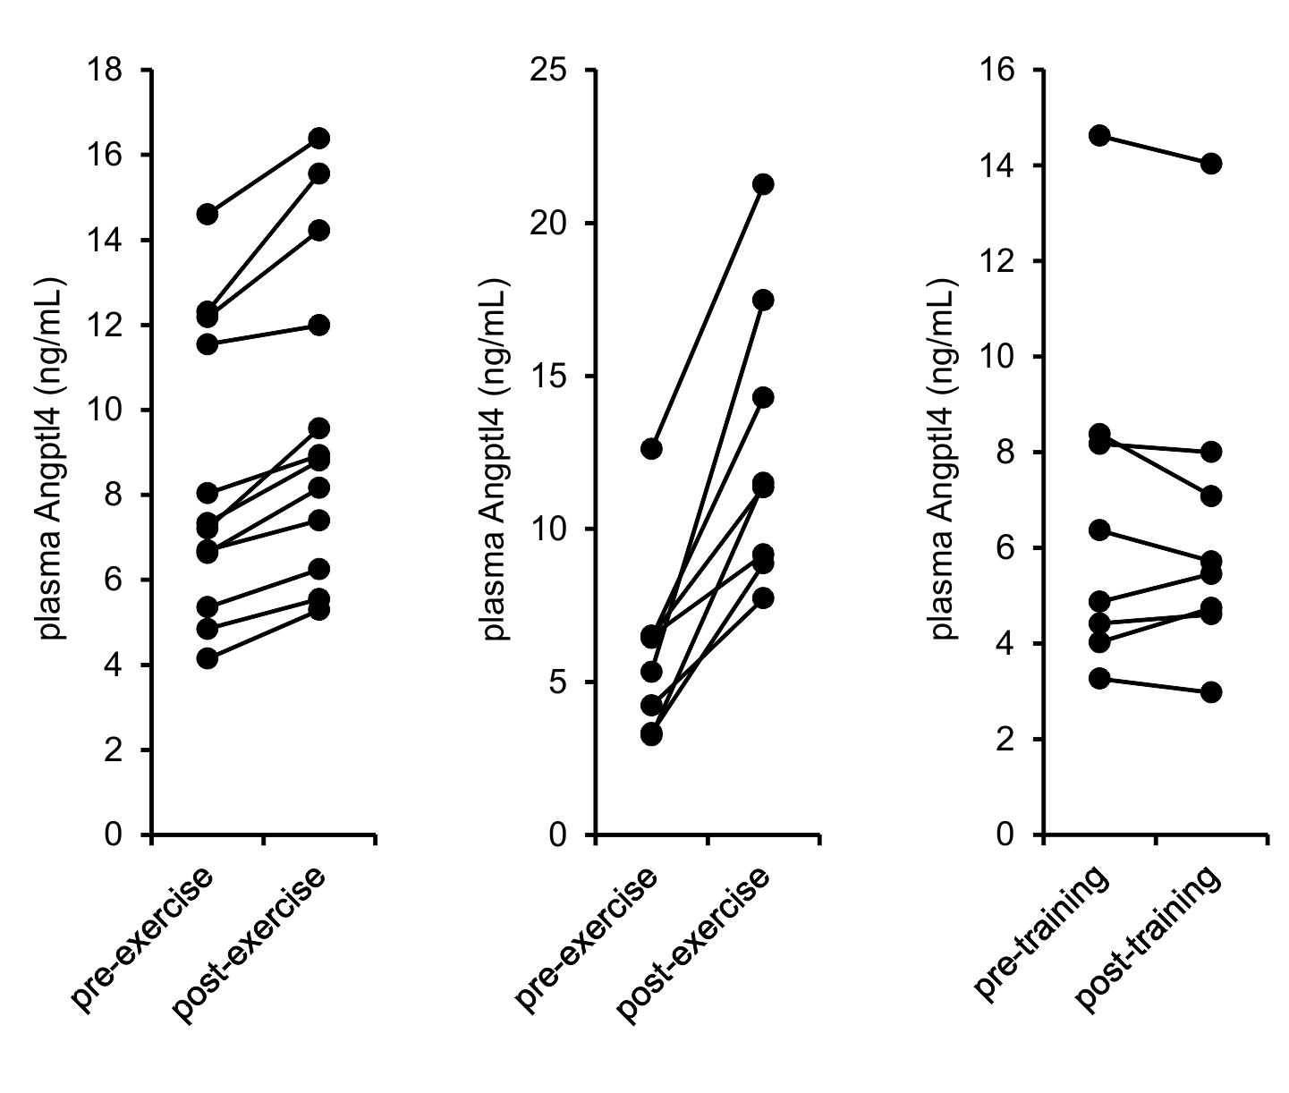
Acute exercise but not training induces
plasma ANGPTL4 levels
One leg Two legs

Slide 24
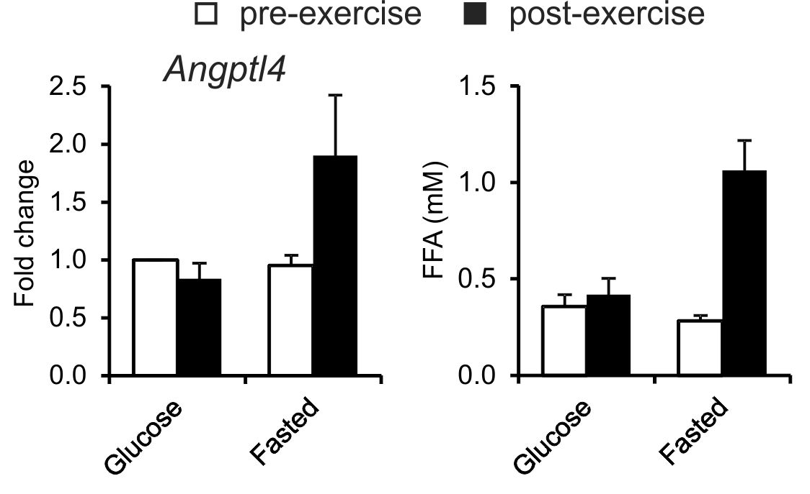
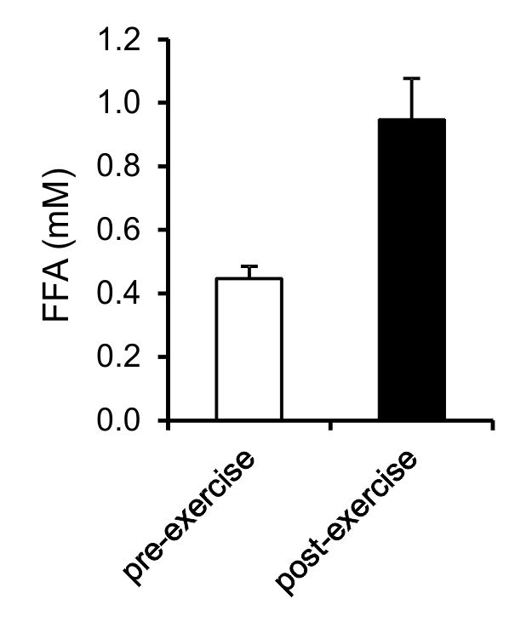
Angptl4 is induced by a circulating factor
*
*
*

Slide 25
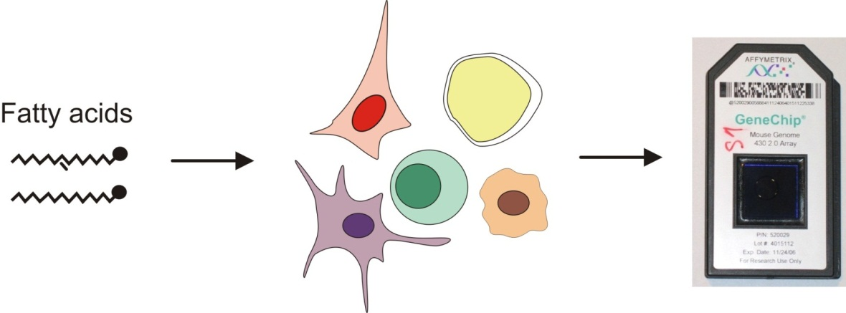
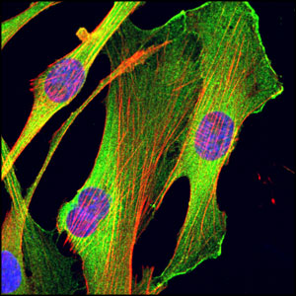
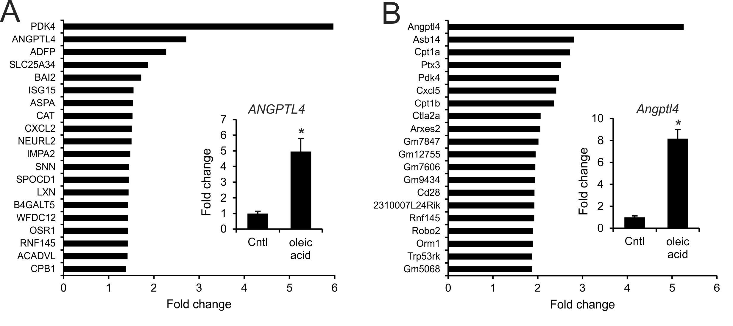
Angptl4 is highly induced by fatty acids
in cultured myotubes
Notes:
Oleic acid treatment in C2C12 cells

Slide 26
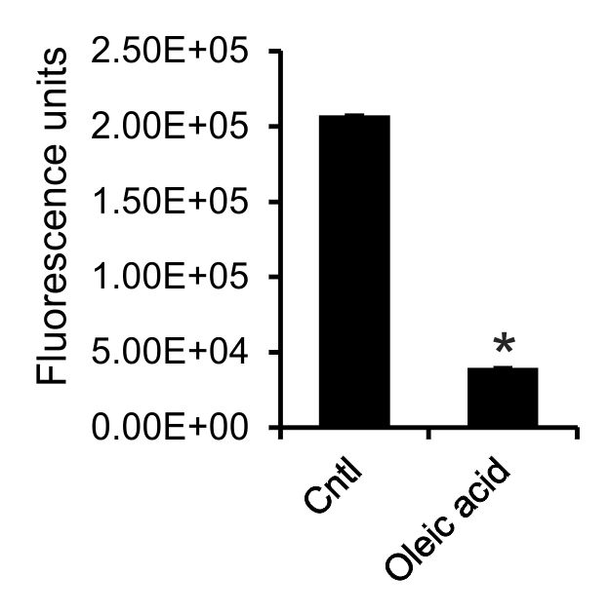
Angptl4 upregulation reduces LPL activity in vitro

Slide 27
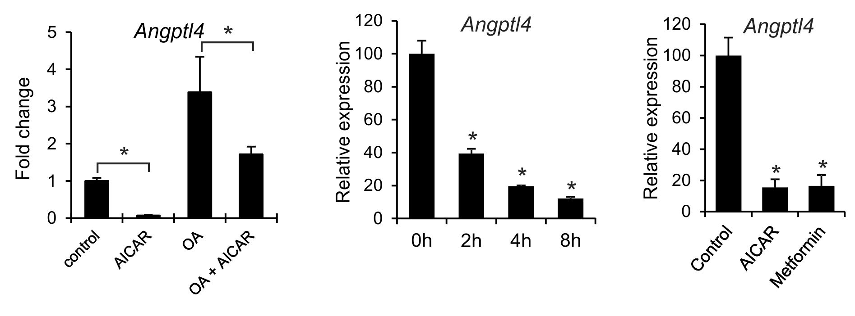
Suppression ANGPTL4 in exercising
muscle may be mediated by AMPK

Slide 28
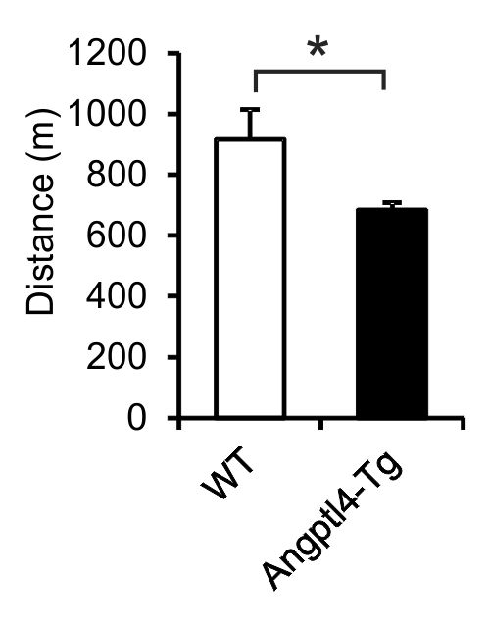
Exercise studies in Angptl4-transgenic
and wildtype mice
Angptl4 overexpression reduces plasma TG-derived fatty acid uptake into muscle during exercise

Slide 29
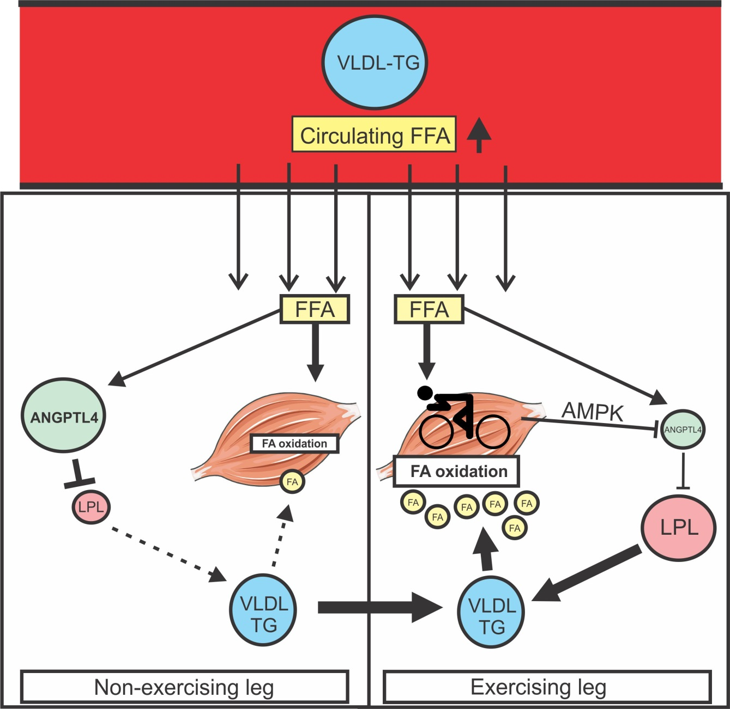
Angptl4 directs lipid fuels from
non-exercising to exercising muscle

Slide 30
Conclusions
GPIHBP1 and Angiopoietin-like proteins are important players in regulation of plasma lipoprotein levels
Angptl4 is a crucial regulator of LPL and consequent fat uptake in skeletal muscle and white adipose tissue

Slide 31








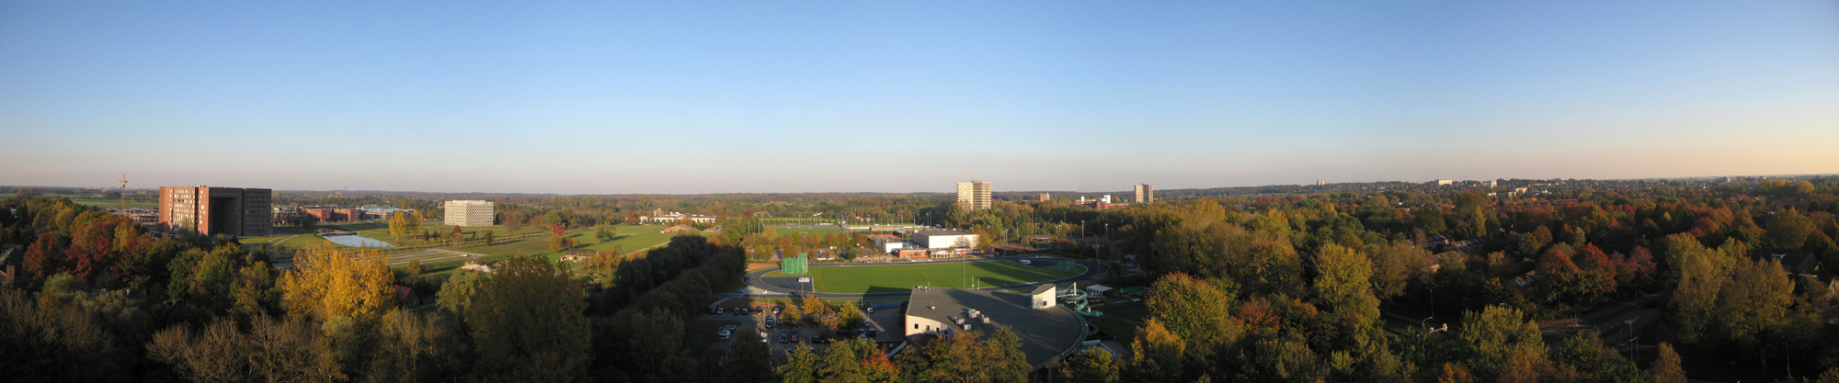
Wageningen University
Sheril Alex
Milene Catoire
Frits Mattijssen
Nicolas Paraskevupolos
Anastasia Georgiadi
Karin Mudde
Rinke Stienstra
Michael Müller
Leiden University
Patrick Rensen
Jimmy Berbee
Yanan Wang
Cornell University, USA
Ling Qi
Umea University, Sweden
Gunilla Olivercrona
Maastricht University
Patrick Schrauwen
Matthijs Hesselink
Utrecht University
Eric Kalkhoven
Nanyang Technological University
Nguan Soon Tan

