Slide 1
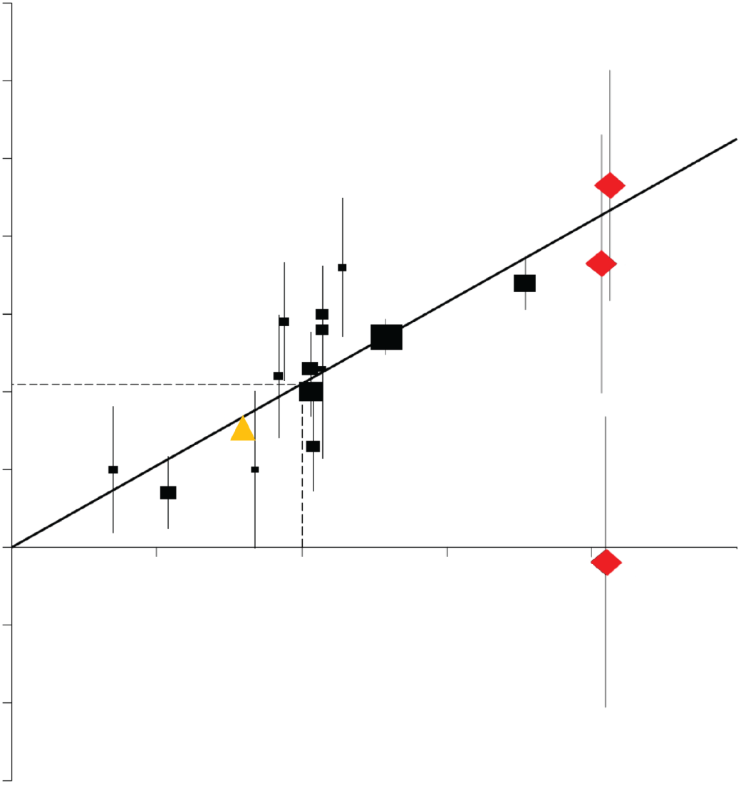
Proportionele reductie van grote ischemische complicaties per gemiddelde daling van de LDL-C in de SEAS & SHARP trials t.o.v in de CTT meta-analyse
60
50
SEAS T1
40
SEAS T2
30
SHARP
20
Proportional reduction in event rates (SE)
10
0
0.5
1.0
1.5
SEAS T3
-10
-20
-30
Reduction in LDL cholesterol (mmol/L)
Phan BA et al, Vasc Health Risk Manag. 2012;8:415-27

