Slide 1
CT angiografie
Cardiovasculair risicomanagement anno 2011
Mark Winkens
Tweesteden Ziekenhuis, Tilburg

Slide 2
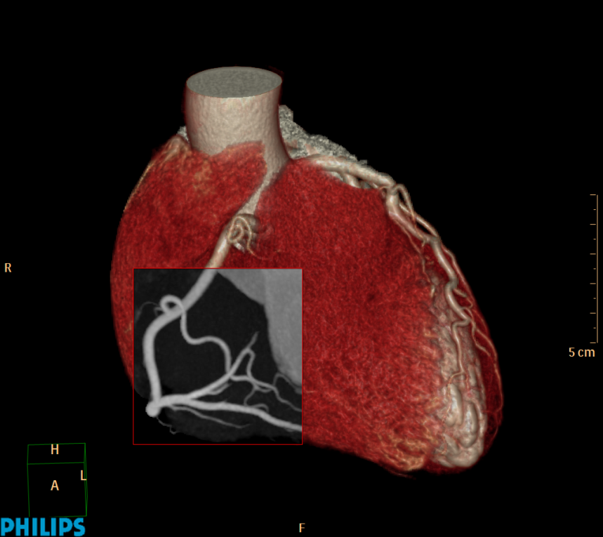
Casus
Vrouw 1956
VG: Hypercholesterolemie, Hypertensie
RF: Familiair belast
Rx: Simvastatine

Slide 3
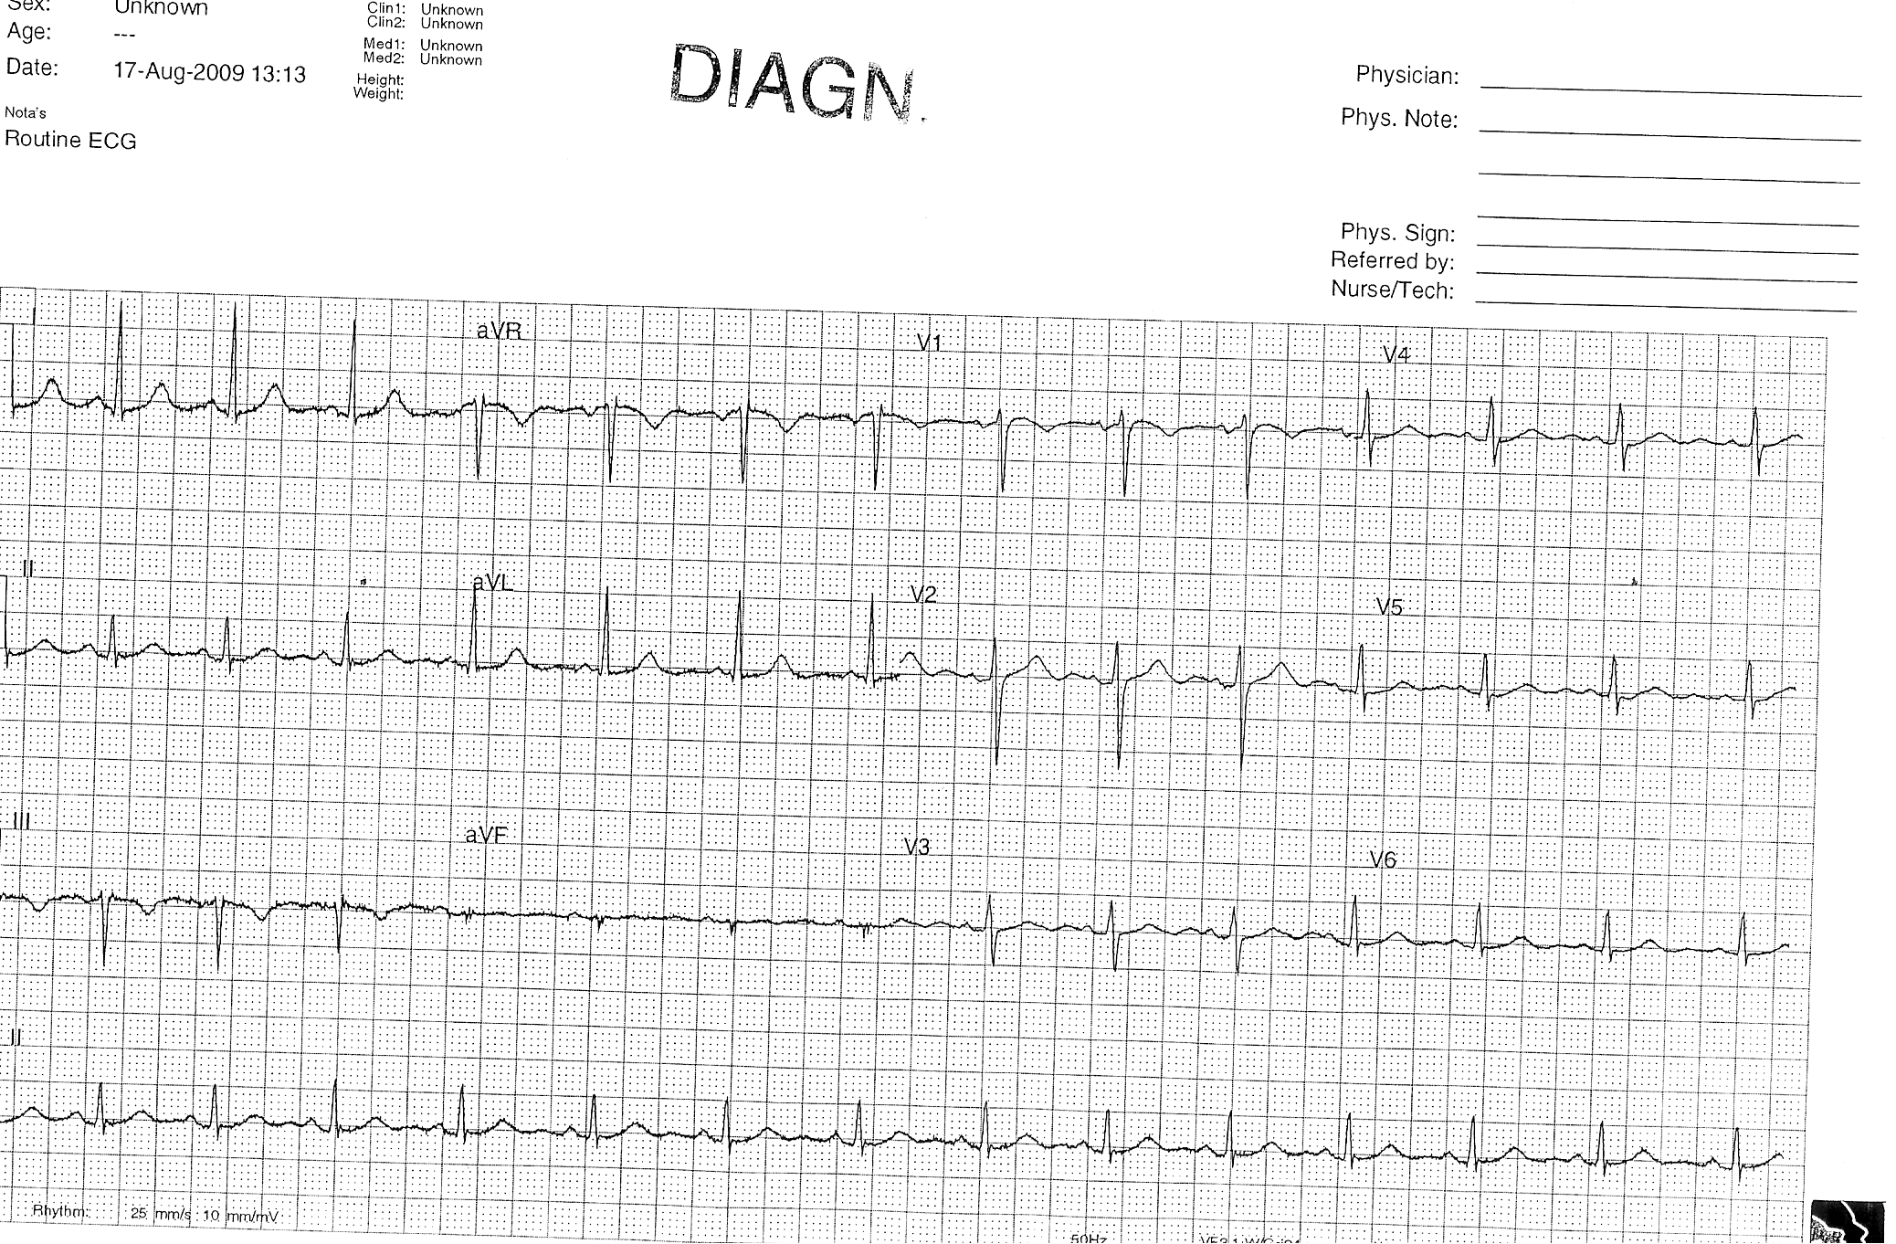
Casus
Presentatie EHH ivm zowel typische als atypische thoracale klachten
Lichamelijk onderzoek: RR 180/90 L=R, p 90 bpm, verder g.b.
Conclusie: deels typische deels atypische thoracale pijn bij 53 jarige vrouw
met verhoogd risicoprofiel en licht afwijkend ecg
lab: trop T < 0.01
Grace score 6 maanden dood of MI: 7%
Plan: direct Cardiale CT ter rule out coronairlijden

Slide 4

CT data collection
rotatie tijd 270 ms!!
X-ray tube
Detector array
At least 180 degrees of data are required for image reconstruction

Slide 5
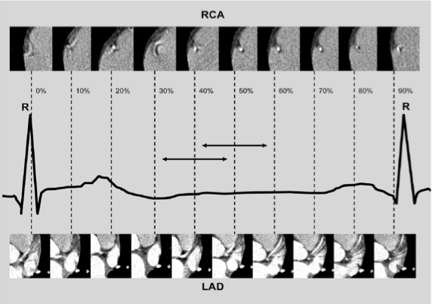

Slide 6
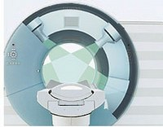
Multislice scanners (MSCT), multi detector (MDCT)
  combi met PET
  4-16-40-64-128-256-320 slice
  Philips, Toshiba, Siemens, GE
Dual source scanners (Siemens)
Toekomst:
  Dual layer scanners
  Dual energy scanners
  Spectral CCT

Slide 7

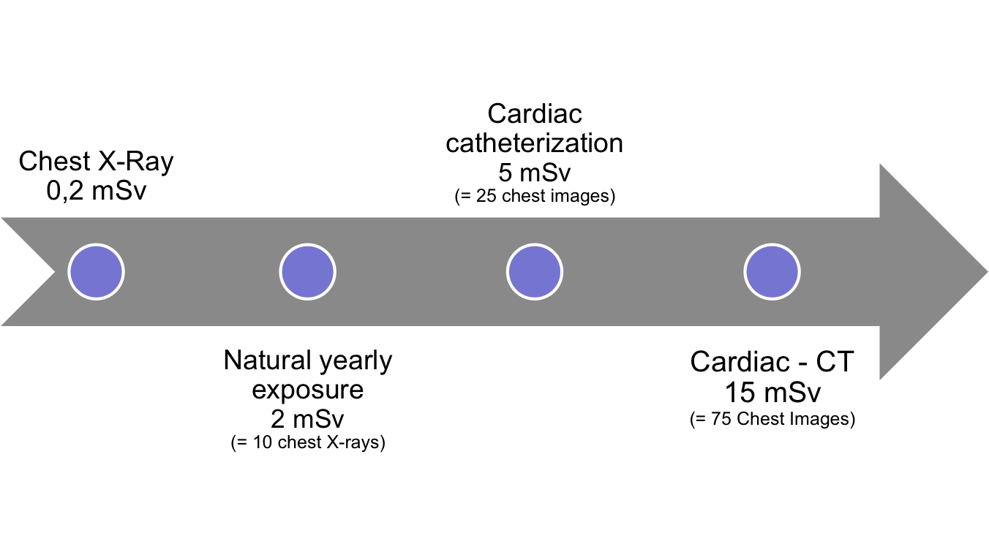
Dose exposure
Iterative reconstruction methods
0,6-2 mSv
high end
Cardiac - CTa
1-3 mSv
BU-CT, DACH, Gerold Krüger, Hamburg
Courtesy: Dr.O. Klass/Dr.M. Hoffmann
2
Notes:
Just to come back to reality I want to show you this slide. The mean dose exposure for a chest X-ray is 0.2 mSV. The natural yearly dose exposure in central europe is 2mSv.The dose exposure for cardiac catherization is 5 -8 mSV depending on the amount of positions the cardiologist needs. The dose exposure for a cardiac CT with helical scan mode is 15 mSV. This is still a lot and so we fully agree that it is very important to seriously check the indication of any kind of CT.

Slide 8
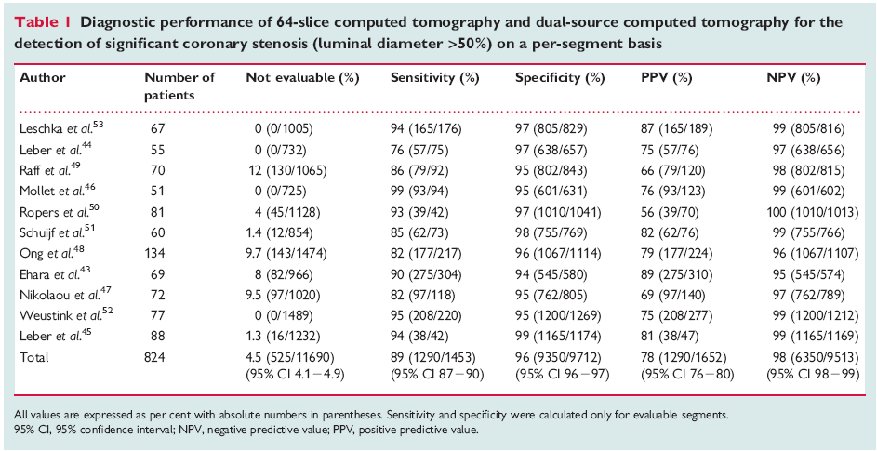
Current status in coronary artery imaging (64 slice)
tekst
CCT; indications, applications, limitations, and traing requirements
EHJ (2008) 29, 531-556

Slide 9
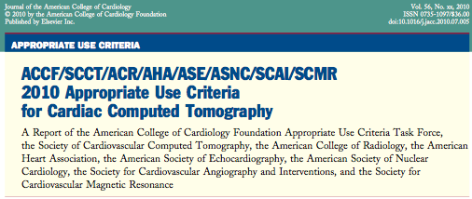


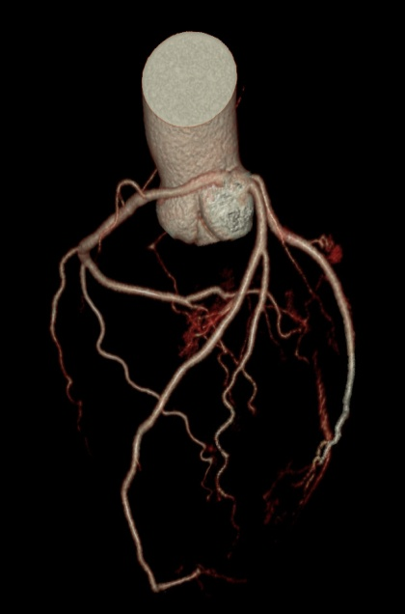

Slide 10

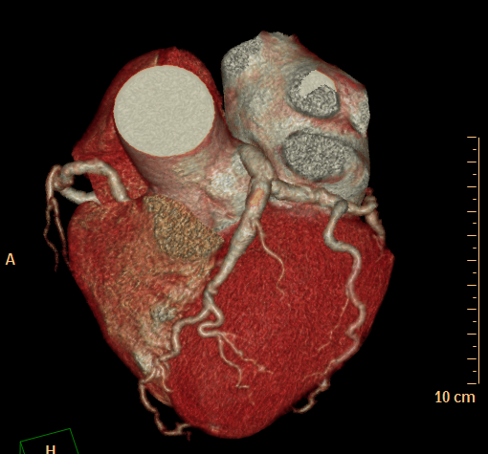
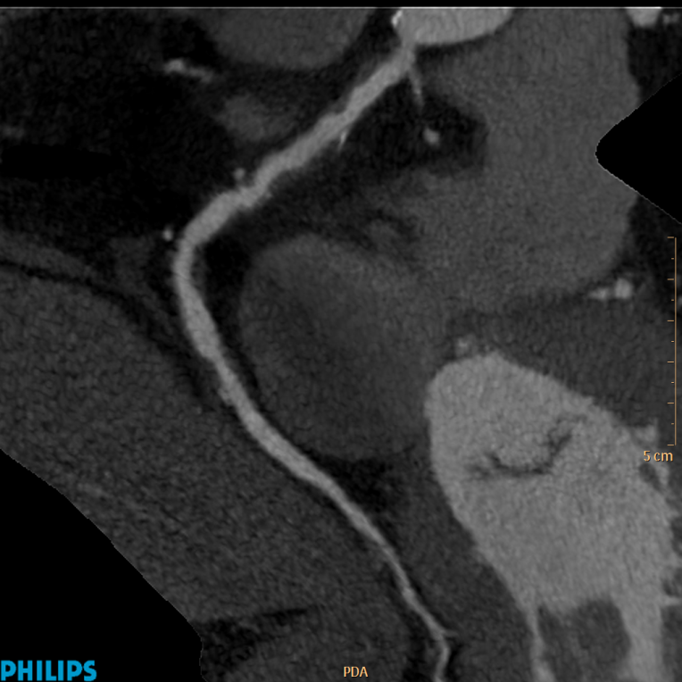
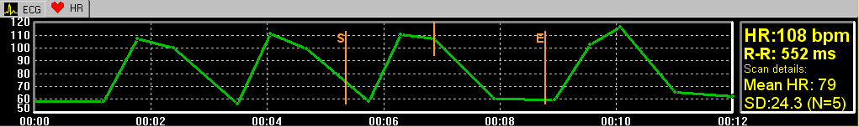
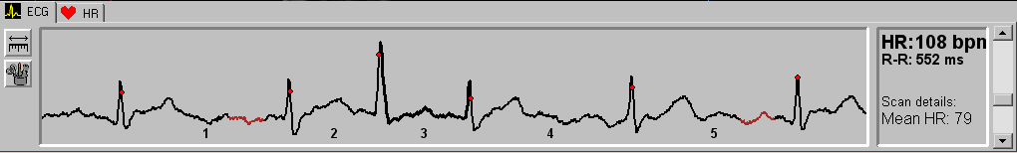
Images Courtesy of:
Medmar, Istanbul, Turkey
Current status : Low dose scanning @ higher HR with arrhythmia
128x0.625
RT 0.27s
S&S @40%
Scan Time 5s
Scan Length 12 cm
120kV, 200mAs
2.8mSv
3
3

Slide 11
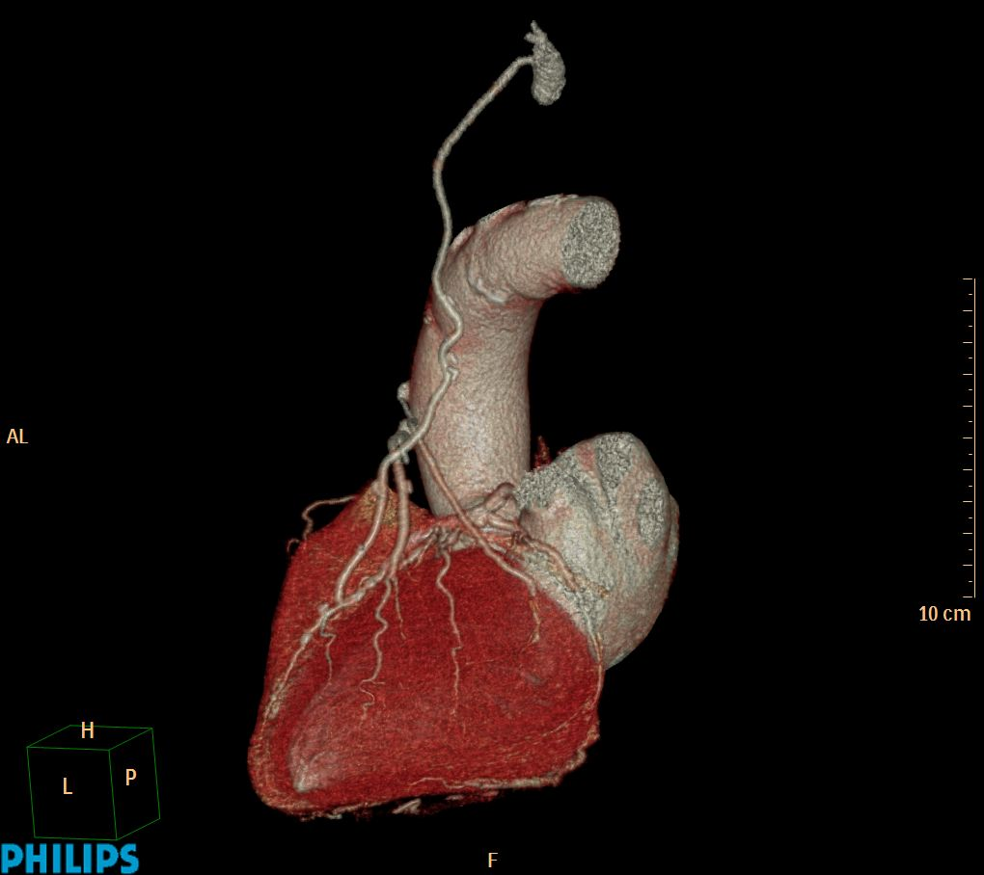
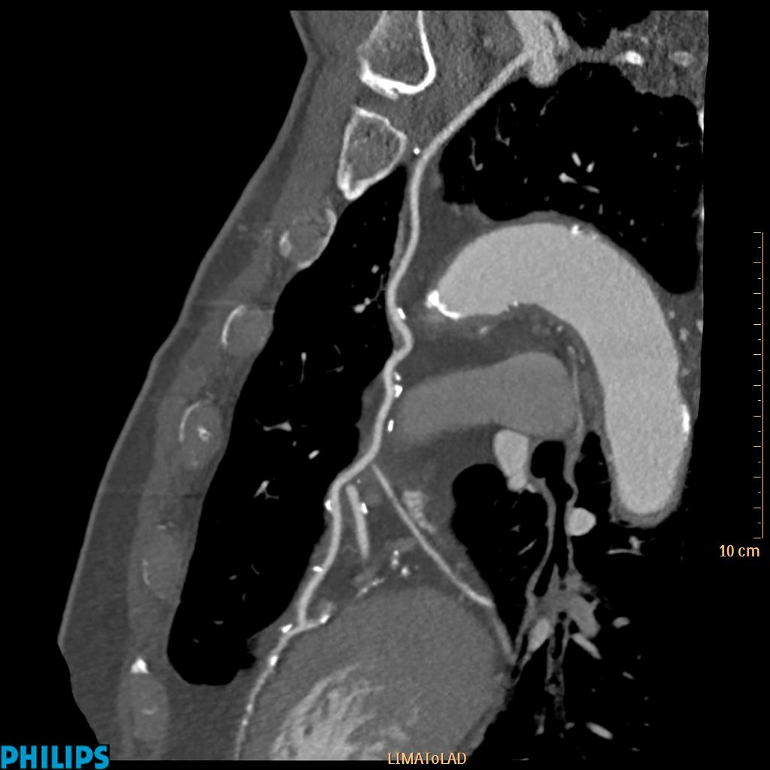
Excellent robust image quality
128x0.625
RT 0.27s
S&S no tolerance
Sharp kernel XCC
Scan Length 28 cm
100kV,150mAs

Slide 12

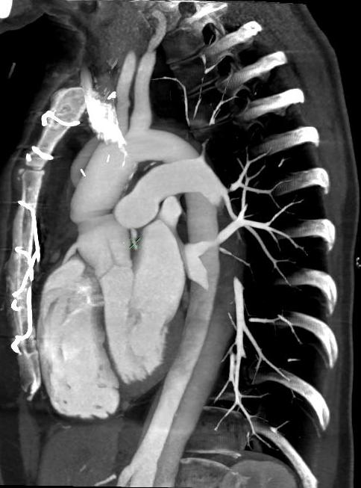
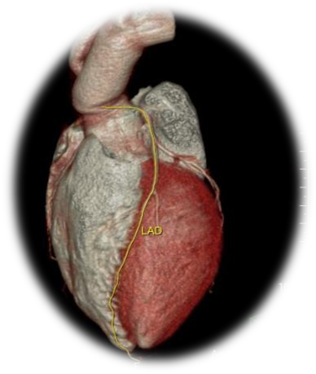
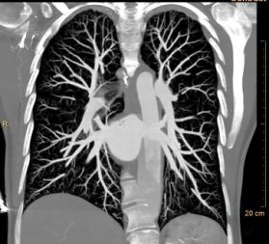

Chest Pain Assessment
1463 images reconstructed in 90 s!
“ Triple rule out”
20778
Acute chest pain, aortic dissection
①46 yrs
Brilliance iCT
    100 kVp
    Step & Shoot Complete
    Adaptive Collimation
    iDose⁴
    3.5 mSv
12
Notes:
Normal ECG, enzyme test negative…so what is the issue in this patient with acute chestpain : PE, Dissection or Coronary issues ?
S&S + iDose wipes the dose issue of the table ( dose was one of the main reasons why clinicians did not start immediately with this kind of protocol)
S&S works with HR up to 75, Flash needs a max of 60bpm…and Tosh has problems over 65bpm…so no real threat of the competitors here. GE is poor in coverage and dose and Tres….
Study shows a dissection of the Aorta as reason for the chestpain. No PE, no coronary lesions. One study shows it all !!! And @ only 3.5mSv….

Slide 13
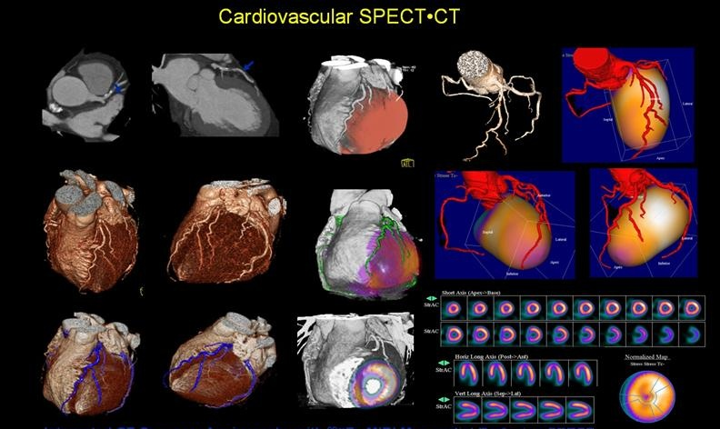
Fusion of Nuclear. Med and CT: PET and SPECT CT

Slide 14
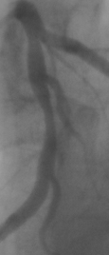
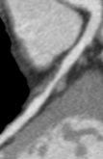
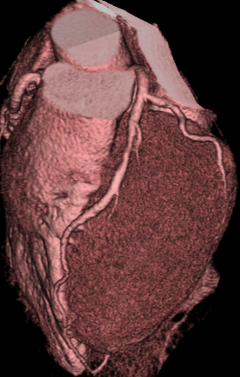
Cardiac CT
the (non invasive) athero burden read out of the future in your practice and research??

Slide 15
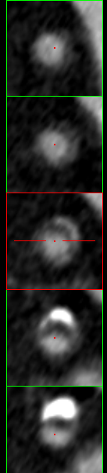
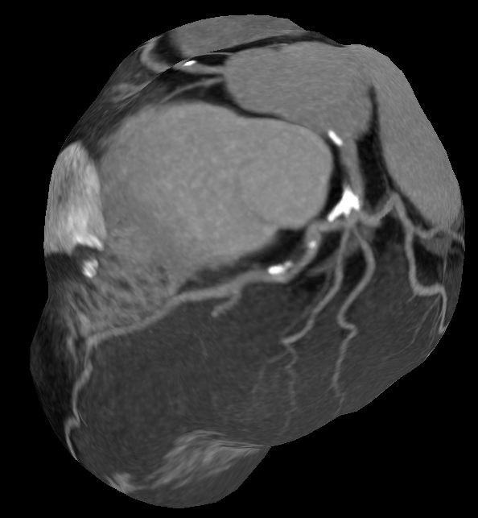
Accuracy of Plaque detection
Detection rate MSCT vs IVUS:
Soft Plaque:
83% (54/65)
Mixed Plaque:
94% (50/53)
Calcified Plaque:
95% (41/43)
Leber et. al. Accuracy of 64-slice computed tomography to classify and quantify plaque volumes in the proximal coronary system:
a comparative study using intravascular ultrasound. J Am Coll Cardiol, 47(3), 672-677, 2006.
Sample CT coronary angiogram
iCT
Correlation IVUS vs CT
quant: r² 0.6-0.8
Leber et. al. Accuracy of 64-slice computed tomography to classify and quantify plaque volumes in the proximal coronary system:
a comparative study using intravascular ultrasound. J Am Coll Cardiol, 47(3), 672-677, 2006.
Notes:
And also these images from the iCT show an improvement of the accuracy of plaque detection. According to Leber et al. there is a good correlation between IVUS and MSCT even at a 64 row scanner. They found that CT detected 83% of softplaques, 94% of mixed plaques and 95% of calcified plaques compared to IVUS.

Slide 16
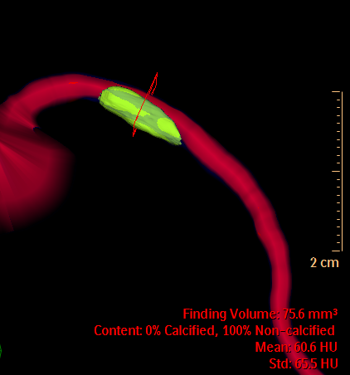
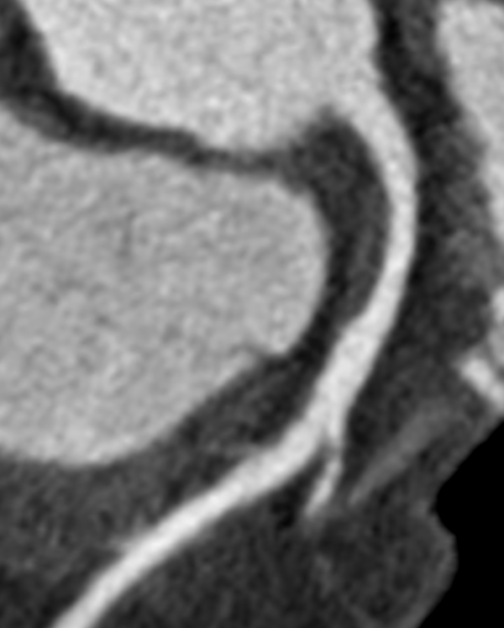
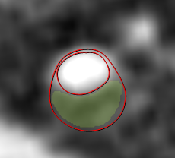
Klass et al.; Int J Cardiovasc Imaging 2010

Slide 17
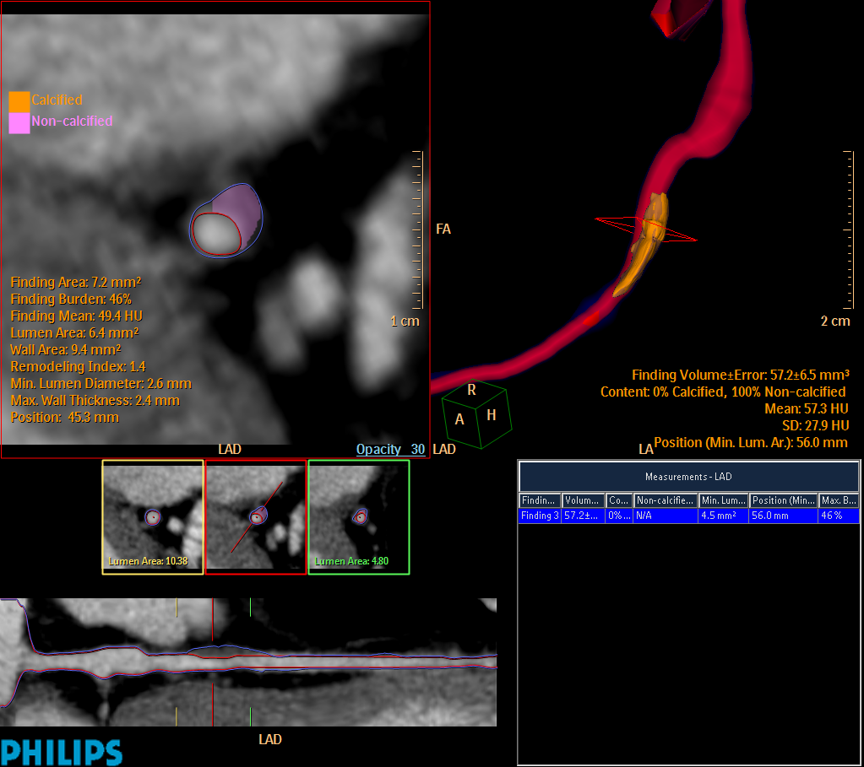
Plaque Imaging
Softplaque
2005
rule out indication
Notes:
For the next next scanner generation we are now equiped with a new software for plaque evaluation and volumetry. This might be very interesting for monitoring the total volume of soft plaque burden for e.g. to monitor a statin therapy. This srceen shot shows a single softplaque of the LAD. The histogramm below shows distribution of plaque components in terms of calcified or soft plaque tissue.

Slide 18
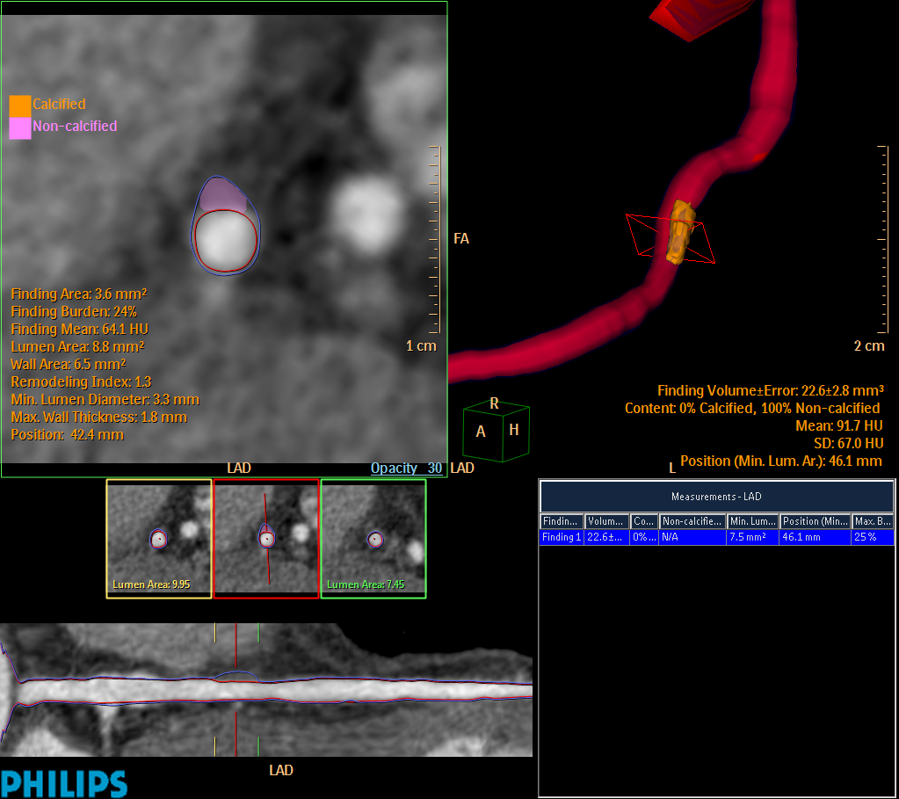
Plaque monitoring
Softplaque
2009
-after 4 years of statin therapy-
Notes:
For the next next scanner generation we are now equiped with a new software for plaque evaluation and volumetry. This might be very interesting for monitoring the total volume of soft plaque burden for e.g. to monitor a statin therapy. This srceen shot shows a single softplaque of the LAD. The histogramm below shows distribution of plaque components in terms of calcified or soft plaque tissue.

Slide 19
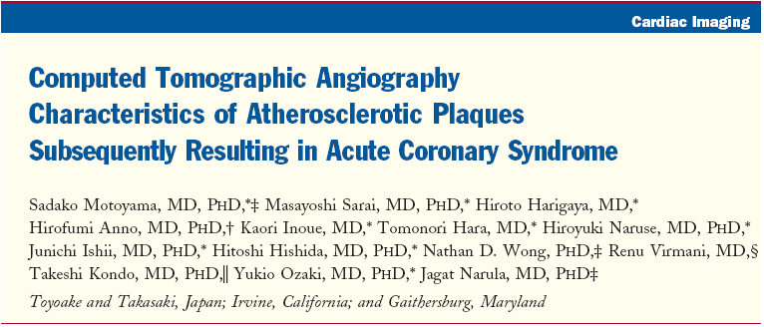
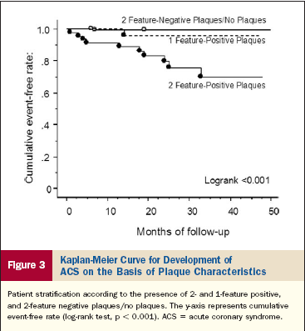
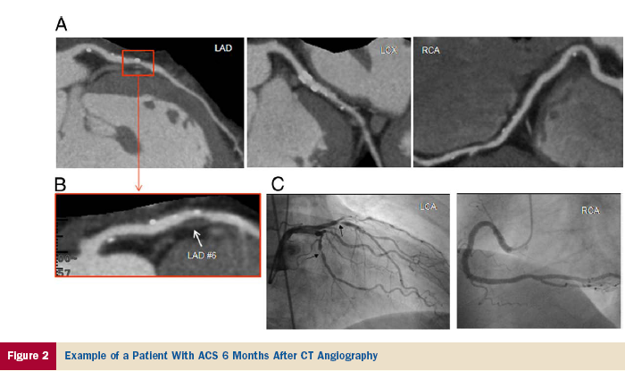
The High risk plaque
JACC july 2009

Slide 20
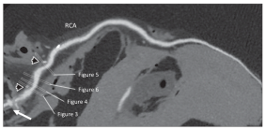
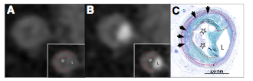
The Napkin-Ring Sign: the high risk coronary plaque?
JACC cv imaging Vol 3 No 4 2010 440-4: Maurovich, Hoffman, Virmani et al.

Slide 21
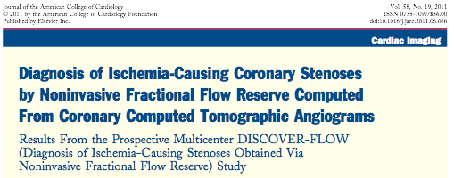
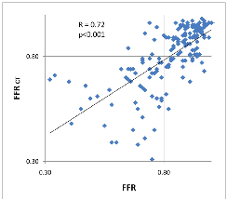
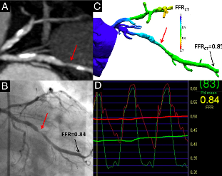

JACC vol. 58 no.19
nov 1 2011:1989-97

Slide 22
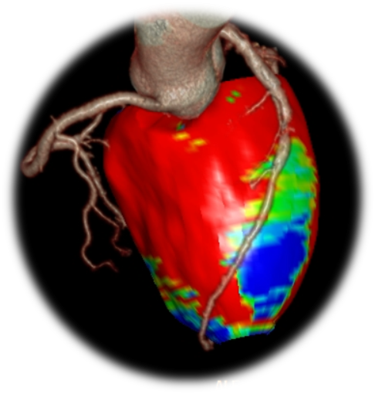
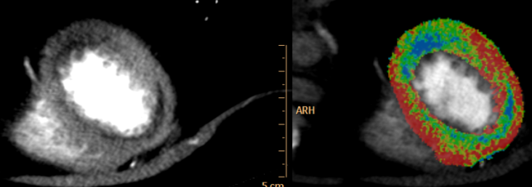
Improving Positive Predictive Value
Anatomy + Perfusion : One Stop Shop @ background radiation
5924
  Recurrent chest pain, old LAD stent
⓪ 42 yrs
Brilliance iCT
    100 kVp
    Step & Shoot
    iDose⁴
    3.0 mSv
    Myocardial Defect Assessment
tekst
22
Notes:
Physicians are looking for ways to improve pos. predictive value. Many C-CTA’s show a sign calc. plaque, which makes it impossible to rate it…
So you either can send the patient to the CATH ( which might be not needed…) or add an additional test for physiology…stress/rest MR or SPECT.
But this involves more modalities……it would be great if CT could do it all….
Large multi center trial started in USA to proof CT rest/stress static perfusion is as good as a SPECT or MR….
Case shows a defect in rest ( so an infarct), but more important to stress is that Intellispace Portal is ready for the ( near) future.

Slide 23
