Slide 1
TRACER: Design
NSTE Acute Coronary Syndromes
Key inclusion criteria
Within 24 hrs of symptoms
↑ biomarkers or ECG changes
1 other high-risk feature
1:1
Randomized
Double-blind
Placebo
Vorapaxar
Loading: 40 mg
Maintenance: 2.5 mg daily
Follow-up: 1, 4, 8, 12 months, then every 6 months
Standard of care based on practice guidelines
Efficacy Endpoints
Primary: CV death, MI, stroke, hospitalization for ischemia, urgent revascularization
Key Secondary: CV death, MI, stroke Bleeding Endpoints: GUSTO moderate or severe and clinically significant TIMI bleeding
Tricoci et al, P, N Engl J Med. 2011 Nov 13

Slide 2
TRACER: Primary Endpoint CV Death, MI, Stroke, Hospitalization for Ischemia, Urgent Revascularization
 | Placebo | Vorapaxar
2-year KM rate | 19.9% | 18.5%
HR (95% CI): 0.92 (0.85, 1.01)
P-value= 0.072
No. at risk
Placebo 6471 5844 5468 5121 3794 2291 795
Vorapaxar 6473 5897 5570 5199 3881 2318 832
Tricoci et al, P, N Engl J Med. 2011 Nov 13

Slide 3
TRACER:Key Secondary Endpoint
CV Death, MI, Stroke
 | Placebo | Vorapaxar
2-year KM rate | 16.4% | 14.7%
HR (95% CI): 0.89 (0.81, 0.98)
P-value= 0.018
No. at risk
Placebo 6471 5895 5575 5263 3922 2383 830
Vorapaxar 6473 5949 5684 5356 4023 2427 868
Tricoci et al, P, N Engl J Med. 2011 Nov 13

Slide 4
TRACER: Selected Efficacy Outcomes
 | Placebo (N=6471) | Vorapaxar (N=6473)
 | 2-yr KM rate (%) | 2-yr KM rate (%) | HR (95% CI) | P-value
Primary endpoint | 19.9 | 18.5 | 0.92 (0.85–1.01) | 0.072
CV death | 3.8 | 3.8 | 1.00 (0.83–1.22) | 0.96
MI | 12.5 | 11.1 | 0.88 (0.79–0.98) | 0.021
Stroke | 2.1 | 1.9 | 0.93 (0.70–1.23) | 0.61
Hospitalization for ischemia | 1.5 | 1.6 | 1.14 (0.83–1.58) | 0.42
Urgent revascularization | 3.5 | 3.8 | 1.07 (0.88–1.31) | 0.49
Stent Thrombosis* | 1.5 | 1.7 | 1.12 (0.78–1.62) | 0.54
All-cause mortality | 6.1 | 6.5 | 1.05 (0.90–1.23) | 0.52
*ARC definite or probable; data are proportions of patients
Tricoci et al, P, N Engl J Med. 2011 Nov 13

Slide 5
TRACER: Bleeding Endpoints
 | Placebo (N=6441) | Vorapaxar (N=6446)
 | 2-yr KM rate (%) | 2-yr KM rate (%) | HR (95% CI) | P-value
GUSTO moderate or severe | 5.2 | 7.2 | 1.35 (1.16–1.58) | <0.001
Clinically significant TIMI | 14.6 | 20.2 | 1.43 (1.31–1.57) | <0.001
GUSTO severe | 1.6 | 2.9 | 1.66 (1.27–2.16) | <0.001
TIMI major | 2.5 | 4.0 | 1.53 (1.24–1.90) | <0.001
Fatal | 0.15 | 0.35 | 1.89 (0.80–4.45) | 0.15
Intracranial hemorrhage | 0.24 | 1.07 | 3.39 (1.78–6.45) | <0.001
CABG-related TIMI major* | 7.3 | 9.7 | 1.34 (0.92–1.95) | 0.13
Tricoci et al, P, N Engl J Med. 2011 Nov 13
* data are proportions of patients

Slide 6
TRACER: Bleeding Outcomes
GUSTO Moderate/Severe
ICH
 | Placebo | Vorapaxar
2-year KM rate | 5.2% | 7.2%
 | Placebo | Vorapaxar
2-year KM rate | 0.24% | 1.07%
HR (95% CI): 3.39 (1.78, 6.45)
P-value <0.001
HR (95% CI): 1.35 (1.16, 1.58)
P-value <0.001
No. at risk
6441 5536 5137 4674 3393 1972 650
6446 5529 5108 4598 3278 1883 625
No. at risk
6441 5673 5281 4823 3511 2038 678
6446 5694 5272 4760 3411 1965 657

Slide 7
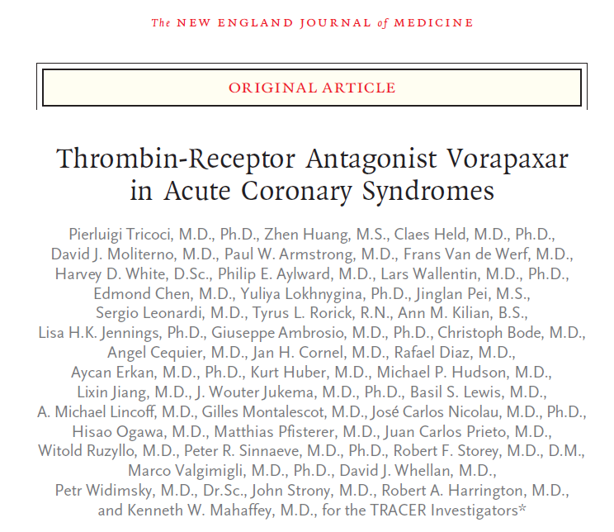
TRACER

