Slide 1



Cardiovascular Exchange Summit 2011
Genes for CV risk prediction & treatment: Fact or fiction?
^{Prof. Steve E. Humphries}
^{University College London}

Slide 2
NORTHWICK PARK HEART STUDY II
3012 healthy middle-aged men (50-61 years), 9 UK GPs
CHD free on entry, annual measures of lipids, clotting factors etc
BMI and smoking status assessed
Study in 15th year, CHD events assessed, >200 in first 10yrs
Risk Factor
Age (years)
BMI (kg/m²)
SYS (mmHg)
Chol (mmol/l)
ApoB (mg/dl)
ApoAI (mg/dl)
Tg (mmol/l)
Fibrinogen (g/l)
CRP (g/l)
Curr. Smoke
No CHD
56.0
26.4
137.7
5.71
0.87
1.61
1.99
2.75
2.26
28%
CHD
56.6
27.1
144.4*
6.13*
0.93*
1.57
2.29*
2.92*
3.29
42%
P value
0.007
0.01
<0.00005
<0.00005
0.002
0.06
0.001
<0.00005
<0.0004
0.0001
What % of these events do these risk factors predict?
Notes:
2

Slide 3
RISK SCORE METHODS - PROCAM/Framingham
Assign a value to each level of risk factor
Trait PROCAM F’Ham
    HDL score
    LDL score
    + Diabetes score
    Total for every subject
Age <55
55-59
>60
SYS <120
120-129
130-139
140-159
>160
Smoke No
Yes
+16
+21
+26
0
+2
+3
+5
+8
0
+8
+6
+8
+10
0
0
+1
+1
+2
0
+3
Risk
Of MI
What % of events does score predict in UK healthy men?

Slide 4
CRFs Predict Poorly in UK Middle-Aged Men
Cooper et al Athero 2004
Classical Risk factors - CRFs
Set Specificity at
5% False Positive
in no-CHD
14% of men who get
CHD have baseline
score over cut-off
Most events occur in men with “average” risk score
86% of the 10 year events not predicted by the CRF score !!.
Can we improve on this with Biomarkers or Genotypes?
Notes:
4

Slide 5
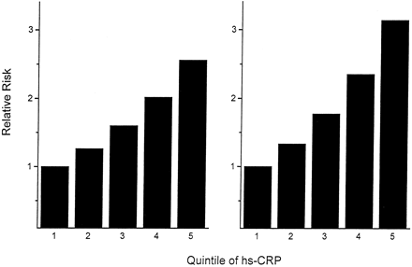
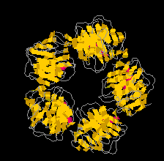
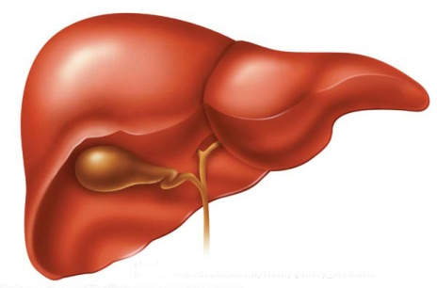
CRP : Origin, Clearance and Function
Hirschfield and Pepys, JCI 2003
CRP is a member of Pentraxin family –
Acute phase reactant - levels >1000 fold
Inflammation
IL-1
IL-6
Phosphocholine
Ridker Lancet 2001
Opsonisation
CRP
Complement fixation
Liver
Meta analysis Danesh et al 2001
1.4mg/l = RR 2.0
Clearance
(half-life 19h)
Bacterial cell wall
Apoptotic cells
Modified lipids
Binds β-VLDL
Men
Women
Will CRP improve prediction in NPHSII ?

Slide 6
Adding CRP to algorithm Risk Score in NPHSII
CRP highly predictive - Risk top vs bottom tertile 2.13
In Univariate analysis
Framingham + CRP score
AROC = 0.62
*
p < 0.0005
For 5% FPR
still only 14%
of events
*
0
* Adj for age and practice
CRP is highly correlated with factors already in algorithm such
as BMI and Smoking - doesn’t add over-and-above CRFs.
Can we improve on this with Genotypes?

Slide 7
Will genotype predict risk over-and-above trait
Genotype may influence Risk but
workıng through impact on trait
MANY
GENES
APOB/LDLR/
MTP/APOBEC
etc
SEVERAL
PROTEINS
eg ApoB,
LDL-R
CHD RISK
TRAIT
eg LDL-C
ATHERO
% Coronary
Stenosis
MI
Most genotypes will not
predict risk over-and-above
measures of cognate trait
Genes involved in traits NOT included in Framingham will be best

Slide 8
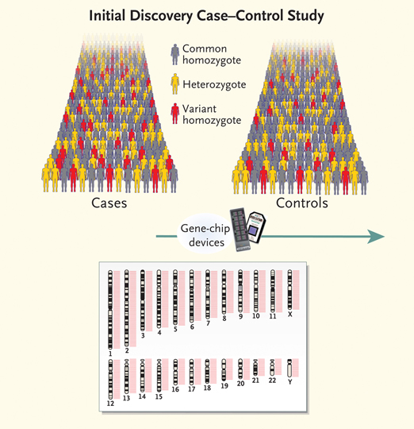

Genome Wide Scans – case control approach
Top-Down approach
Hypothesis free
Using a CHIP
can genotype
300,000-1 million SNPs
Have to set very low
p value since so many tests
Look for frequency difference
between cases and controls
Have to replicate effect
in second sample

Slide 9
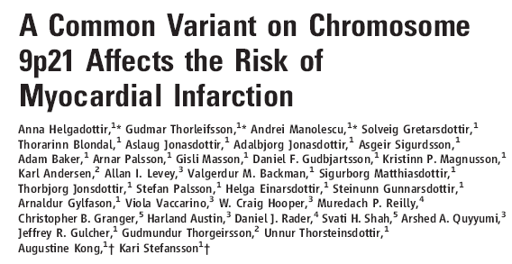
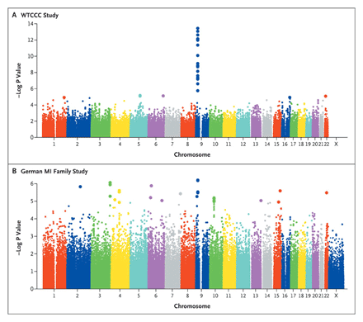
Major New “Gene” for MI/CHD Identified on Chromosome 9
Science 2007, Nature Genetics 2007
58Kb region near CDKN2A/2B – no annotated genes
Common SNPs strongly associated with risk
Compared to AA group AG OR = 1.3, GG OR = 1.6 Schunkert et al Circ 2008
No association with any CHD traits
(p < 0.00000000000000000001)
Will Chr9p21.3 genotype have clinical utility in genetic testing?
Notes:
9

Slide 10
Is Chr9 SNP CHD risk effect robust?
Talmud, et al Clin Chem 2008
Humphries et al Circ 2010
Genotyped NPHSII men
rs10757274
Study
Odds
%
HR for CAD for rs10757274
ID
ratio (95% CI)
Weight
Prospective
ARIC ¹²
1.17 (1.06, 1.28)
11.22
OHS3 ¹²
1.33 (1.15, 1.54)
9.24
CCHS ¹²
1.16 (1.08, 1.26)
11.75
Total/CAD
GG [564/73]
DHS ¹²
1.34 (1.04, 1.72)
5.72
Rotterdam study ⁷⁸
1.03 (0.90, 1.18)
9.61
NPHS II ²⁸
1.28 (1.07, 1.53)
7.96
-
FH ⁷
1.39 (1.14, 1.69)
7.43
WGHS ²⁹
1.16 (1.02, 1.32)
9.84
Subtotal (I
squared = 37.4%, p = 0.131)
1.20 (1.13, 1.27)
72.76
.
AG [1186/138]
Case
control
-
1.69 (1.35, 2.12)
6.57
p = 0.04 adj for age, Chol, TG, BMI, SYS smoke
OHS1 ¹²
1.46 (1.17, 1.82)
6.63
OHS2 ¹²
1.78 (1.46, 2.18)
7.24
AA [680/53]
GeneQuest ⁷⁹
1.25 (1.01, 1.55)
6.81
Verona Heart Project ⁸⁰
1.53 (1.31, 1.80)
27.24
Subtotal (I
squared = 54.0%, p = 0.089)
.
1.29 (1.19, 1.40)
100.00
Overall (I
squared = 70.2%, p = 0.000)
1
1.5
2
2.5
1
NOTE: Weights are from random effects analysis
Effect size confirmed in UK
Effect consistent and cross ethnic groups
Does it add to prediction over-and-above CRFs?
Notes:
10

Slide 11
ROC to test predictive power
Commonly used metric to determine predictive power is
Area under the Receiver Operator Curve (A_{ROC})
ROC curve
100
75
True positive
50
25
Good prediction
No prediction
0
0
25
50
75
100
False positive
A_{ROC} 1.00 - perfect
A_{ROC} 0.50 - chance

Slide 12
Chr9 SNP and Risk Prediction in NPHSII men
Assessed predictive power by AROC
Talmud, et al Clin Chem 2008
Framingham
+ Chr 9
AROC Framingham = 0.62 (0.58-0.66)
AROC F’ham + Chr 9 = 0.64 (0.60-0.68)
i.e. a 3% improvement p = 0.14
Framingham
Just as with single classical risk factors, no single SNP is clinically useful
Need to use several SNPs in combination
Notes:
12

Slide 13
SEVEN GWAS SNPs FOR CHD RISK IDENTIFIED
July 2007 – Dec 2010, 9 different GWAS identified and replicated CHD-risk SNPs.
Risk allele
freq.
Nearest
Gene
WTCCC 2007
McPherson 2007
Helgadottir et al 2007
Samani et al, 2007
Willer et al 2008
Samani et al 2009
Kathiresan et al 2009
Erdmann et al 2009
Gudbjartsson et al 2009
Chr 9p 0.47 CDKN2A/B
Chr 1p 0.81 CELSR2
Chr 10q 0.84 CXCL12
Chr 3q 0.20 MRAS
Chr 1q 0.72 MAI3
Chr 12q 0.49 SH2B3
Chr 6q 0.26 MTHFDIL
Effect size modest
But allele freq high
Gene Function ?? Functional SNPs ?
Even without this knowledge we can use these in risk prediction

Slide 14
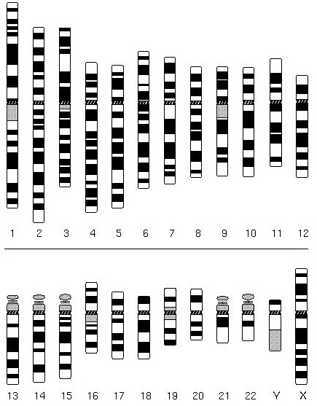
Current CHD GWAS loci
Cardiogram/C4D SNPs
Lipid Gene SNPs
Early GWS SNPs
PPAP2B
PCSK9
ANKSIA
LPL
KIAA146
SORT1
9p21
CXCL12
MRAS
DAB2IP
TCF21
ZC3HC1
CYP17A1
APOA5
ABO
HNF1A
WDR12
MTHFDIL
LIPA
SH2B3
MIA3
LPA
SMG5
LDLR
RASD1
APOE
CETP
UBE2Z
SMAD3
COL4A1
HHIPL1
ADAMTS7
Risk alleles common but all have modest effect – OR 1.3 -1.1

Slide 15
Combining Modest-Risk Genotypes – Gene Score
Used 13 meta-analysis proven candidate gene SNPs,
Casas et al Annals Hum Genet 2006
APOB, APOE, CETP, LPL, PCSK9, APOA5, ACE, PAI1, ENOS, LPA
Added 7 GWAS SNPs
Determined 20 SNP genotype frequency distribution
Determined combined risk over and above Framingham
Genes involved in lipid metabolism, clotting, endothelial function, etc
Constructed a simple “Gene score”
At each SNP score = 0 for no risk allele, = 1 for carrier = 2 for Hoz
Assumes equal and additive effects
NPHS-II → complete data in 1389 men → 150 CHD events
Notes:
15
15

Slide 16
Distribution of Risk alleles in NPHSII men
Distribution
Hazard Ratio
250
F’ham
F’ham +GS
200
Hazard ratio per risk allele carried
1.12 (1.04-1.20) p=0.003
150
Frequency
100
50
0
5
10
15
20
25
Genescore
Medium number of risk alleles
carried = 15 (range 8-22)
AROC increases sig (p = 0.04)
0.66 (0.61-0.70) → 0.68 (0.63-0.72)
In men at intermediate risk gene score →
Significant Net 12% improvement in reclassification

Slide 17

Where is the rest of the Genetic contribution ?
Heritability estimate of CHD are 45-55%
40% still to be explained
GWAS identified genes
→ 10-20% of predicted heritability
Identified SNPs explain
only 10% of CHD risk
Environment 50%
Are heritability estimates from twins accurate?
Gene:Gene or gene:enviroment interactions
Dont have robust way of detecting this in GWAS
Other forms of genetic variants unconsidered
Differential methylation- epigenetic effects (Barker)
Copy Number Variations
Additional new genes? (effect size even smaller)
Rare mutations of large effect (not identified by SNPs)
BUT how to identify “important” functional changes??
At the discovery phase – Still lot to learn
Notes:
17
17

Slide 18
ELSI - Risk Perception and Behaviour Change
Aim of screening, testing and clinical management - find those at high risk and get them (scared enough) to change behaviour.
Quit Smoking, loose weight
change diet, take pills
Statin adherence → better outcome.
UK, n=6000, 5 yrs, Post MI
those with >80% adherence → RR
recurrent MI = 0.19 vs non- adherent.
Wei et al Heart 2006
Benner JAMA 2002, Jackevicius JAMA 2002
34,501 elderly US patients
Two year adherence
Biomarker Risk Information
Inadequate behaviour change
If DNA information motivates
patient to maintain drug use
will be clinically useful!

Slide 19
CARE PATHWAY FOR CARDIOVASCULAR RISK CLINIC
General Practice
Cardiology
REFERRAL
Patient Appointment
Saliva sample request + Informed consent
Genetics
Laboratory
20 SNPs
Clinical Chem
T-Chol/HDL/TG
Lp(a)? etc?
CLINIC VISIT
Results
RISK SCORE
Results
RISK SCORE + BMI/BP/Smoke
Blood Pressure
Lowering
Lipid
Lowering
ACTION PLAN
Smoking
Cessation
Weight
Loss
Diabetes
Referral
Retest In 12 months
Cardiology
Referral

