Slide 1
SATURN: Objective
To compare the effects of rosuvastatin 40 mg versus atorvastatin 80 mg on progression of coronary atherosclerosis assessed by intravascular ultrasound.

Slide 2
SATURN; Study Design
1385 patients with symptomatic CAD (angiographic stenosis >20%)
LDL-C with (>80 mg/dL) or without (>100 mg/dL) statin use last 4 weeks
Atorva 40 mg
Rosuvastatin 40 mg (n =694)
Rosuva 20 mg
Atorvastatin 80 mg (n=691)
Visit:
Week:
1
–4
2
–2
3
0
4
13
5
26
6
39
7
52
8
65
9
78
10
91
11
104
IVUS
Lipids
Lipids
Safety
Safety
Lipids Safety
Safety
Safety
Lipids Safety
Lipids Safety
Safety
IVUS
Lipids
Safety
Screening Period
Randomization Period

Slide 3
SATURN Trial: Flow of Patients
4255 patients screened and 1578 patients treated at
centers in North America, Europe, South America and Australia
Treatment for 2 weeks with atorvastatin 40 mg or rosuvastatin
20 mg for 2 weeks to achieve LDL-C <116 mg/dL
Atorvastatin 80 mg (n=691)
24 months treatment
Rosuvastatin 40 mg (n=694)
346 (25%) patients withdrew or did not have an evaluable final IVUS
Follow-up IVUS of originally imaged “target” vessel (n=1039)

Slide 4
SATURN: Clinical Characteristics
Parameter | Atorvastatin (n=519) | Rosuvastatin (n=520)
Mean age in years | 57.9 | 57.4
Males | 74.4% | 72.9%
Median Body Mass Index | 29.2 | 28.9
History of Hypertension | 70.7% | 70.0%
History of Diabetes | 16.8% | 13.8%
Prior Statin Use | 61.5% | 58.3%
Concomitant Medications
Anti-platelet Therapy | 97.9% | 97.5%
Beta-blockers | 61.1% | 60.6%
ACE Inhibitors | 44.5% | 43.5%
Angiotensin Receptor Antagonists | 15.8% | 16.7%

Slide 5
SATURN: Time-Weighted Lipid Levels and hsCRP
Parameter | Atorvastatin (n=519) | Rosuvastatin (n=520) | P Value
LDL cholesterol (mg/dL) | 70.2 | 62.6 | <0.001
HDL cholesterol (mg/dL) | 48.6 | 50.4 | 0.01
Triglycerides (mg/dL)* | 110 | 120 | 0.02
LDL:HDL cholesterol | 1.5 | 1.3 | <0.01
hsCRP (mg/L)* | 1.0 | 1.1 | 0.05

Slide 6
SATURN: Primary IVUS Efficacy Parameter
Median Change Percent Atheroma Volume
P=0.17†
Change Percent Atheroma Volume
-0.99
P<0.001*
-1.22
P<0.001*

Slide 7
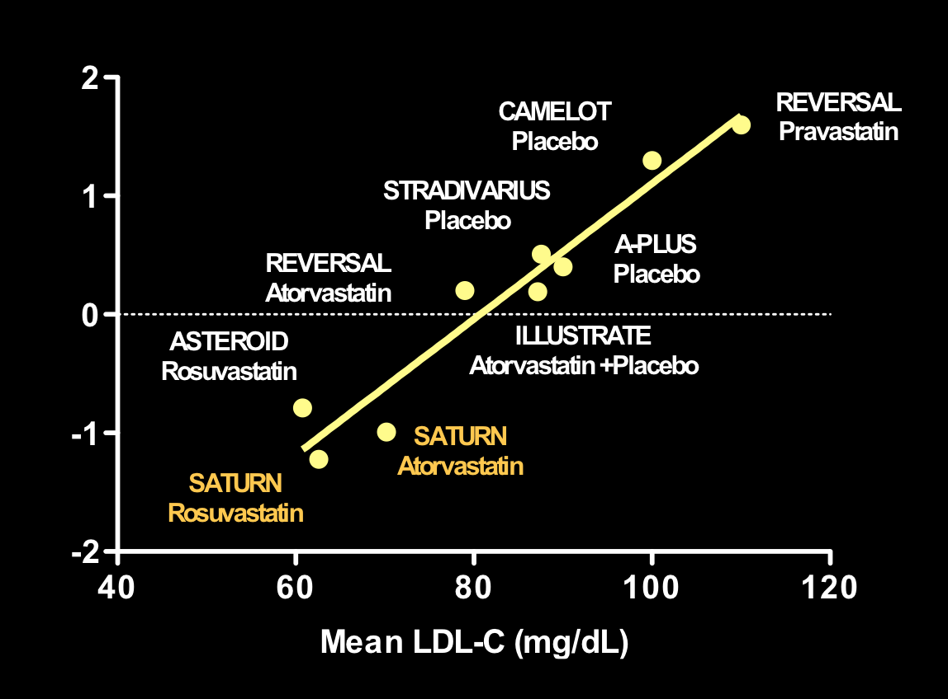
LDL-C and Disease Progression
Median Change Percent Atheroma Volume

