Slide 1
LDL and cardiovascular disease: Latest insights
MSD minisymposium
John Kastelein
Academisch Medisch Centrum
Amsterdam

Slide 2
New Approaches to LDL Reduction and HDL Increase
What is in development?
Cholesterol Absorption Inhibitors
Cholesterol Ester Transfer Protein (CETP) inhibitors
ER-Niacin / Laropiprant combination
Squalene Synthase (SSI) inhibitors
Apo B mRNA antisense drugs
Microsomal Triglyceride Transfer Protein (MTP) inhibitors
Acyl Coenzyme A AcylTransferase (ACAT) inhibitors
DiacylGlycerol AcylTransferase (DGAT) inhibitors
Thyroxin Receptor Agonists
ApoA1 based strategies

Slide 3
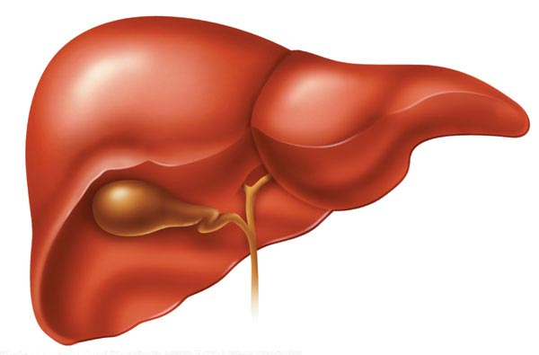
Ezetimibe strongly increases TICE
bile
Control
Ezetimibe
Control
Ezetimibe
TICE
(re)absorption
Diet
Feces
Control
+ Ezetimibe
Control
Ezetimibe
Control
Ezetimibe

Slide 4
Prospective Clinical Events Trials Examining the Effects of Statins in ESRD Patients
(Transplant or Dialysis)
Notes:
4

Slide 5
Graded and Independent Relationship Between Estimated Glomerular Filtration Rate (GFR) and CVD Outcomes*
Shastri S et al. Am J Kidney Dis. 2010 Jul 2. [Epub ahead of print].

Slide 6
4D Study: Effects of Atorvastatin on Cardiovascular Events in Patients with Type 2 Diabetes Mellitus Undergoing Hemodialysis - Study Design
Patients with Type 2 diabetes mellitus (N=1255)
Inclusion criteria:
  Pts 18-80 yrs receiving
  hemodialysis <2 yrs
Exclusion criteria:
  Fasting serum LDL< 80 mg/dL
  or >190 mg/dL
  Triglyceride > 1000 mg/dL
  Liver function >3× ULN
  Hematologic disease
  Disease unrelated to ESRD
  Vascular intervention, CHF or
  MI < 3 months before enrollment
  Unsuccessful kidney transplant
  Hypertension resistant to therapy
R
A
N
D
O
M
I
Z
E
n=619
Atorvastatin
(20 mg/day)
Placebo
n=636
Primary endpoint: A composite of death from cardiac causes, nonfatal MI, and stroke
Secondary endpoints: Death from all causes and total cardiac and cerebrovascular events
Wanner C et al. N Engl J Med. 2005;353(3):238–248.

Slide 7
4D Study: Cumulative Incidence of Primary Composite Endpoint
Placebo
Atorvastatin
Hazard ratio: 0.92; 95% CI 0.77-1.10;
P=0.37
Primary endpoint: composite of death from cardiac causes, nonfatal MI, and stroke.
Median follow-up on the placebo and atorvastatin group was 4.0 yrs and 4.08 yrs, respectively
Wanner C et al. N Engl J Med. 2005;353(3):238–248.
Notes:
7

Slide 8
AURORA Study: Objectives and Endpoints
Primary endpoint
  Time to a major cardiovascular event
    Cardiovascular death, fatal myocardial infarction or non-fatal stroke
Secondary endpoints
  All-cause mortality, cardiovascular event-free survival, cardiovascular death, noncardiovascular death, procedures as a result of stenosis or thrombosis of the vascular access for chronic hemodialysis, and coronary or peripheral revascularizations
Tolerability of rosuvastatin in ESRD patients
  Health economic impact of rosuvastatin treatment
Fellström B et al. Curr Control Trials Cardiovasc Med. 2005;6(1):9.
Notes:
Primary endpoint
Time to a major cardiovascular event
Cardiovascular death, fatal myocardial infarction or non-fatal stroke
Secondary endpoints
All-cause mortality, cardiovascular event-free survival, cardiovascular death, noncardiovascular death, procedures as a result of stenosis or thrombosis of the vascular access for chronic hemodialysis (arteriovenous fistulas and grafts only), and coronary or peripheral revascularizations
Tolerability of rosuvastatin in ESRD patients
Health economic impact of rosuvastatin treatment
Tertiary objectives
Efficacy of treatment at 3 and 12 months post-randomization on high sensitivity C-reactive protein (hsCRP) and various fasting lipid parameters
TC, LDL-C, HDL-C, non-HDL-C, TC/ HDL-C, LDL-C/HDL-C, triglycerides, Apo B, Apo AI, Apo B/Apo AI ratio, and oxidized LDL
Lipid profile changes
24 months, 36 months (yearly as required) and at the final visit
Subgroup studies and optional genetic studies
Analysis of biomarkers of cardiovascular risk

Slide 9
AURORA Study Design
Screening
Treatment
Month
Visit
-14 days
1
0
2
3
3
6
4
12
5
Every 6 months
6
Final Visit
Rosuvastatin (10 mg/day)
~2,750
patients
Randomization
(1:1)
Placebo
Fellström B et al. Curr Control Trials Cardiovasc Med. 2005;6(1):9.
Notes:
9

Slide 10
AURORA Study: Cumulative Incidence of Primary Endpoint
40
Cumulative Incidence of the Primary Endpoint (%)
35
Placebo
Rosuvastatin
30
25
20
15
Hazard ratio, 0.96
P=0.59
10
5
0
0
1
2
3
4
5
Years since randomization
No. at Risk
Placebo 1384 1163 952 809 534 153
Rosuvastatin 1390 1152 962 826 551 148
Fellström BC et al. N Engl J Med. 2009;360(14):1395-1407.

Slide 11

The results of the Study of Heart and Renal Protection (SHARP)
Disclosure: SHARP was sponsored, designed, run, and analysed by the University of Oxford. Funding was received from Merck, the UK MRC, British Heart Foundation, and Australian NHMRC.

Slide 12
SHARP: Rationale
Risk of vascular events is high among patients with chronic kidney disease
Lack of clear association between cholesterol level and vascular disease risk
Pattern of vascular disease is atypical, with a large proportion being non-atherosclerotic
Previous trials of LDL-lowering therapy in chronic kidney disease are inconclusive

Slide 13
SHARP: Eligibility
History of chronic kidney disease
  not on dialysis: elevated creatinine on 2 occasions
    Men: ≥1.7 mg/dL (150 µmol/L)
    Women: ≥1.5 mg/dL (130 µmol/L)
  on dialysis: haemodialysis or peritoneal dialysis
Age ≥40 years
No history of myocardial infarction or coronary revascularization
Uncertainty: LDL-lowering treatment not definitely indicated or contraindicated

Slide 14
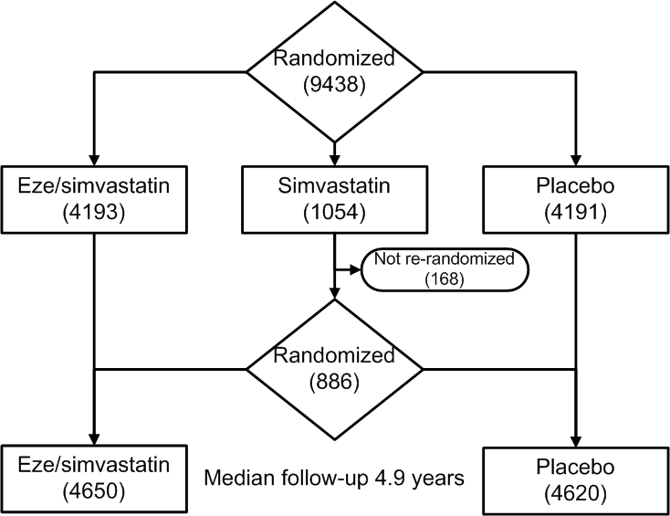
SHARP: Assessment of LDL-lowering

Slide 15
SHARP: Baseline characteristics
Characteristic | Mean (SD) or %
Age | 62 (12)
Men | 63%
Systolic BP (mm Hg) | 139 (22)
Diastolic BP (mm Hg) | 79 (13)
Body mass index | 27 (6)
Current smoker | 13%
Vascular disease | 15%
Diabetes mellitus | 23%
Non-dialysis patients only | (n=6247)
eGFR (ml/min/1.73m²) | 27 (13)
Albuminuria | 80%
Notes:
15

Slide 16
SHARP: Compliance and LDL-C reduction at study midpoint
 | Eze /simv | Placebo
Compliant | 66% | 64%
Non-study statin | 5% | 8%
Any lipid-lowering | 71% | 8%
~2/3 compliance
LDL-C reduction of 32 mg/dL with 2/3 compliance,
equivalent to 50 mg/dL with full compliance
Notes:
Of those who had final FU completed, 79% were done face-to-face and a further 11% were done directly with the patient by telephone, so that only 10% of the final FU visits were completed remotely. At the final FU visit, nurses were asked to indicate when they last knew the pt to be alive and to have adequate f/up for non-fatal SAEs.
Only 15 participants did not have final FU visit – site closed early in USA; but another 59 know also lost to follow-up: 19 withdrew consent, 19 moved away, 21 lost to follow-up unspecified. In addition of the 690 participants with final FU forms, in 233 cases, the nurse entered a date for mortality f/up before 1st March 2010, so potentially 2.6% of participants had shorter follow-up than anticipated.
16

Slide 17
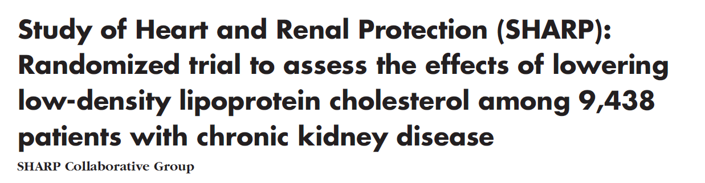
SHARP: Baseline paper and Data Analysis Plan
Am Heart J 2010;0:1-10.e10
1-year LDL-C reduction of 30 mg/dL with simvastatin 20 mg alone and of 43 mg/dL with eze/simv 10/20mg
Confirmation of safety of ezetimibe when added to simvastatin (1-year results)
Revised data analysis plan published as an appendix before unblinding of main results

Slide 18
SHARP: Main outcomes
Key outcome
  Major atherosclerotic events (coronary death, MI, non-haemorrhagic stroke, or any revascularization)
Subsidiary outcomes
  Major vascular events (cardiac death, MI, any stroke, or any revascularization)
  Components of major atherosclerotic events
Main renal outcome
  End stage renal disease (dialysis or transplant)

Slide 19
SHARP: Major Atherosclerotic Events
25
Risk ratio 0.83 (0.74 – 0.94)
20
Logrank 2P=0.0022
Placebo
15
Proportion suffering event (%)
Eze/simv
10
5
0
0
1
2
3
4
5
Years of follow-up

Slide 20
CTT: Effects on Major Atherosclerotic Events
30%
Statin vs control
(21 trials)
25%
20%
More vs Less
atherosclerotic event rate (95% CI)
Proportional reduction in
15%
(5 trials)
10%
SHARP
32 mg/dL
5%
0%
0
10
20
30
40
Mean LDL cholesterol difference
between treatment groups (mg/dL)
Notes:
20

Slide 21
CTT: Effects on Major Atherosclerotic Events
30%
Statin vs control
(21 trials)
25%
20%
SHARP
17% risk
reduction
More vs Less
atherosclerotic event rate (95% CI)
Proportional reduction in
15%
(5 trials)
10%
SHARP
32 mg/dL
5%
0%
0
10
20
30
40
Mean LDL cholesterol difference
between treatment groups (mg/dL)
Notes:
21

Slide 22
SHARP: Major Vascular Events
Event
Eze/simv
Placebo
Risk ratio & 95% CI
(n=4650)
(n=4620)
Major coronary event
213
(4.6%)
230
(5.0%)
Non-haemorrhagic stroke
131
(2.8%)
174
(3.8%)
Any revascularization
284
(6.1%)
352
(7.6%)
Major atherosclerotic event
526
(11.3%)
619
(13.4%)
16.5% SE 5.4
reduction
(p=0.0022)
Other cardiac death
162
(3.5%)
182
(3.9%)
Haemorrhaghic stroke
45
(1.0%)
37
(0.8%)
Other major vascular events
207
(4.5%)
218
(4.7%)
5.4% SE 9.4
reduction
(p=0.57)
Major vascular event
701
(15.1%)
814
(17.6%)
15.3% SE 4.7
reduction
(p=0.0012)
0.6
0.8
1.0
1.2
1.4
Eze/simv better
Placebo better

Slide 23
SHARP: Effects in subgroups
Among 8384 patients originally randomized to eze/simv vs placebo, major vascular events risk ratio = 0.84 (95% CI 0.75 – 0.93; p=0.0010)
Similar reductions in major atherosclerotic events in all subgroups studied (including non-dialysis and dialysis patients)

Slide 24
SHARP: Major Atherosclerotic Events
by renal status at randomization
Eze/simv
Placebo
Risk ratio & 95% CI
(n=4650)
(n=4620)
Non-dialysis (n=6247)
296
(9.5%)
373
(11.9%)
Dialysis (n=3023)
230
(15.0%)
246
(16.5%)
Major atherosclerotic event
526
(11.3%)
619
(13.4%)
16.5% SE 5.4
reduction
(p=0.0022)
No significant heterogeneity between non-dialysis and dialysis patients (p=0.25)
0.6
0.8
1.0
1.2
1.4
Eze/simv better
Placebo better

Slide 25
SHARP: Cause-specific mortality
Event
Eze/simv
Placebo
Risk ratio & 95% CI
(n=4650)
(n=4620)
Coronary
91
(2.0%)
90
(1.9%)
Other cardiac
162
(3.5%)
182
(3.9%)
Subtotal: Any cardiac
253
(5.4%)
272
(5.9%)
7.4% SE 8.4
reduction
Stroke
68
(1.5%)
78
(1.7%)
(p=0.38)
Other vascular
40
(0.9%)
38
(0.8%)
Subtotal: Any vascular
361
(7.8%)
388
(8.4%)
7.3% SE 7.0
reduction
Cancer
150
(3.2%)
128
(2.8%)
(p=0.30)
Renal
164
(3.5%)
173
(3.7%)
Other non-vascular
354
(7.6%)
311
(6.7%)
Subtotal: Any non-vascular
668
(14.4%)
612
(13.2%)
8.6% SE 5.8
increase
Unknown cause
113
(2.4%)
115
(2.5%)
(p=0.14)
Total: Any death
1142
(24.6%)
1115
(24.1%)
1.9% SE 4.2
increase
(p=0.65)
0.6
0.8
1.0
1.2
1.4
Eze/simv better
Placebo better

Slide 26
SHARP: Renal outcomes
Event
Eze/simv
Placebo
Risk ratio & 95% CI
(n=3117)
(n=3130)
Main renal outcome
End-stage renal disease (ESRD)
1057
(33.9%)
1084
(34.6%)
0.97 (0.89-1.05)
Tertiary renal outcomes
ESRD or death
1477
(47.4%)
1513
(48.3%)
0.97 (0.90-1.04)
ESRD or 2 x creatinine
1190
(38.2%)
1257
(40.2%)
0.94 (0.86-1.01)
0.6
0.8
1.0
1.2
1.4
Eze/simv
better
Placebo
better
Notes:
26

Slide 27
SHARP: Cancer incidence
25
20
Risk ratio 0.99 (0.87 – 1.13)
Logrank 2P=0.89
15
Proportion suffering event (%)
Eze/simv
10
Placebo
5
0
0
1
2
3
4
5
Years of follow-up

Slide 28
SHARP: Safety
 | Eze/simv (n=4650) | Placebo (n=4620)
Myopathy
CK >10 x but ≤40 x ULN | 17 (0.4%) | 16 (0.3%)
CK >40 x ULN | 4 (0.1%) | 5 (0.1%)
Hepatitis | 21 (0.5%) | 18 (0.4%)
Persistently elevated ALT/AST >3x ULN | 30 (0.6%) | 26 (0.6%)
Complications of gallstones | 85 (1.8%) | 76 (1.6%)
Other hospitalization for gallstones | 21 (0.5%) | 30 (0.6%)
Pancreatitis without gallstones | 12 (0.3%) | 17 (0.4%)
Notes:
28

Slide 29
SHARP: Conclusions
No increase in risk of myopathy, liver and biliary disorders, cancer, or nonvascular mortality
No substantial effect on kidney disease progression
Two-thirds compliance with eze/simv reduced the risk of major atherosclerotic events by 17% (consistent with meta-analysis of previous statin trials)
Similar proportional reductions in all subgroups (including among dialysis and non-dialysis patients)
Full compliance would reduce the risk of major atherosclerotic events by one quarter, avoiding 30–40 events per 1000 treated for 5 years

Slide 30
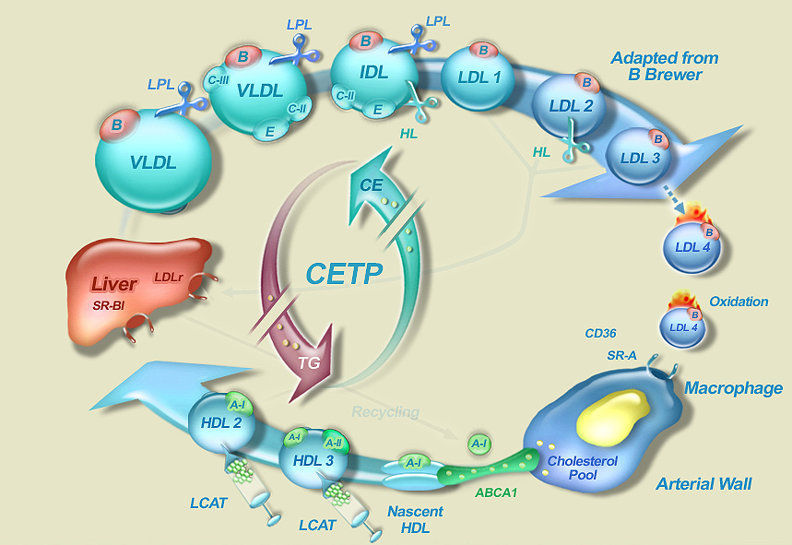
The Inhibition of Cholesterol Ester Transfer Protein

Slide 31
CETP Levels and CAD risk:
The EPIC – Norfolk study
4
3
Odds ratio for future CAD
2
Trig
>1.7 mmol/L
1
Trig
<1.7 mmol/L
0
CETP quintile 1 2 3 4 5
Range, mg/L <2.4 2.4–2.9 3.0–3.7 3.8–4.9 >4.9
Boekholdt et al. Circulation 2004

Slide 32
Scientific Case for Developing the
CETP inhibitor Anacetrapib
CHD remains a significant unmet medical need; substantial residual CV risk on statins
Strong biologic plausibility of CETP inhibition mechanism
  Strong epidemiology supporting CV protective role of HDL
  Large LDL-C lowering and HDL-C raising with anacetrapib
  No evidence that HDL from anacetrapib-treated patients is dysfunctional
CETP inhibition is at equipoise and anacetrapib is an appropriate molecule to test the mechanism

Slide 33
Anacetrapib Dose Ranging Study
LDL-C
HDL-C
20
160
140
0
120
-20
100
Percent Change from Baseline
in LDL-C
Percent Change from Baseline
in HDL-C
80
-40
60
40
-60
20
0
-80
-20
0
2
4
8
0
2
4
8
Weeks on Treatment
Weeks on Treatment
Placebo
Anacetrapib 10 mg
Anacetrapib 40 mg
Anacetrapib 150 mg
Anacetrapib 300 mg
Bloomfield et al. Am Heart J 2009;157:352-60

Slide 34
Effect of HDL from Anacetrapib-treated Patients (300 mg) on Cholesterol Efflux from Human Macrophages
20
Before treatment
20
Before treatment
20
Before treatment
After treatment
*
After treatment
After treatment
15
*
15
15
∆TC in media
(μg/mg cell protein)
∆FC in media
(μg/mg cell protein)
∆CE in media
(μg/mg cell protein)
*
*
10
10
*
10
*
*
5
5
5
0
0
0
12
36
72
12
36
72
12
36
72
HDL cholesterol concentration (μg/mL)
HDL cholesterol
concentration (μg/mL)
HDL cholesterol
concentration (μg/mL)
Tall A, 2009 XV International Symposium on Atherosclerosis; June 2009

Slide 35
Effect of Torcetrapib and Anacetrapib on Blood Pressure in Rhesus Monkeys
Torcetrapib
(500 mg/kg)
MK-0859
Anacetrapib (50 mg/kg)
Forrest et al. British Journal of Pharmacology (2008) 154, 1465–1473

Slide 36
The Effect of Torcetrapib and Anacetrapib on Aldosterone Secretion from Primary Rat Adrenocortical Cells
Torcetrapib
Anacetrapib
Dose-dependent increase in aldosterone release with torcetrapib
Anacetrapib has no effect on aldosterone release up to 10 uM
Forrest et al., British Journal Pharmacology 2008;154:1465-1473

Slide 37
Effects on LDL-C and HDL-C
LDL-C
HDL-C
100
120
80
100
-39.8% (p<0.001)
80
+138.1% (p<0.001)
LDL-C (mg/dL) (SE)
60
HDL-C (mg/dL) (SE)
60
40
40
20
Anacetrapib
Anacetrapib
Placebo
20
Placebo
0
0
Base-
line
6
12
18
24
30
46
62
76
Base-
line
6
12
18
24
30
46
62
76
Study week
Study week
Notes:
37
The point estimates are for wk 24

Slide 38
Conclusion
Anacetrapib treatment had robust effects on HDL-C, LDL-C, non HDL-C and Lp(a) with sustained effects over 18 months
Anacetrapib had an acceptable side-effect profile with no effects on blood pressure, electrolytes or aldosterone
Within the power of the study, anacetrapib did not exhibit adverse cardiovascular effects seen with a prior CETP inhibitor
The long term safety and efficacy of anacetrapib will now be tested in a large clinical outcomes trial
Cannon CP, et al. N Engl J Med 2010; 363: 2406–15.

Slide 39
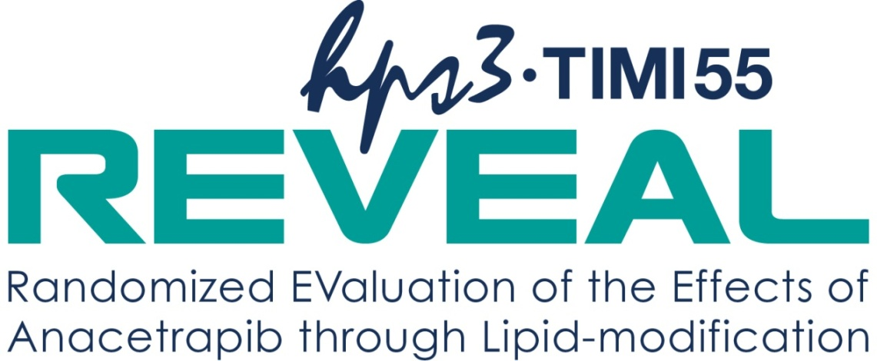
Future
30,000 patients with occlusive arterial disease in North America, Europe and Asia
Background LDL-lowering with atorvastatin
Randomized to anacetrapib 100 mg vs. placebo
Primary outcome: Coronary death, myocardial infarction or coronary revascularization
www.revealtrial.org.

Slide 40
Nicotinic Acid
Treatment of Dyslipidemia and Atherosclerosis
First used as lipid-altering agent in 1955
  Well understood safety profile
Broad spectrum of lipid effects*
  ↓LDL-C (15%–25%)
  ↑HDL-C (20%–35%)
  ↓TG (20%–40%)
  ↓Apo B, non-HDL-C, Lp(a)
Cardiovascular (CV) benefits
  ↓ CV events (Coronary Drug Project)
  ↓ Plaque progression (angiographic and IMT studies)
Niacin added to a statin may address residual CV risk
Notes:
Niacin was first used as lipid-altering agent in 1955. It demonstrated a broad spectrum of lipid effects: reducing LDL-C (15%–25%) and triglycerides (20%–40%) and increasing HDL-C (20%–35%). Niacin has also shown to have Cardiovascular (CV) benefits to reduce cardiovascular events as in the Coronary Drug Project Study and to reduce plaque progression as shown by angiographic and IMT (intima media thickness) studies. Niacin added to a statin may address residual CV risk.
*Management of lipid and lipoprotein disorders. In: Gotto Am Jr., Pownall HJ, eds. Manual of lipid disorders.
Baltimore: Williams & Wilkins. 1992. Rubins HB, et al. N Engl J Med. 1999;341:410-418.

Slide 41
Niacin Raises HDL-C and Decreases LDL-C, TG, and Lp(a) in a Dose-Dependent Manner
HDL
LDL
Lp(a)
TG
Lipid effects
  Most potent agent for ↑HDL: 20%+; nonlinear
  Favorable effects on LDL-particle density
  ↓LDL (linear), TG, and Lp(a)
Tolerability with concomitant statin therapy
  No change in rate of liver adverse effects or myositis vs statin monotherapy

Slide 42
Effectiveness of 2 g vs 1 g of ER Niacin
Mean % change from baseline
Lipid-modifying efficacy generally seen with at least 1 g/day
Use of 2 g versus 1 g provides:
  About twice the LDL-C reduction
  About twice the HDL-C elevation
  Several times the reduction of TG
 | LDL-C | HDL-C | TG
1 g/day | –9 | +15 | –11
2 g/day | –17 | +26 | –35
NIASPAN™ US Prescribing information.
Notes:
Reference:
NIASPAN™ [Package Insert]. North Chicago, Illinois; Abbott Laboratories: 2007.

Slide 43
Most Patients on ER Niacin Therapy
Do Not Reach a 2-g Dose
100
> 1500 mg
1001–1500 mg
80
751–1000 mg
60
501–750 mg
Users, %
≤ 500 mg
40
20
0
4 weeks
N = 14,386
8 weeks
n = 6,349
12 weeks
n = 5,277
24 weeks
n = 5,402
1 year
n = 2,104
Notes:
Reference:
Kamal-Bahl S, Burke T, Watson D, et al. Dosage and titration patterns of extended release niacin in clinical practice. Abstract presented at the 7th American Heart Association Scientific Forum on Quality of Care and Outcomes Research in Cardiovascular Disease and Stroke; May 2006; Washington, DC, USA.

Slide 44
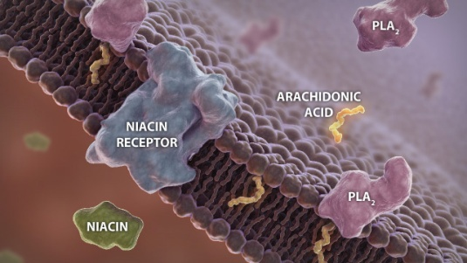
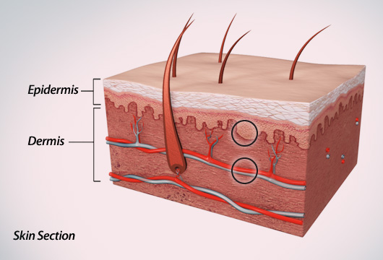
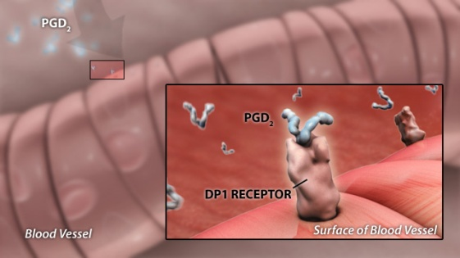
Niacin Flushing Pathway:
Two Separate Steps and Sites of Action
1. Epidermal Langerhans Cells
  Niacin binds
  PGD₂ is produced and released
2. Dermal Blood Vessels
  PGD₂ binds to DP1
  Vasodilation results
Illustrations are artistic renditions.
PGD₂=prostaglandin D₂; PLA₂=phospholipase A₂; DP1=prostaglandin D₂ receptor 1.
Benyó Z et al. Mol Pharmacol. 2006;70:1844–1849; Morrow JD et al. J Invest Dermatol. 1992;98:812–815; Cheng K et al. Proc Natl Acad Sci USA. 2006;103:6682–6687.
Notes:
Slide 13
Takeaway: The niacin flushing pathway has 2 separate sites of action in the skin: epidermal Langerhans cells and dermal blood vessels.^{1,2}
Build 1: Niacin binds to its receptor on epidermal Langerhans cells, leading to the production and release of PGD₂^{1–3}
Build 2: PGD₂, binding to DP1, causes vasodilation of dermal blood vessels^{1–3}
References:
1. Benyó Z, Gille A, Bennett CL, et al. Nicotinic acid-induced flushing is mediated by activation of epidermal Langerhans cells. Mol Pharmacol. 2006;70:1844–1849.
2. Morrow JD, Awad JA, Oates JA, Roberts LJ II. Identification of skin as a major site of prostaglandin D₂ release following oral administration of niacin in humans. J Invest Dermatol. 1992;98:812–815.
3. Cheng K, Wu T-J, Wu KK, et al. Antagonism of the prostaglandin D₂ receptor 1 suppresses nicotinic acid-induced vasodilation in mice and humans. Proc Natl Acad Sci USA. 2006;103:6682–6687.
R1/Benyó-1
p1848-Par.4-L1
R2/Morrow-2
p815-Par.3-L1
3/Cheng
p6682-Par.4-L1
R1/Benyó-1
p1848-Par.4-L1
R2/Morrow-2
p815-Par.3-L1
R3/Cheng
p6682-Par.4-L1
R1/Benyó-1
p1848-Par.4-L1
R2/Morrow-2
p815-Par.3-L1
R3/Cheng
p6682-Par.4-L1

Slide 45
Lipid/Flushing Study: Lower Incidence of Moderate or Greater Flushing vs ER Niacin
Average number of days per week
with moderate or greater flushing symptoms across weeks 1–24
Percentage of patients with moderate
or greater flushing symptoms
across weeks 1–24
2
dose advancement
60
dose advancement
50
40
Number of Days per Week
% Patients
1
30
20
10
0
0
0
1
2
3
4
5
6
7
8
9
10
11
12
13
14
15
16
17
18
19
20
21
22
23
24
25
0
1
2
3
4
5
6
7
8
9
10
11
12
13
14
15
16
17
18
19
20
21
22
23
24
25
Weeks on Treatment
Weeks on Treatment
ER niacin (n = 508)  ER niacin/laropiprant (n = 763) O Placebo (n = 268)
Notes:
Reference:
Data on file, MSD.

Slide 46
Factorial Study: Lipid Efficacy
27.5
30
HDL-C
Primary end point
20
23.4
% Change
0
10
6.0
-10
-17.0
-20
0
% Change
-37.0
0
4
8
12
-30
Weeks on Treatment
-40
-47.9
0
-50
LDL-C
-10
-14.7
-60
-20
0
4
8
12
% Change
-21.6
Weeks on Treatment
-30
-33.3
TG
❐ ER niacin/laropiprant (n = 160)
 Simvastatin (all doses pooled; n = 565)
 ER niacin/laropiprant + simvastatin
(all doses pooled; n = 520)
-40
0
4
8
12
Weeks on Treatment
Notes:
Reference:
Data on file, MSD.

Slide 47
HPS2-THRIVE
(Heart Protection Study 2 – Treating HDL to Reduce Vascular Events)
ER niacin/laropiprant 2 g/40mg
All patients receive either simvastatin 40mg or ezetimibe/simvastatin 10/40 mg
Placebo
Patient Population | Subjects | Primary End Point
Age 50-80 History of MI or cerebrovascular atherosclerotic disease or PAD or diabetes mellitus with any of the above or with other evidence of symptomatic CHD | 25,000 UK (n=8500), Scandinavia (n=6000) and China (n=10500) | Major vascular events (non-fatal MI or coronary death, non-fatal or fatal stroke or revascularisation)
Notes:
Study Design: 20,000 patients, Age 50-80 all with atherosclerotic vascular disease (1/3 with diabetes)
Study Sites: UK (n=7500), Scandinavia (n=5000) and China (n=7500)
Study start: January 2007
Expected completion: January 2013
Primary Outcome Measures: time to first major vascular event (defined as non-fatal MI or coronary death, non-fatal or fatal stroke, or revascularisation) by the end of study
Inclusion Criteria: History of MI or cerebrovascular atherosclerotic disease or PAD or Diabetes mellitus with any of the above or with other evidence of symptomatic CHD
Interventions: ER niacin/laropiprant 2 g daily versus matching placebo tablets. All patients receive LDL lowering therapy with either 40 mg of simvastatin or 10/40 mg ezetimibe/simvastatin.

Slide 48
Conclusion
In the next five years, we will prove or disprove that additional LDL lowering with other agents than statins is effective
and
we will show or not show that the HDL hypothesis is true.

