Slide 1
Boezemfibrilleren
Antistollingstherapie
Charles Kirchhof
Rijnland Ziekenhuis, Leiderdorp

Slide 2
ESC Guidelines 2010

Slide 3
ESC Guidelines 2010
Do:
Preventie van AF gerelateerde complicaties
Optimale veiligheid van behandeling
Behandeling van klachten
Don’t:
Kiezen tussen ‘Rate OR Rhythm control’
Agressieve conversie strategie ter behoud SR
ASCAL profylaxe

Slide 4
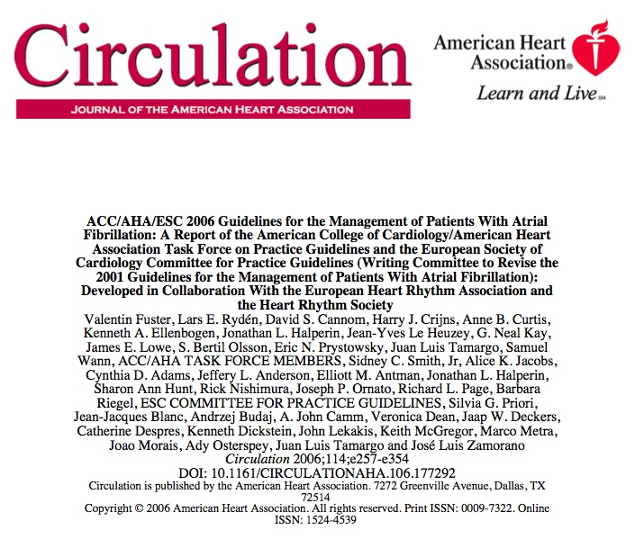
CHADS₂ versus CHA₂DS₂-VASc
Guideline ACC/AHA/ESC 2006:
VKA
INR 2-3
Eerste ‘evidence based’ risk score voor Stroke in nonvalvular AF

Slide 5
CHADS₂: Onduidelijkheid over ‘intermediate risk’
Problemen in de praktijk:
Naleving CHADS₂ (55%)
Wat te doen in ‘intermediate group’
Wat te doen bij verhoogd bloedingsrisico
CHADS₂
AF
Vit-K antagonist
2
1
ASA ?
ASA ?
40
Leeftijd
60
65
75
80
90
100

Slide 6
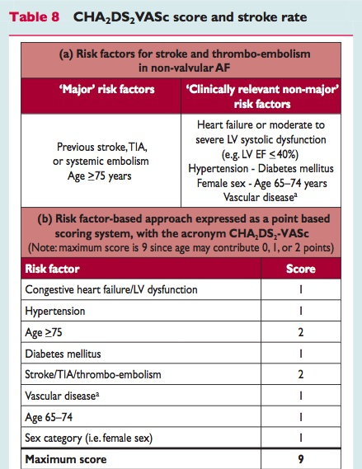
CHA₂DS₂-VASc

Slide 7
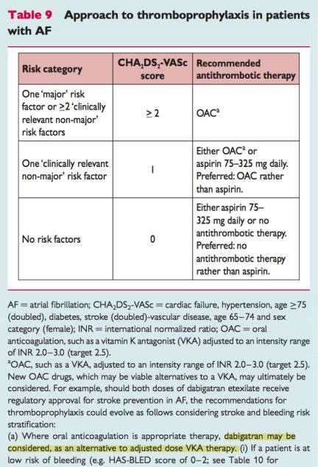
CHA₂DS₂-VASc
‘ Preferred: OAC rather than ASA’
‘ Preferred: No antitrombotic therapy rather than ASA’

Slide 8
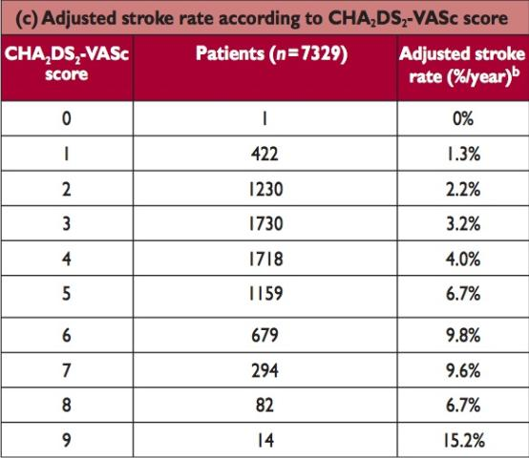
Stroke Risk in AF patients
VKA
INR 2-3
CHADS₂
VKA
INR 2-3

Slide 9
Vitamine-K antagonisten
Vit-K antagonisten (marcoumar, sintrom, warfarine):
Goedkoop, adequate infrastructuur voor controle
Makkelijk te couperen
Belastend voor patiënt
Suboptimaal tgv nauwe therapeutische breedte
invloed van voeding
Invloed van R/
Oplossing?: Factor Xa-antagonisten of directe Trombine-antagonisten?
INR
4.0
Bloeding
3.0
2.0
1.0
CVA
INR

Slide 10
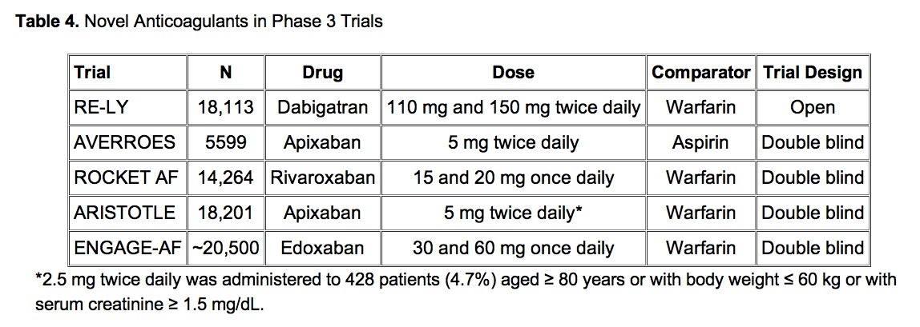
Dabigatran, Rivaroxaban, Apixaban, Endoxaban voor trombo-embolische preventie bij AF

Slide 11
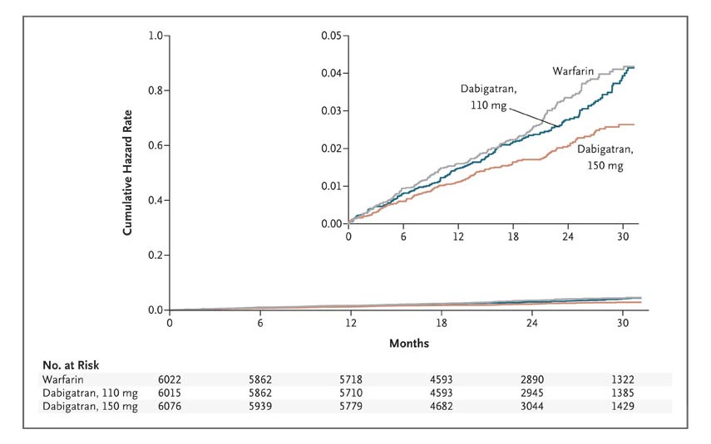
RE-LY: Cumulative Hazard Rates for the Primary Outcome of Stroke or Systemic Embolism
Connolly SJ et al. N Engl J Med 2009;361:1139-1151
Notes:
Figure 1. Cumulative Hazard Rates for the Primary Outcome of Stroke or Systemic Embolism, According to Treatment Group.

Slide 12
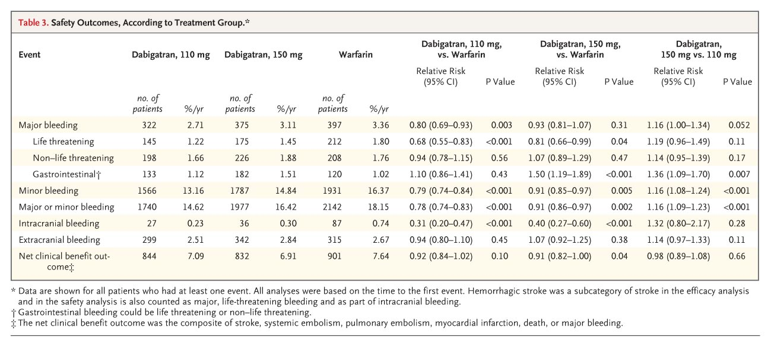
RE-LY: Safety outcomes
Connolly SJ et al. N Engl J Med 2009;361:1139-1151

Slide 13
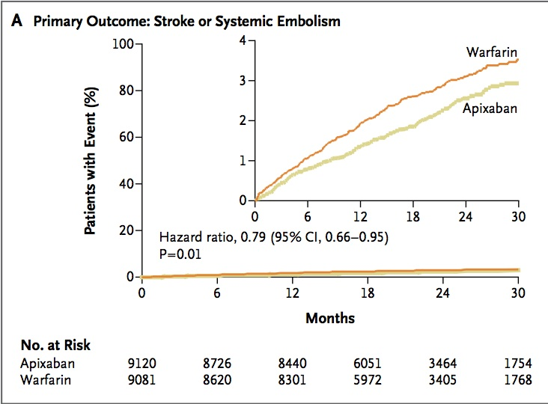
ARISTOTLE: Apixaban versus Warfarine
Granger CB. NEJM 2011; 365: 981-992

Slide 14
ARISTOTLE: Apixaban versus Warfarine
Granger CB. NEJM 2011; 365: 981-992

Slide 15
Appropriate AF management?
1.
Prevention, Symptoms + V-Rate
2.
Rhythm
3.
Improving CV Outcome
Camm AJ, Reiffel JA. Eur Heart J Suppl 2008;10:H55-78.

Slide 16
‘Rate-related’ complicaties (RACE II)
Primary Outcome:
Composite endpoint:
CV death, Hosp heart failure, Stroke, Embolism, Bleeding, Arrhythmic event
< 80/min
< 110/min
Van Gelder IC et al. NEJM 2010; 362: 1363-1373

Slide 17
Appropriate AF management?
1.
Prevention, Symptoms + V-Rate
2.
Rhythm
3.
Improving CV Outcome
Camm AJ, Reiffel JA. Eur Heart J Suppl 2008;10:H55-78.

Slide 18
3 ‘key-issues’ bij acuut AF
Onderliggende oorzaak AF
Behandelbaar?
‘Trombo-embolic Risk’
CHA₂DS₂-VASc, INR, TEE?
Cardiale functie en hemodynamische status
Rate- or Rhythm control?
Risico’s van gekozen strategie
Recidief kans
Chemische of Elektrische conversie naar SR

Slide 19
Acute conversie: farmacologisch of elektrisch?
ESC guidelines 2010
Succes: ‘slechts 2 P-toppen lang’ = Cardiac RESET

Slide 20
Conversion technique
ESC guidelines 2010
> 75%
NL

Slide 21
Toch Chemische Conversie? Welk antiaritmicum?
Flecaïnide: AF < 24 h; 67-92% SR in 6H
Propafenon: AF < 24 h; 41-91% SR in 6H
Beiden NIET bij verminderde LV / ischemie /structurele hartziekten / geleidingsstoornis

Slide 22
Welk antiaritmicum?
Flecaïnide: AF < 24 h; 67-92% SR in 6H
Propafenon: AF < 24 h; 41-91% SR in 6H
Beiden NIET bij verminderde LV / ischemie /structurele hartziekten / geleidingsstoornis
Amiodarone: AF < 48 h; 80-90% SR in 24H
Ibutilide: AF < 48 h; 50% SR, veel NSVT’s door QT prolongatie (10%), langdurige nabewaking
Vernakalant: AF < 48 h; 52% SR in 90 minuten; Geen proaritmische bijwerkingen

Slide 23
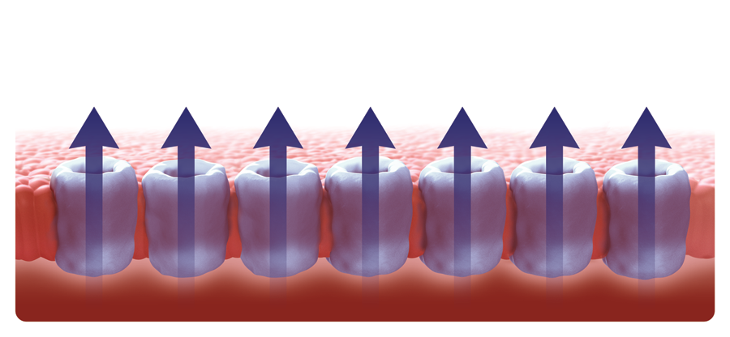
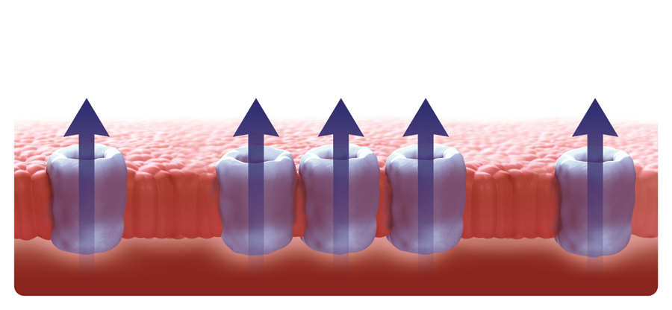
Action Potential in the Atria and the Ventricles: Some K⁺ Ion Currents Are Present Only in the Atria¹
I_{to1}
Atrial AP
I_{Kur}
I_{K-Ach}
I_{to}
I_{Kr}
I_{Ks}
I_{K1}
I_{K(ATP)}
I_{Kur}
I_{Kr}
I_{Ks}
I_{K1}
I_{KATP}
Atrium
I_{K-Ach}
Ventricular AP
I_{to1}
I_{to}
I_{Kr}
I_{Ks}
I_{K1}
I_{K(ATP)}
I_{Kr}
I_{Ks}
I_{K1}
I_{KATP}
Ventricle
AP = action potential; I_{to} = transient outward current; I_{Kur} = ultrarapid delayed-rectifier potassium current; I_{Kr} = rapid delayed-rectifier potassium current; I_{Ks} = slow delayed-rectifier potassium current; I_{K1} = inward rectifier potassium current; I_{K-Ach} = acetylcholine-regulated potassium current; I_{K(ATP)} = ATP-sensitive potassium current.
Ravens U et al. Europace. 2008;10:1133–1137. Adapted with permission from Ravens U et al. Europace. 2008.
Notes:
Key Point:
Ion currents contributing to the action potentials in the atria and ventricles are similar, with some being present only in the atria.
Background:
Action potentials exhibit distinct shapes in atria and ventricles.¹
The plateau phase occurs at more negative potentials in the atria compared with the ventricles.
Overall action potential duration is shorter in the atria when compared with the ventricles.
Differences between the atria and the ventricles that contribute to the differences in the action potentials are due to nonuniform distribution of ion channels.¹
The ultrarapid potassium current I_{Kur} and the acetylcholine potassium current I_{K-Ach} are thought to be present in the atria and not in the ventricles.
Ravens 2008:
p1134A
1. Ravens U et al. Europace. 2008;10:1133–1137.
I_{Kur} = ultrarapid delayed-rectifier potassium current; I_{K-Ach} = acetylcholine-regulated potassium current.
Ravens 2008:
p1134B

Slide 24
Vernakalant
Voornamelijk atrium specifiek door blokkade van I_{Kur} & I_{KAch}, maar ook enige I_{to} & I_{Na} blokkade
Hierdoor actie potentiaal duur verlenging
Geen proaritmische bijwerkingen
Geen QT-verlenging of andere SAE
Hierdoor veilig en bruikbaar bij patiënten met contra-ïndicaties voor klasse Ic antiaritmica

Slide 25
AVRO trial: Rapid Conversion of AF With Vernakalant for Infusion vs Amiodarone
0.6
Vernakalant (N=116)
51.7%
0.4
P<0.0001
Percentage of Patients With Conversion of AF
0.2
Amiodarone (N=116)
5.2%
0
0
5
10
15
20
25
35
50
70
90
Time, minutes
In patients with short-duration AF (3 hours to 2 days).
Camm AJ et al. JACC 2011, 57: 313-321.
Notes:
Key Points:
Conversion of AF to sinus rhythm within 90 minutes in AVRO was significantly more frequent with vernakalant for infusion than with intravenous amiodarone (51.7% vs 5.2% with placebo; P<0.0001).¹
Dosing of amiodarone was as follows: 60-minute infusion of 5 mg/kg followed by an additional 60-minute maintenance infusion of 50 mg, equivalent to 15 mg/kg over 24 hours.¹
AF = atrial fibrillation
1. Camm AJ et al. J Am Coll Cardiol. In press.
Camm 2010 JACC: p26A, p11A
Camm 2010 JACC: p11A
Camm 2010 JACC: p8A

Slide 26
Appropriate AF management?
1.
Prevention, Symptoms + V-Rate
2.
Rhythm
3.
Improving CV Outcome
Camm AJ, Reiffel JA. Eur Heart J Suppl 2008;10:H55-78.

Slide 27
Take Home messages
Antistolling met Vit-K antagonisten of nieuwe F Xa / Trombine antagonisten op basis van CHA₂DS₂-VASc
ASA alleen bij laag risico patient of hoog bloedingsrisico
Nieuwe F Xa- of Trombine-antagonisten lijken superieur aan vitamine K antagonisten t.a.v. effectiviteit en veiligheid
Bij recent ontstaan AF is chemische conversie de therapie van eerste keuze, en dan bij voorkeur met behulp van een veilig en snel werkend antiaritmicum (Flecaïnide, Vernakalant)

Slide 29
Behandeling AF door decennia heen
’70-’80: mechanisme atrium fibrilleren
‘80-’90: farmacologische behandeling AF
‘90-’00: electrical remodeling, agressief behandelen, behoud van sinus ritme
‘00-’05: ‘rate’ versus ‘rhythm control’
‘05- ‘10: geïndividualiseerde behandeling, preventie complicaties

Slide 30
Conclusion
In patients with atrial fibrillation, dabigatran given at a dose of 110 mg was associated with rates of stroke and systemic embolism that were similar to those associated with warfarin, as well as lower rates of major hemorrhage
Dabigatran administered at a dose of 150 mg, as compared with warfarin, was associated with lower rates of stroke and systemic embolism but similar rates of major hemorrhage

